Slide 1
Reusable maps and graphs from ECDC Communicable Disease Threats Report Week 17, 2023
You are encouraged to reuse our maps and graphs for your own purposes and are free to translate them, provided the content is not altered and the source is acknowledged.

Slide 2
Geographical distribution of cholera cases reported worldwide from May 2022 to April 2023

Slide 3
Geographical distribution of cholera cases reported worldwide from February to April 2023

Slide 4
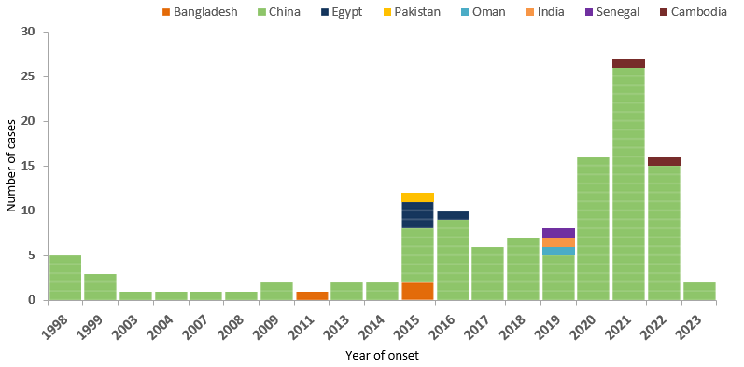
Distribution of confirmed human cases of avian influenza A(H9N2) virus infection by year of onset and country, 1998 to 27 April 2023 (n=123)

Slide 5
Distribution of confirmed human cases of avian influenza A(H9N2) virus infection by age and sex, 1998 to 27 April 2023 (n=123)

