Slide 1
Reusable maps and graphs from ECDC Communicable Disease Threats Report
Week 17, 2022
You are encouraged to reuse our maps and graphs for your own purposes and are free to translate them, provided the content is not altered and the source is acknowledged.

Slide 2
Distribution of COVID-19 cases worldwide, in accordance with the applied case definitions in the affected countries, as of week 16 2022

Slide 3
Distribution of COVID-19 deaths worldwide, as of week 16 2022

Slide 4
Distribution of laboratory-confirmed cases of COVID-19 in the EU/EEA, as of week 16 2022

Slide 5
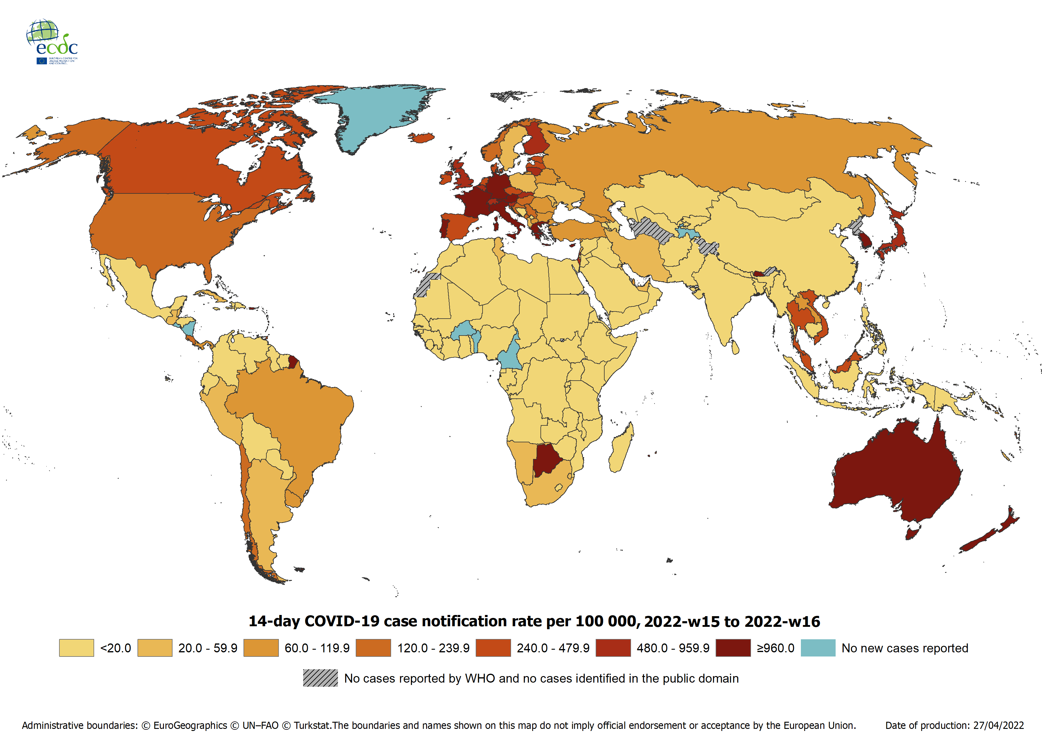
Geographic distribution of 14-day cumulative number of reported COVID-19 cases per 100 000 population, worldwide, as of week 16 2022

Slide 6
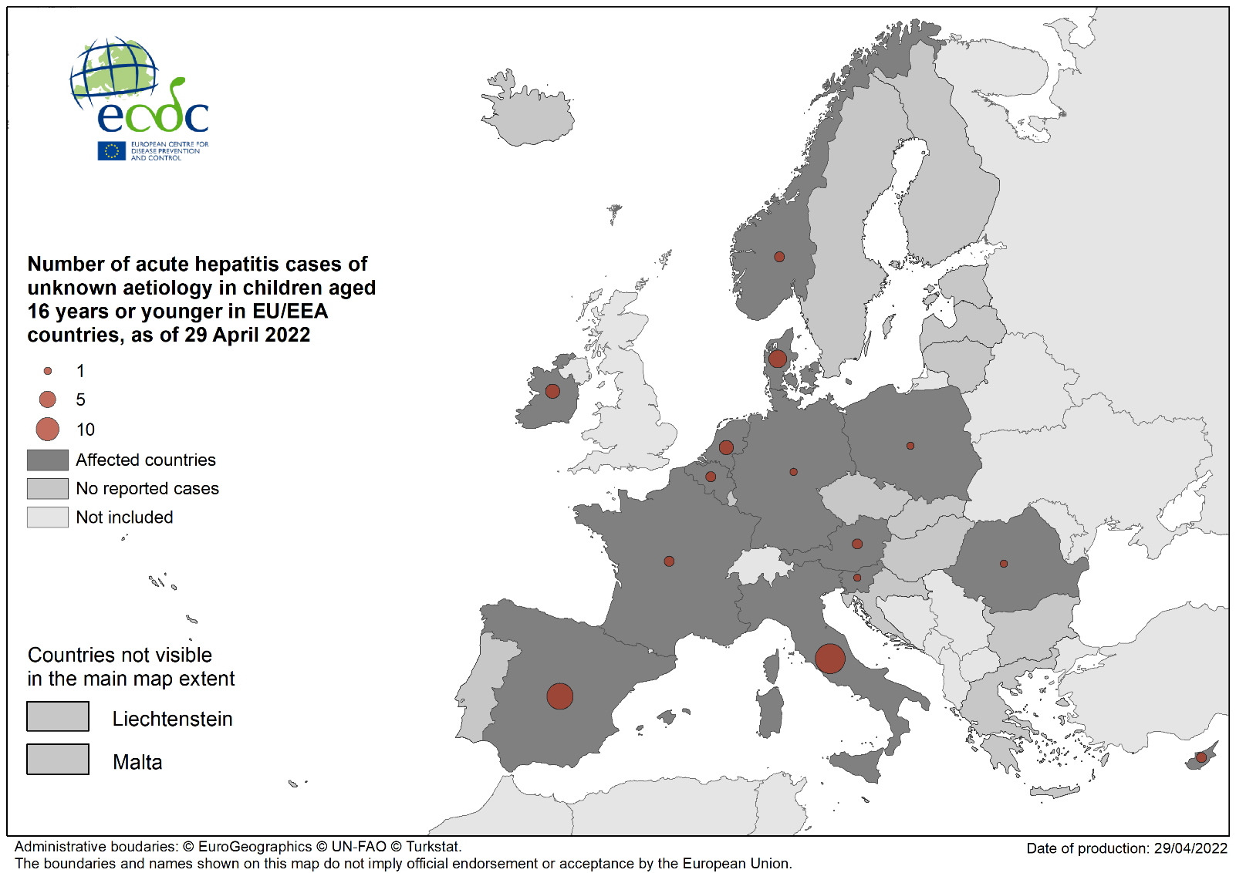
Number of acute hepatitis cases of unknown aetiology in children aged 16 years or younger in EU/EAA countries, as of 29 April 2022

Slide 7
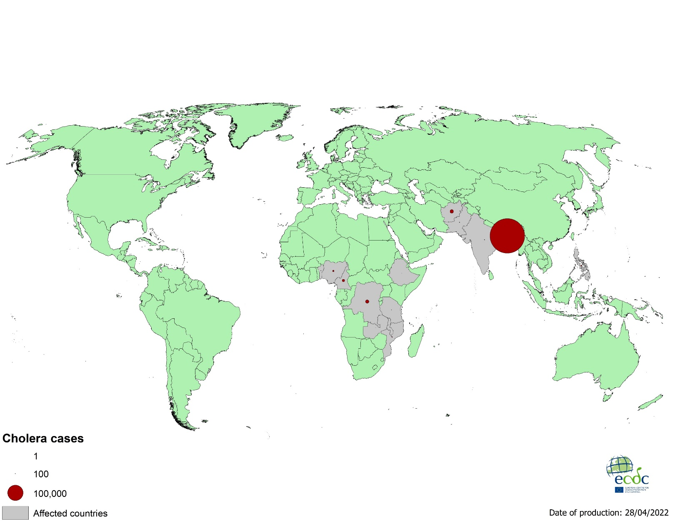
Geographical distribution of cholera cases reported worldwide from February to April 2022

Slide 8

Geographical distribution of cholera cases reported worldwide as of April 2022

Slide 9
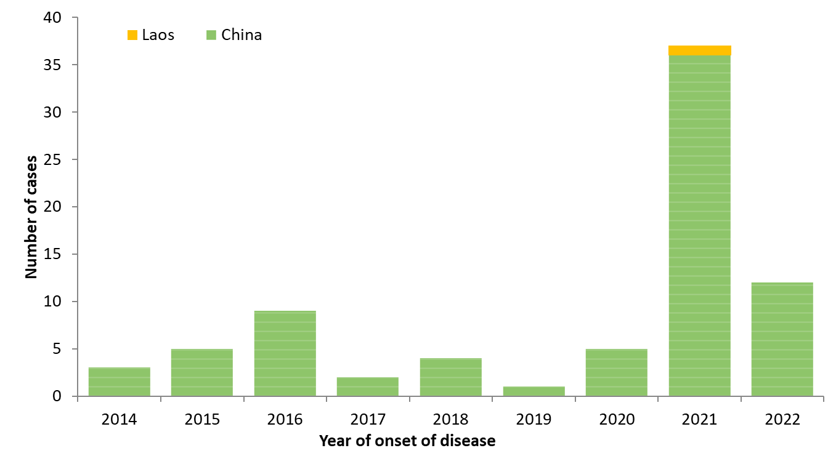
Distribution of confirmed human cases of avian influenza A(H5N6) virus infection by year of onset and country,
2014–2022 (n=78)

Slide 10
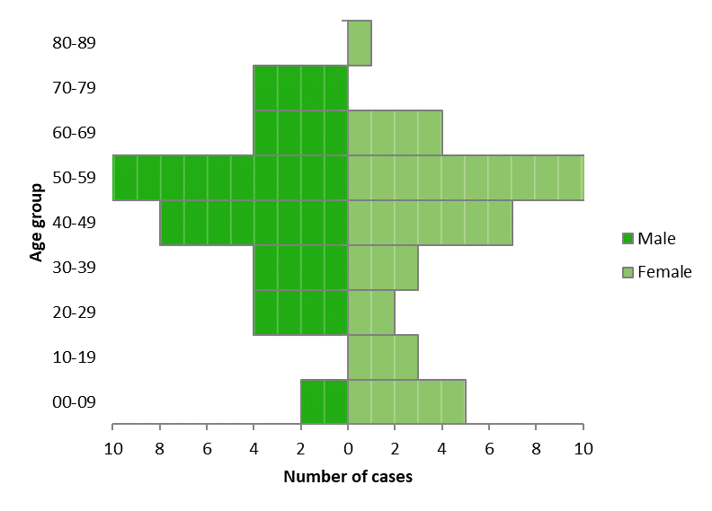
Age and sex distribution of confirmed human cases with influenza A(H5N6) virus infection,
2014–2022, China and Laos (n=78)

