Slide 1
Reusable maps and graphs from ECDC Communicable Disease Threats Report
Week 16 2022
You are encouraged to reuse our maps and graphs for your own purposes and are free to translate them, provided the content is not altered and the source is acknowledged.

Slide 2
Distribution of COVID-19 cases worldwide, in accordance with the applied case definitions in the affected countries, as of week 15 2022

Slide 3
Distribution of COVID-19 deaths worldwide, as of week 15 2022

Slide 4
Distribution of COVID-19 deaths worldwide, as of week 15 2022

Slide 5
Distribution of COVID-19 deaths worldwide, as of week 15 2022

Slide 6
Distribution of laboratory-confirmed cases of COVID-19 in the EU/EEA, as of week 15 2022

Slide 7
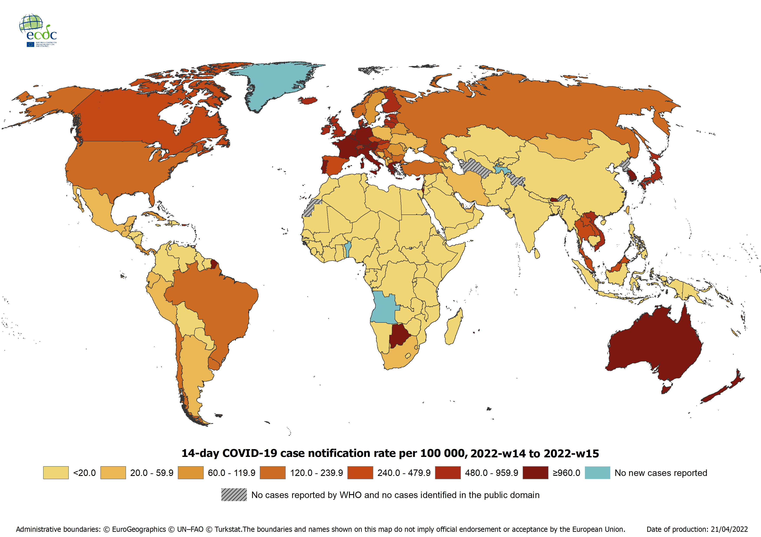
Geographic distribution of 14-day cumulative number of reported COVID-19 cases per 100 000 population, worldwide, as of week 15 2022

