Slide 1
Reusable maps and graphs from ECDC Communicable Disease Threats Report
Week 14, 2019
You are encouraged to reuse our maps and graphs for your own purposes and free to translate, provided the content is not altered and the source is acknowledged.

Slide 2
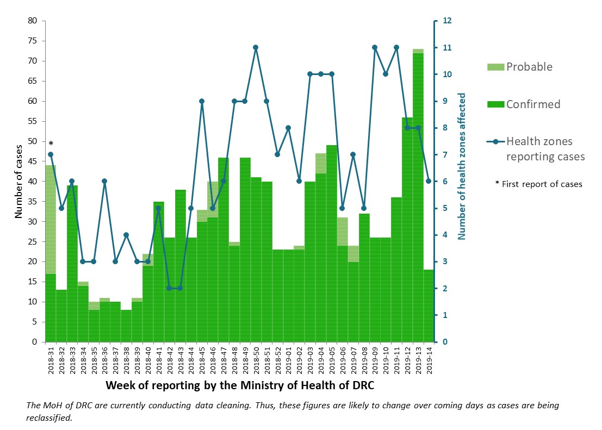
Distribution of confirmed and probable cases of Ebola virus disease and health zones reporting cases, North Kivu and Ituri Provinces, Democratic Republic of the Congo, as of 3 April 2019

Slide 3
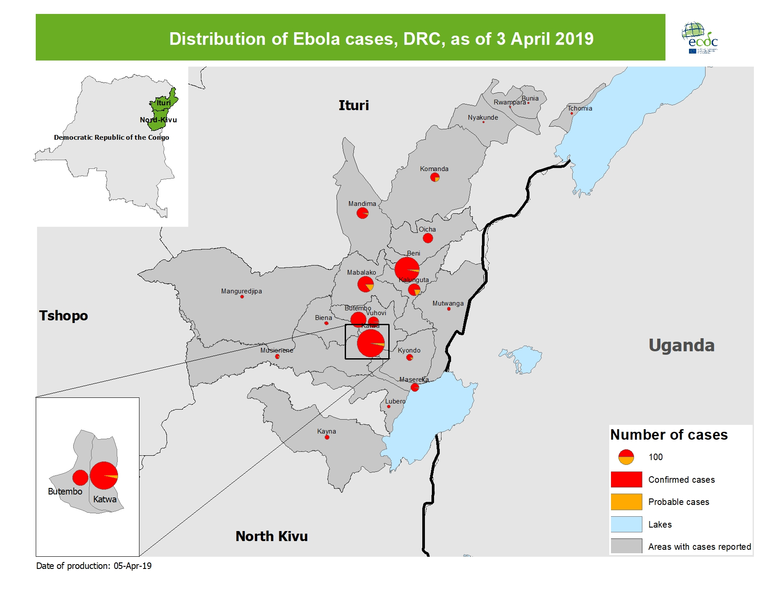
Geographical distribution of confirmed and probable cases of Ebola virus disease, North Kivu and Ituri Provinces, Democratic Republic of the Congo, as of 3 April 2019

Slide 4
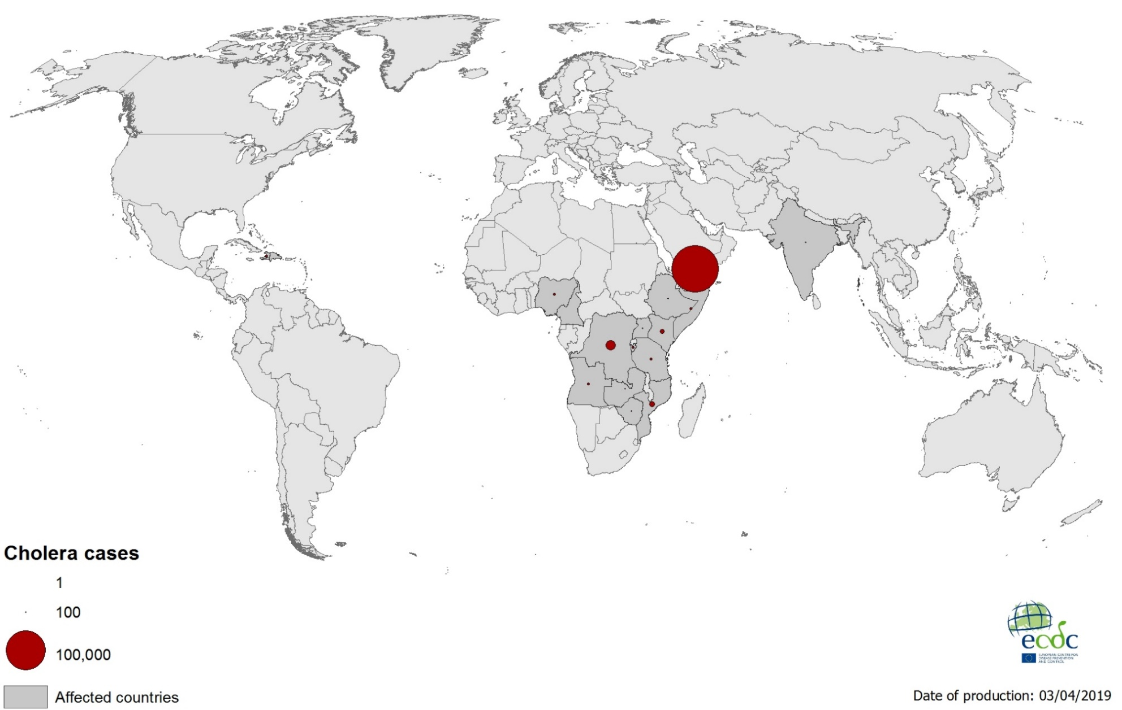
Geographical distribution of new cholera cases reported worldwide, January–April 2019

Slide 5
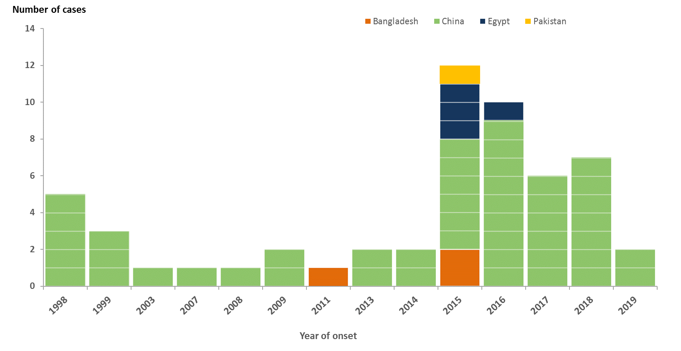
Distribution of confirmed human cases of A(H9N2) by reporting country since 1998 and as of 3 April 2019

Slide 6
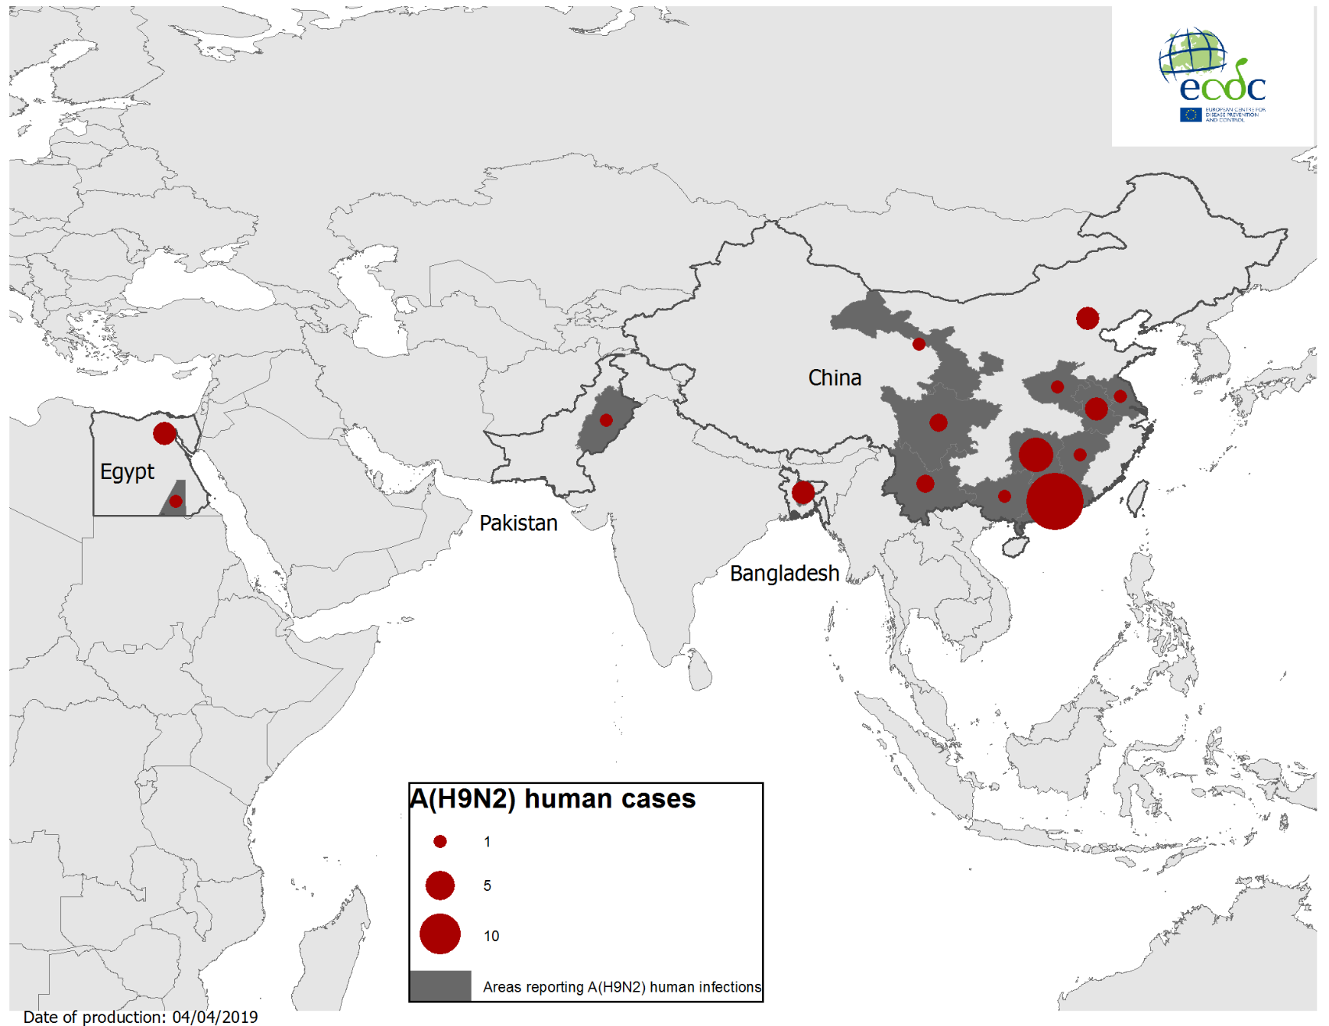
Geographical distribution of confirmed human cases of A(H9N2), 1998–3 April 2019

Slide 7
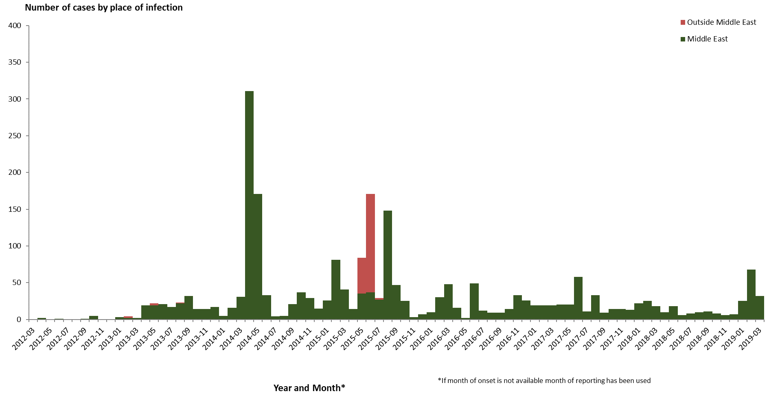
Distribution of confirmed cases of MERS-CoV by place of infection and month of onset,
March 2012–4 April 2019

Slide 8
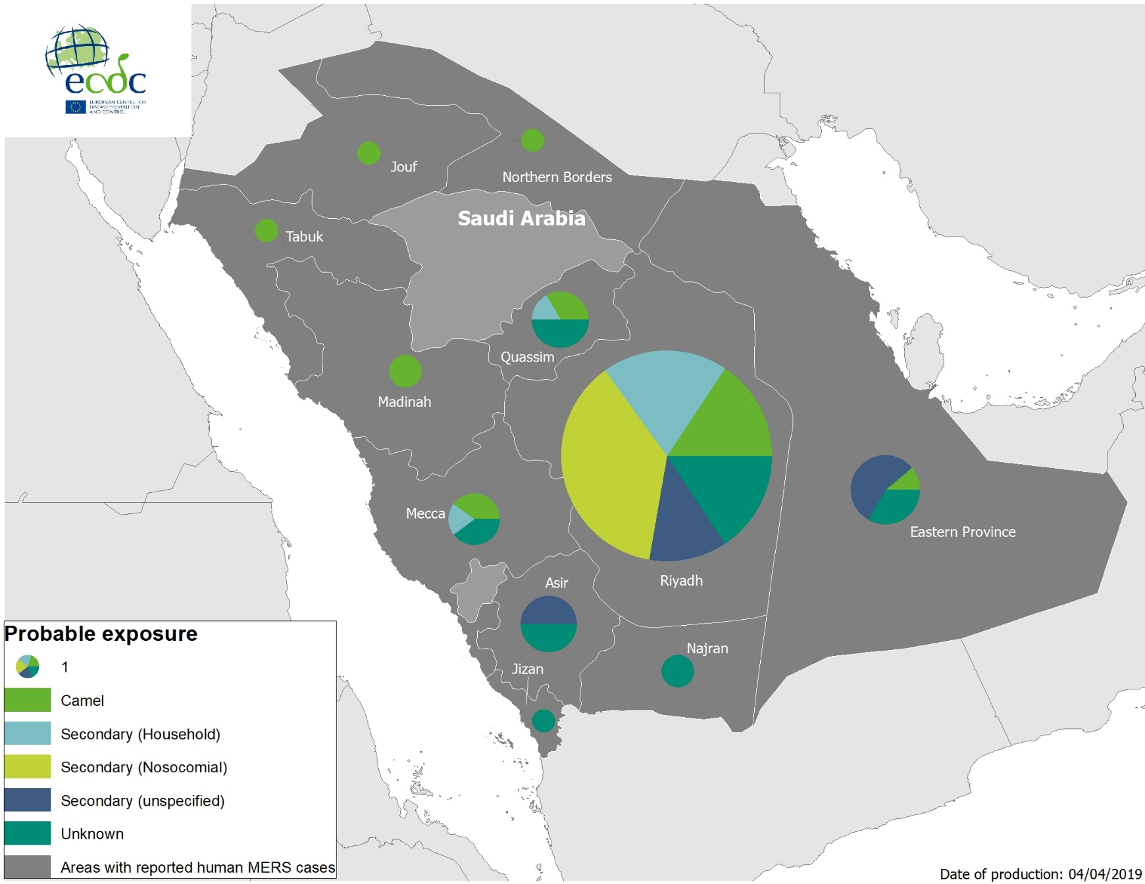
Geographical distribution of confirmed MERS-CoV cases by probable region of infection and exposure in 2019, as of 4 April 2019

Slide 9
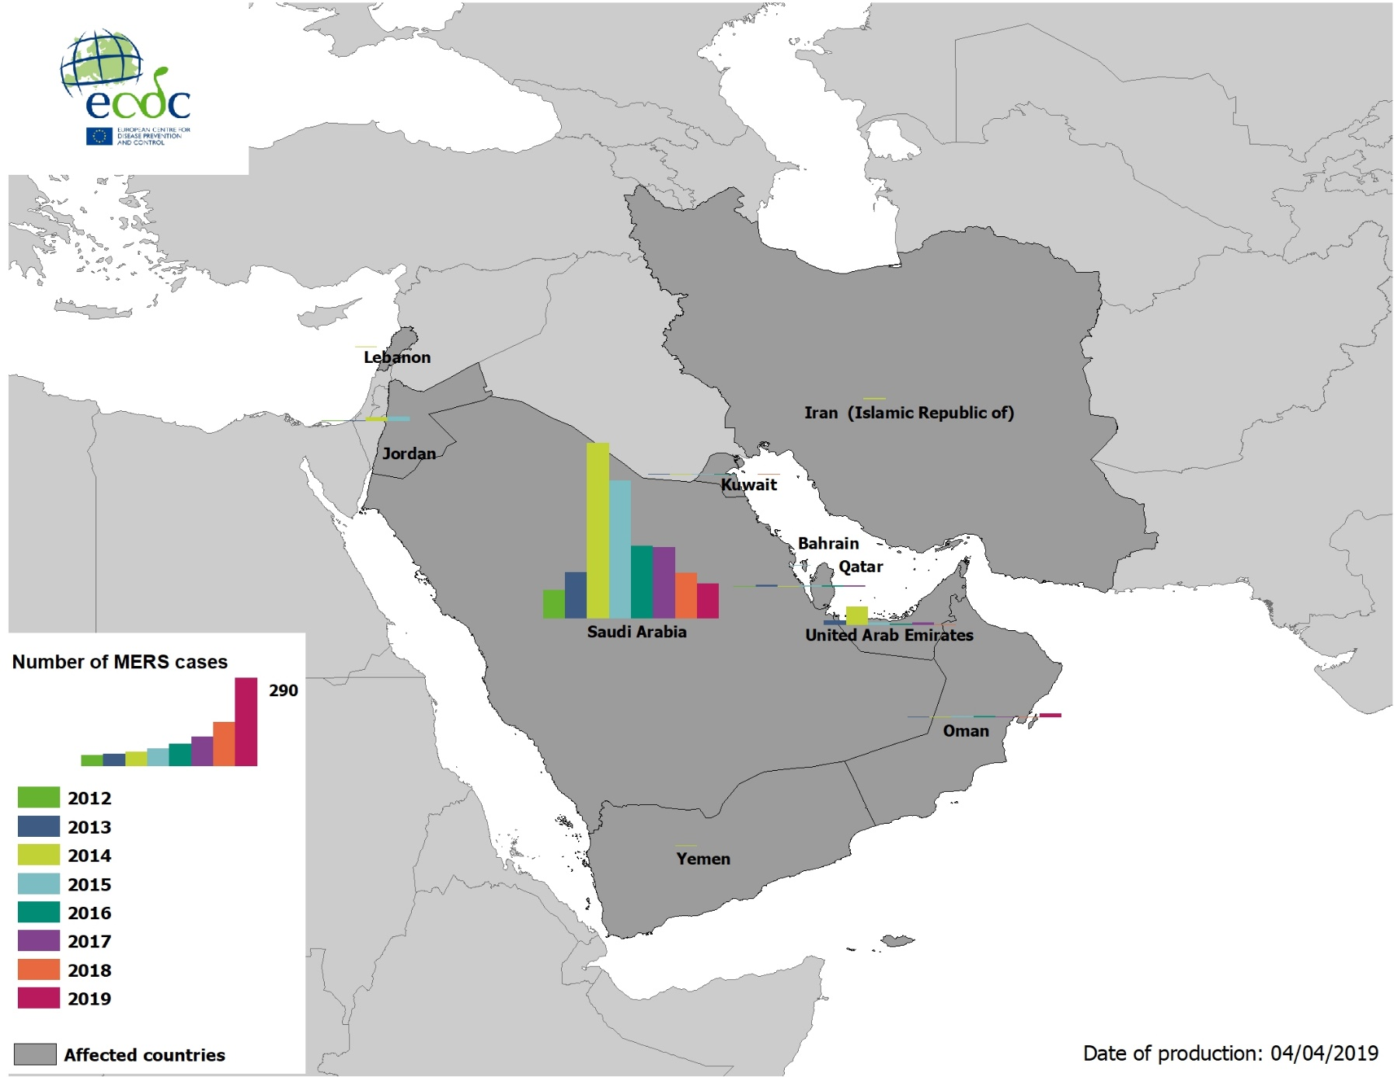
Geographical distribution of confirmed MERS-CoV cases by country of infection and year,
April 2012–4 April 2019

Slide 10
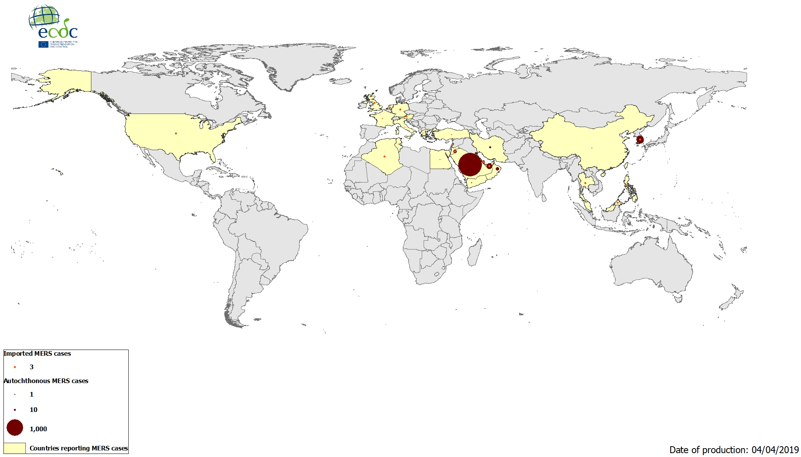
Geographical distribution of confirmed MERS-CoV cases by reporting country,
April 2012–4 April 2019

