Slide 1
You are encouraged to reuse our maps and graphs for your own purposes and free to translate, provided the content is not altered and the source is acknowledged. Either copy the images from the following slides or download directly from: ecdc.europa.eu/en/publications/surveillance_reports/Communicable-Disease-Threats-Report/Pages/cdtr.aspx
European Centre for Disease Prevention and Control
Reusable maps and graphs from ECDC Communicable Disease Threats Report, week 14, 2018

Slide 2
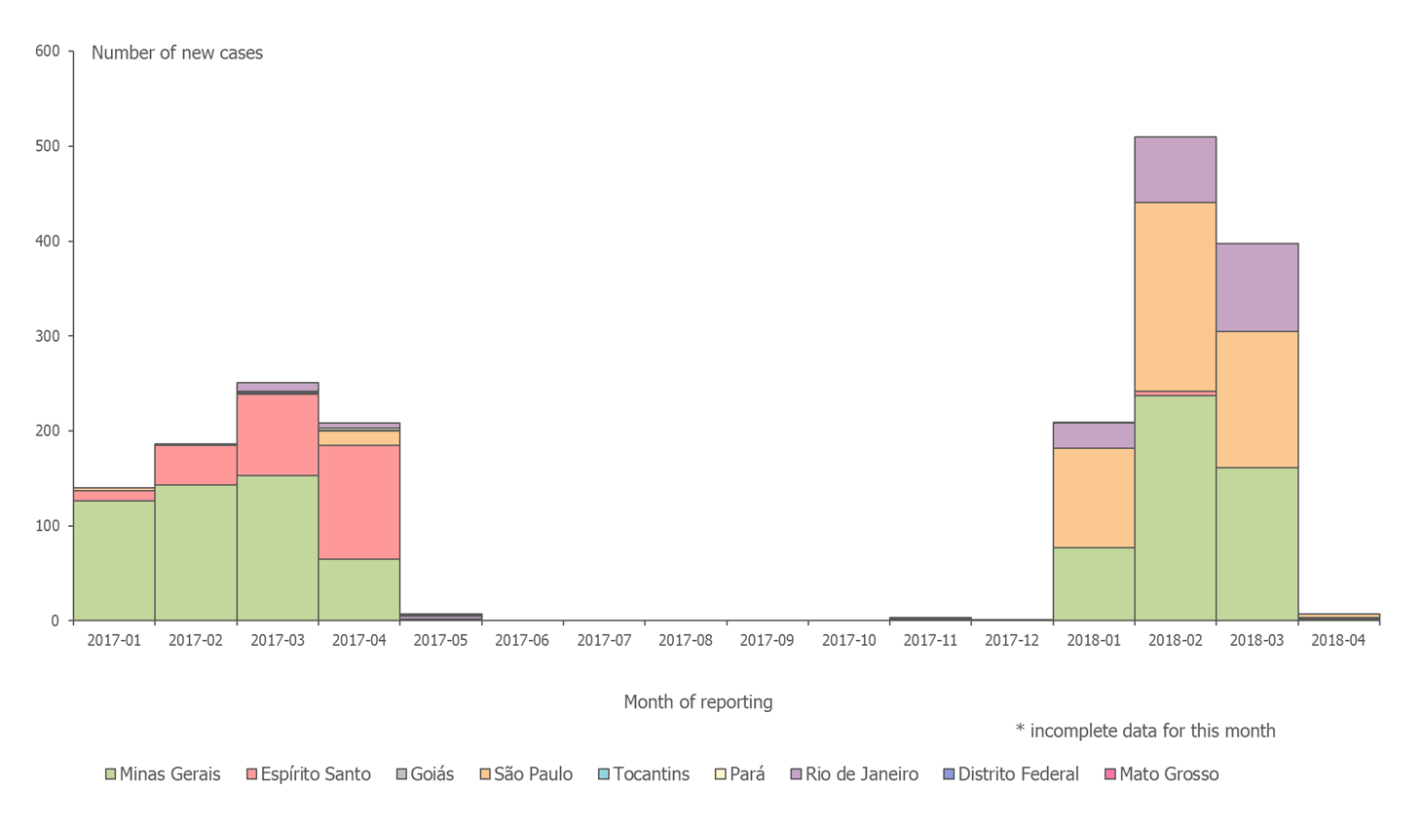
Distribution of confirmed human cases of yellow fever by month, Brazil,
January 2017– 3 April 2018
*

Slide 3
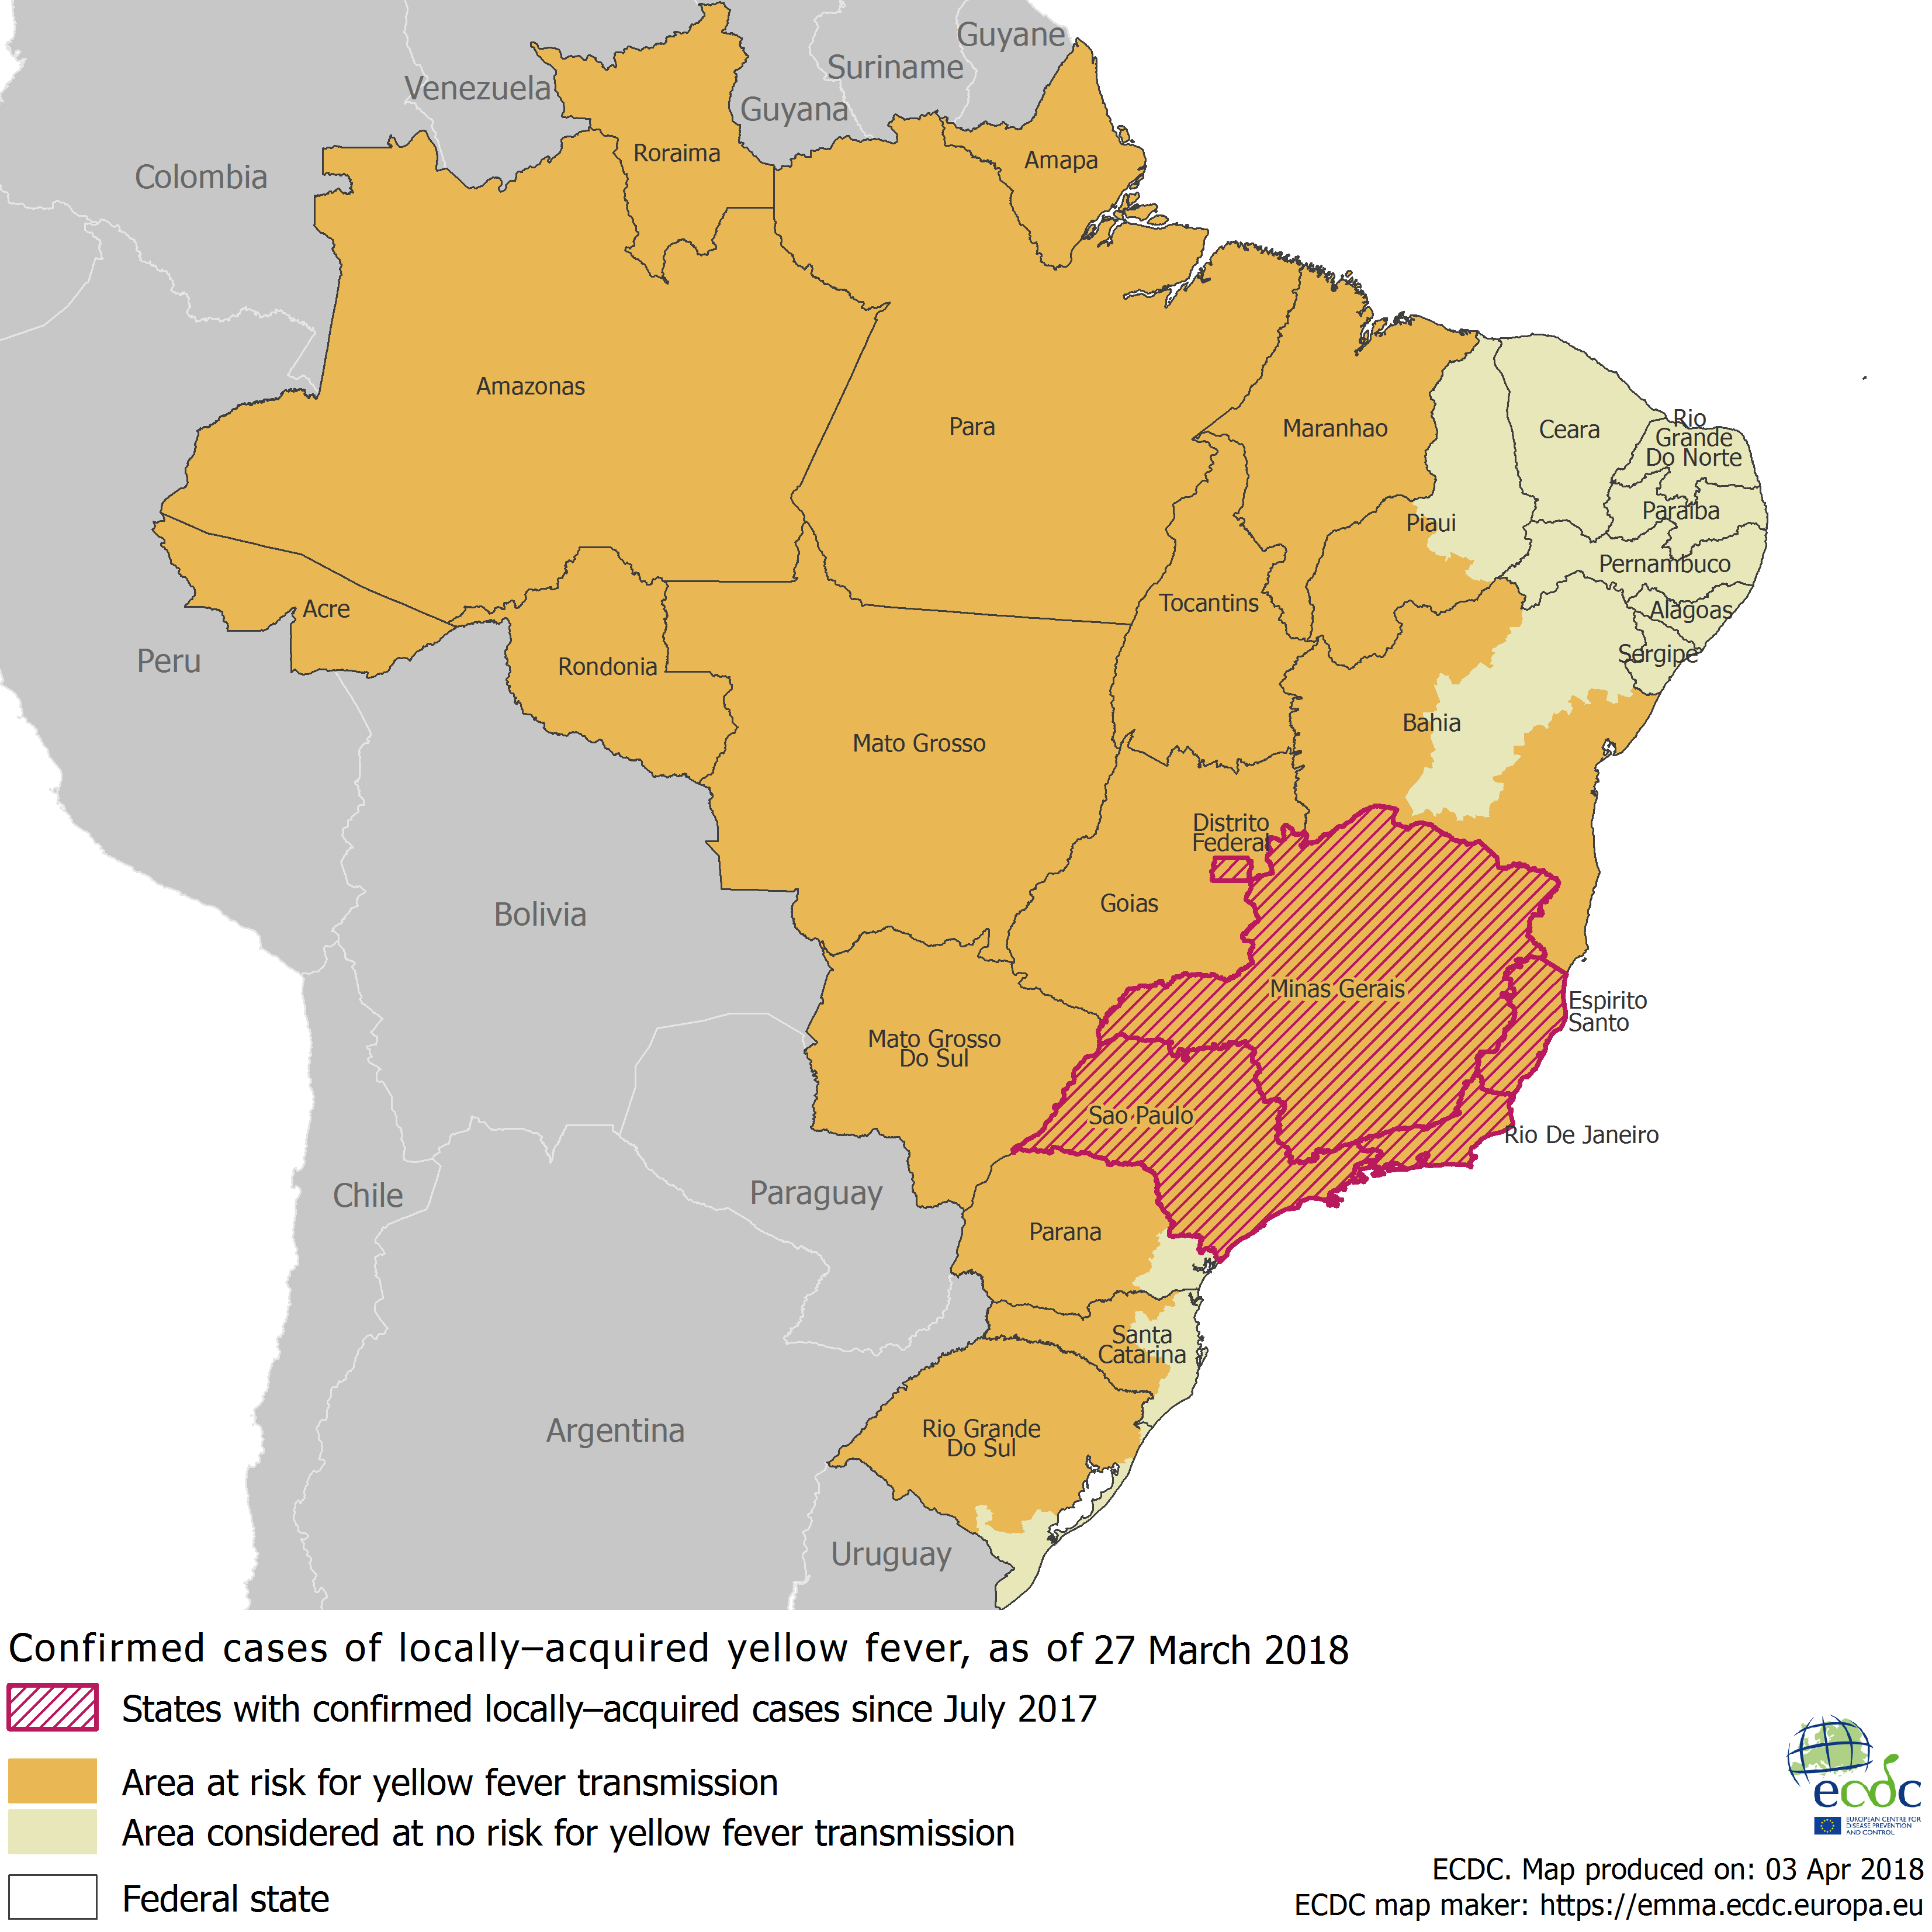
Distribution of confirmed yellow fever cases by state, Brazil, July 2017 – April 2018

Slide 4
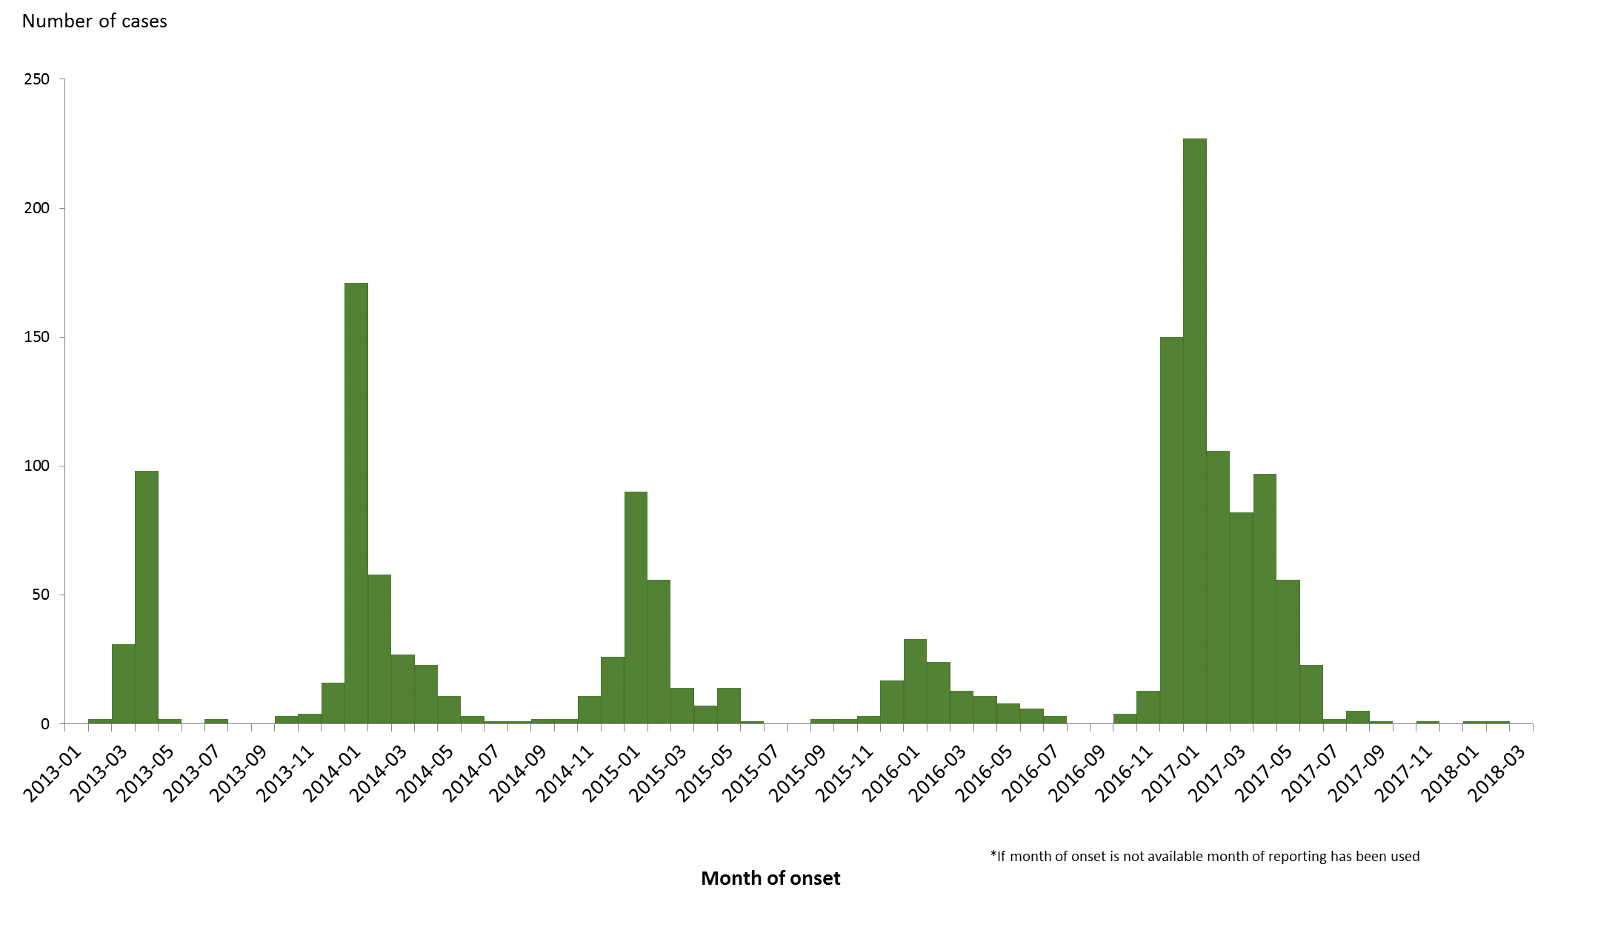
Distribution of confirmed cases of A(H7N9) by first available month*
February 2013 – 31 March 2018 (n= 1 567)

Slide 5
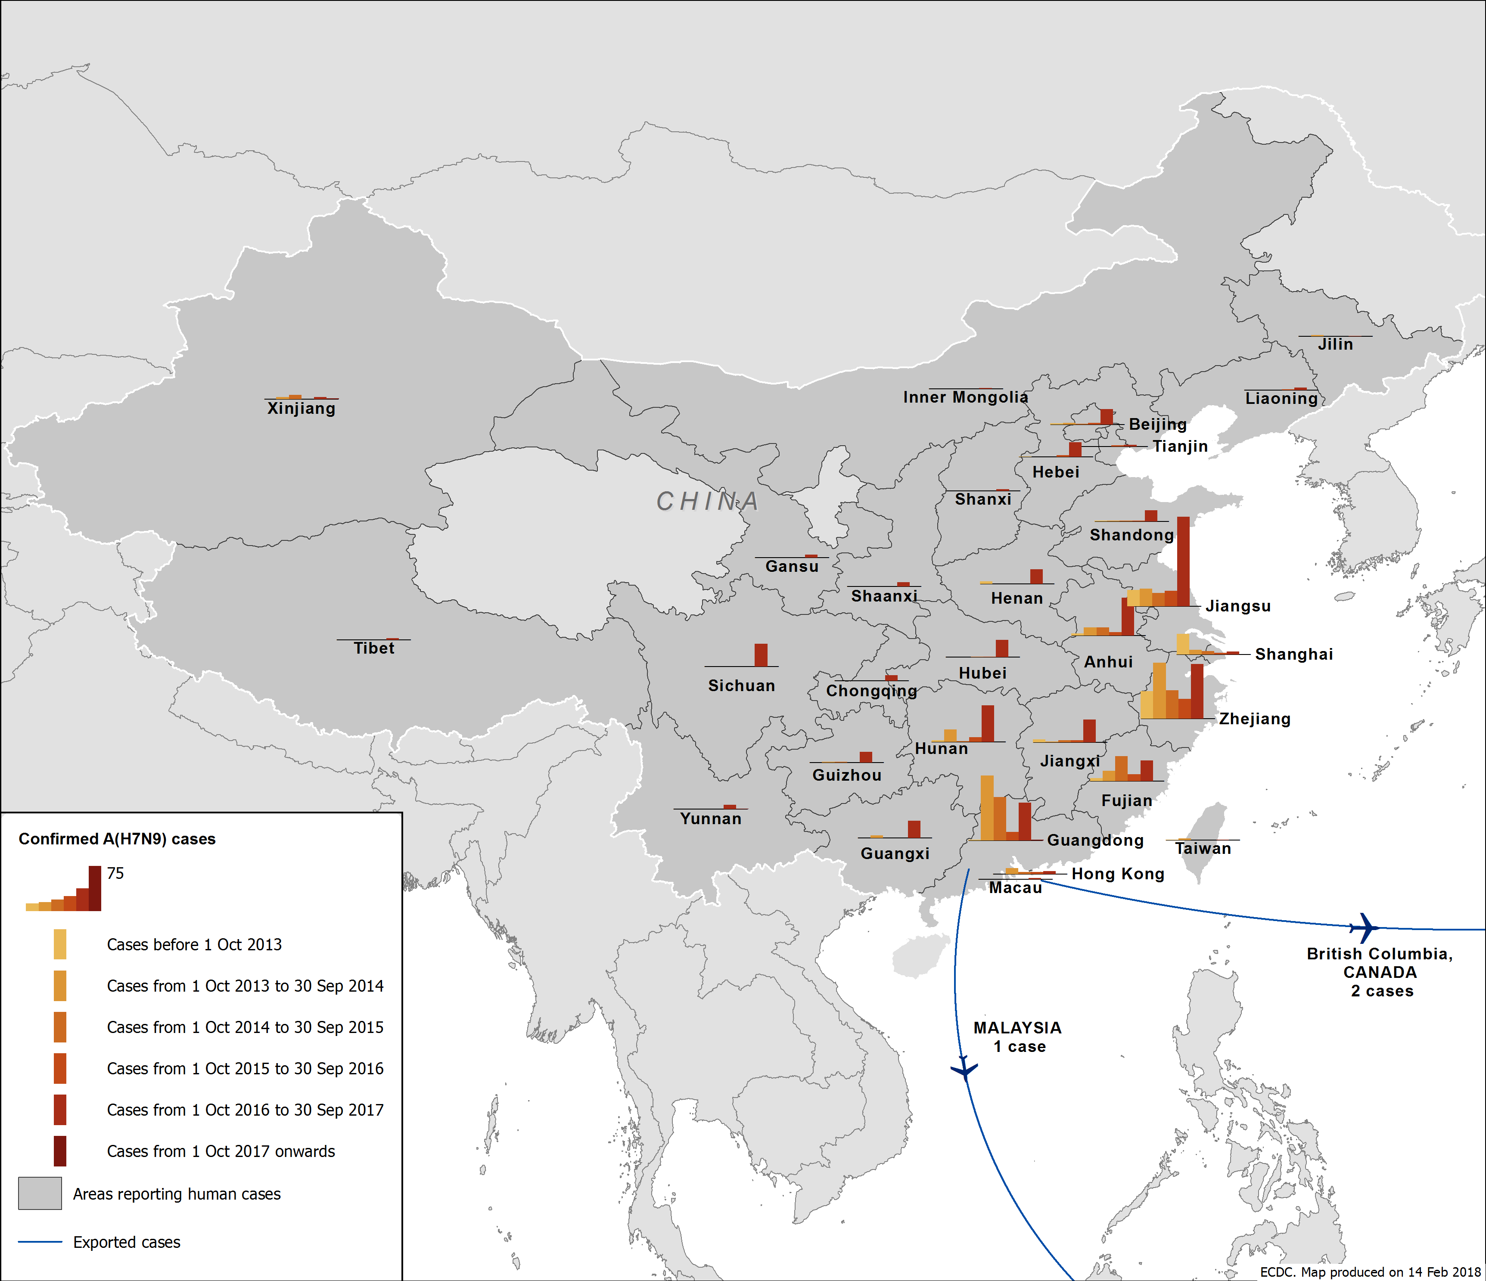
Distribution of confirmed cases of A(H7N9) by first available month,
February 2013 to 31 March 2018

Slide 6
Number of reported cases and fatalities due to A(H7N9) infection
 | First wave (02/2013–09/2013) | Second wave (10/2013–09/2014) | Third wave (10/2014–09/2015) | Fourth wave (09/2015–09/2016) | Fifth wave (10/2016 - 09/2017) | Sixth wave (10/2017 - current date) | Cumulative number of cases
Cases | 135 | 320 | 223 | 120 | 766 | 3 | 1567
Deaths* | 43 | 134 | 98 | 45 | 248 | 1 | 569
CFR (%) | 32% | 42% | 44% | 38% | 32% | 33% | 36%
Source: WHO and Hong Kong Centre for Health Protection
http://www.who.int/influenza/human_animal_interface/Influenza_Summary_IRA_HA_interface_04_20_2017.pdf?ua=1
http://www.chp.gov.hk/en/guideline1_year/29/134/332.html
*The estimates in the table are based on the information available at the time of notification. Therefore, CFR may be affected by completeness of information about outcome at time of notification.

Slide 7
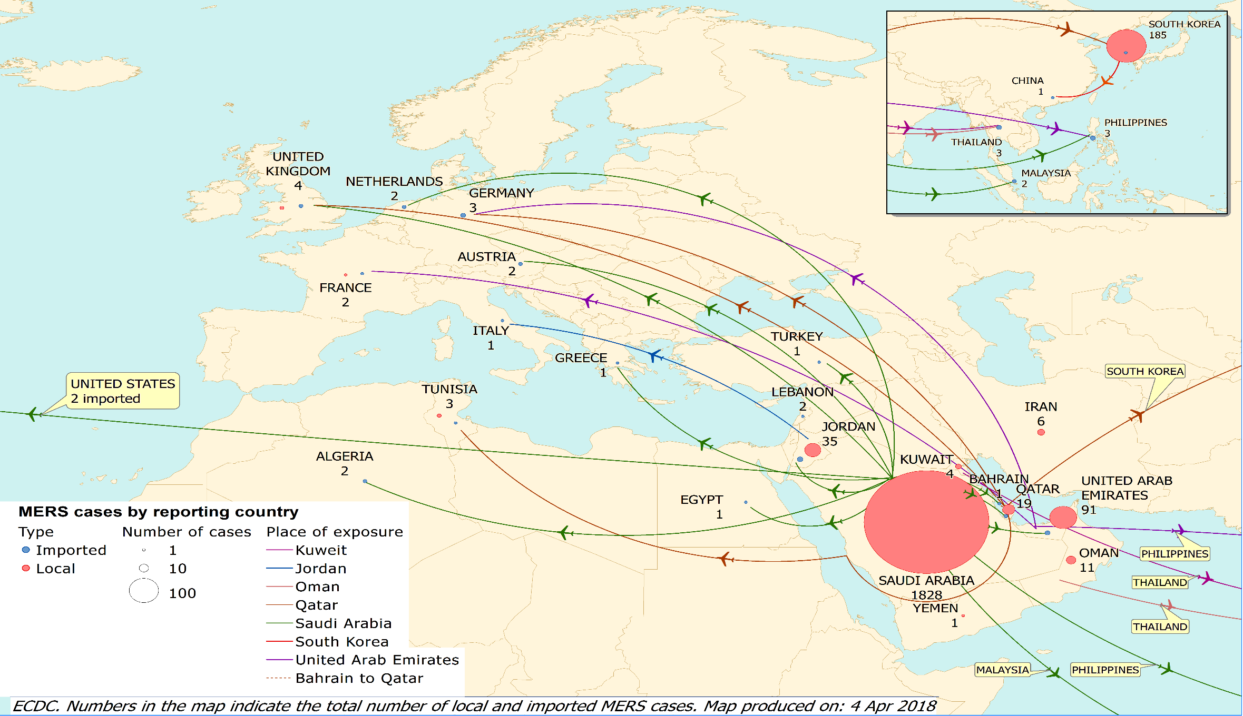
Distribution of confirmed cases of MERS-CoV by country of probable infection and country of report from March 2012 and as of 31 March 2018

Slide 8
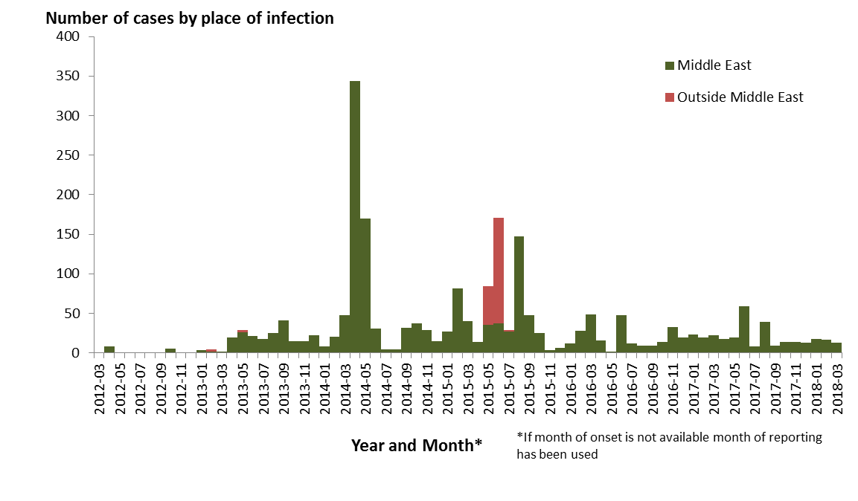
Distribution of confirmed cases of MERS-CoV by first available month and region, from March 2012 and as of 31 March 2018

