Slide 1
Reusable maps and graphs from ECDC Communicable Disease Threats Report Week 14, 2024
You are encouraged to reuse our maps and graphs for your own purposes and are free to translate them, provided the content is not altered and the source is acknowledged.

Slide 2
Geographical distribution of confirmed MERS-CoV cases by country of infection and year, April 2012 to March 2024

Slide 3
Confirmed cases of MERS-CoV by place of infection and month of onset, March 2012 to March 2024

Slide 4
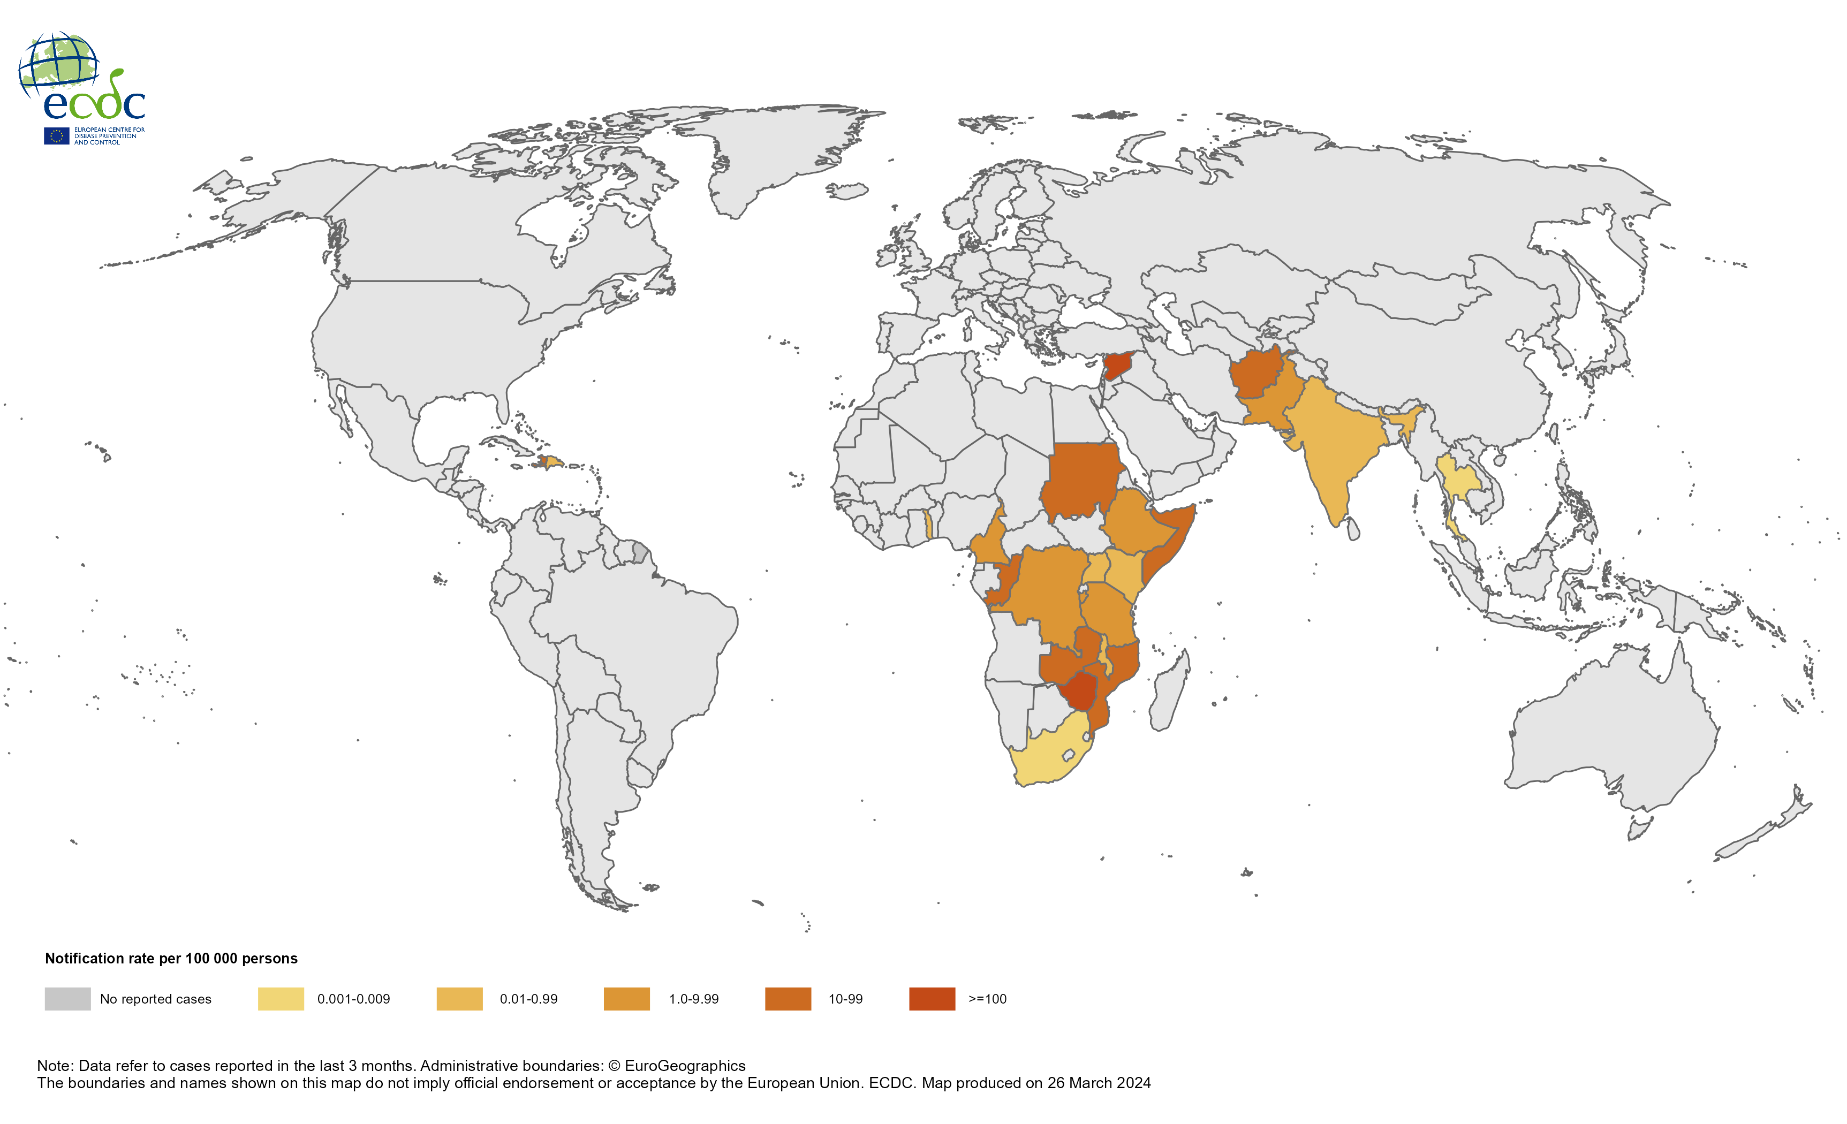
Geographical distribution of cholera cases reported worldwide, December 2023 to February 2024

Slide 5
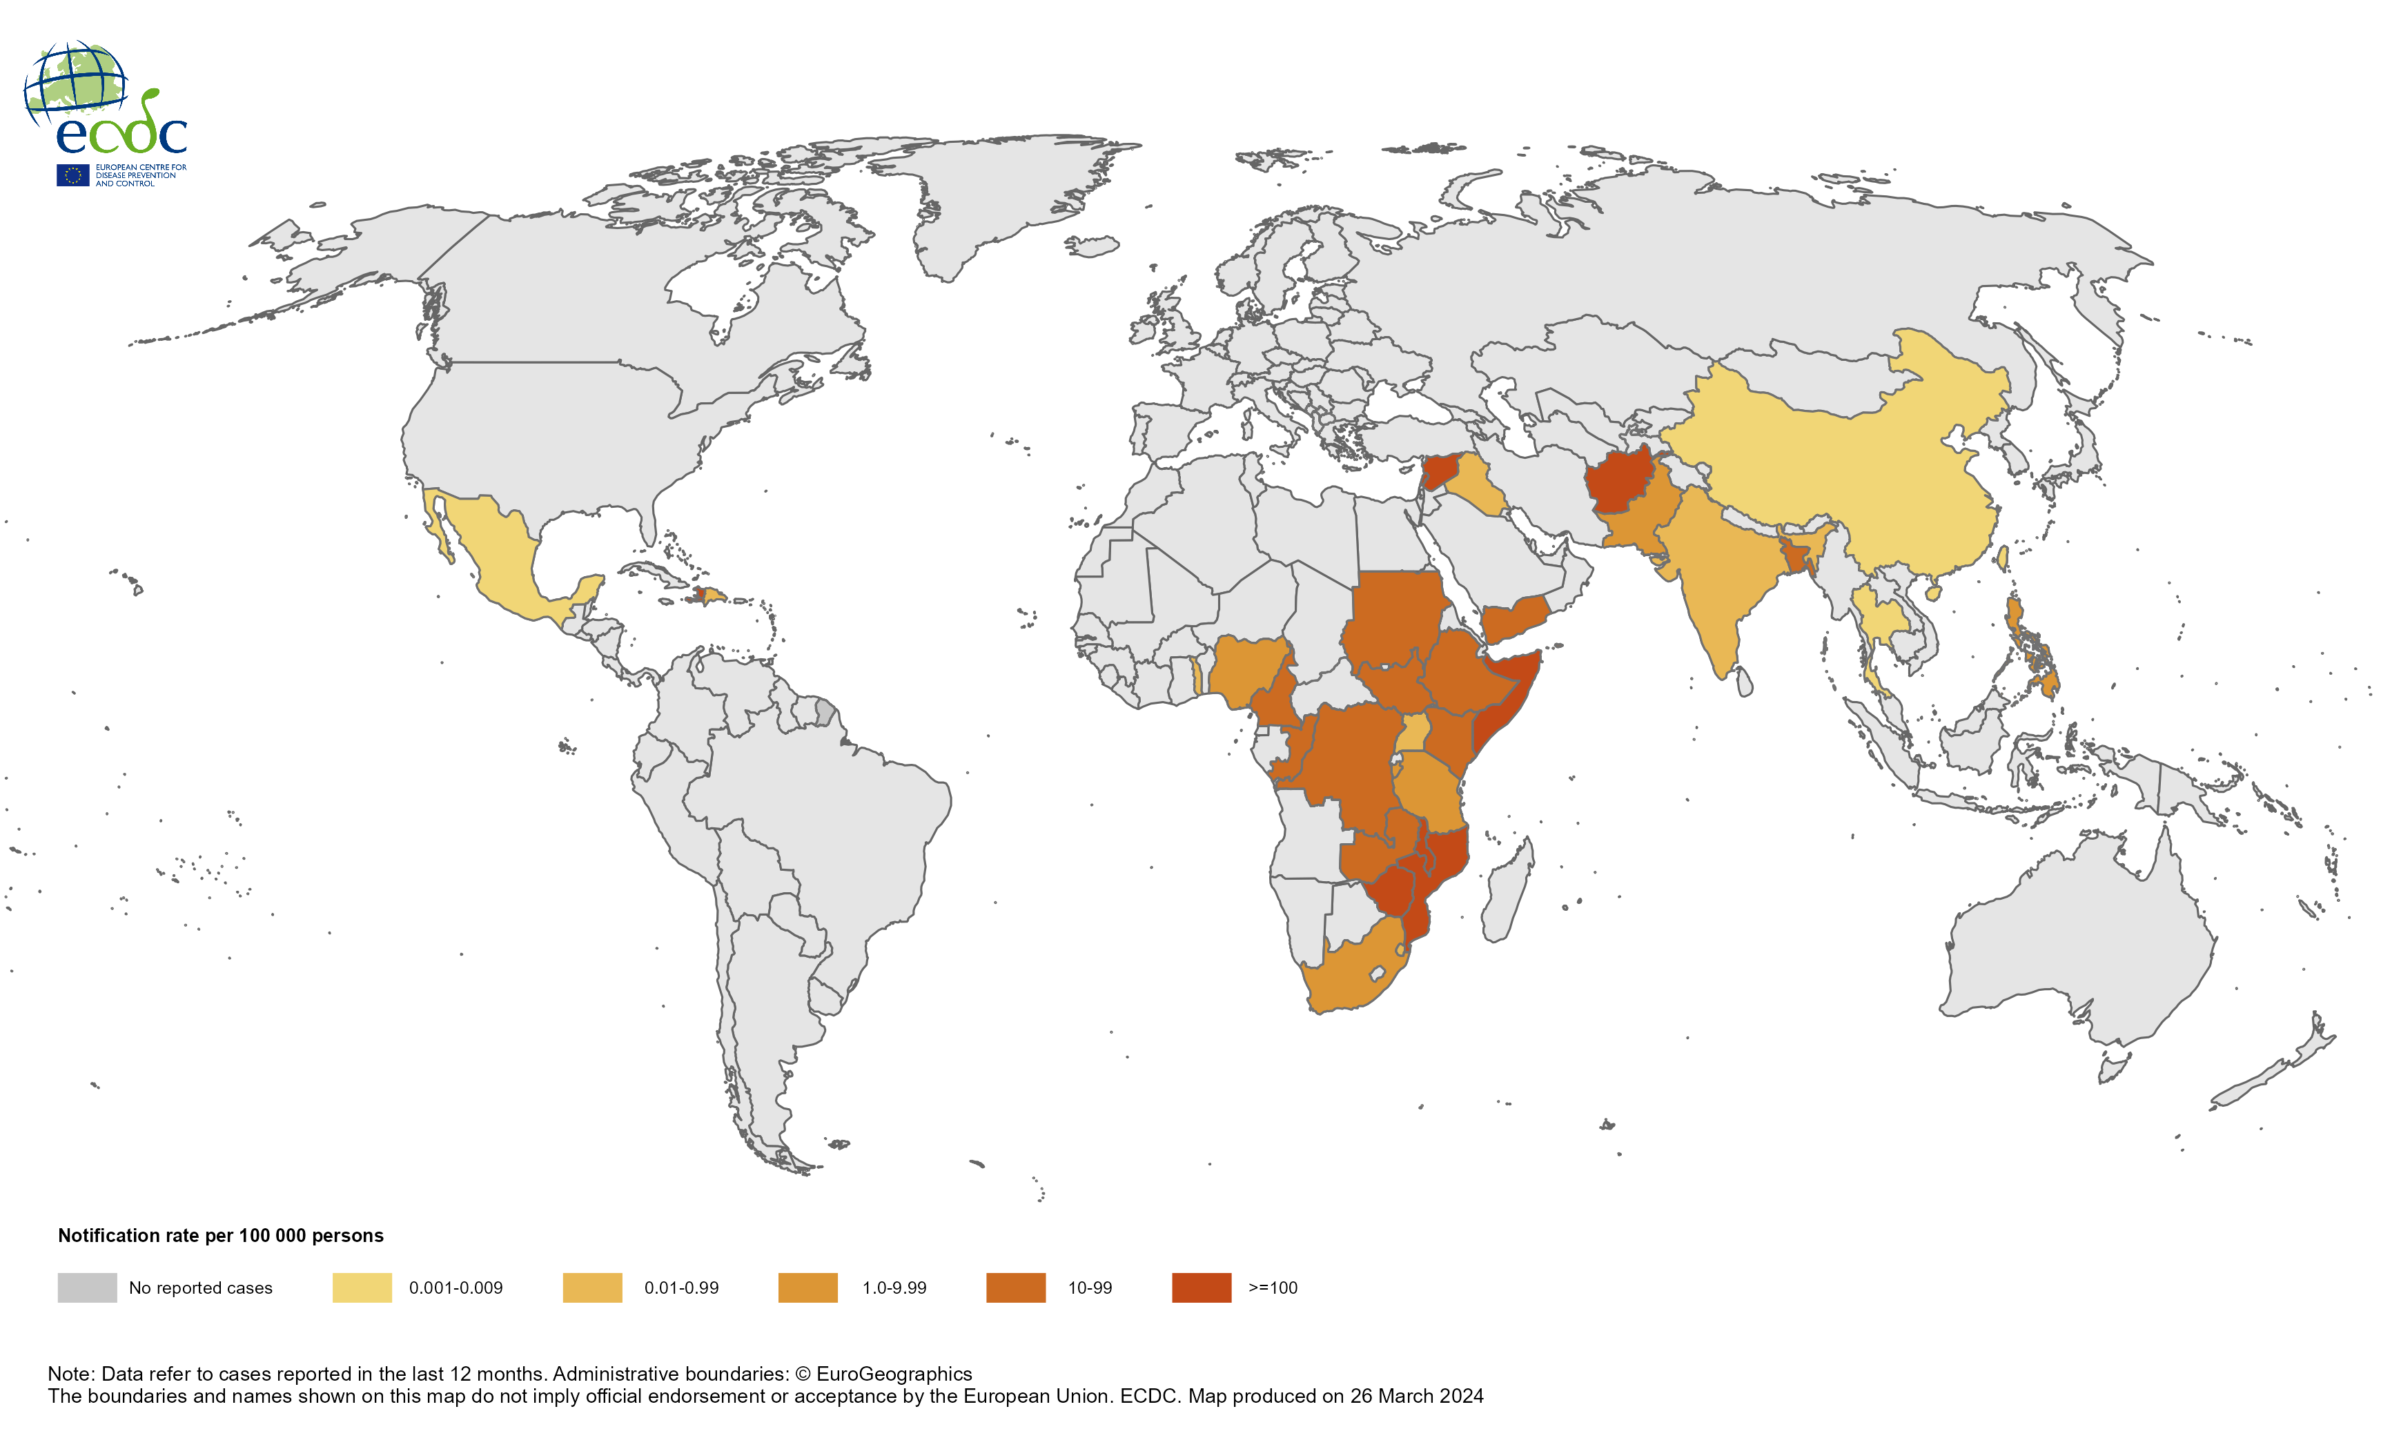
Geographical distribution of cholera cases reported worldwide, March 2023 to February 2024

Slide 6
Confirmed human cases of avian influenza A(H5N1) virus infection by year of onset and country, 2003 to 26 March 2024 (n =888)

