Slide 1
Reusable maps and graphs from ECDC Communicable Disease Threats Report
Week 14 2022
You are encouraged to reuse our maps and graphs for your own purposes and are free to translate them, provided the content is not altered and the source is acknowledged.

Slide 2
Distribution of COVID-19 cases worldwide, in accordance with the applied case definitions in the affected countries, as of week 13 2022

Slide 3
Distribution of COVID-19 deaths worldwide, as of week 13, 2022

Slide 4
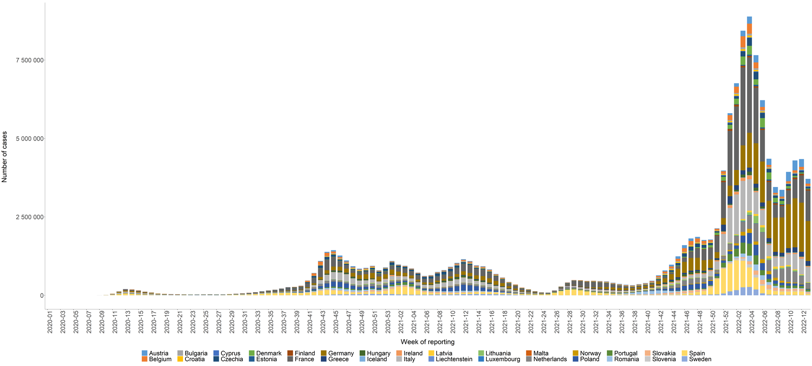
Distribution of laboratory-confirmed cases of COVID-19 in the EU/EEA, as of week 13, 2022

Slide 5
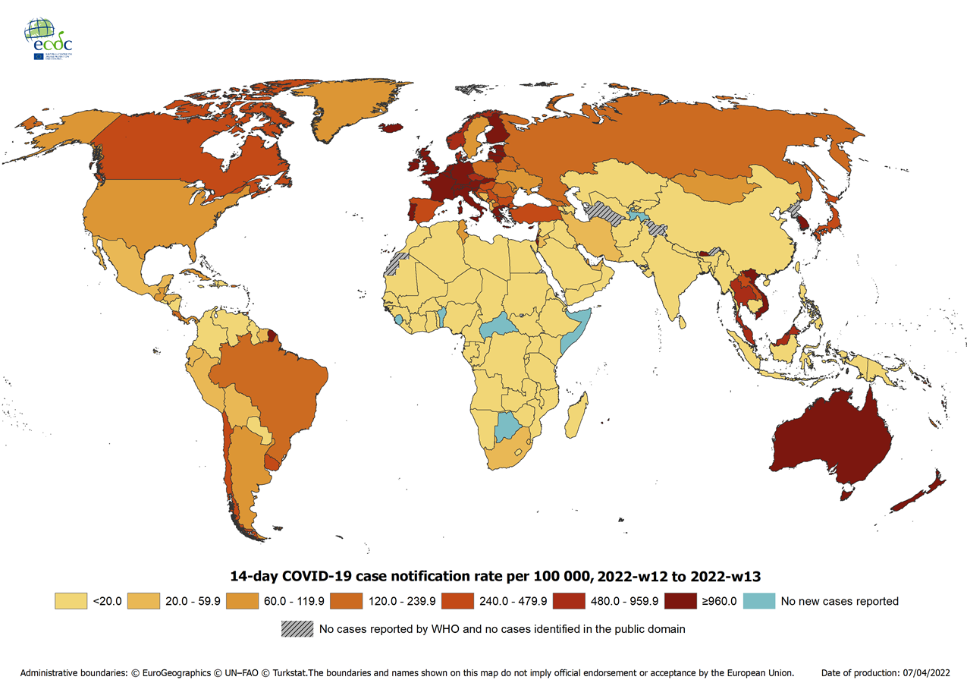
Geographical distribution of 14-day cumulative number of reported COVID-19 cases per 100 000 population, worldwide, as of week 13, 2022
14-day notification rates and trends are collected using epidemic intelligence from various sources and are affected by the testing strategy, laboratory capacity and effectiveness of surveillance systems. As all of these factors can differ greatly between countries, ECDC does not recommend using notification rates to directly compare countries. Particular caution is needed when interpreting reported rates from areas with small populations, where small changes in the numbers of reported cases can have a large impact on the notification rate. In addition, the retrospective adjustment of data by reporting authorities is possible. Negative counts of new cases can arise if countries or subnational areas report cumulative totals that are lower than those reported previously, which can affect the presentation of data in maps and time-series plots.

Slide 6

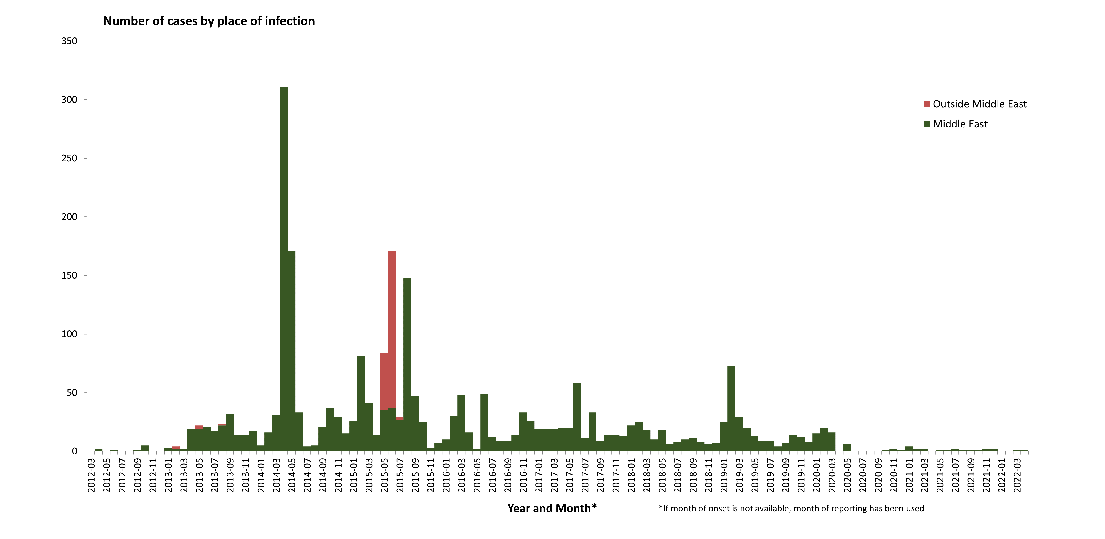
Distribution of confirmed cases of MERS-CoV by place of infection and month of onset,
March 2012 – April 2022
Notes:
Cases in 2020: 61
Cases in 2019: 223

Slide 7
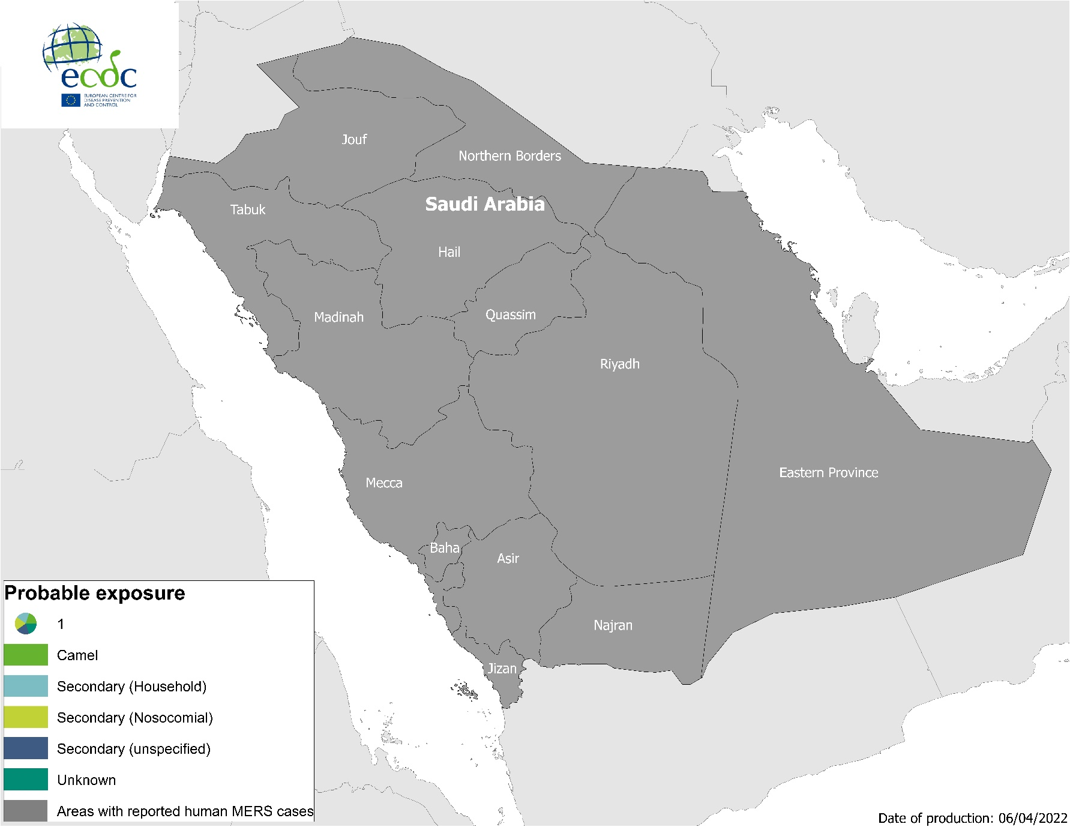
Geographical distribution of confirmed MERS-CoV cases by probable region of infection and exposure, from 1 January 2022 to 6 April 2022

Slide 8
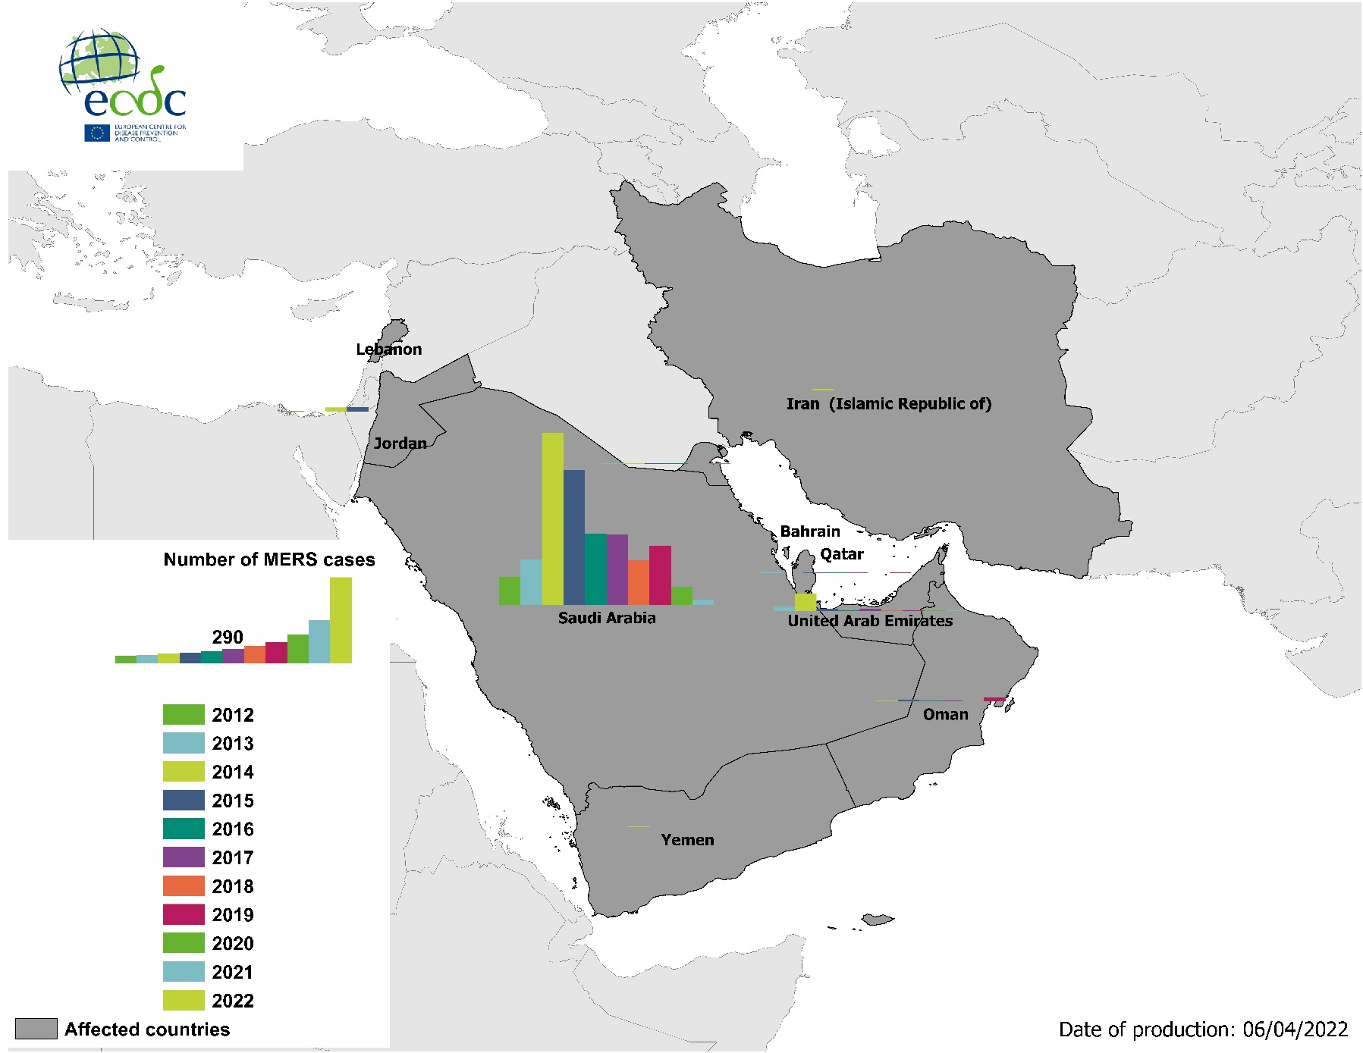
Geographical distribution of confirmed MERS-CoV cases by country of infection and year, from April 2012 to 6 April 2022
Notes:
Cases only in SA and UAE

Slide 9
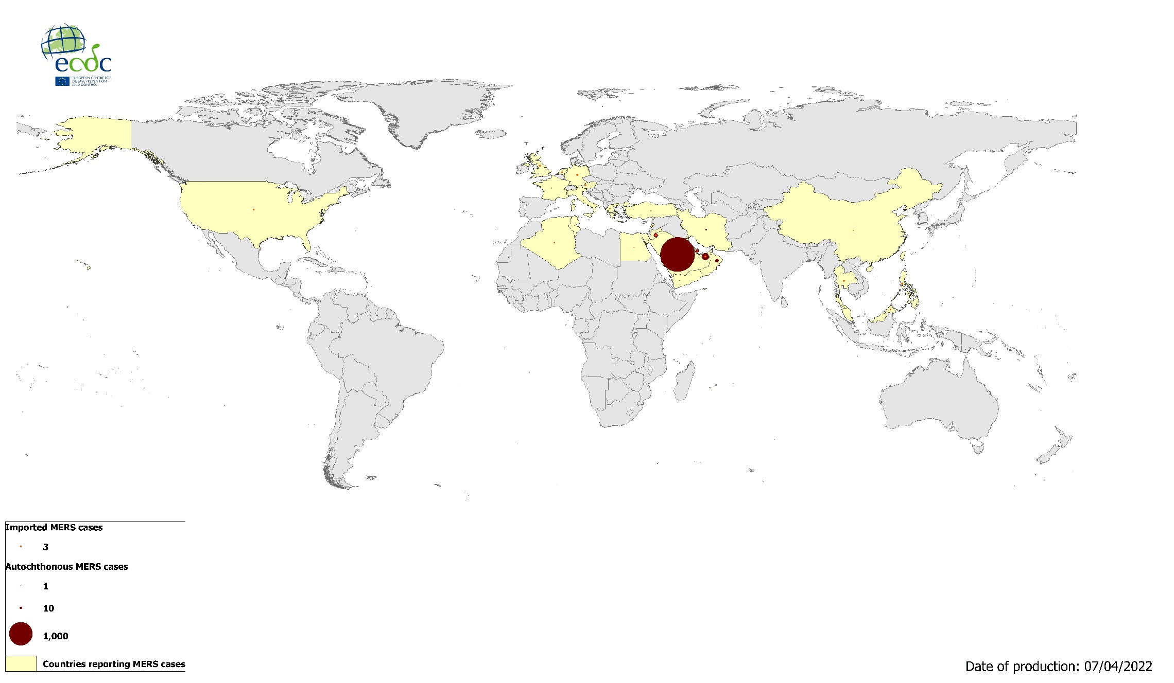
Geographical distribution of confirmed MERS-CoV cases by reporting country from April 2012 to 6 April 2022
Notes:
2600 total cases ww and 943 deaths

Slide 10
Geographical distribution of chikungunya cases reported worldwide in 2022, as of 6 April 2022

Slide 11
Geographical distribution of dengue cases
reported worldwide in 2022, as of 6 April 2022

