Slide 1
Reusable maps and graphs from ECDC Communicable Disease Threats Report Week 13, 2024
You are encouraged to reuse our maps and graphs for your own purposes and are free to translate them, provided the content is not altered and the source is acknowledged.

Slide 2
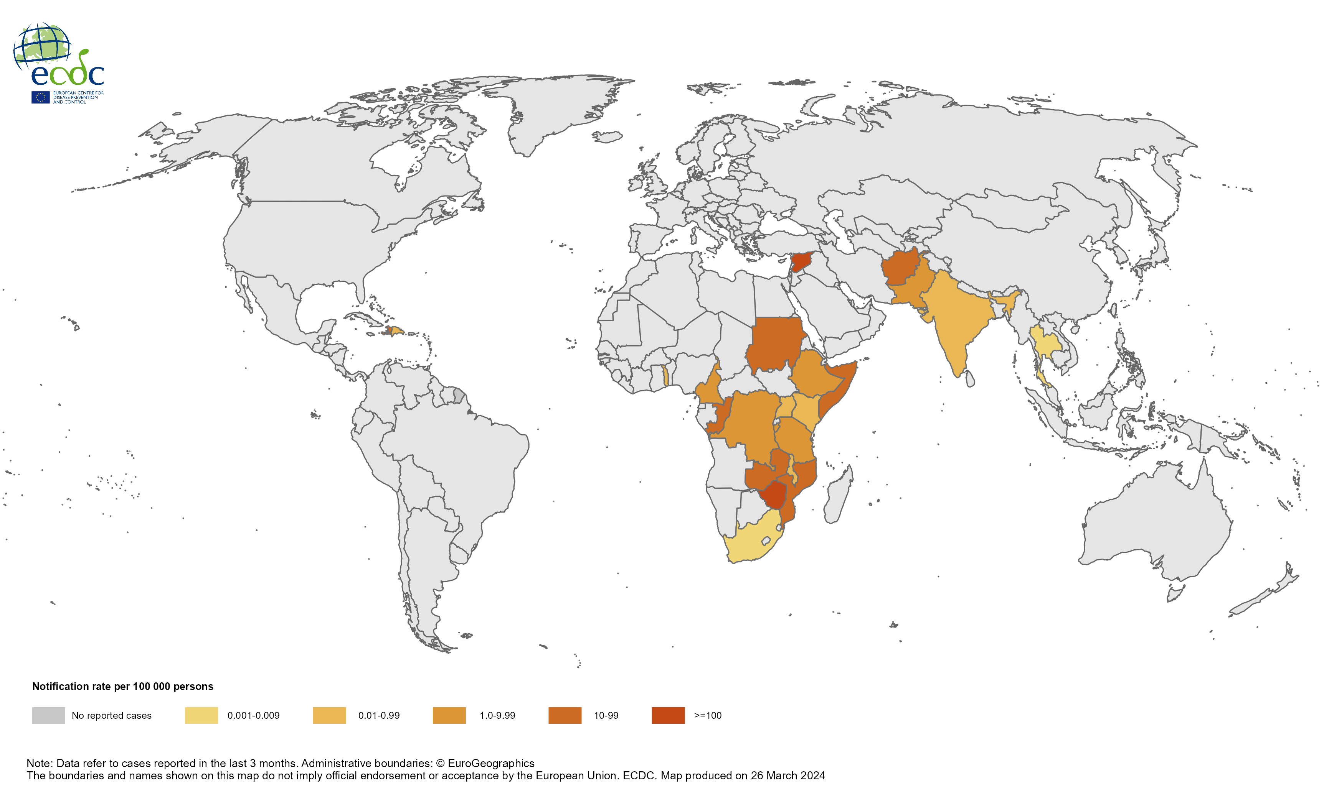
Geographical distribution of cholera cases reported worldwide from December 2023 to February 2024

Slide 3
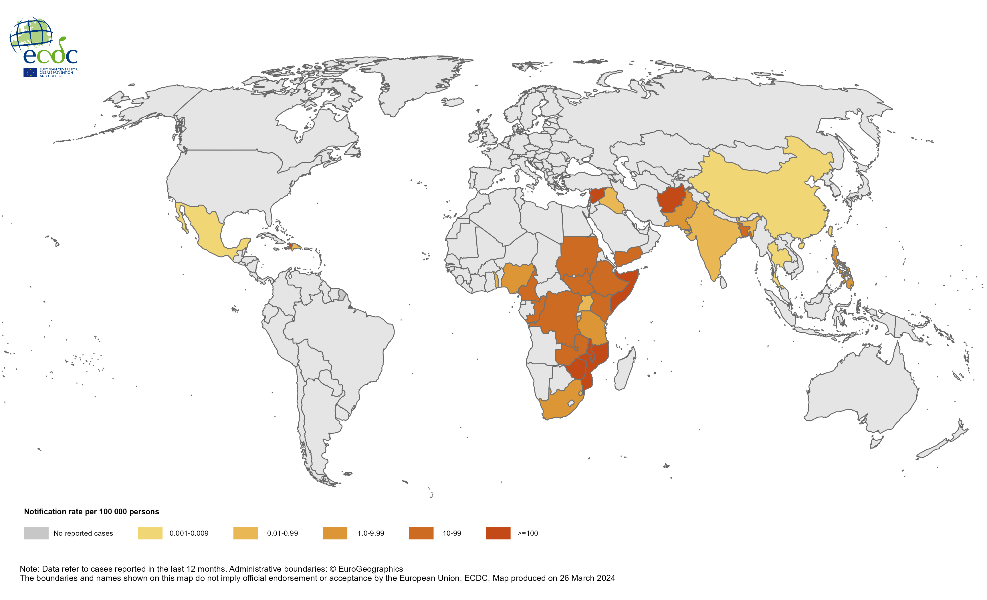
Geographical distribution of cholera cases reported worldwide from March 2023 to February 2024

Slide 4
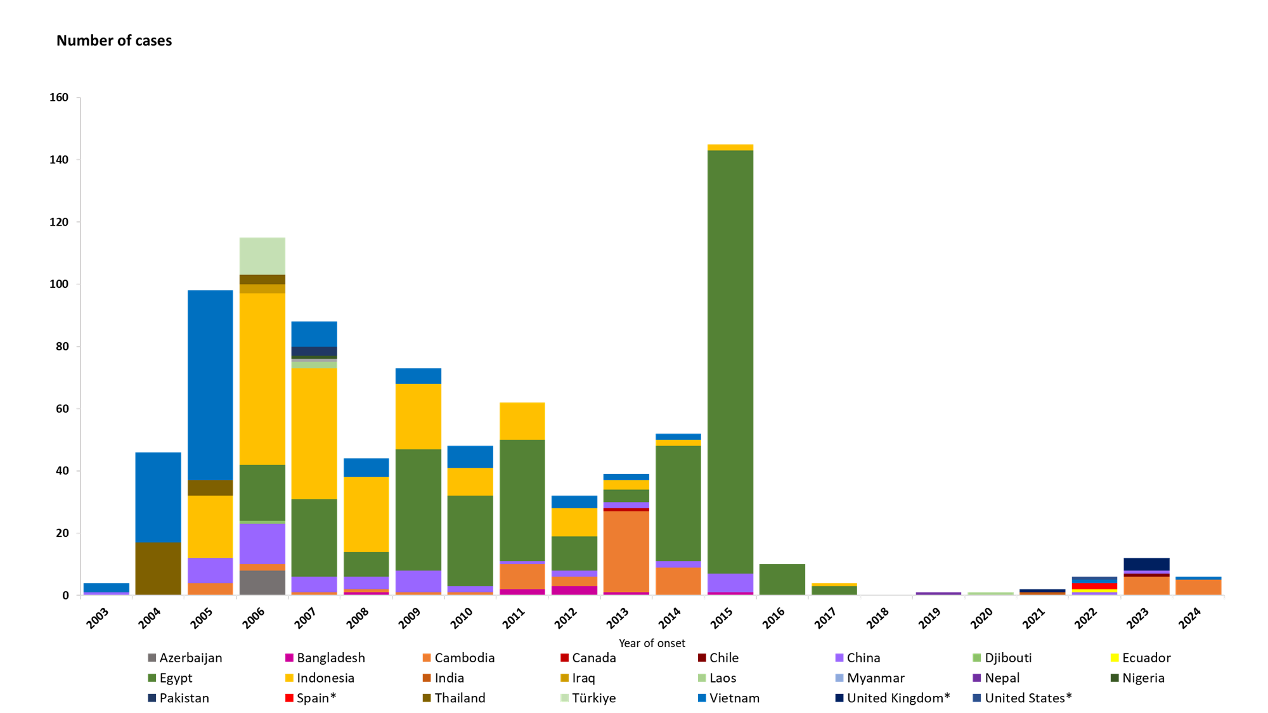
Distribution of confirmed human cases of avian influenza A(H5N1) virus infection by year of onset and country, 2003–26 March 2024 (n=888)

