Slide 1
Reusable maps and graphs from ECDC Communicable Disease Threats Report
Week 13, 2023
You are encouraged to reuse our maps and graphs for your own purposes and are free to translate them, provided the content is not altered and the source is acknowledged.

Slide 2
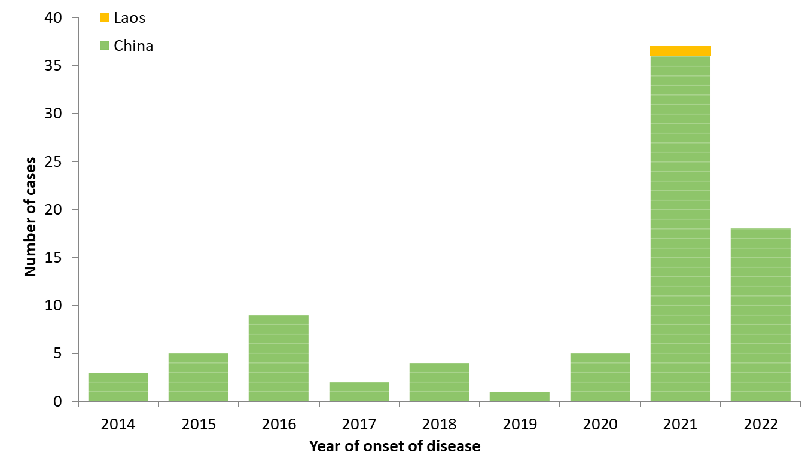
Distribution of confirmed human cases of avian influenza A(H5N6) virus infection by year of onset and country, 2014–30 March 2023 (n=84)

Slide 3
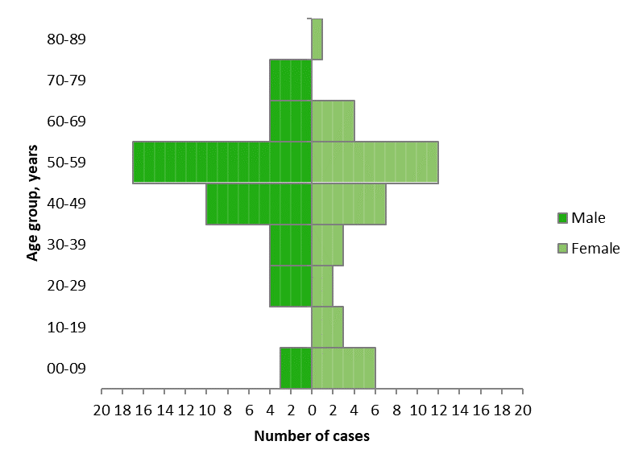
Distribution of confirmed human cases of avian influenza A(H5N6) virus infection by age and gender, 2014–30 March 2023 (n=84)

Slide 4
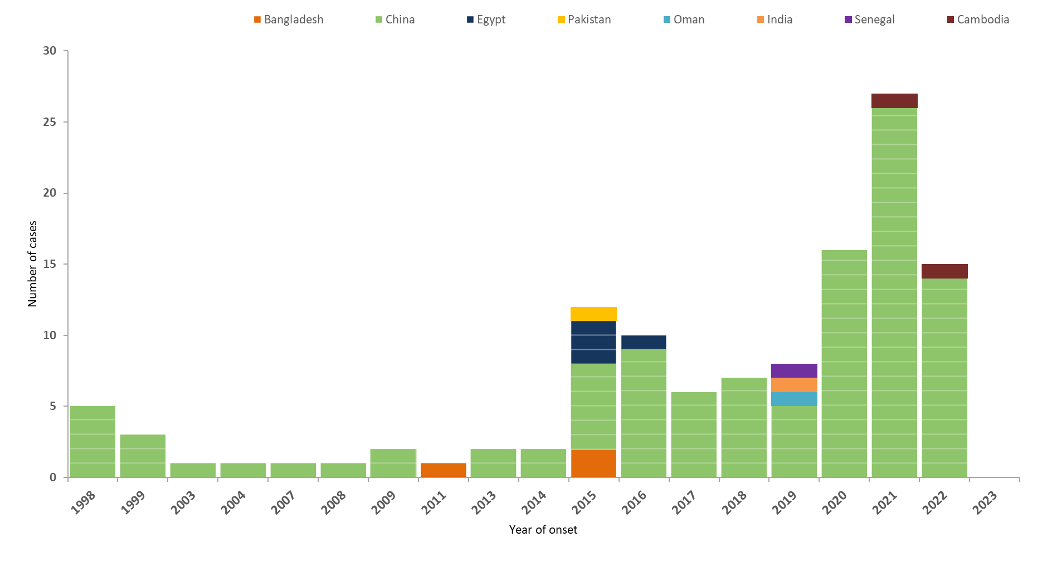
Distribution of confirmed human cases of avian influenza A(H9N2) virus infection by year of onset and country, 1998–30 March 2023 (n=120)

Slide 5
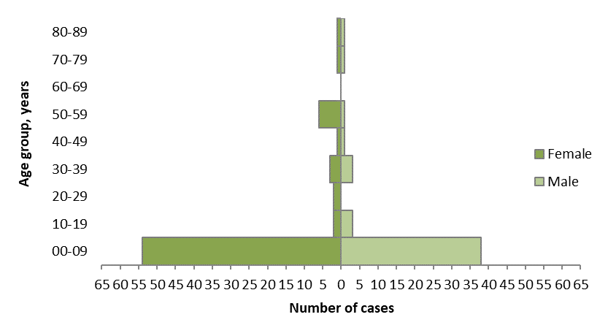
Distribution of confirmed human cases of avian influenza A(H9N2) virus infection by sex and gender, 1998–30 March 2023 (n=120)

Slide 6
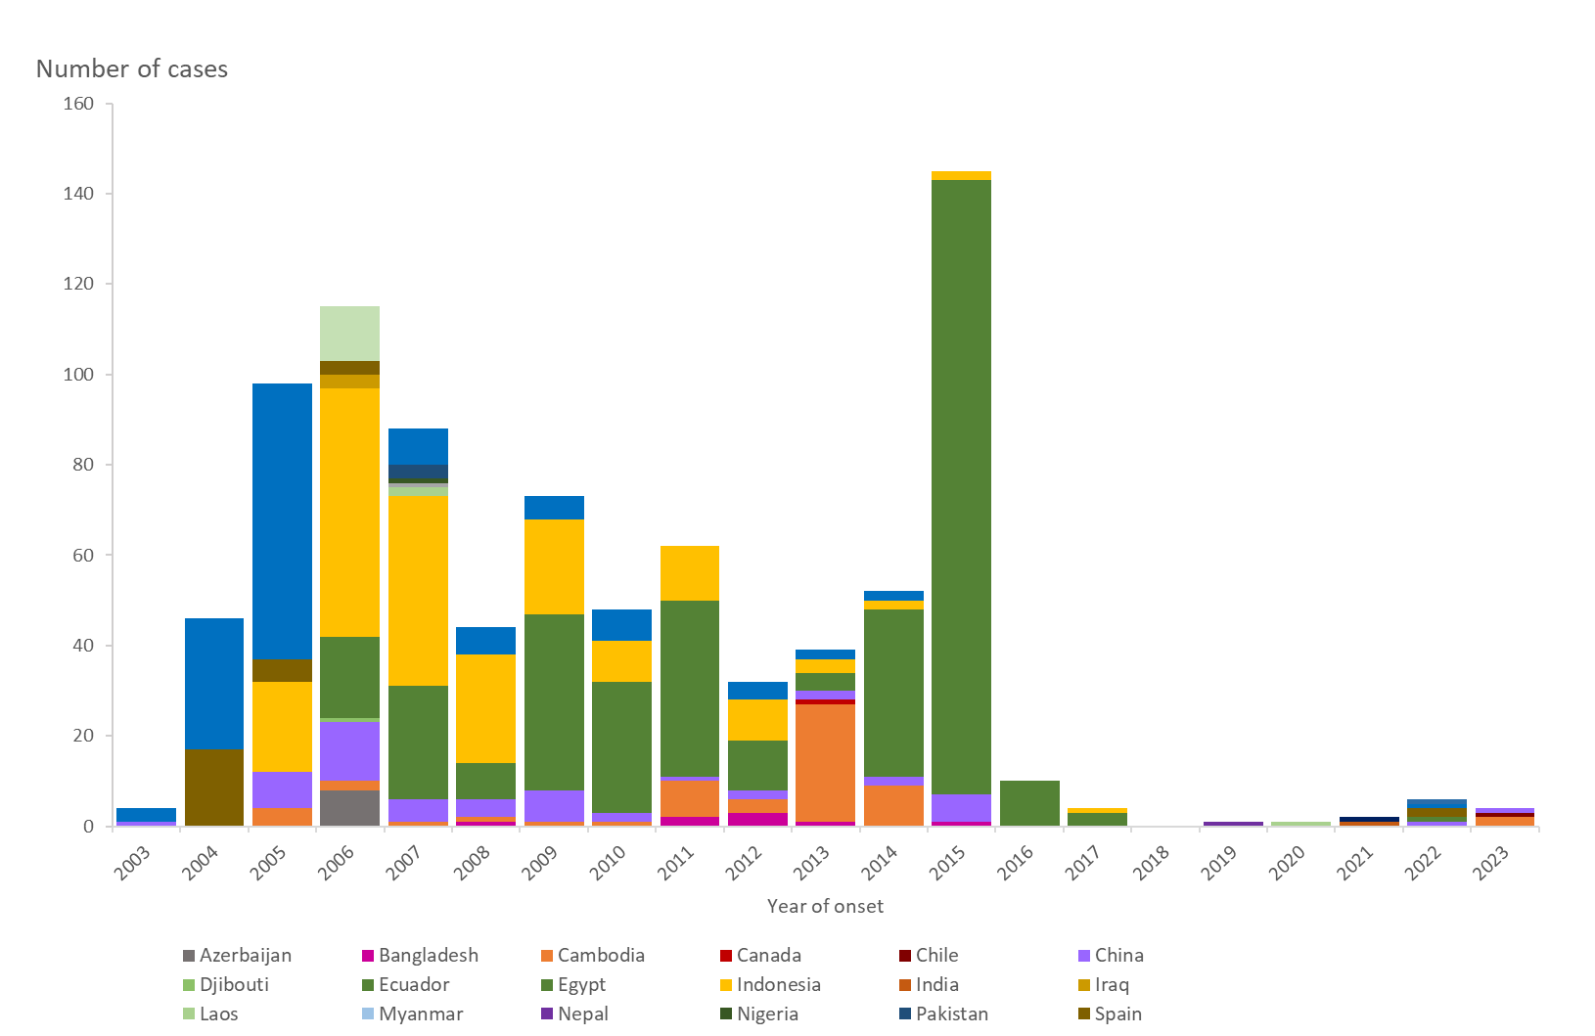
Distribution of confirmed human cases of avian influenza A(H5N1) virus infection by year of onset and country, 2003–2023 (updated on 30 March 2023, n=874)

