Slide 1
Reusable maps and graphs from ECDC Communicable Disease Threats Report
Week 12, 2020
You are encouraged to reuse our maps and graphs for your own purposes and free to translate, provided the content is not altered and the source is acknowledged.

Slide 2
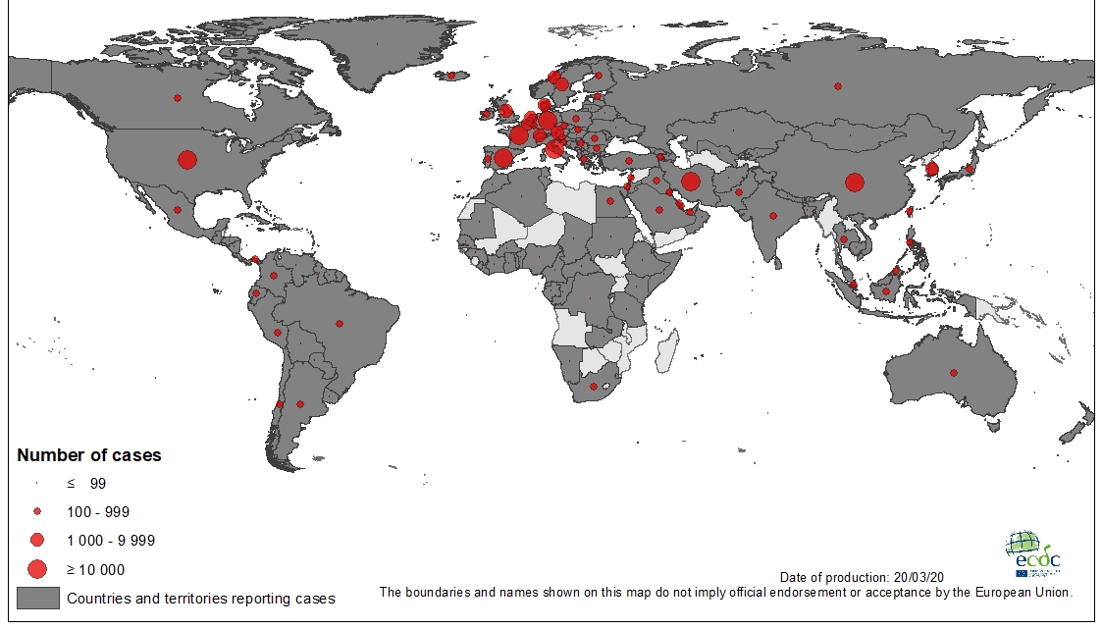
Geographical distribution of COVID-19 cases (in accordance with the applied case definition in the country), as of 20 March 2020

Slide 3
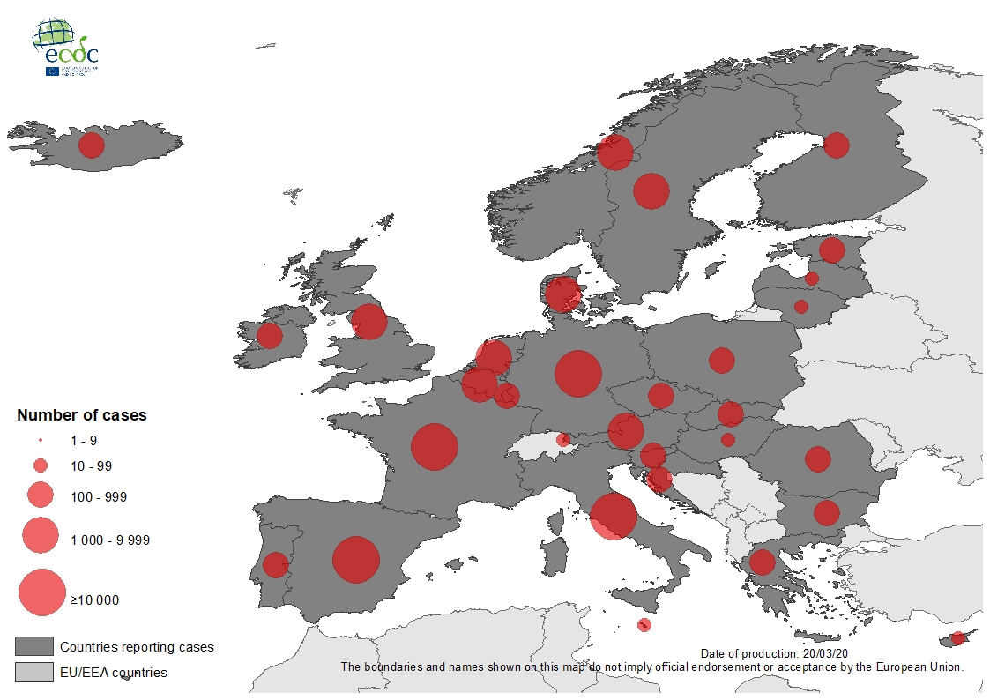
Geographic distribution of laboratory confirmed COVID-19 cases in the EU/EEA and the UK, as of 20 March 2020

Slide 4
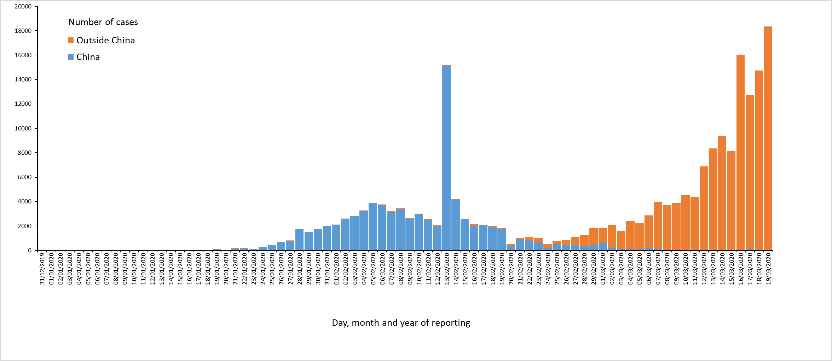
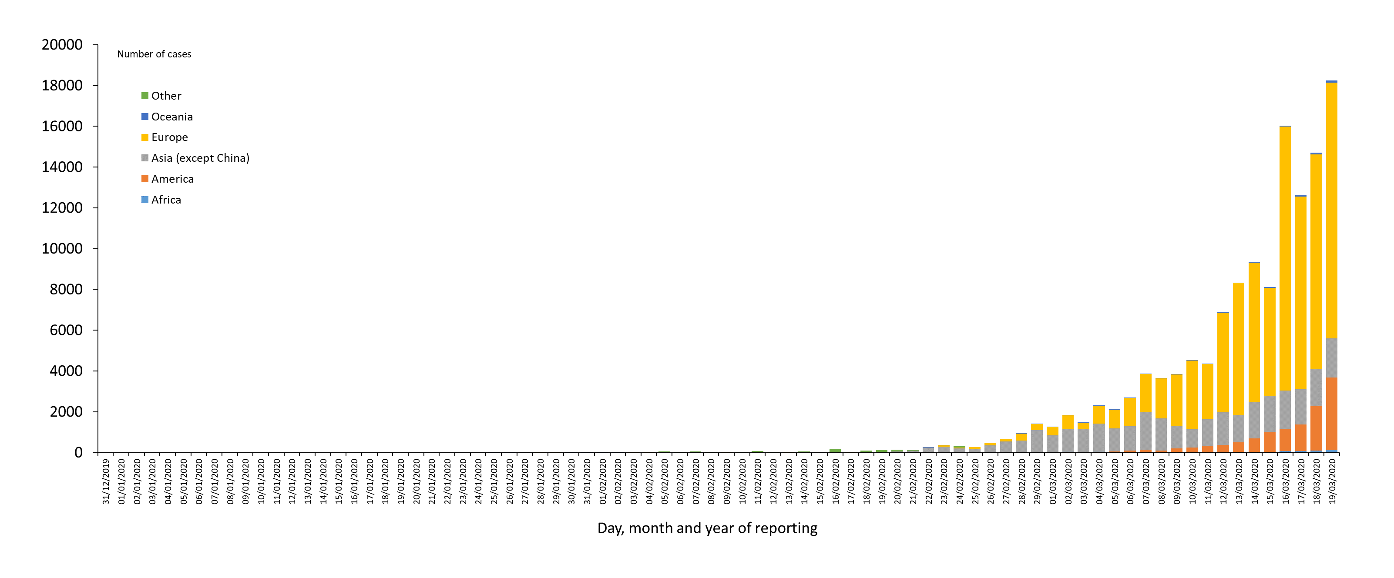
Distribution of COVID-19 cases (in accordance with the applied case definition in the country) by country and region, as of 20 March 2020
All countries
Countries outside China Mainland

Slide 5
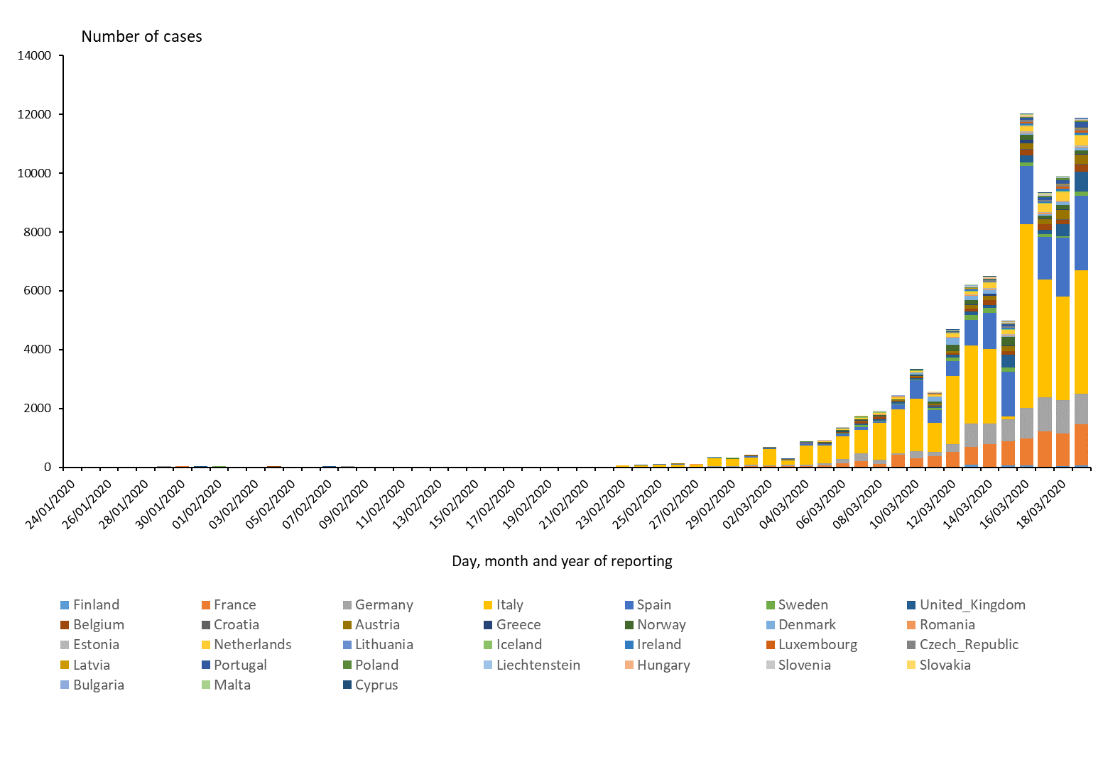
Distribution of COVID-19 cases (according to the applied case definition in the country) in EU/EEA and the UK, as of 13 March 2020

Slide 6
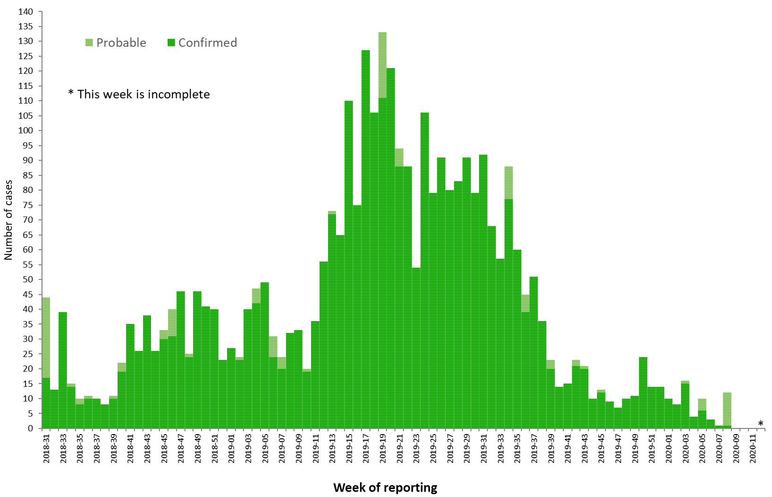
Distribution of confirmed and probable cases of Ebola virus disease by week of reporting, Democratic Republic of the Congo and Uganda, as of 17 March 2020

Slide 7
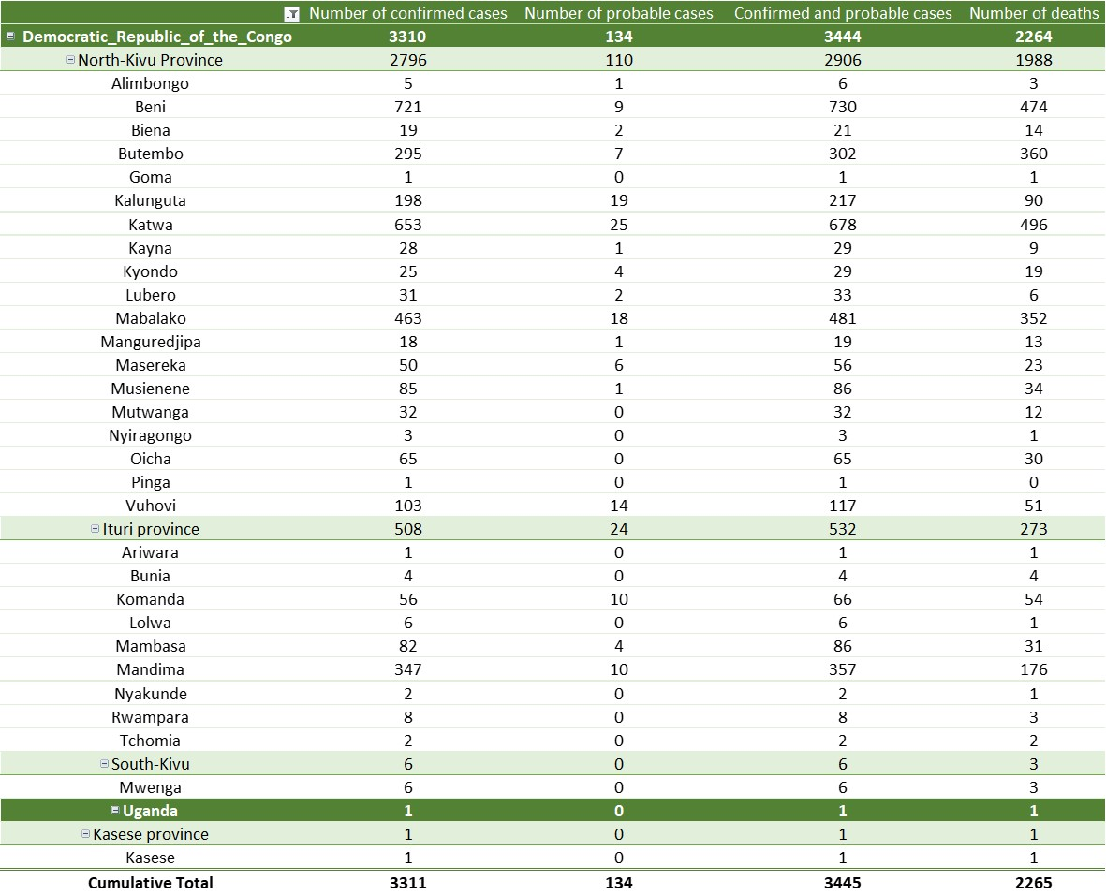
Ebola Virus Disease case distribution in DRC and Uganda as of 17 March 2020

Slide 8
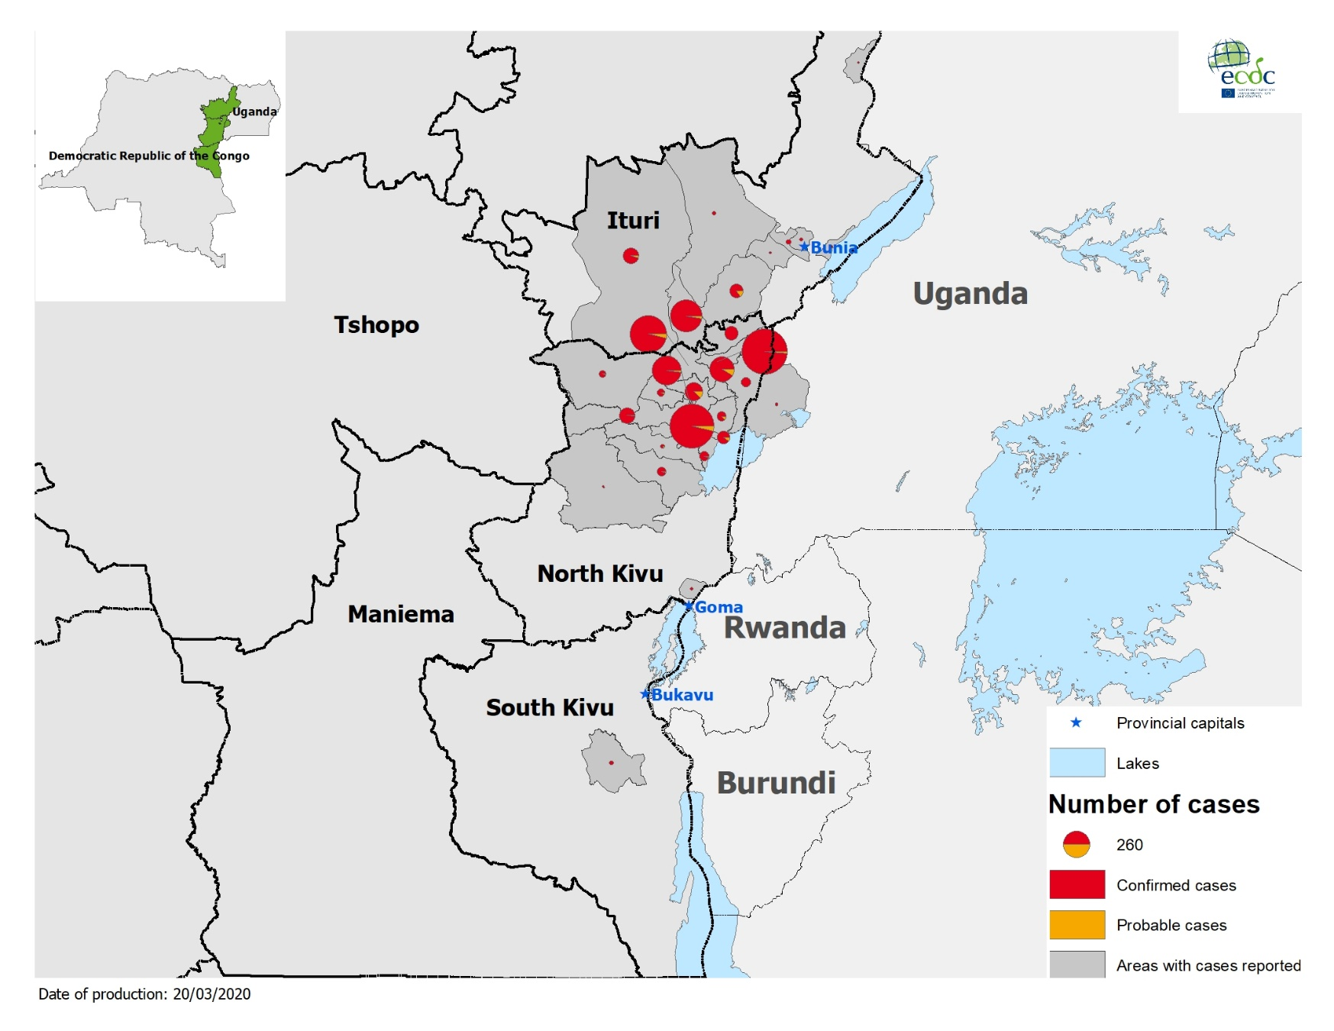
Geographical distribution of confirmed and probable cases of Ebola virus disease, Democratic Republic of the Congo and Uganda as of 17 March 2020

