Slide 1
Reusable maps and graphs from ECDC Communicable Disease Threats Report Week 11, 2020
You are encouraged to reuse our maps and graphs for your own purposes and free to translate, provided the content is not altered and the source is acknowledged.

Slide 2
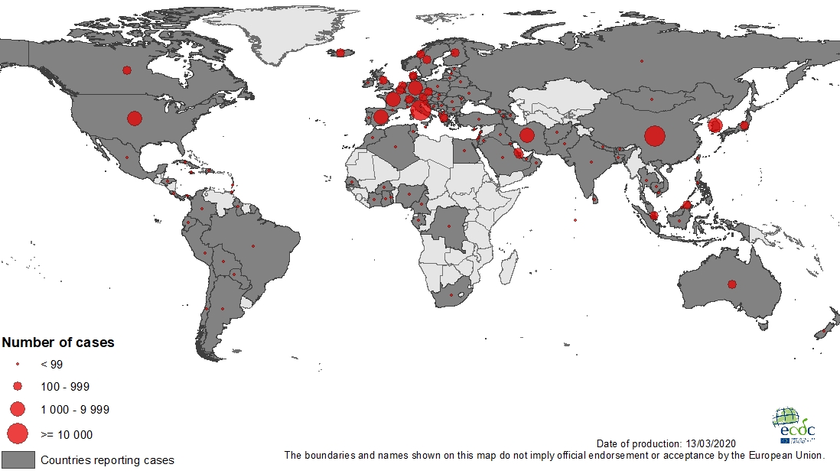
Geographical distribution of COVID-19 cases (in accordance with the applied case definition in the country), as of 13 March 2020

Slide 3
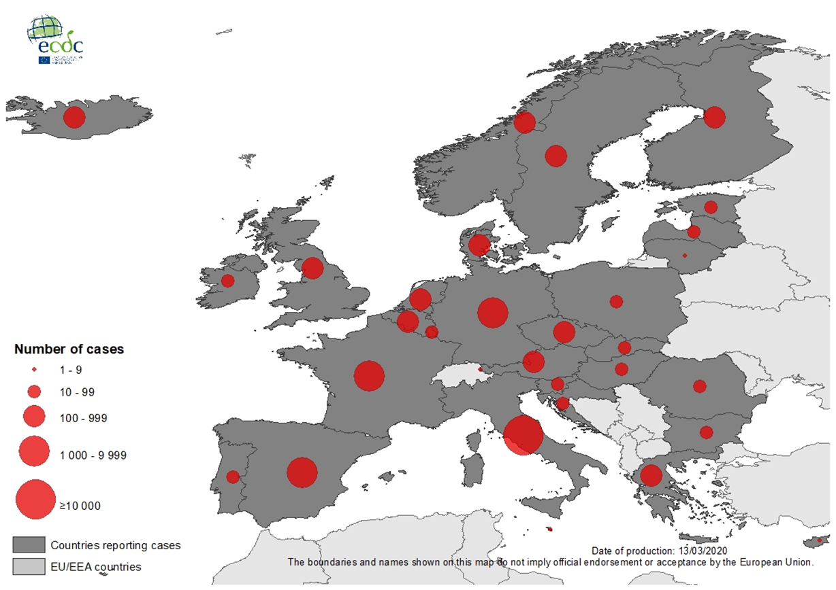
Geographic distribution of laboratory confirmed COVID-19 cases in the EU/EEA and the UK, as of 13 March 2020

Slide 4
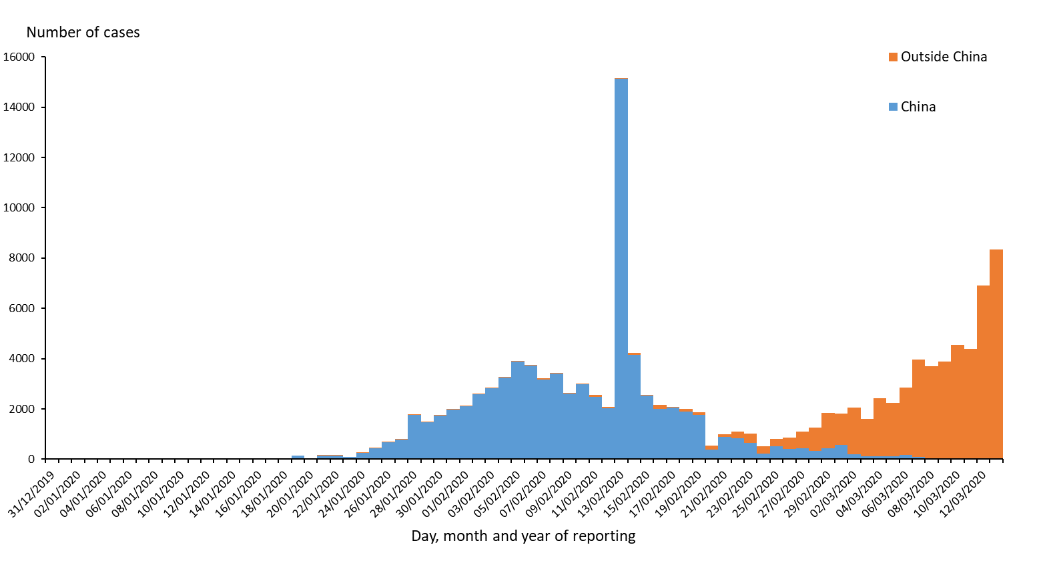
Distribution of COVID-19 cases (in accordance with the applied case definition in the country) by country and region, as of 13 March 2020
All countries
Countries outside China Mainland

Slide 5
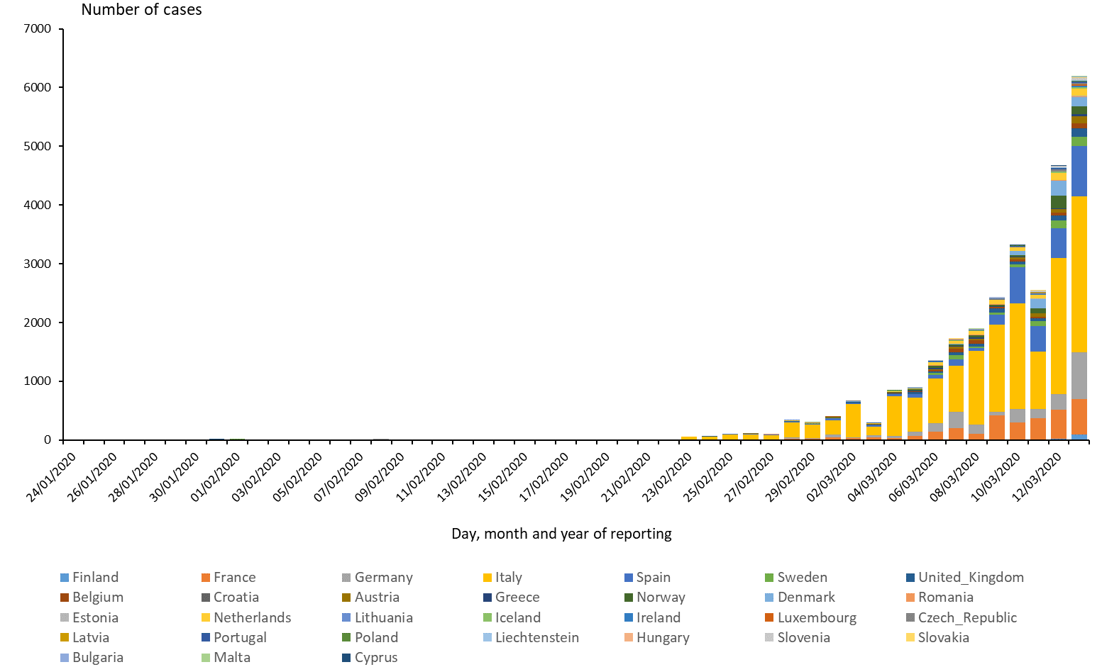
Distribution of COVID-19 cases (according to the applied case definition in the country) in EU/EEA and the UK, as of 13 March 2020

Slide 6
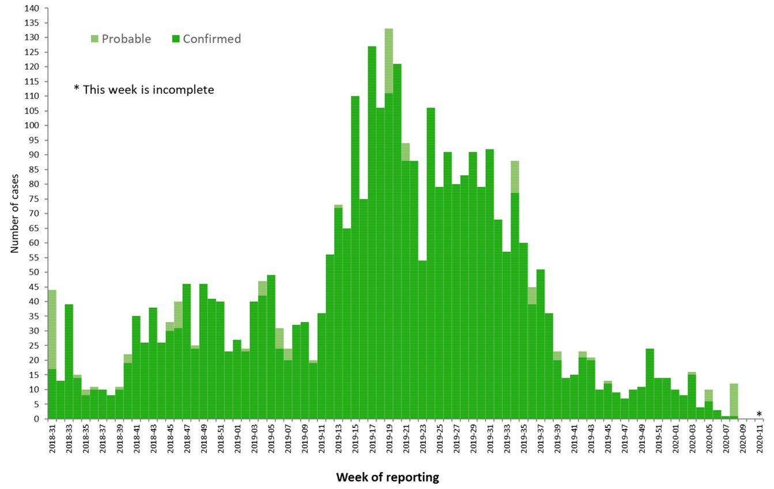
Distribution of confirmed and probable cases of Ebola virus disease by week of reporting, Democratic Republic of the Congo and Uganda, as of 10 March 2020

Slide 7
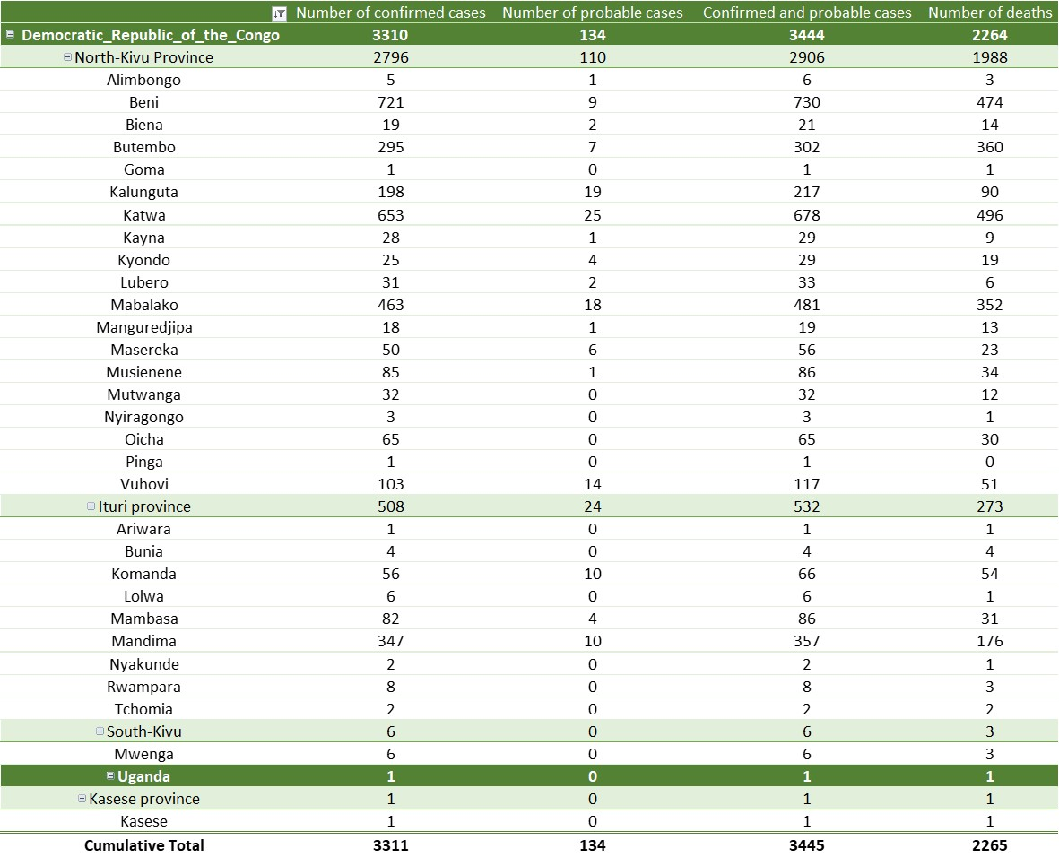
Ebola Virus Disease case distribution in DRC and Uganda as of 10 March 2020

Slide 8
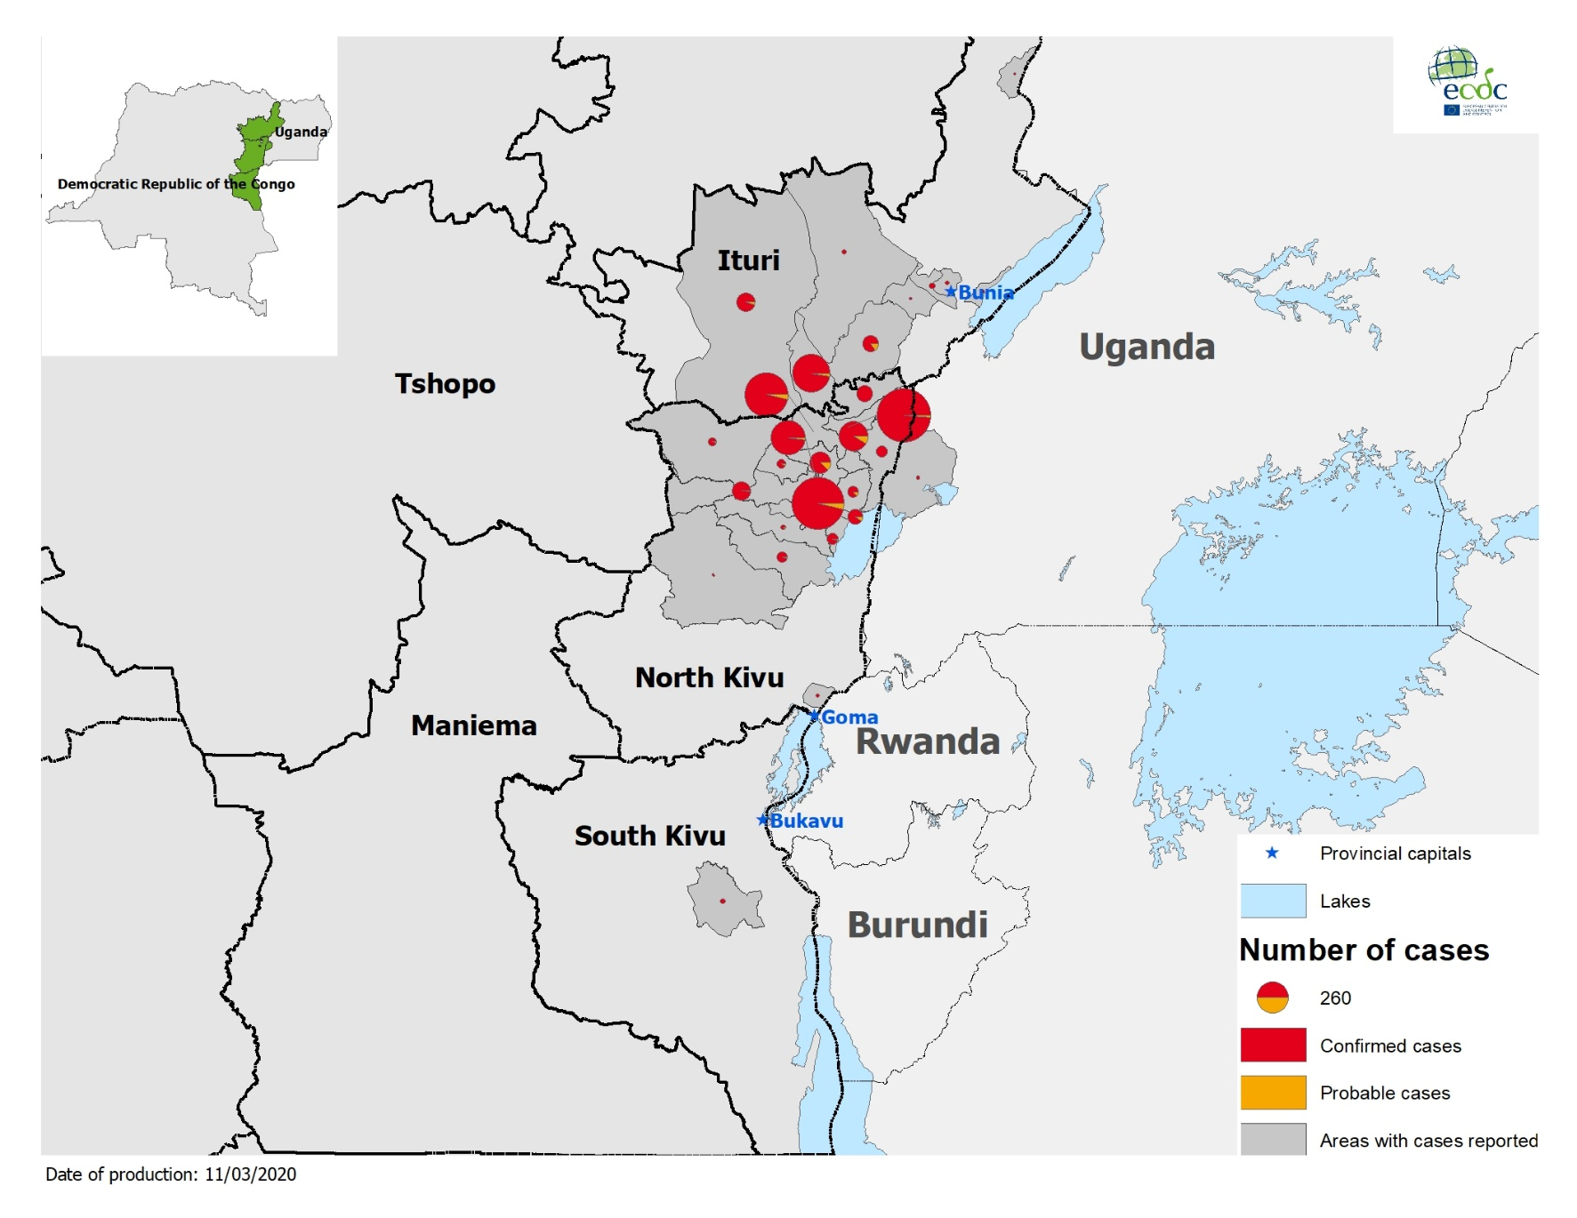
Geographical distribution of confirmed and probable cases of Ebola virus disease, Democratic Republic of the Congo and Uganda as of 10 March 2020

Slide 9
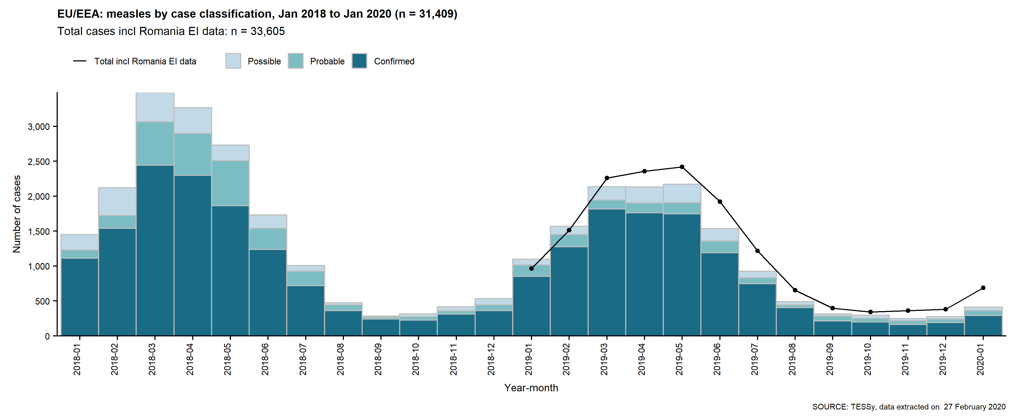
Measles cases in EU/EEA and the UK, from January 2018 to January 2020

Slide 10
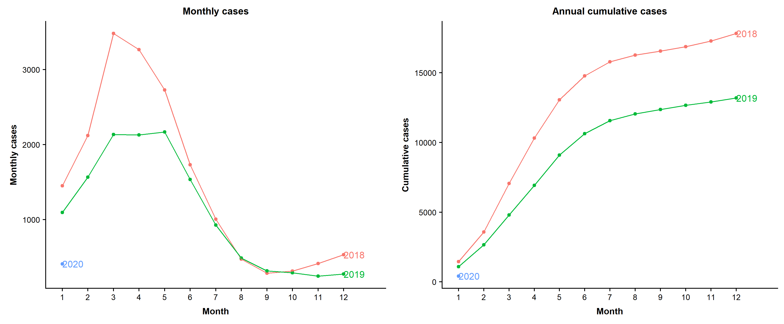
Seasonality and annual cumulative cases of measles in EU/EEA and the UK, from January 2018 to January 2020

Slide 11
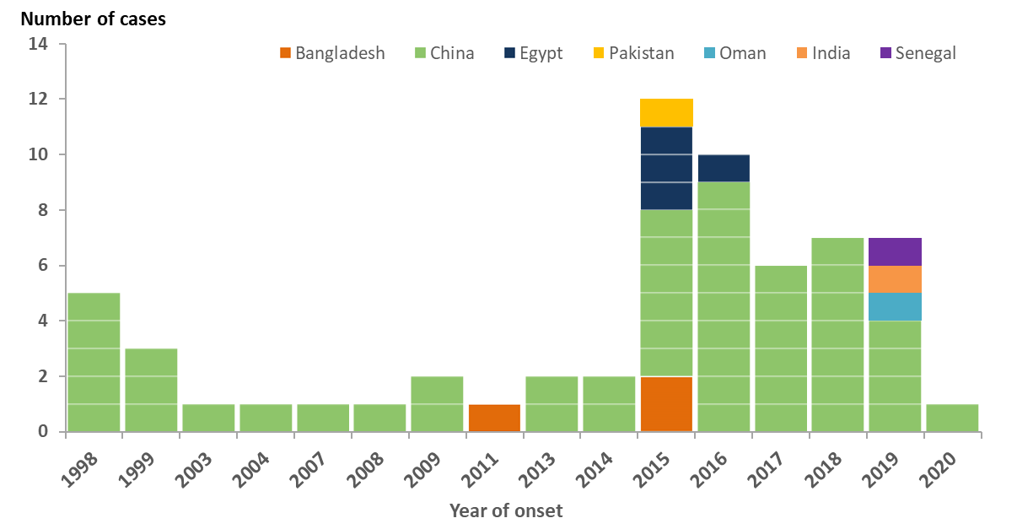
Distribution of confirmed human cases of influenza A(H9N2) by reporting country, from 1998 to 11 March 2020

Slide 12
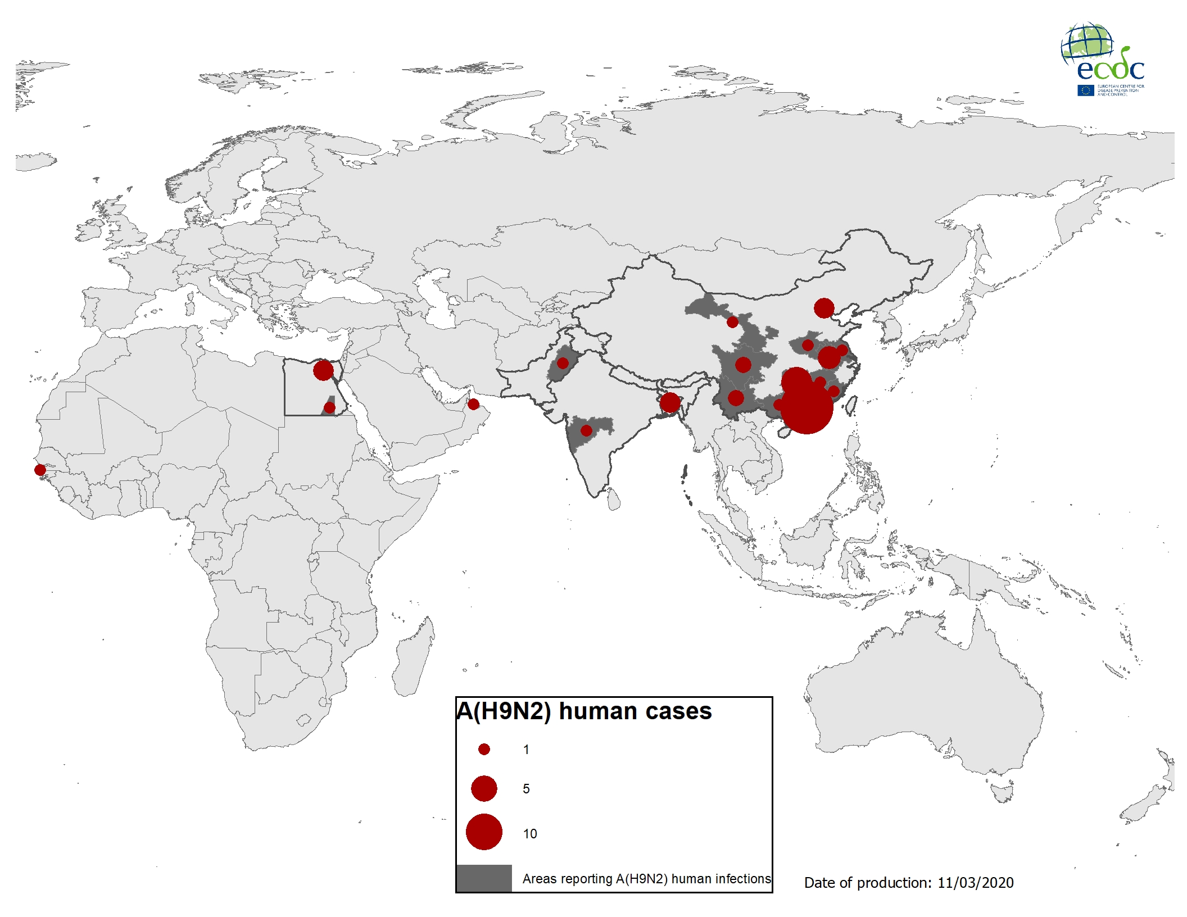
Geographical distribution of confirmed human cases of influenza A(H9N2), 1998 – 11 March 2020

