Slide 1
Reusable maps and graphs from ECDC Communicable Disease Threats Report Week 10, 2019
You are encouraged to reuse our maps and graphs for your own purposes and free to translate, provided the content is not altered and the source is acknowledged.

Slide 2
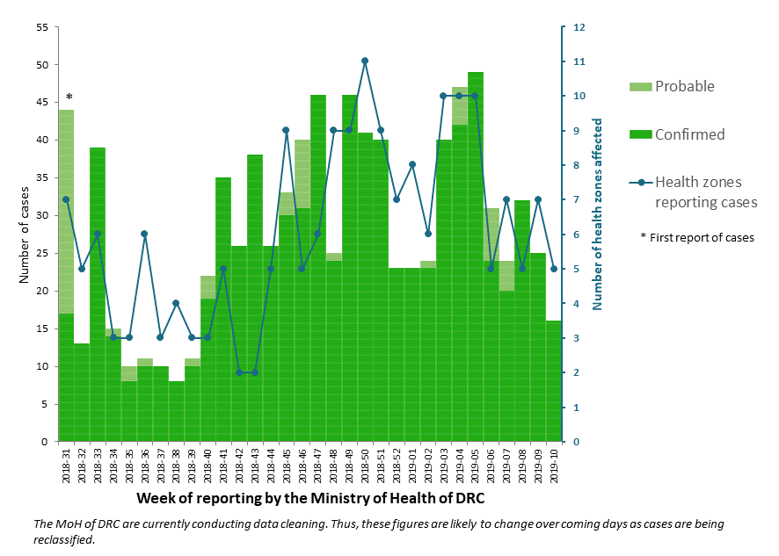
Distribution of confirmed and probable cases of Ebola virus disease and health zones reporting cases, North Kivu and Ituri Provinces, Democratic Republic of the Congo, as of 6 March 2019

Slide 3
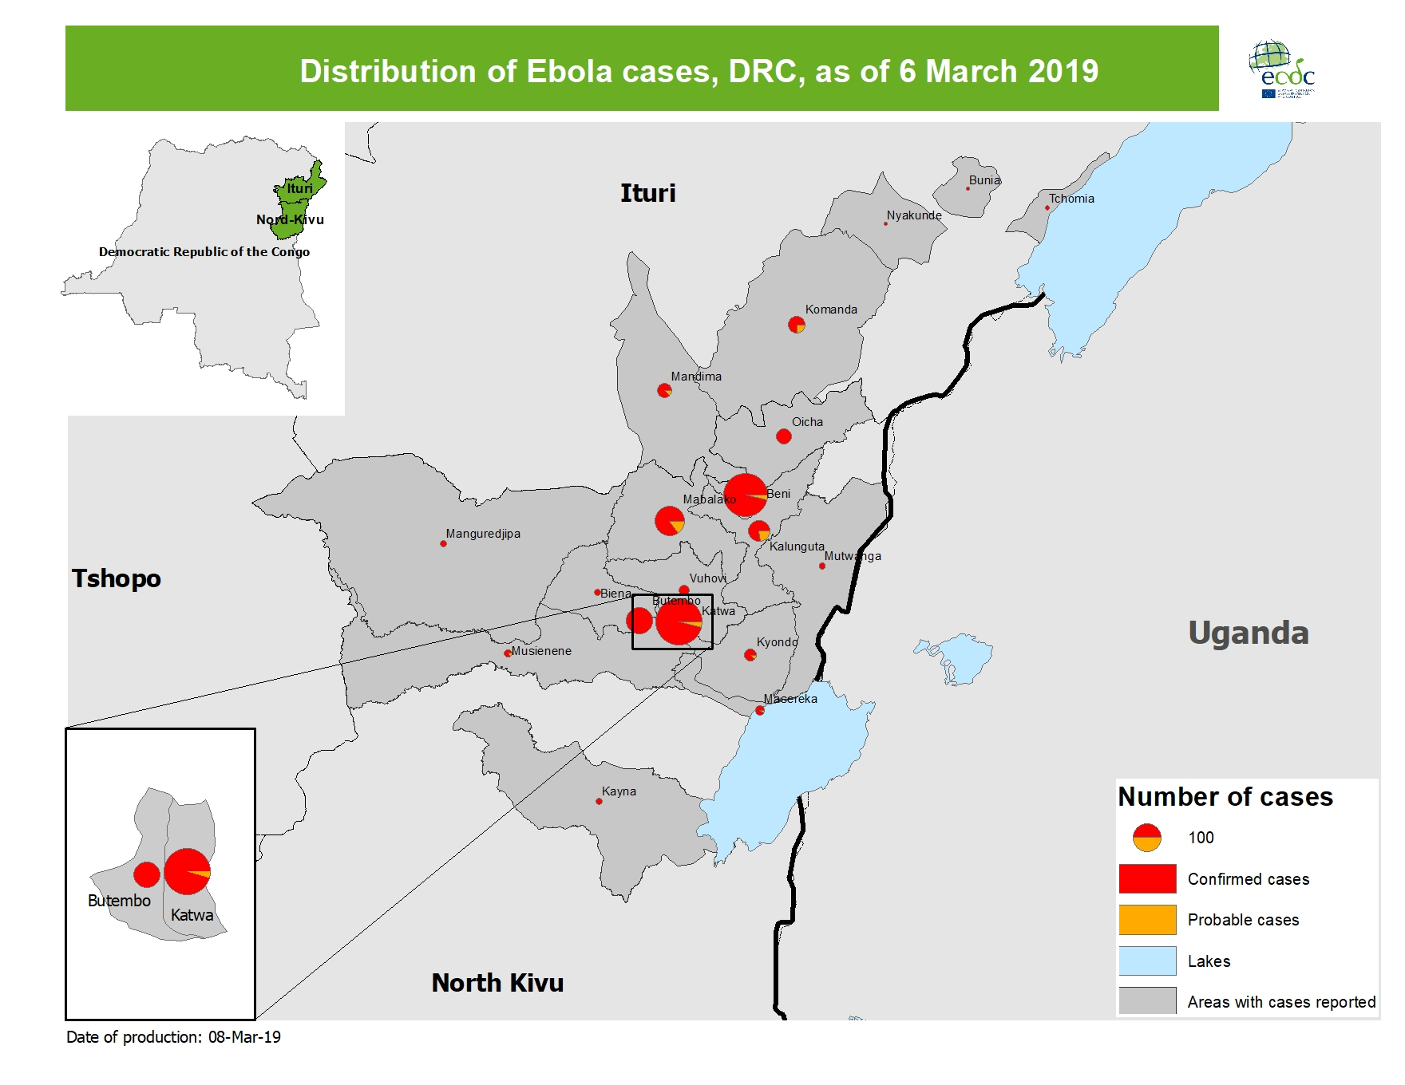
Geographical distribution of confirmed and probable cases of Ebola virus disease, North Kivu and Ituri Provinces, Democratic Republic of the Congo, as of 6 March 2019

Slide 4
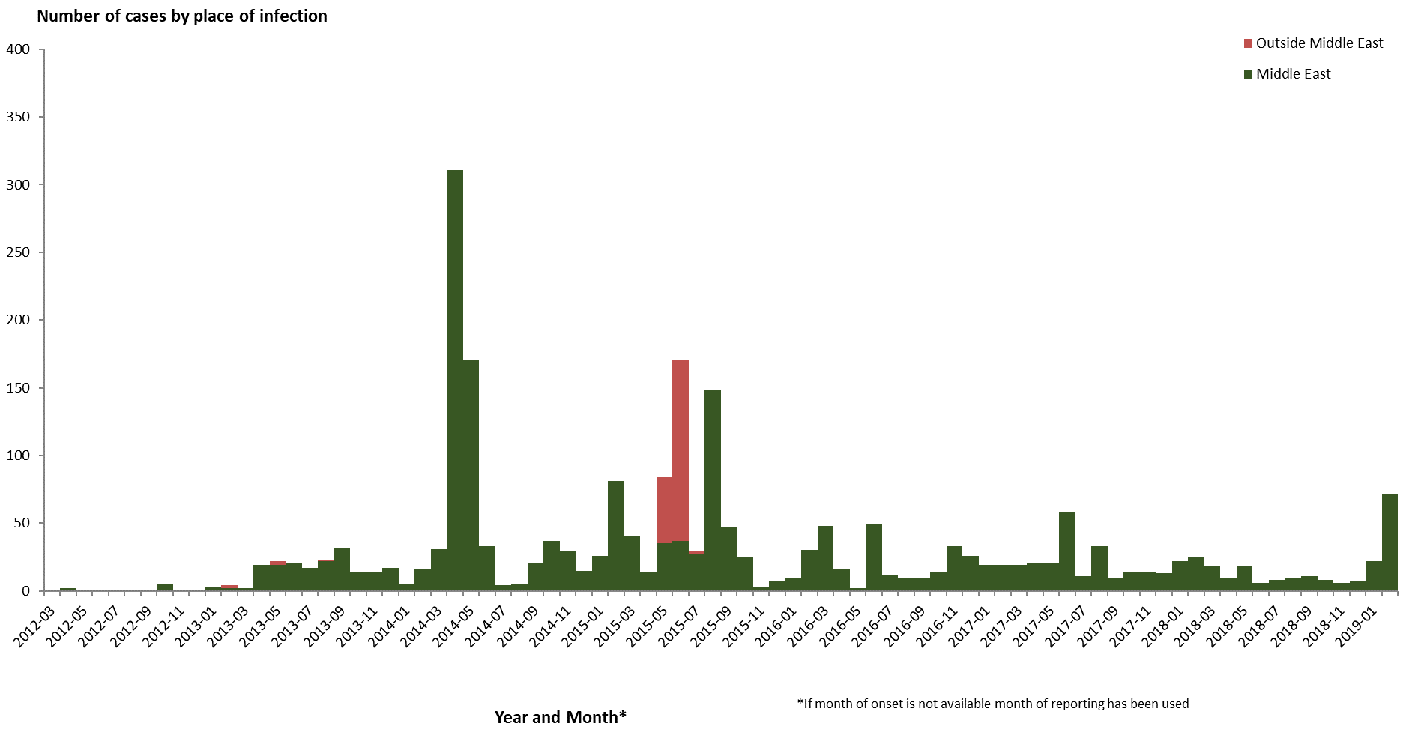
Distribution of confirmed cases of MERS-CoV by place of infection and month of onset, March 2012–7 March 2019

Slide 5
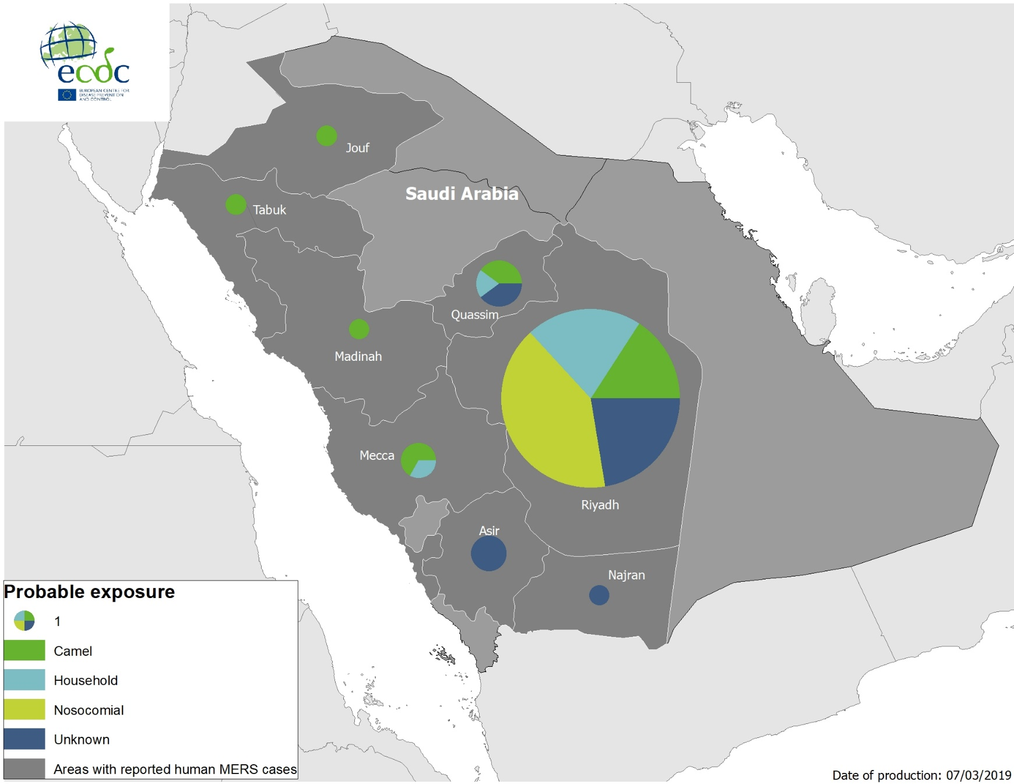
Geographical distribution of confirmed MERS-CoV cases by probable region of infection and exposure in 2019, as of 7 March 2019

Slide 6
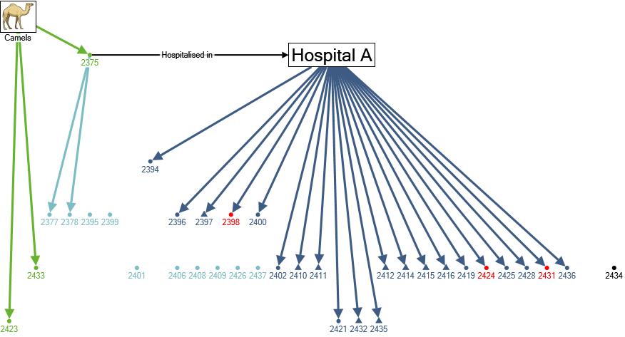
Transmission chain of confirmed cases of MERS-CoV in Wadi Aldwasir, Saudi Arabia, by week of disease onset, weeks 2–7, 2019 (n=35)
Week of disease onset
*
2019-02
2019-03
2019-04
2019-05
2019-06
2019-07
Primary cases (camel contact)
Under investigation
Nosocomial transmission
Household contacts
Fatal cases
Healthcare workers
* Following the admission of this patient in Hospital A, several new cases in contact with this hospital have been identified.

Slide 7
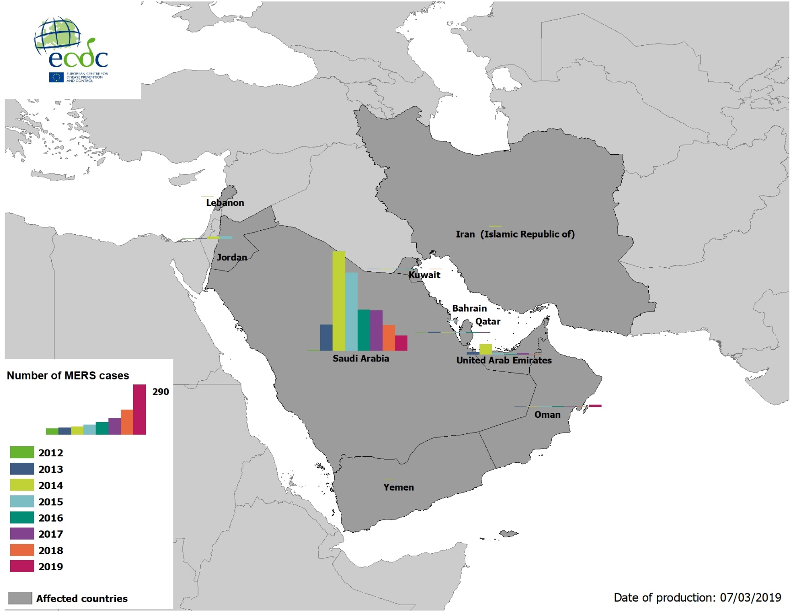
Geographical distribution of confirmed MERS-CoV cases by country of infection and year, April 2012–7 March 2019

Slide 8
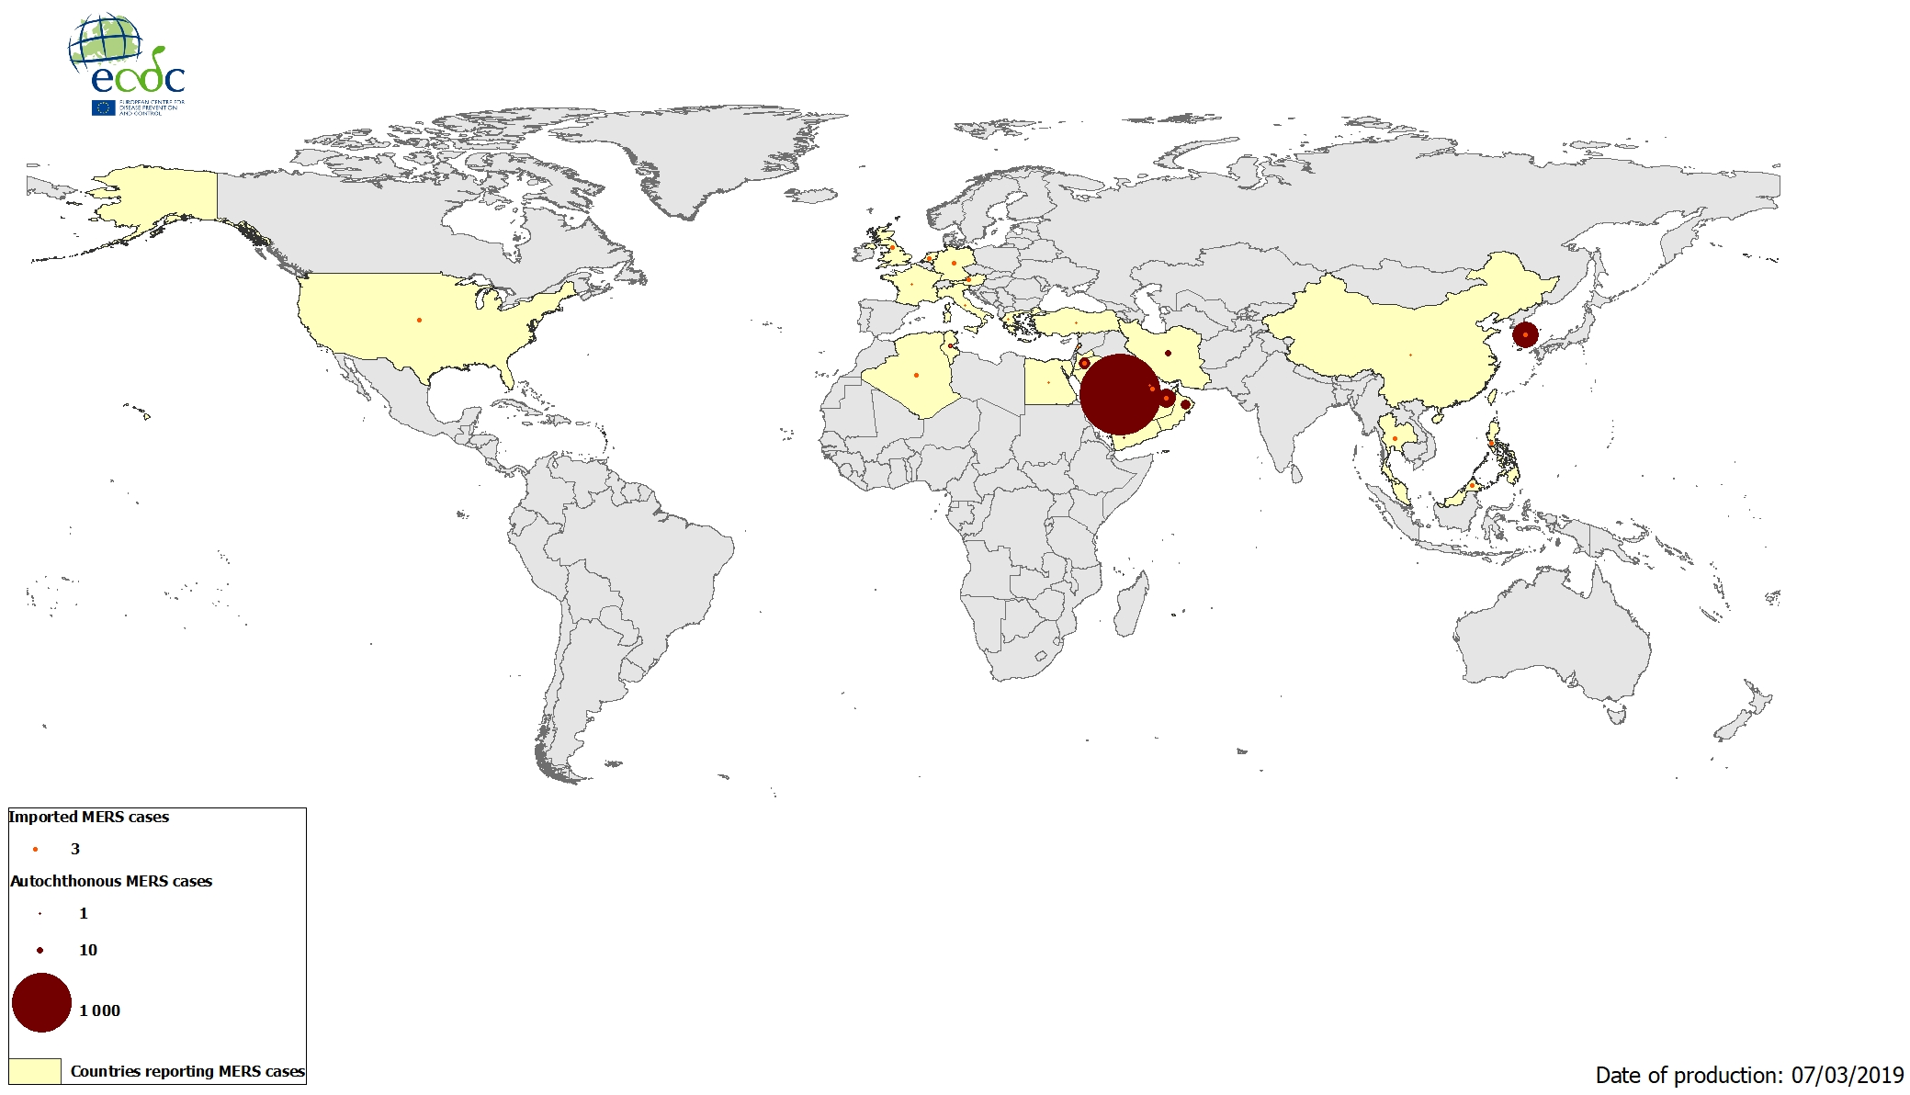
Geographical distribution of confirmed MERS-CoV cases by reporting country, April 2012–7 March 2019

Slide 9
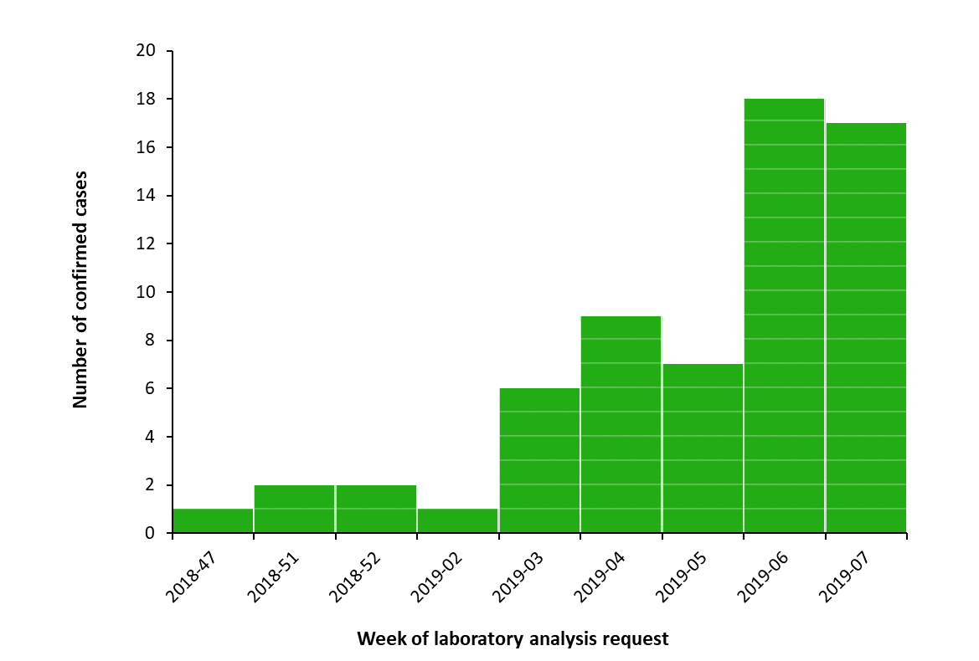
Distribution of confirmed human cases of Rift Valley fever in Mayotte (n=63) by week of laboratory analysis request, 22 November 2018–21 February 2019

Slide 10
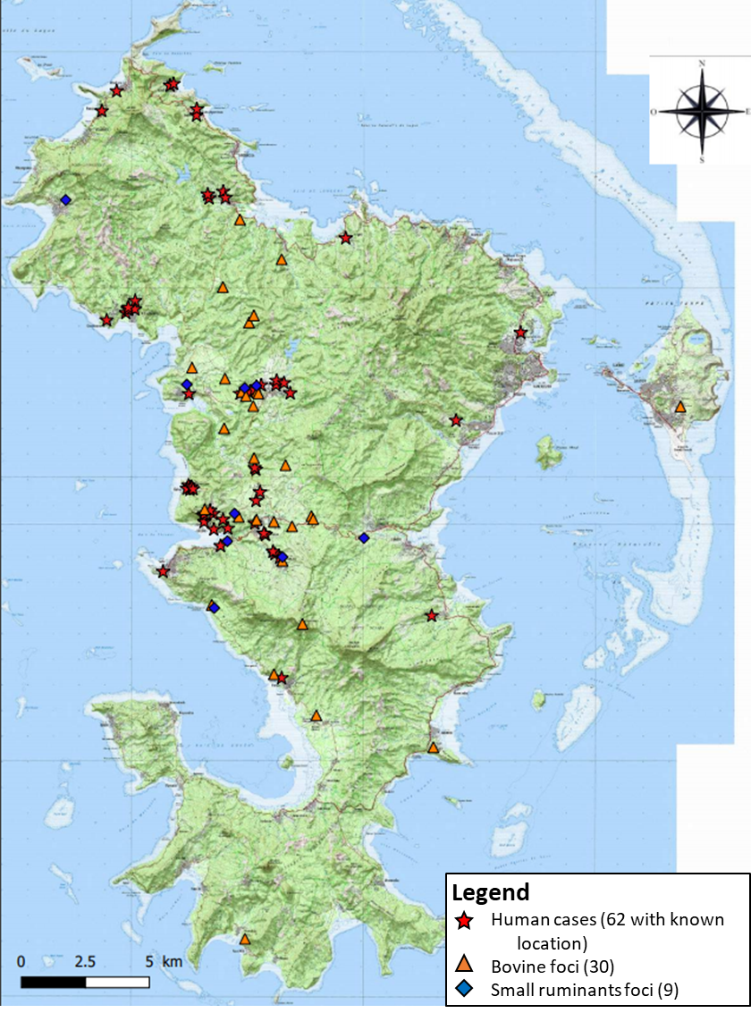
Geographic distribution of human cases (stars) and animal outbreaks in cattle (triangles) and small ruminants (diamonds) of Rift Valley fever in Mayotte, 22 November 2018–1 March 2019

Slide 11
Measles monthly update

Slide 12
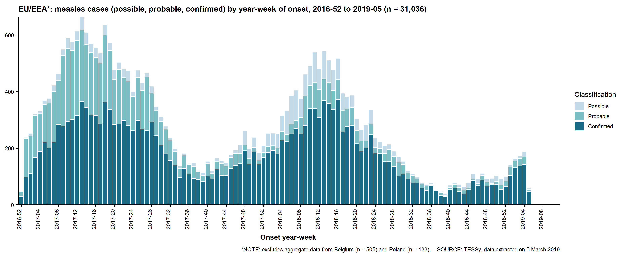
EU/EEA, January 2017–January 2019

Slide 13
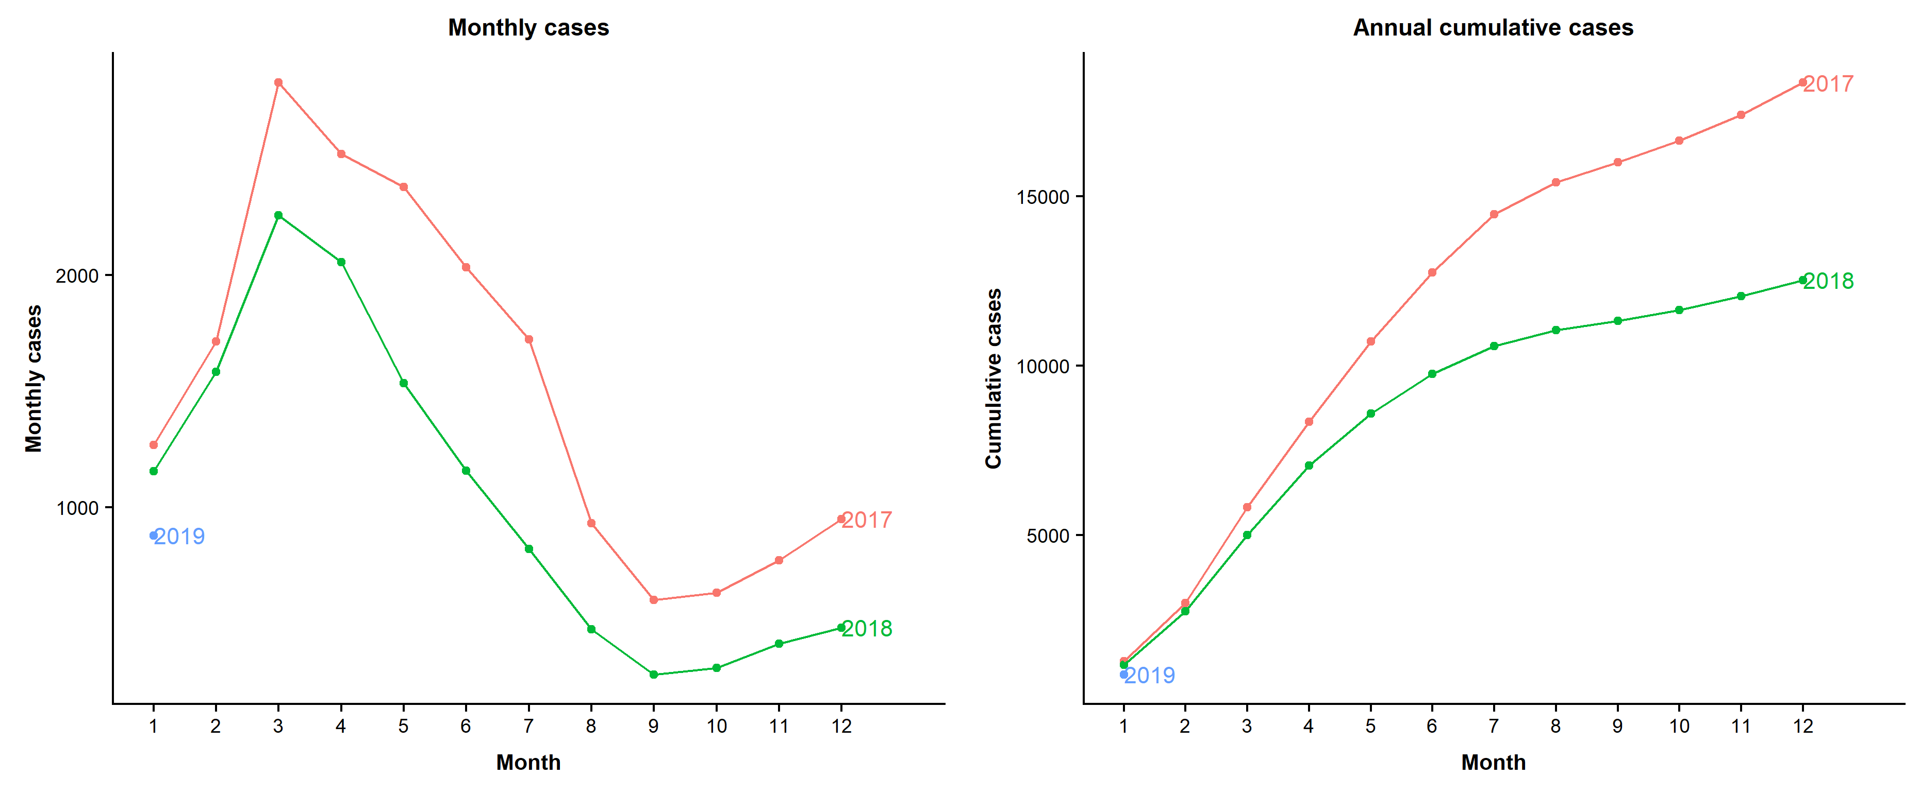
Seasonality and annual cumulative cases, January 2017–January 2019

Slide 14
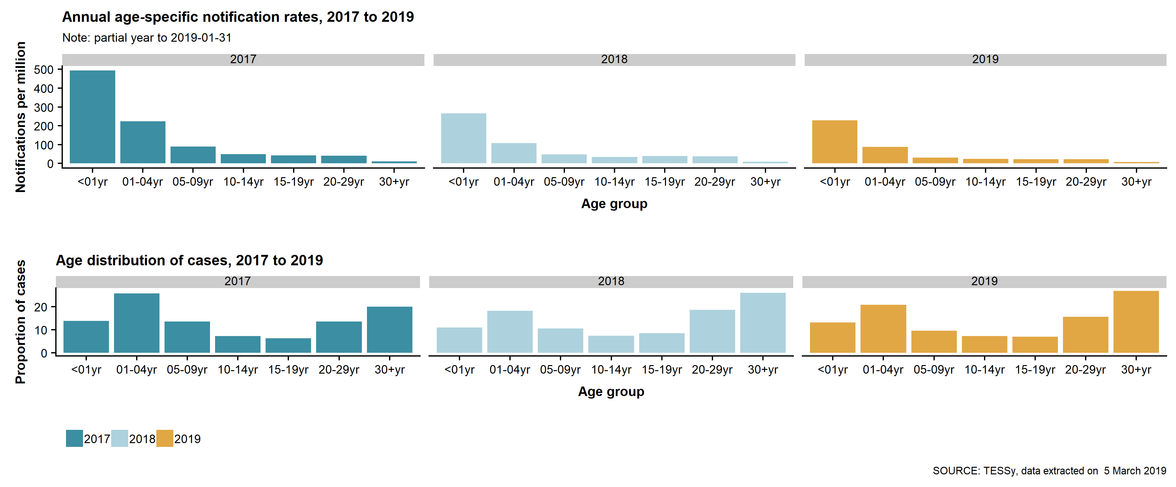
Age distribution of and rates, January 2017–January 2019

Slide 15
Annual deaths by country, January 2017–January 2019
Country | 2017 | 2018 | 2019 | Total
Romania | 24 | 22 | 1 | 47
Italy | 5 | 9 |  | 14
France | 1 | 3 |  | 4
Greece | 2 | 2 |  | 4
Bulgaria | 1 |  |  | 1
Germany | 1 |  |  | 1
Portugal | 1 |  |  | 1
EU/EEA | 35 | 36 | 1 | 72
2019: 2 recent deaths in Romania detected by epidemic intelligence that are not in TESSy

Slide 16
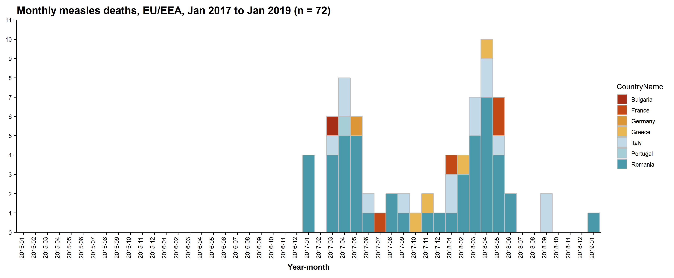
Monthly deaths by country, January 2017–January 2019

Slide 17
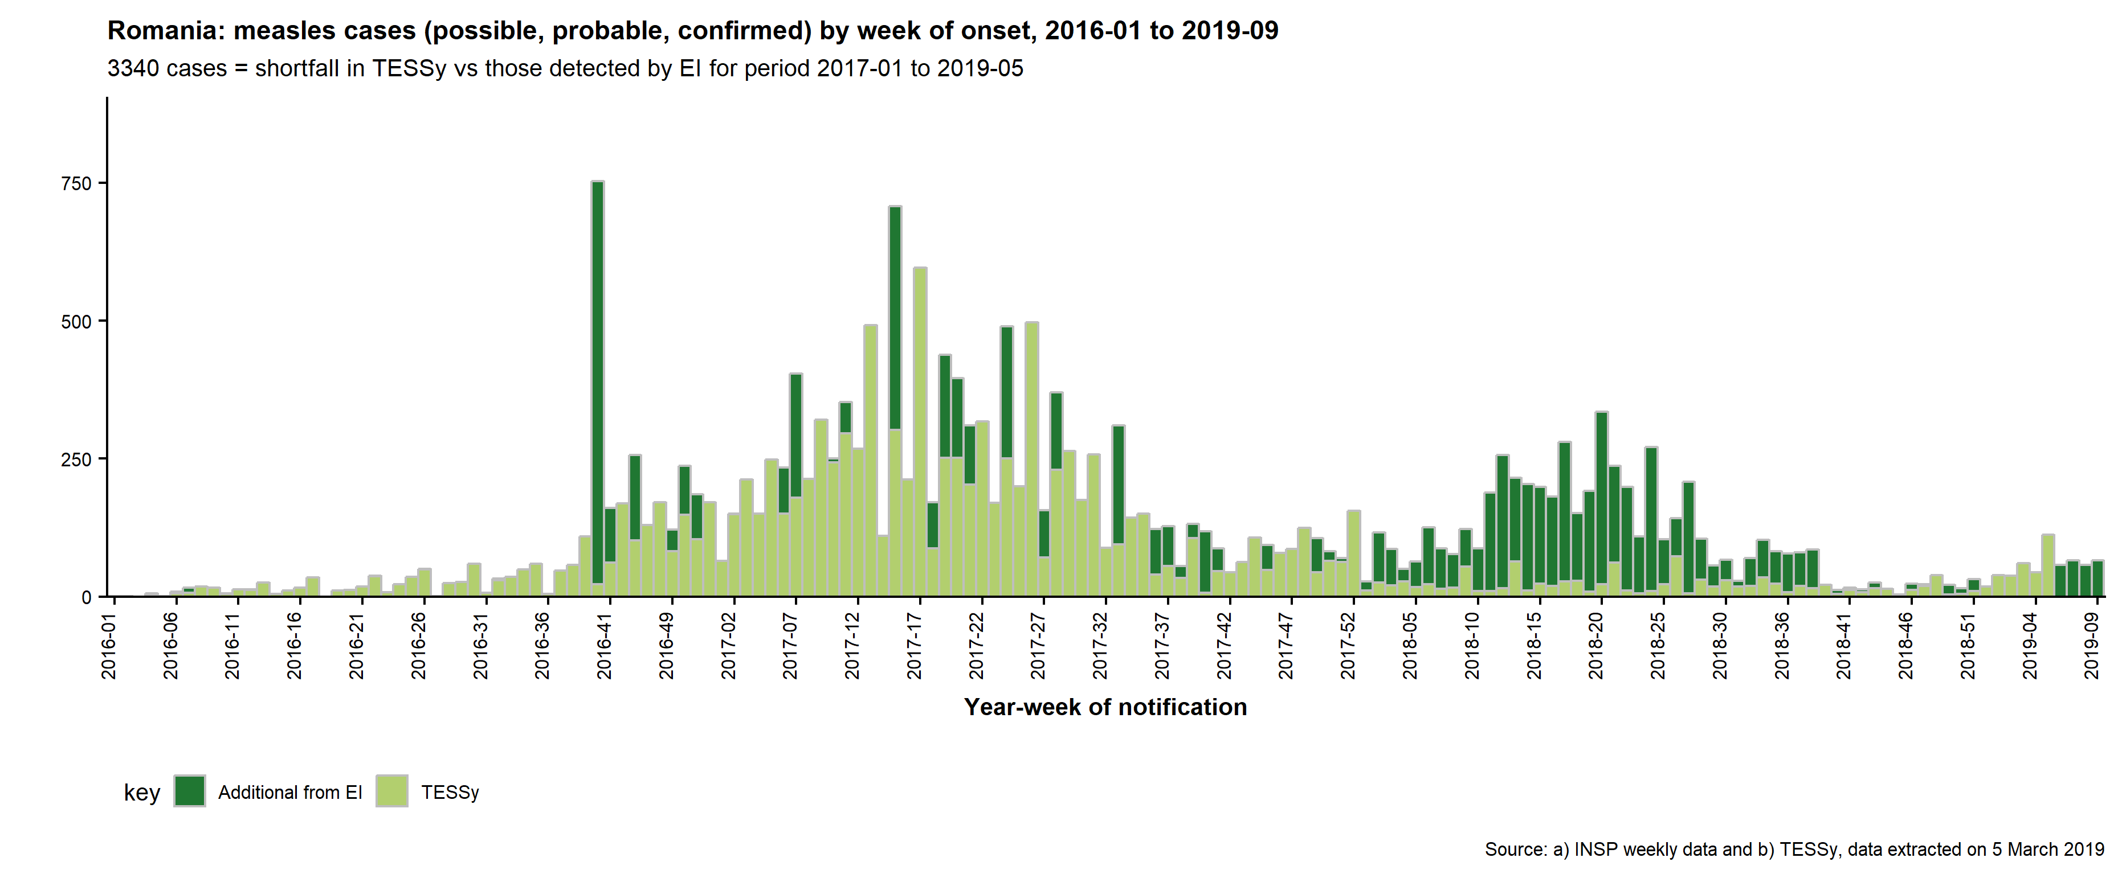
Romania, January 2017–January 2019

Slide 18
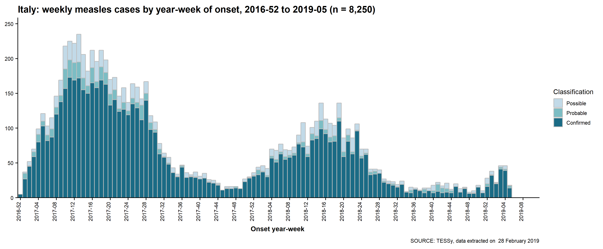
Italy, January 2017–January 2019
2019: No more recent cases detected through epidemic intelligence

Slide 19
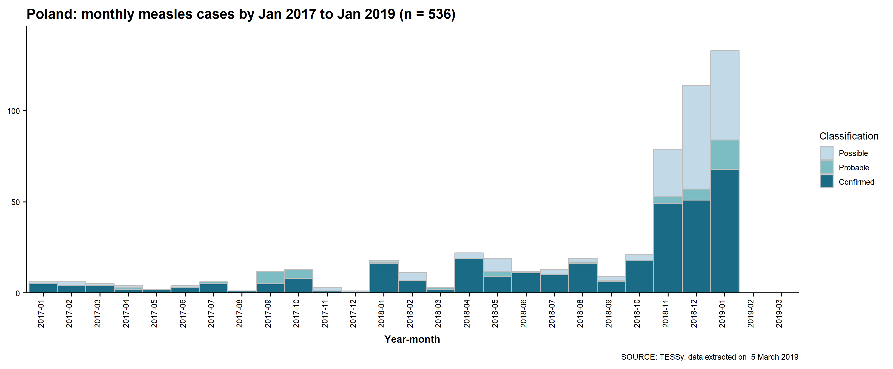
Poland, January 2017–January 2019
2019: 314 cases detected through epidemic intelligence vs 133 in TESSy to 31 January 2019

Slide 20
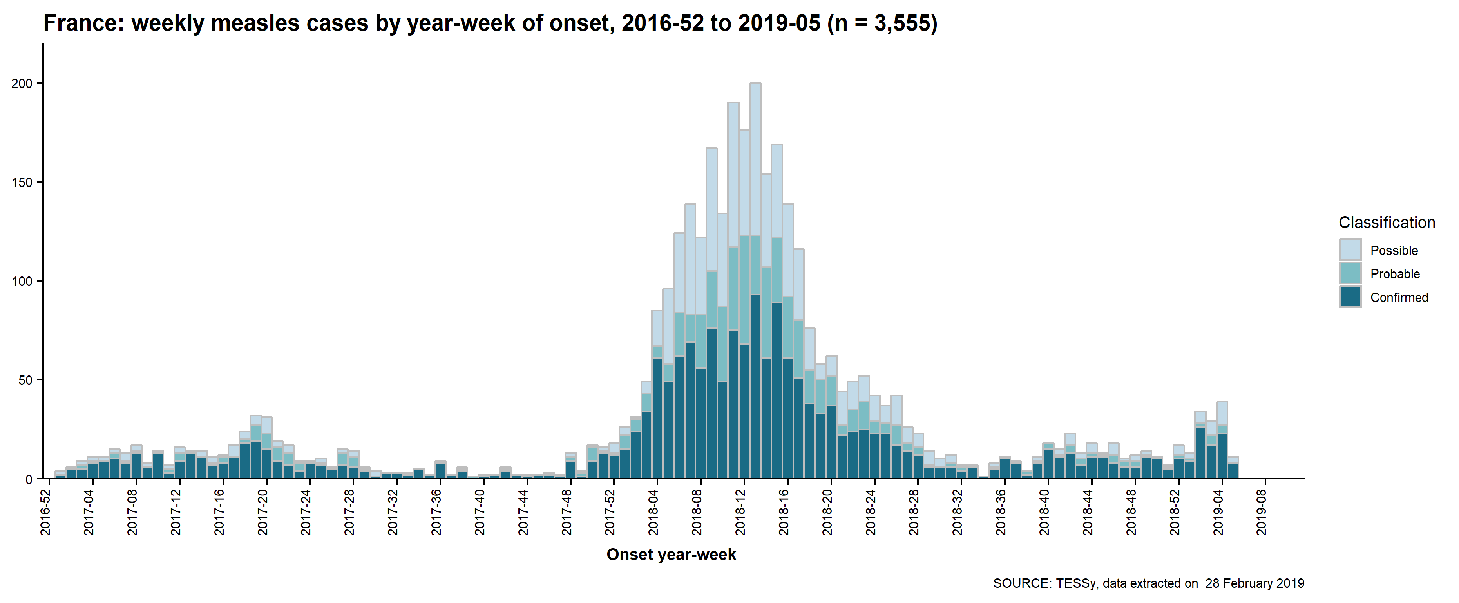
France, January 2017–January 2019
2019: 224 cases detected through epidemic intelligence vs 124 in TESSy to 31 January 2019

Slide 21
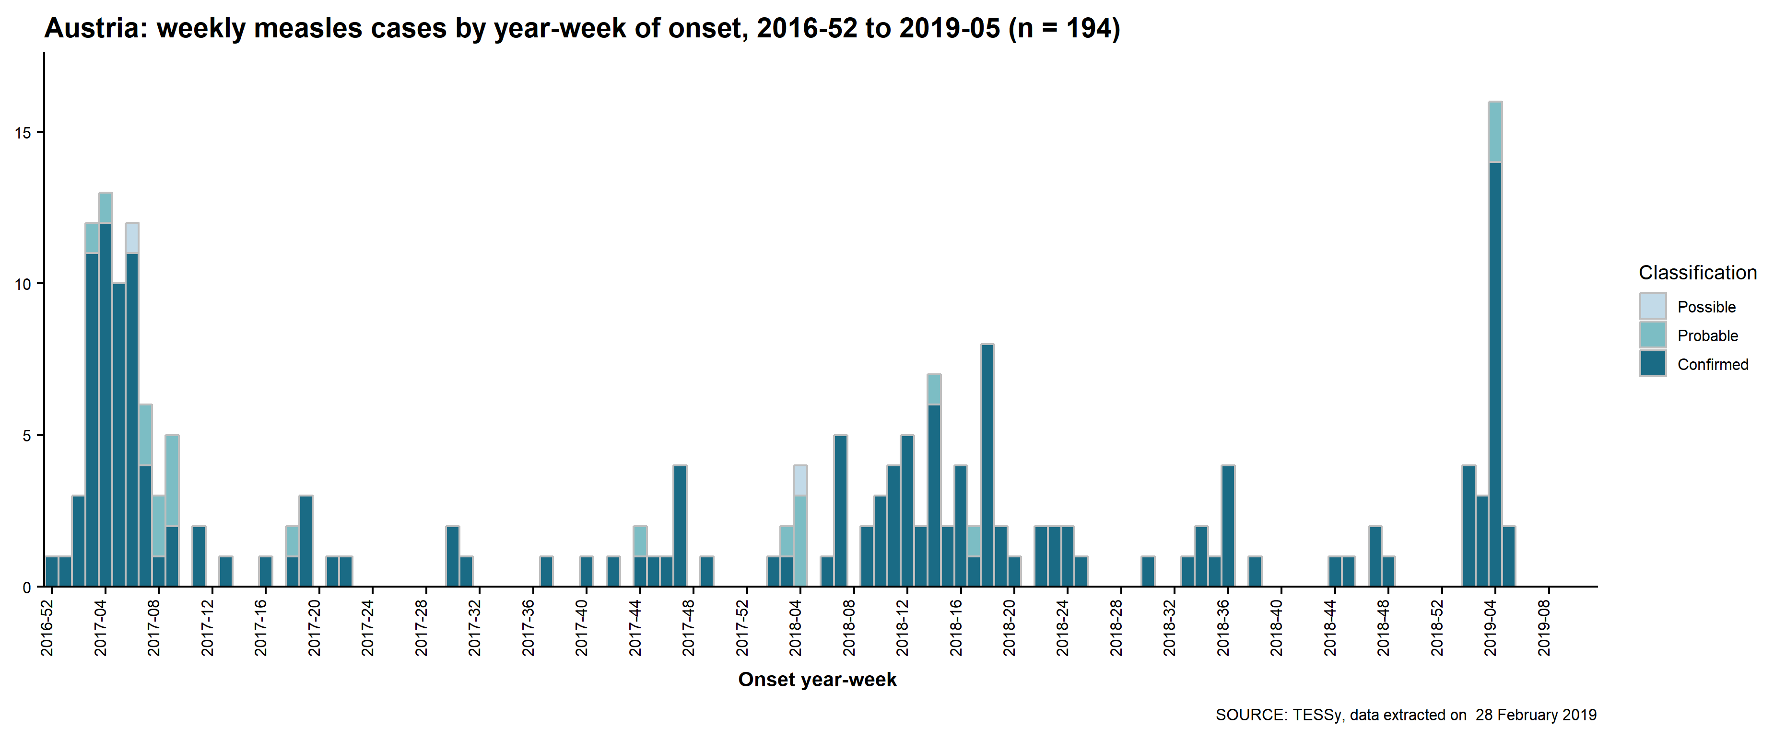
Austria, January 2017–January 2019
2019: 53 cases detected through epidemic intelligence vs 25 in TESSy to 31 January 2019

Slide 22
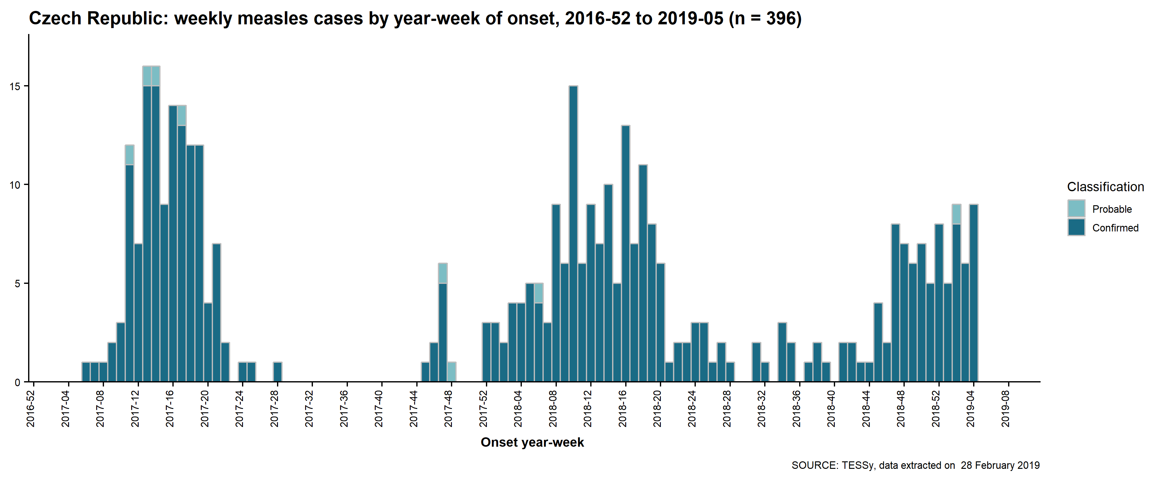
Czech Republic, January 2017–January 2019
2019: 170 cases detected through epidemic intelligence vs 29 in TESSy to 31 January 2019

