Slide 1
You are encouraged to reuse our maps and graphs for your own purposes and free to translate, provided the content is not altered and the source is acknowledged.
Either copy the images from the following slides or download directly from: ecdc.europa.eu/en/publications/surveillance_reports/Communicable-Disease-Threats-Report/Pages/cdtr.aspx
European Centre for Disease Prevention and Control
Reusable maps and graphs from ECDC Communicable Disease Threats Report, week 10, 2018

Slide 2
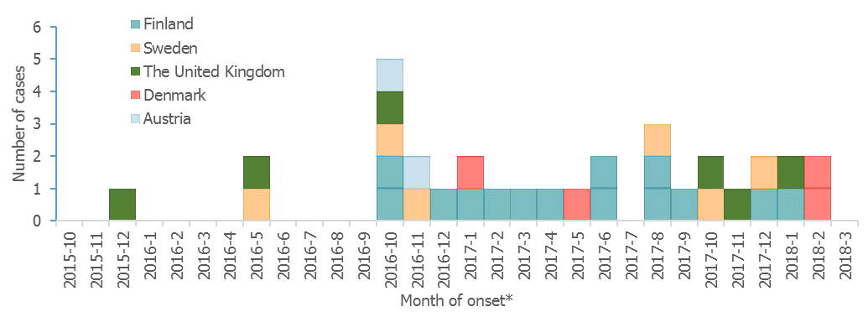
Listeria monocytogenes PCR serogroup IVb, MLST 6; confirmed outbreak cases by month of symptom onset*, European Union, 2015–2018 (n=32)

Slide 3
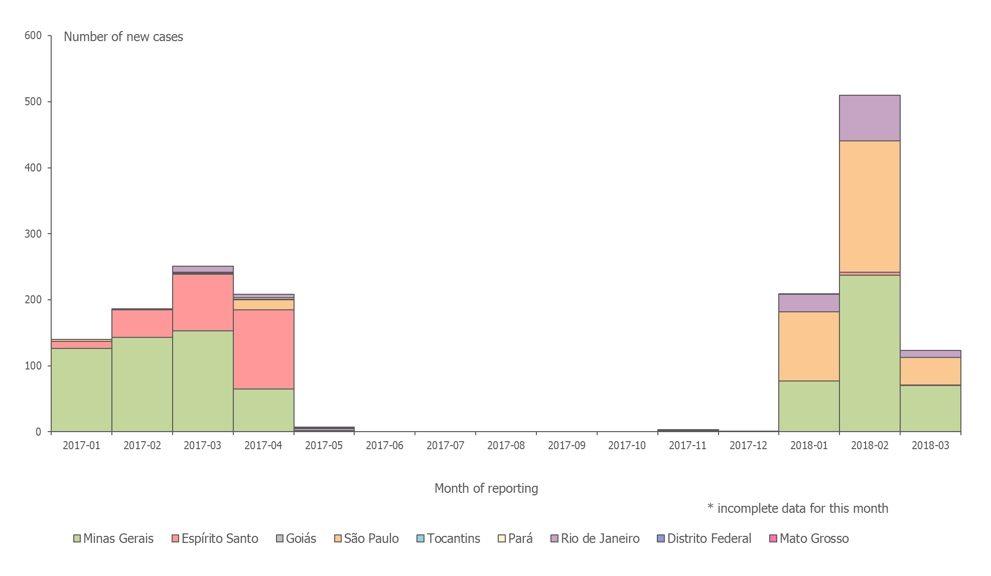
Distribution of confirmed human cases of yellow fever by month, Brazil,
January 2017– 6 March 2018
*

Slide 4
Distribution of confirmed yellow fever cases by state, Brazil, July 2017 – 6 March 2018

Slide 5
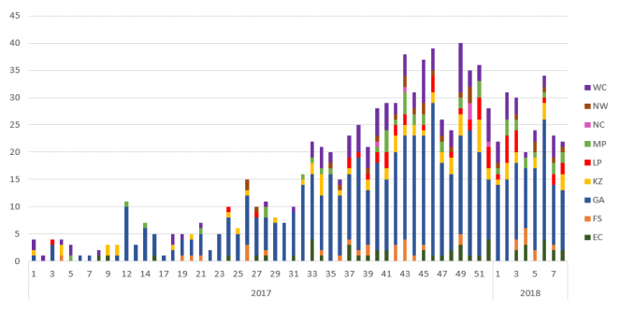
Epidemic curve of laboratory-confirmed listeriosis cases by epidemiological week and date of sample collection and province, South Africa, 01 January 2017 to 2 March 2018
Source: http://www.nicd.ac.za/wp-content/uploads/2018/03/Listeria-Sitrep-03Mar2018.pdf

Slide 6
Distribution of measles cases (possible, probable, confirmed) by week of onset, France, 2015-2018
Number of measles cases
Week of onset
Source: TESSy as of 6 March 2018

Slide 7
Distribution of measles cases (possible, probable, confirmed) by week of onset, Greece, 2017-2018
Number of measles cases
Week of onset
Source: KEELPNO, as of 1 March 2018

