Slide 1
You are encouraged to reuse our maps and graphs for your own purposes and free to translate, provided the content is not altered and the source is acknowledged. Either copy the images from the following slides or download directly from: ecdc.europa.eu/en/publications/surveillance_reports/Communicable-Disease-Threats-Report/Pages/cdtr.aspx
European Centre for Disease Prevention and Control
Reusable maps and graphs from ECDC Communicable Disease Threats Report, week 1, 2018

Slide 2
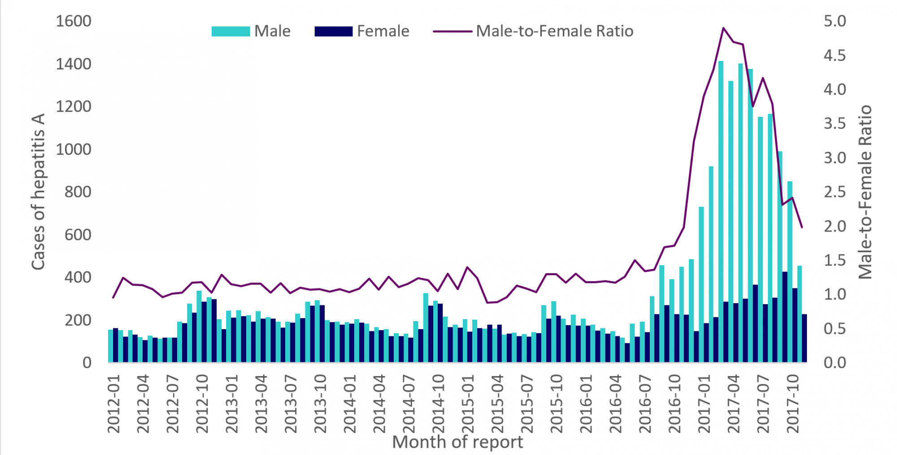
Distribution of hepatitis A cases by gender and male-to-female ratio, January 2012 to November 2017, as of 16 December 2017, EU/EEA

Slide 3
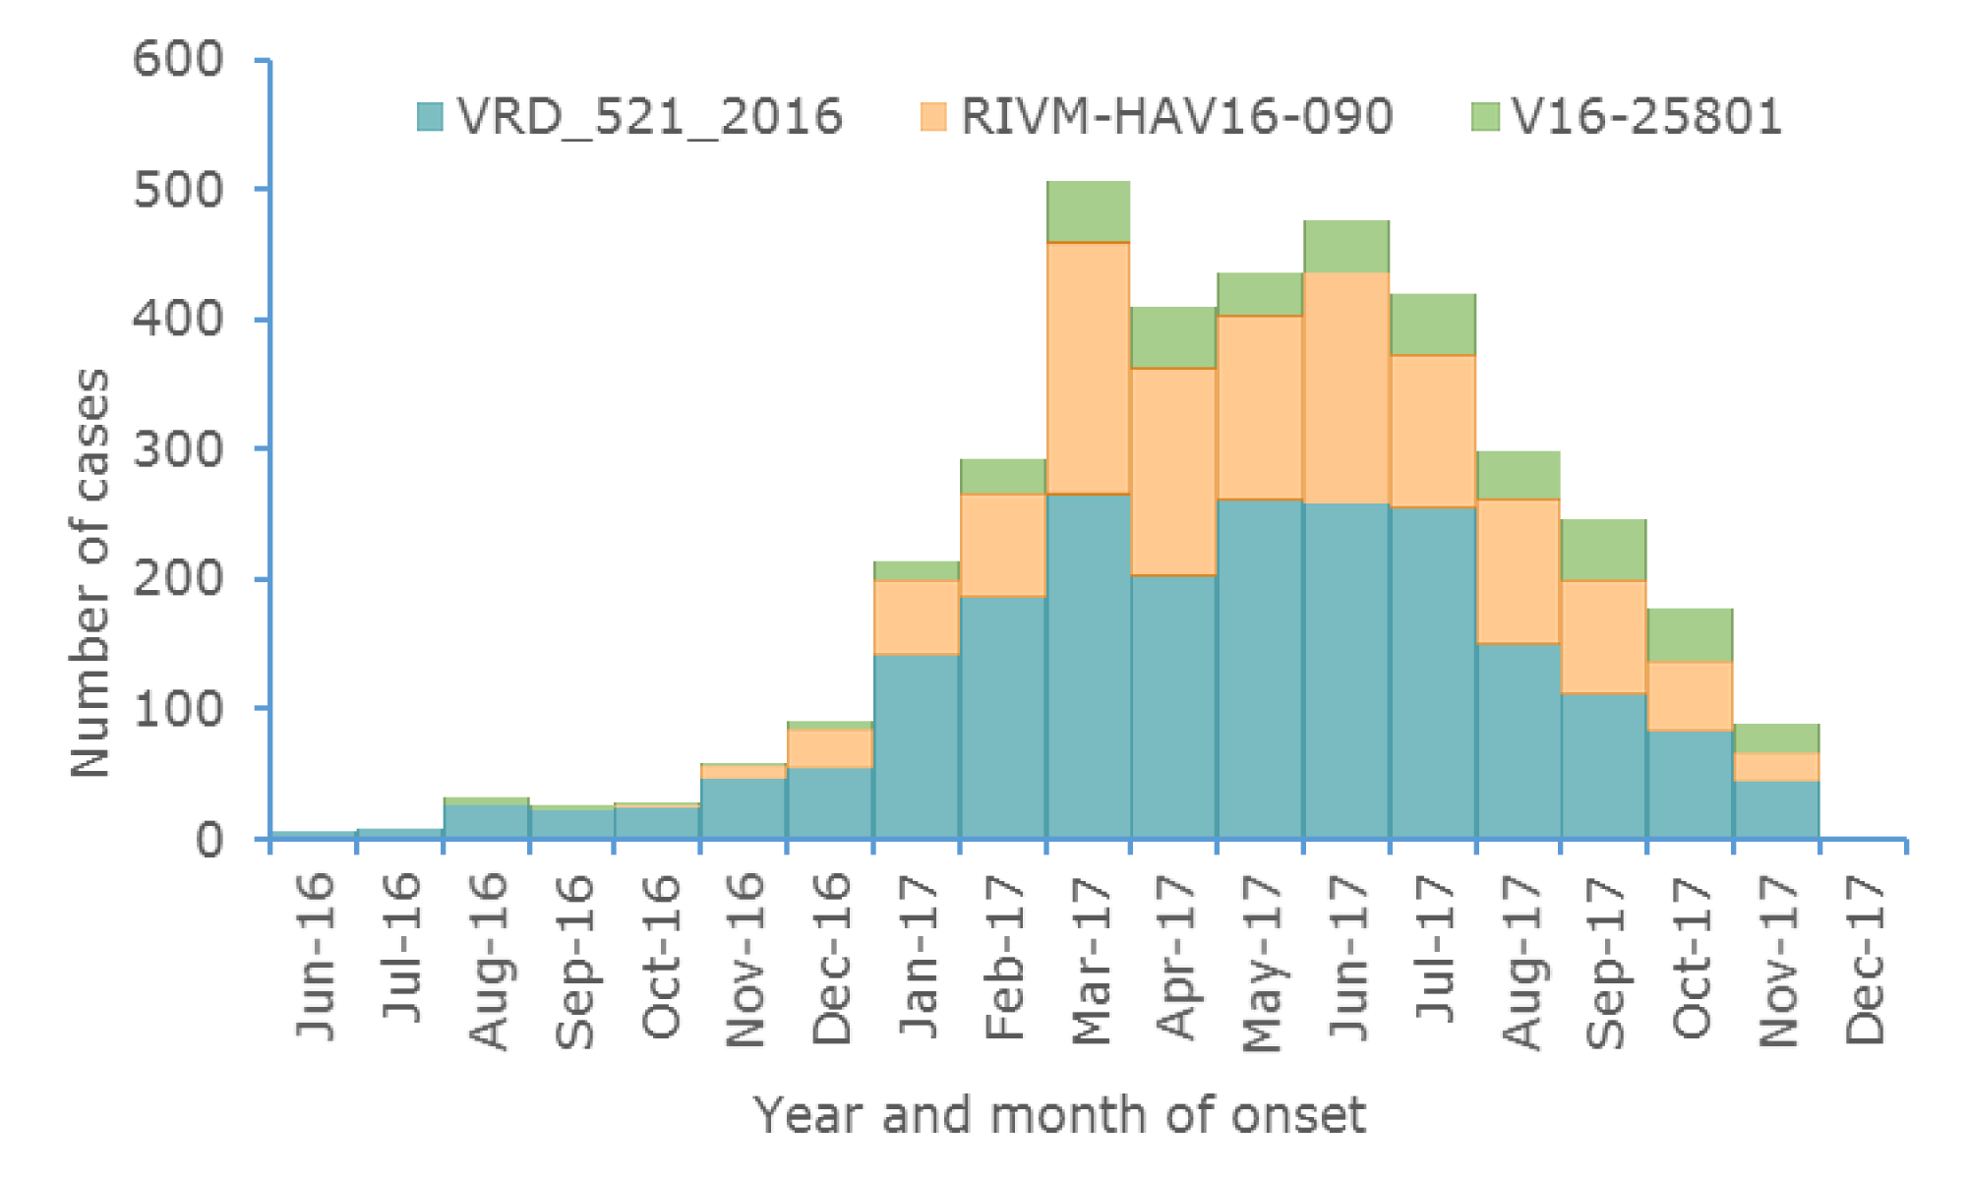
Distribution of hepatitis A outbreak-confirmed cases, by month of onset and genetic sequence, June 2016 to December 2017, as of 12 December 2017, EU/EEA (n=3 813)

Slide 4
Distribution of confirmed cases of A(H7N9) by first available month*
February 2013 – 31 December 2017 (n= 1 565)

Slide 5
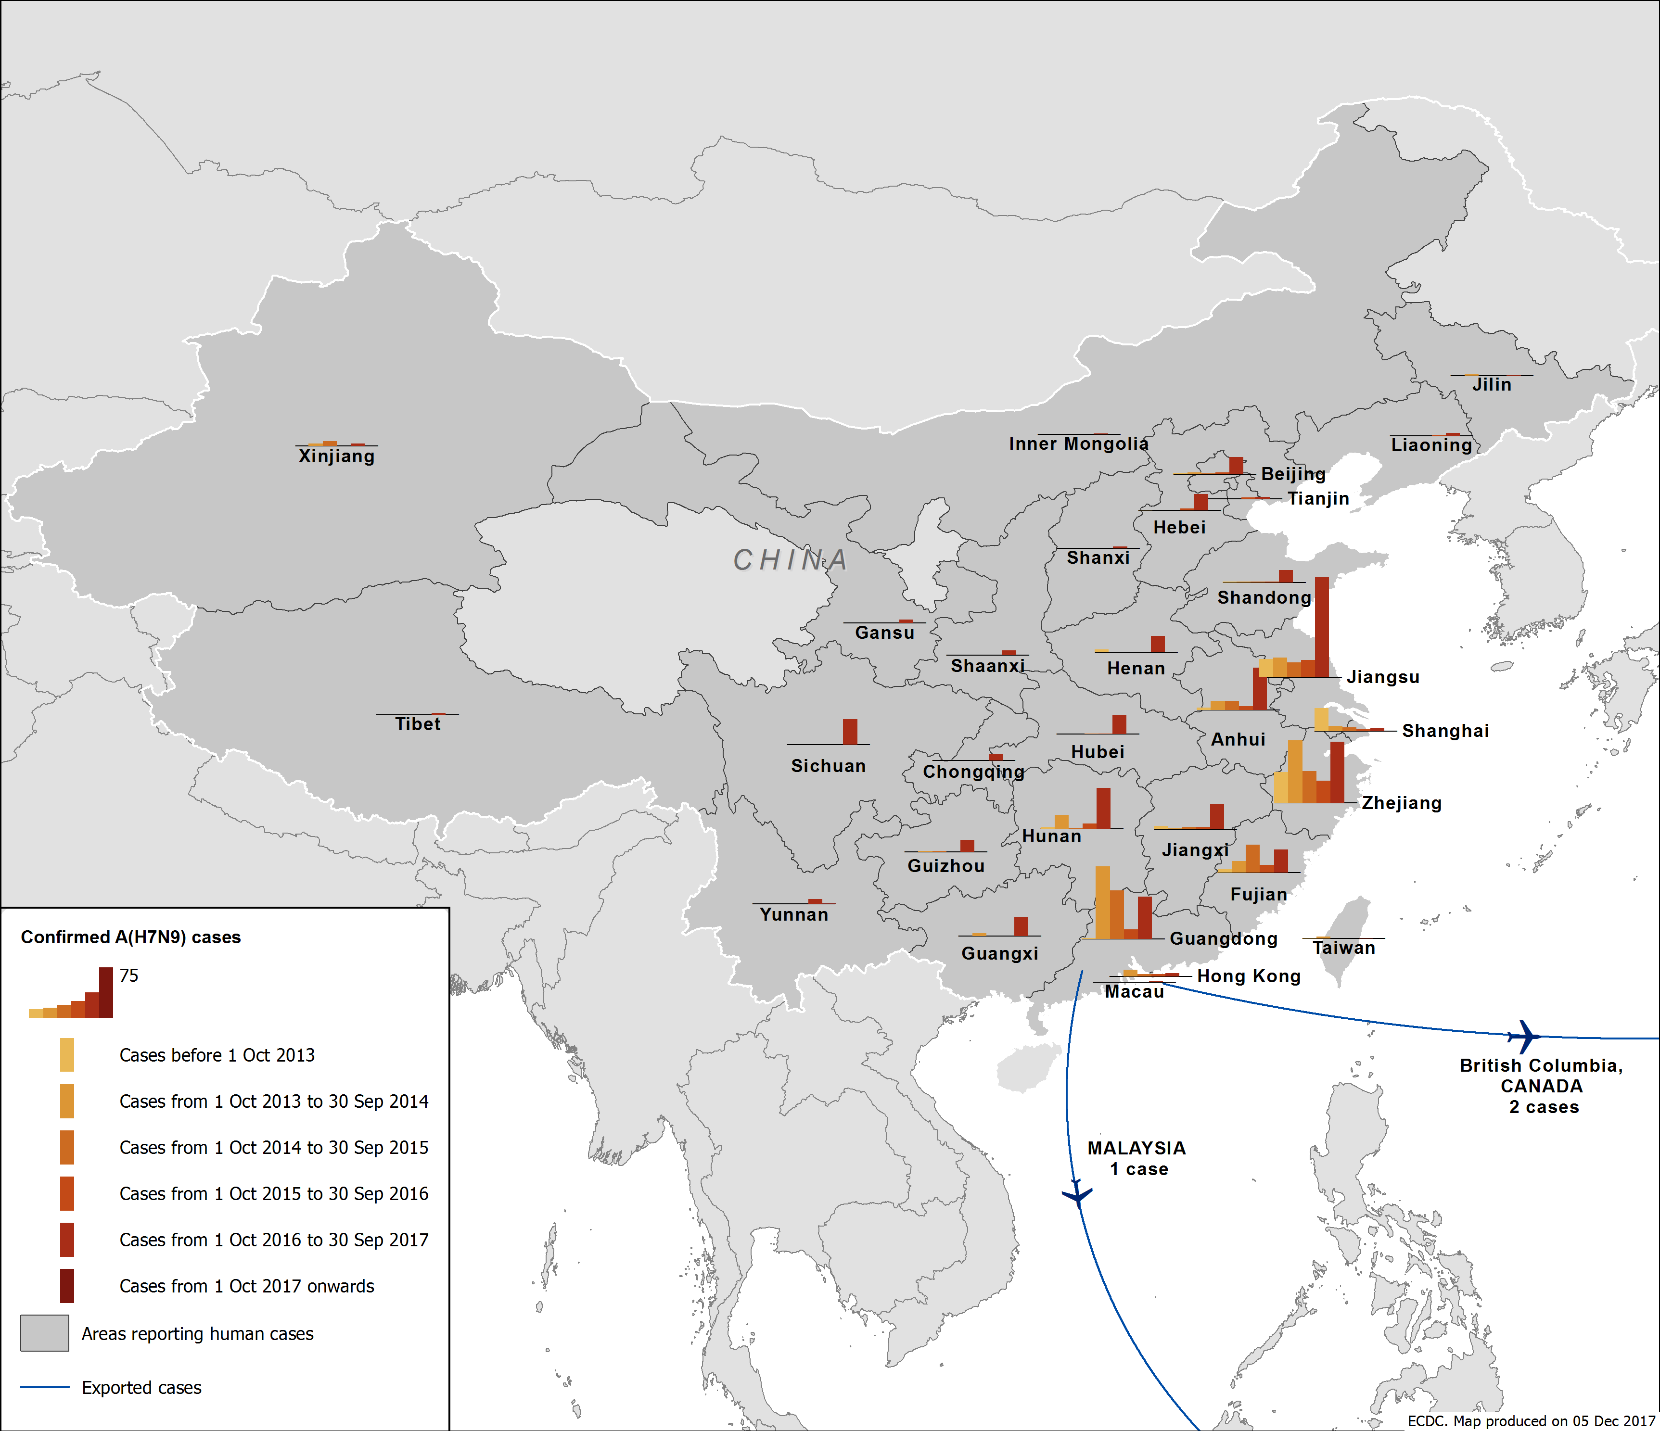
Distribution of confirmed cases of A(H7N9) by first available month,
February 2013 to 31 December 2017

Slide 6
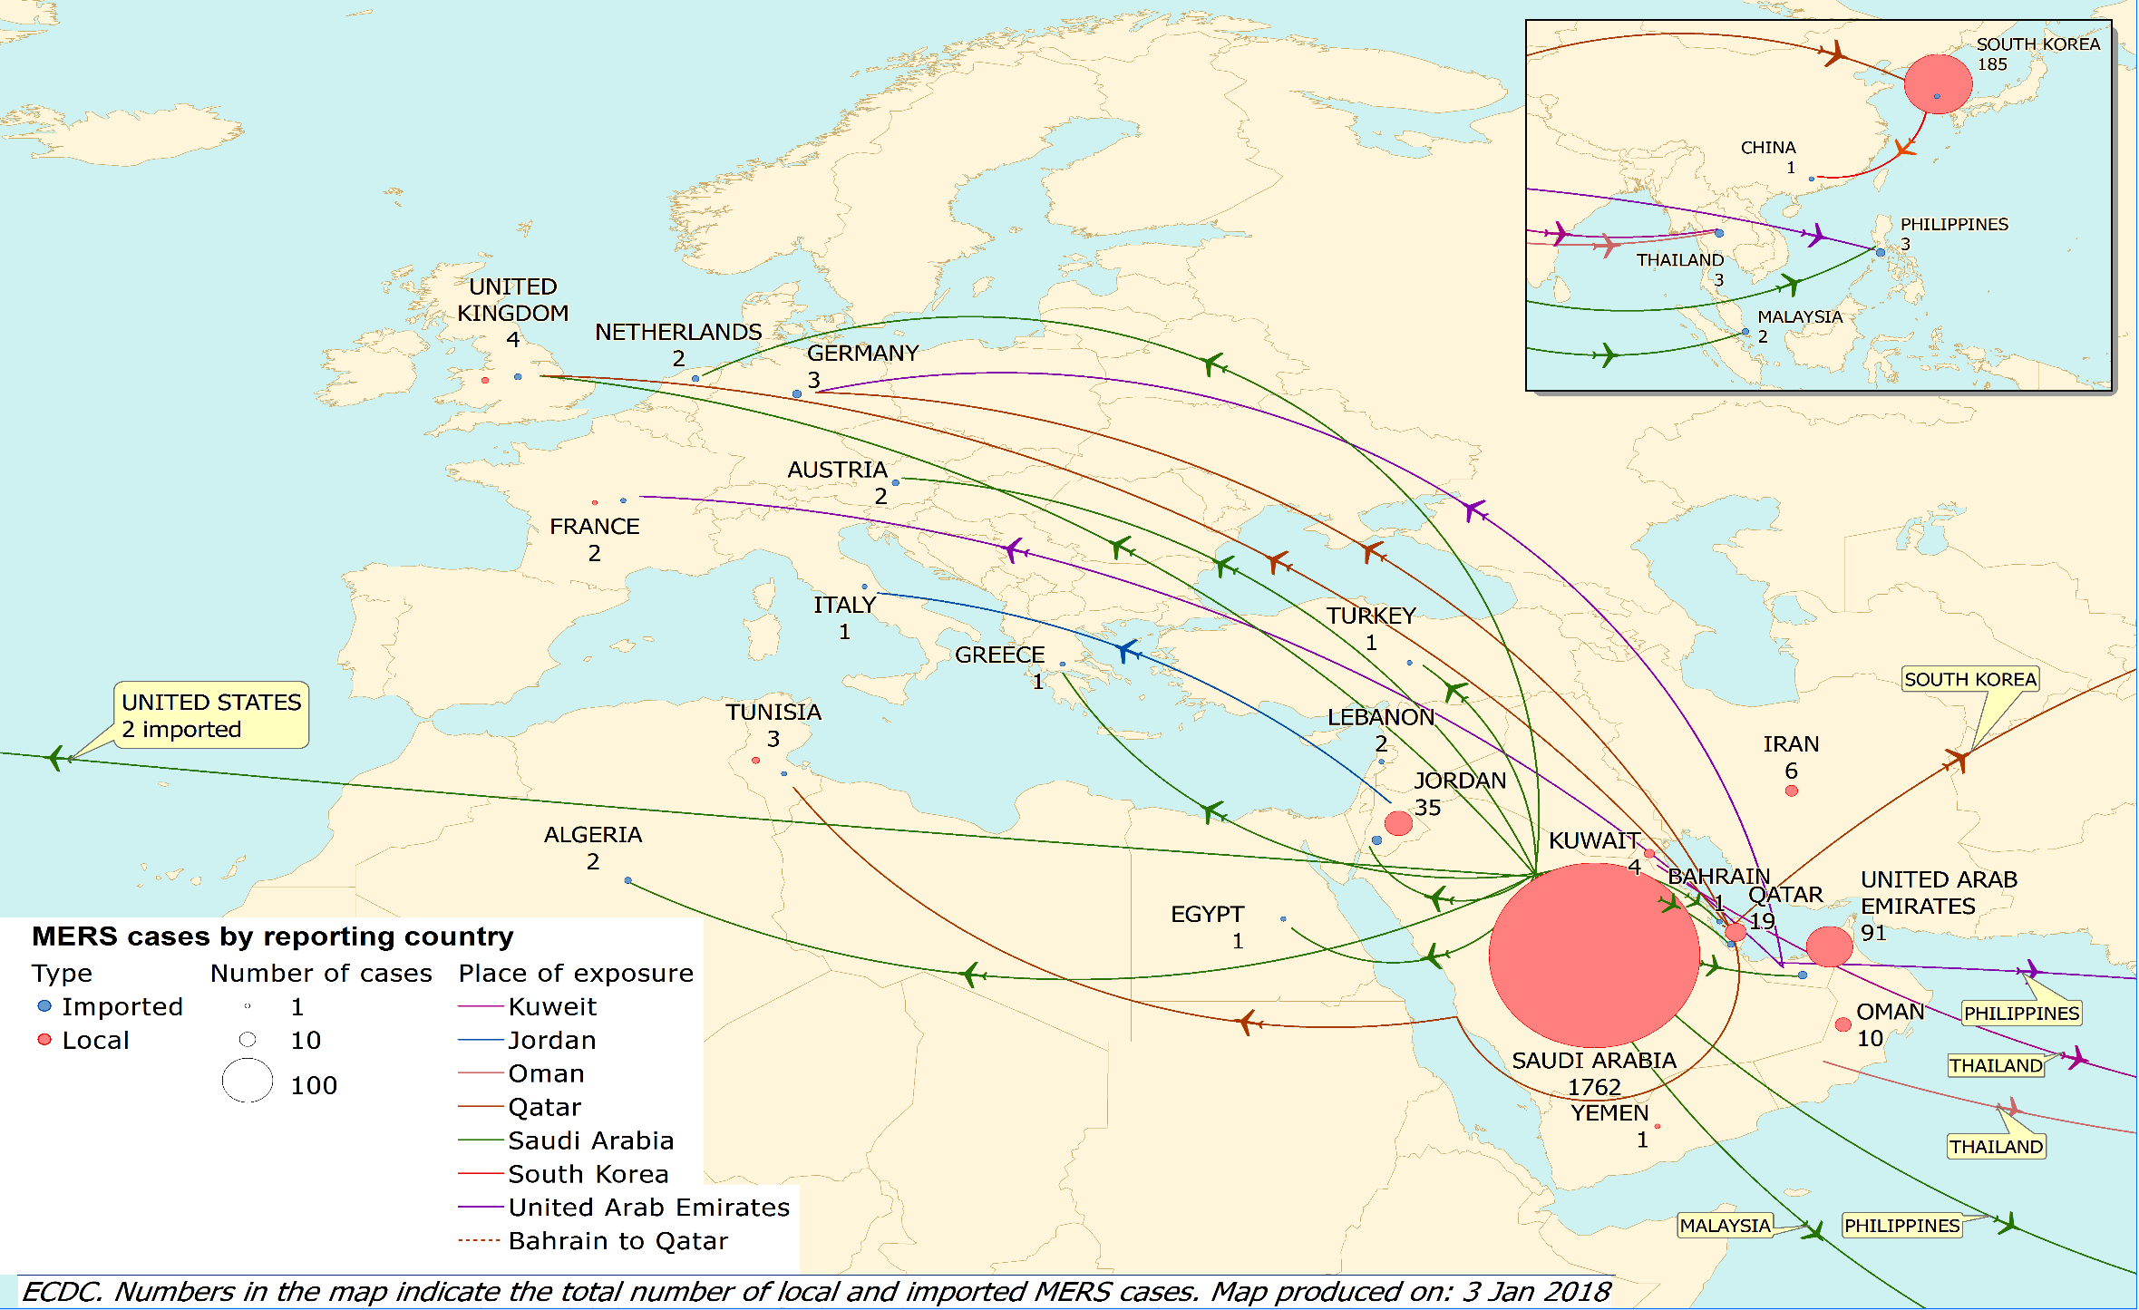
Distribution of confirmed cases of MERS-CoV by country of probable infection and country of report from March 2012 and as of 3 January 2018

Slide 7
Distribution of confirmed cases of MERS-CoV by first available month and region, from March 2012 and as of 31 December 2018

