Slide 1
Reusable maps and graphs from ECDC Communicable Disease Threats Report
Week 1, 2023
You are encouraged to reuse our maps and graphs for your own purposes and are free to translate them, provided the content is not altered and the source is acknowledged.

Slide 2
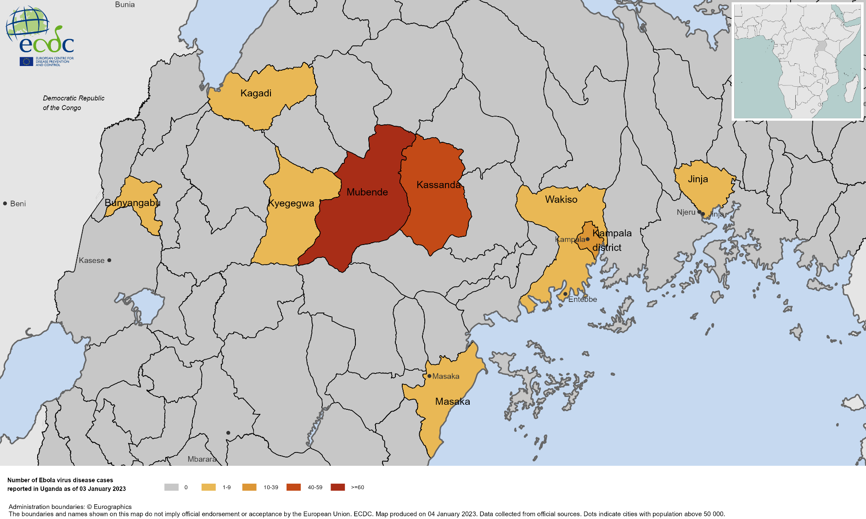
Geographical distribution of Sudan virus disease (SVD) cases in Uganda, 2022

Slide 3
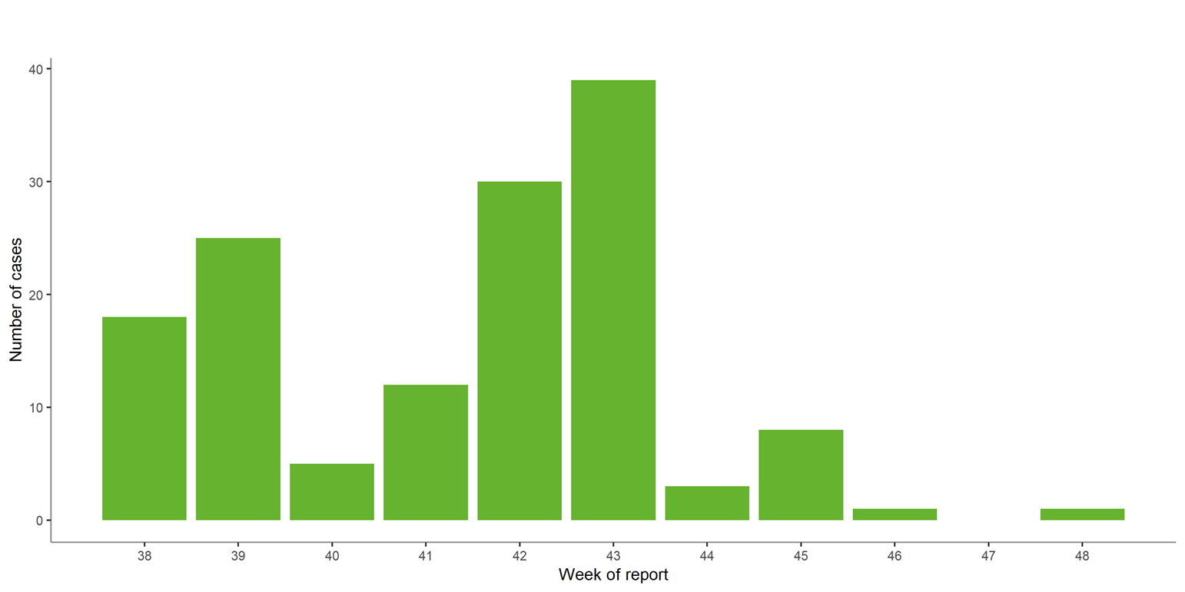
Ebola disease cases reported in Uganda 2022, by week of reporting

