Slide 1
You are encouraged to reuse our maps and graphs for your own purposes and free to translate, provided the content is not altered and the source is acknowledged. Either copy the images from the following slides or download directly from: ecdc.europa.eu/en/publications/surveillance_reports/Communicable-Disease-Threats-Report/Pages/cdtr.aspx
European Centre for Disease Prevention and Control
Reusable maps and graphs from ECDC Communicable Disease Threats Report, week 48, 2017

Slide 2
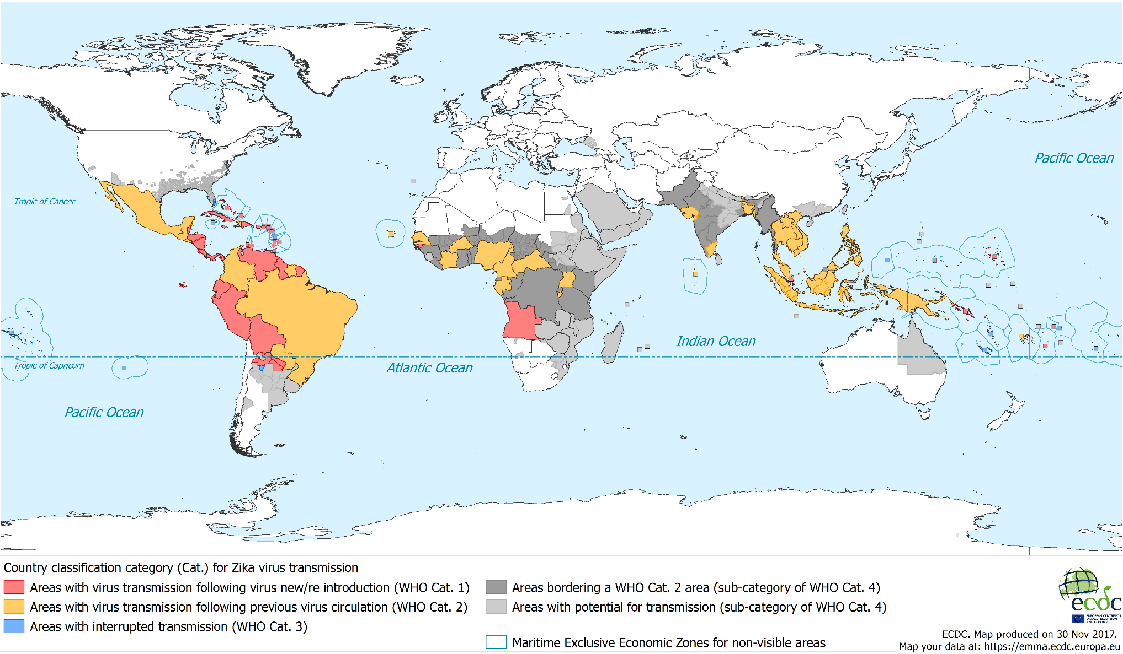
Countries and territories with reported confirmed autochthonous vector-borne
transmission worldwide of Zika virus infection as of 30 November 2017

Slide 3
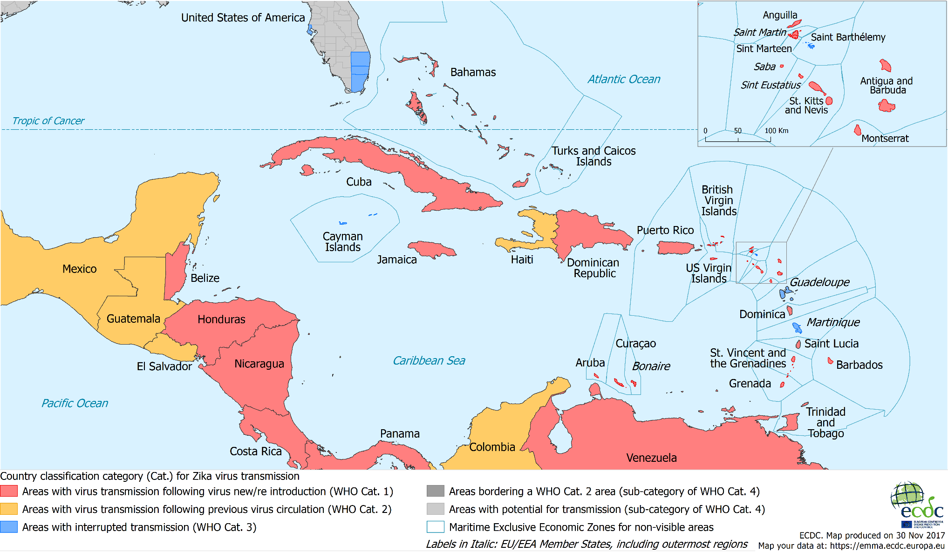
Countries and territories with reported confirmed autochthonous vector-borne
transmission worldwide of Zika virus infection as of 30 November 2017

Slide 4
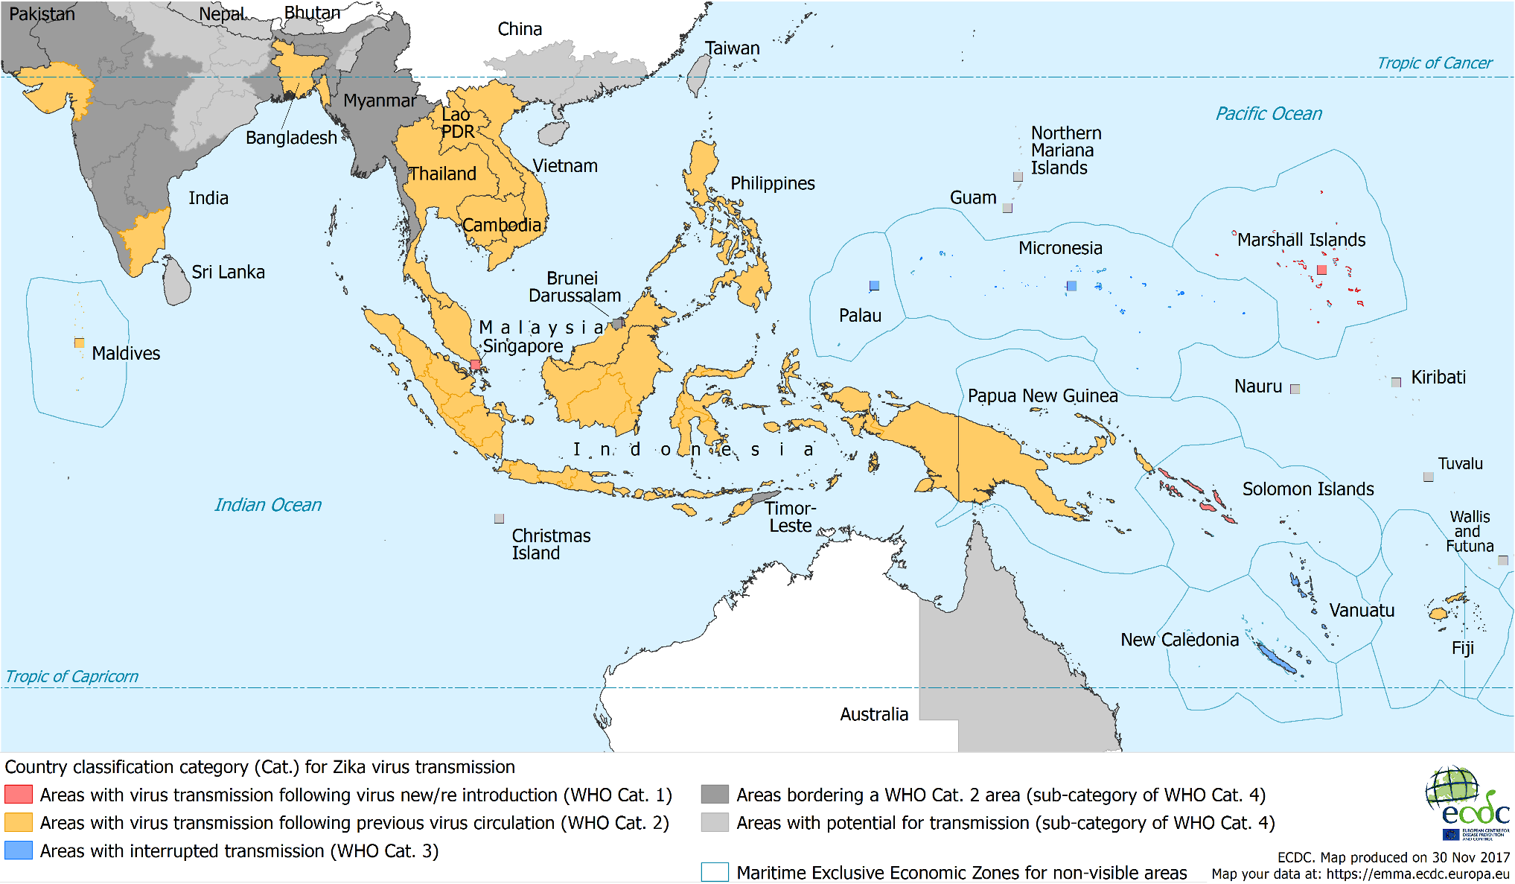
Countries and territories with reported confirmed autochthonous vector-borne
transmission worldwide of Zika virus infection as of 30 November 2017

