Slide 1
Reusable maps and graphs from ECDC Communicable Disease Threats Report Week 47 2021
You are encouraged to reuse our maps and graphs for your own purposes and are free to translate them, provided the content is not altered and the source is acknowledged.

Slide 2
Distribution of COVID-19 cases worldwide, in accordance with the applied case definitions in the affected countries, as of week 46 2021

Slide 3
Distribution of COVID-19 deaths worldwide, as of week 46 2021

Slide 4
Distribution of laboratory-confirmed cases of COVID-19 in the EU/EEA, as of week 46 2021

Slide 5
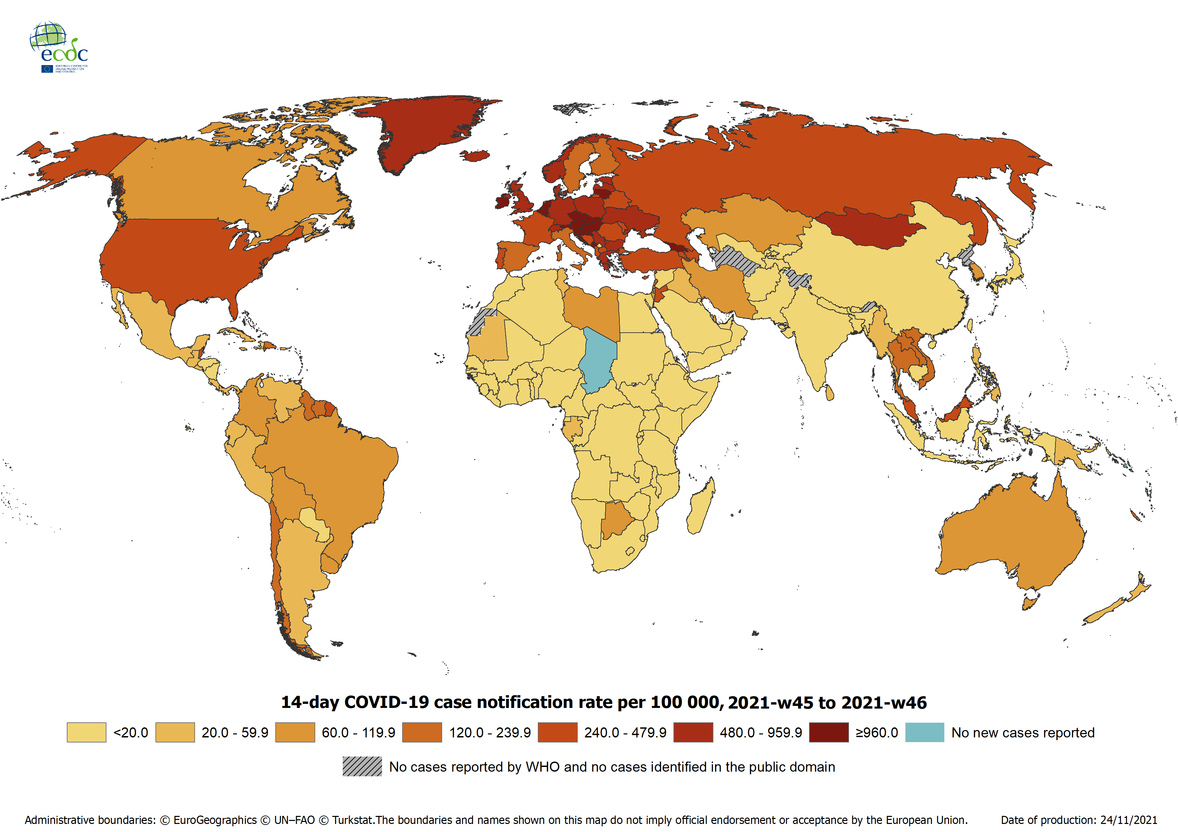
Geographical distribution of 14-day cumulative number of reported COVID-19 cases per 100 000 population, worldwide, week 45 to week 46 2021
14-day notification rates and trends are collected using epidemic intelligence from various sources and are affected by the testing strategy, laboratory capacity and effectiveness of surveillance systems. As all of these factors can differ greatly between countries, ECDC does not recommend using notification rates to directly compare countries. Particular caution is needed when interpreting reported rates from areas with small populations, where small changes in the numbers of reported cases can have a large impact on the notification rate. In addition, the retrospective adjustment of data by reporting authorities is possible. Negative counts of new cases can arise if countries or subnational areas report cumulative totals that are lower than those reported previously, which can affect the presentation of data in maps and time-series plots.

Slide 6
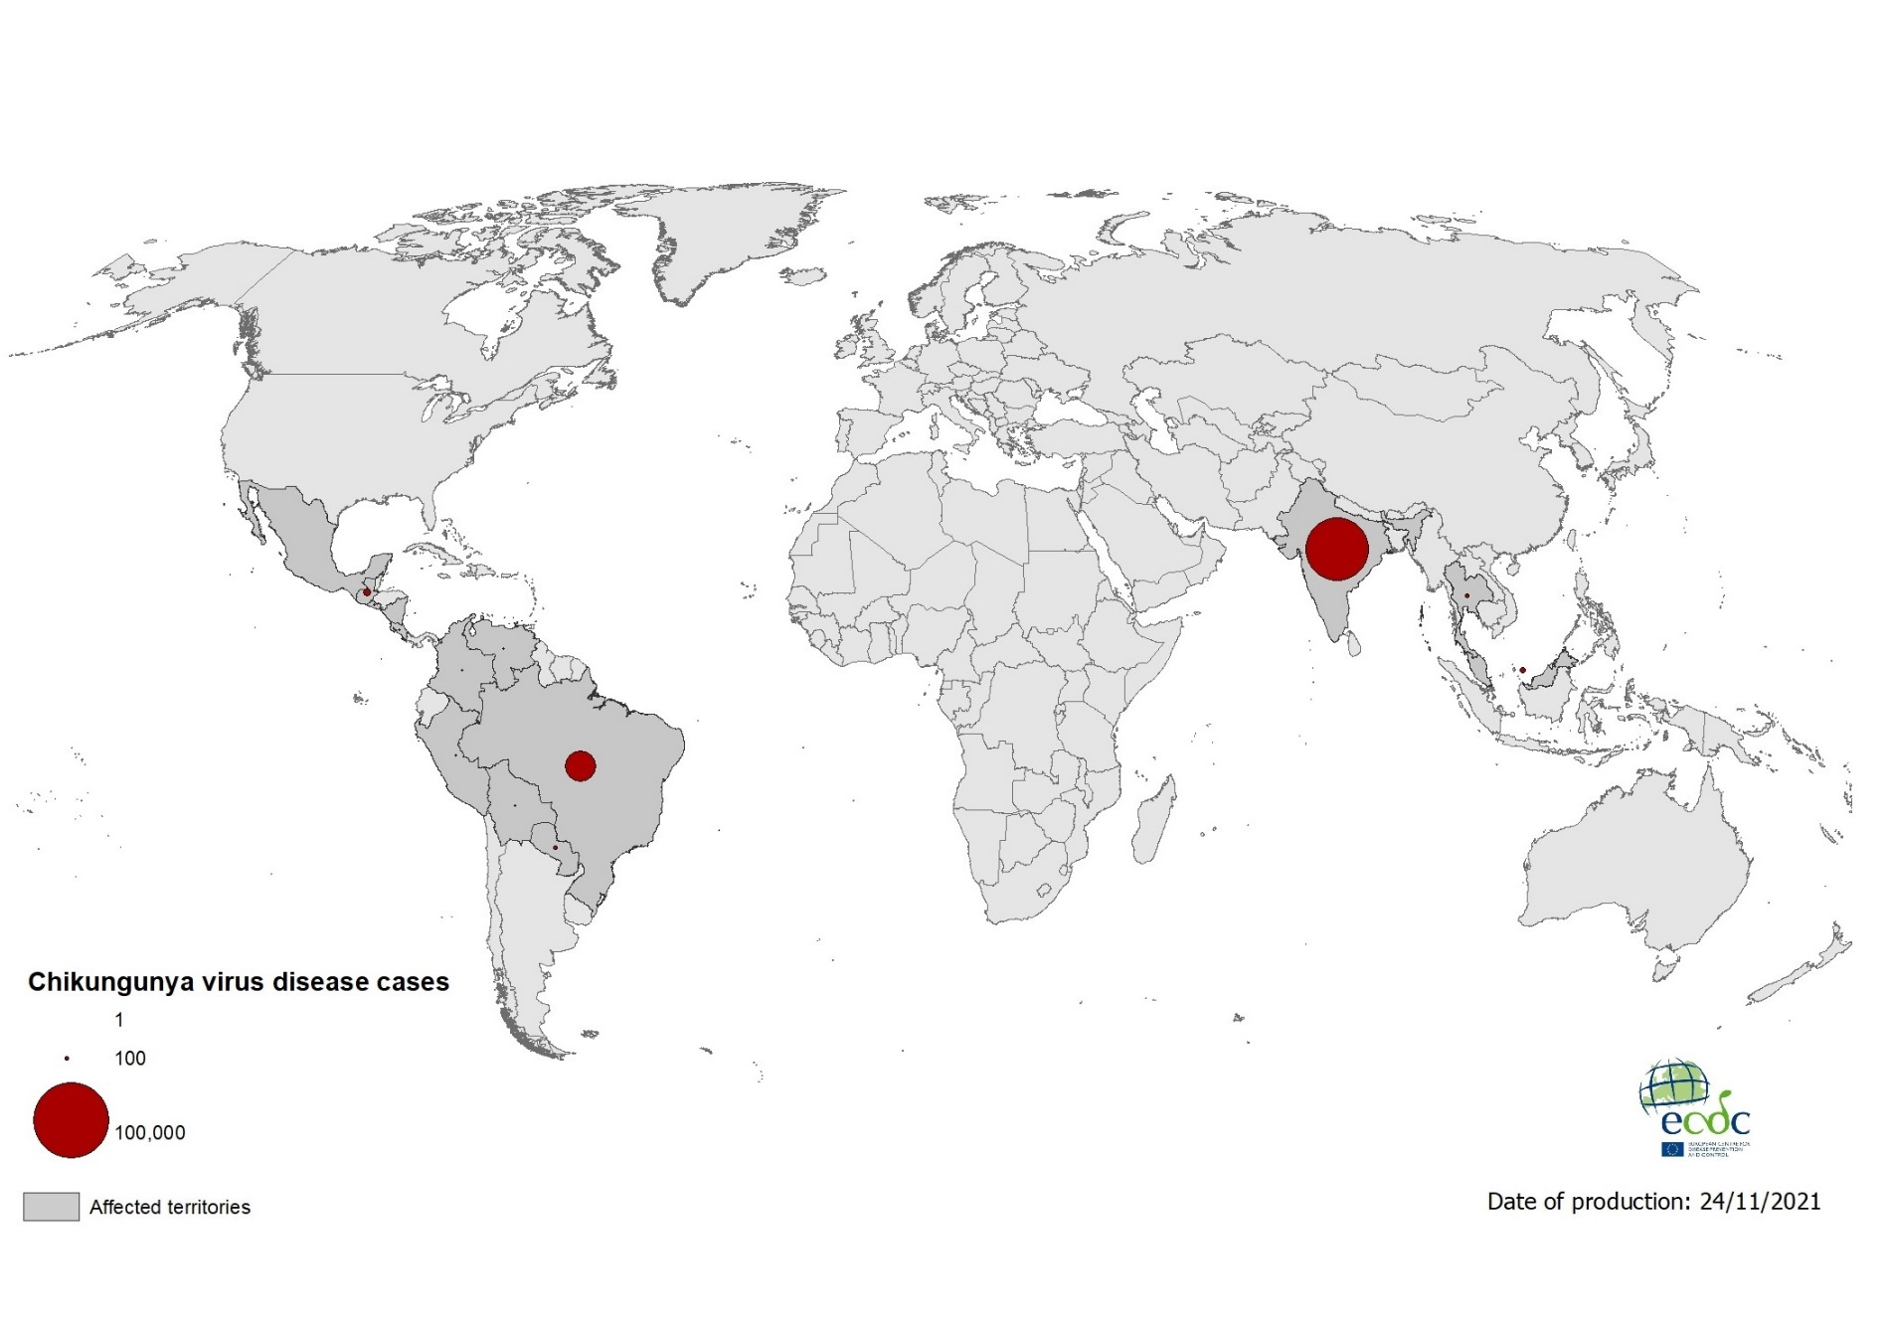
Geographical distribution of chikungunya cases reported worldwide, September to November 2021

Slide 7
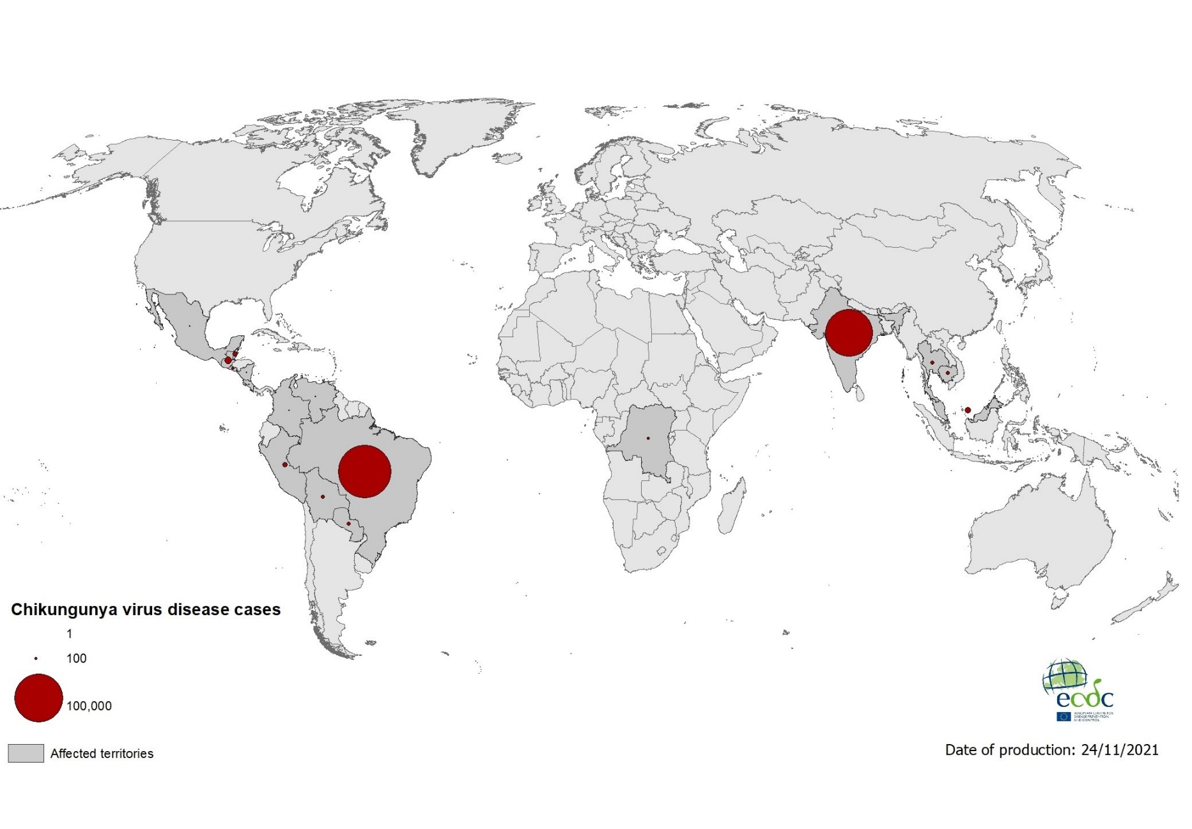
Geographical distribution of chikungunya cases reported worldwide, January to November 2021

Slide 8
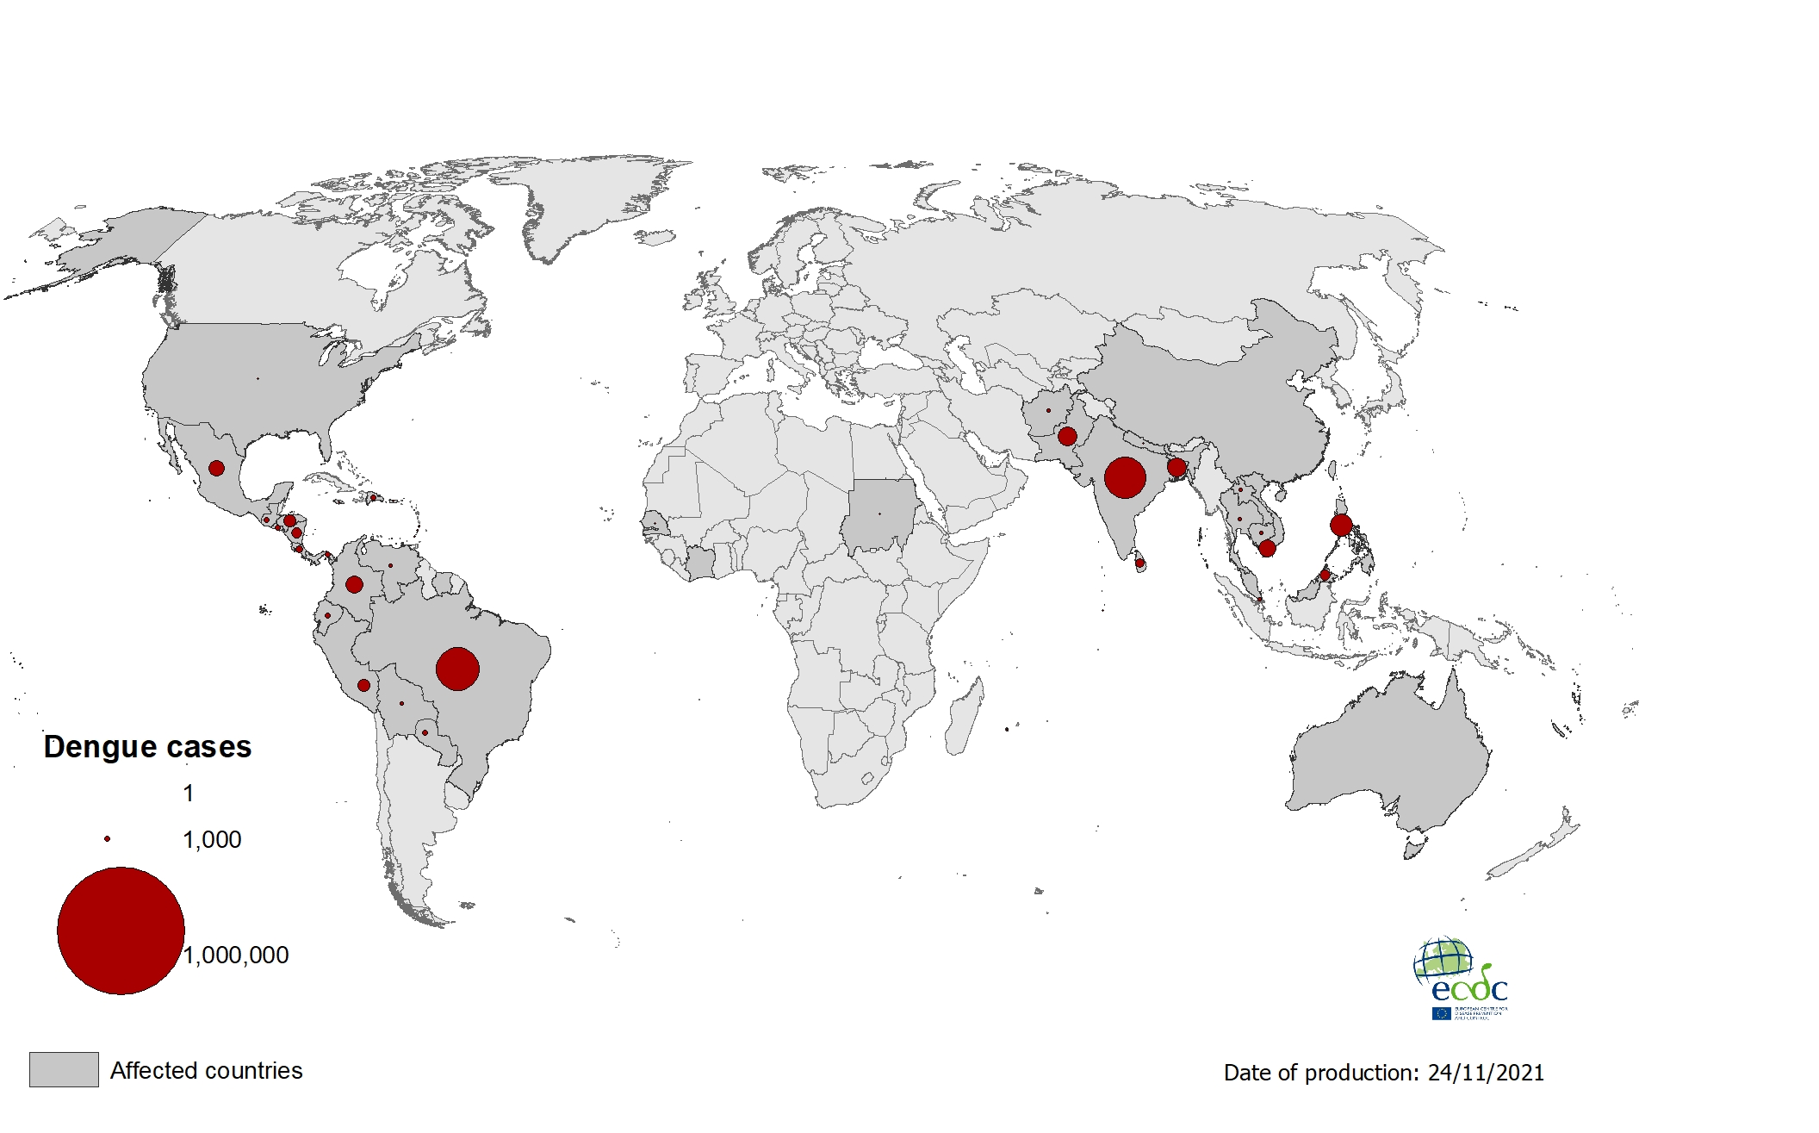
Geographical distribution of dengue cases reported worldwide, September to November 2021

Slide 9
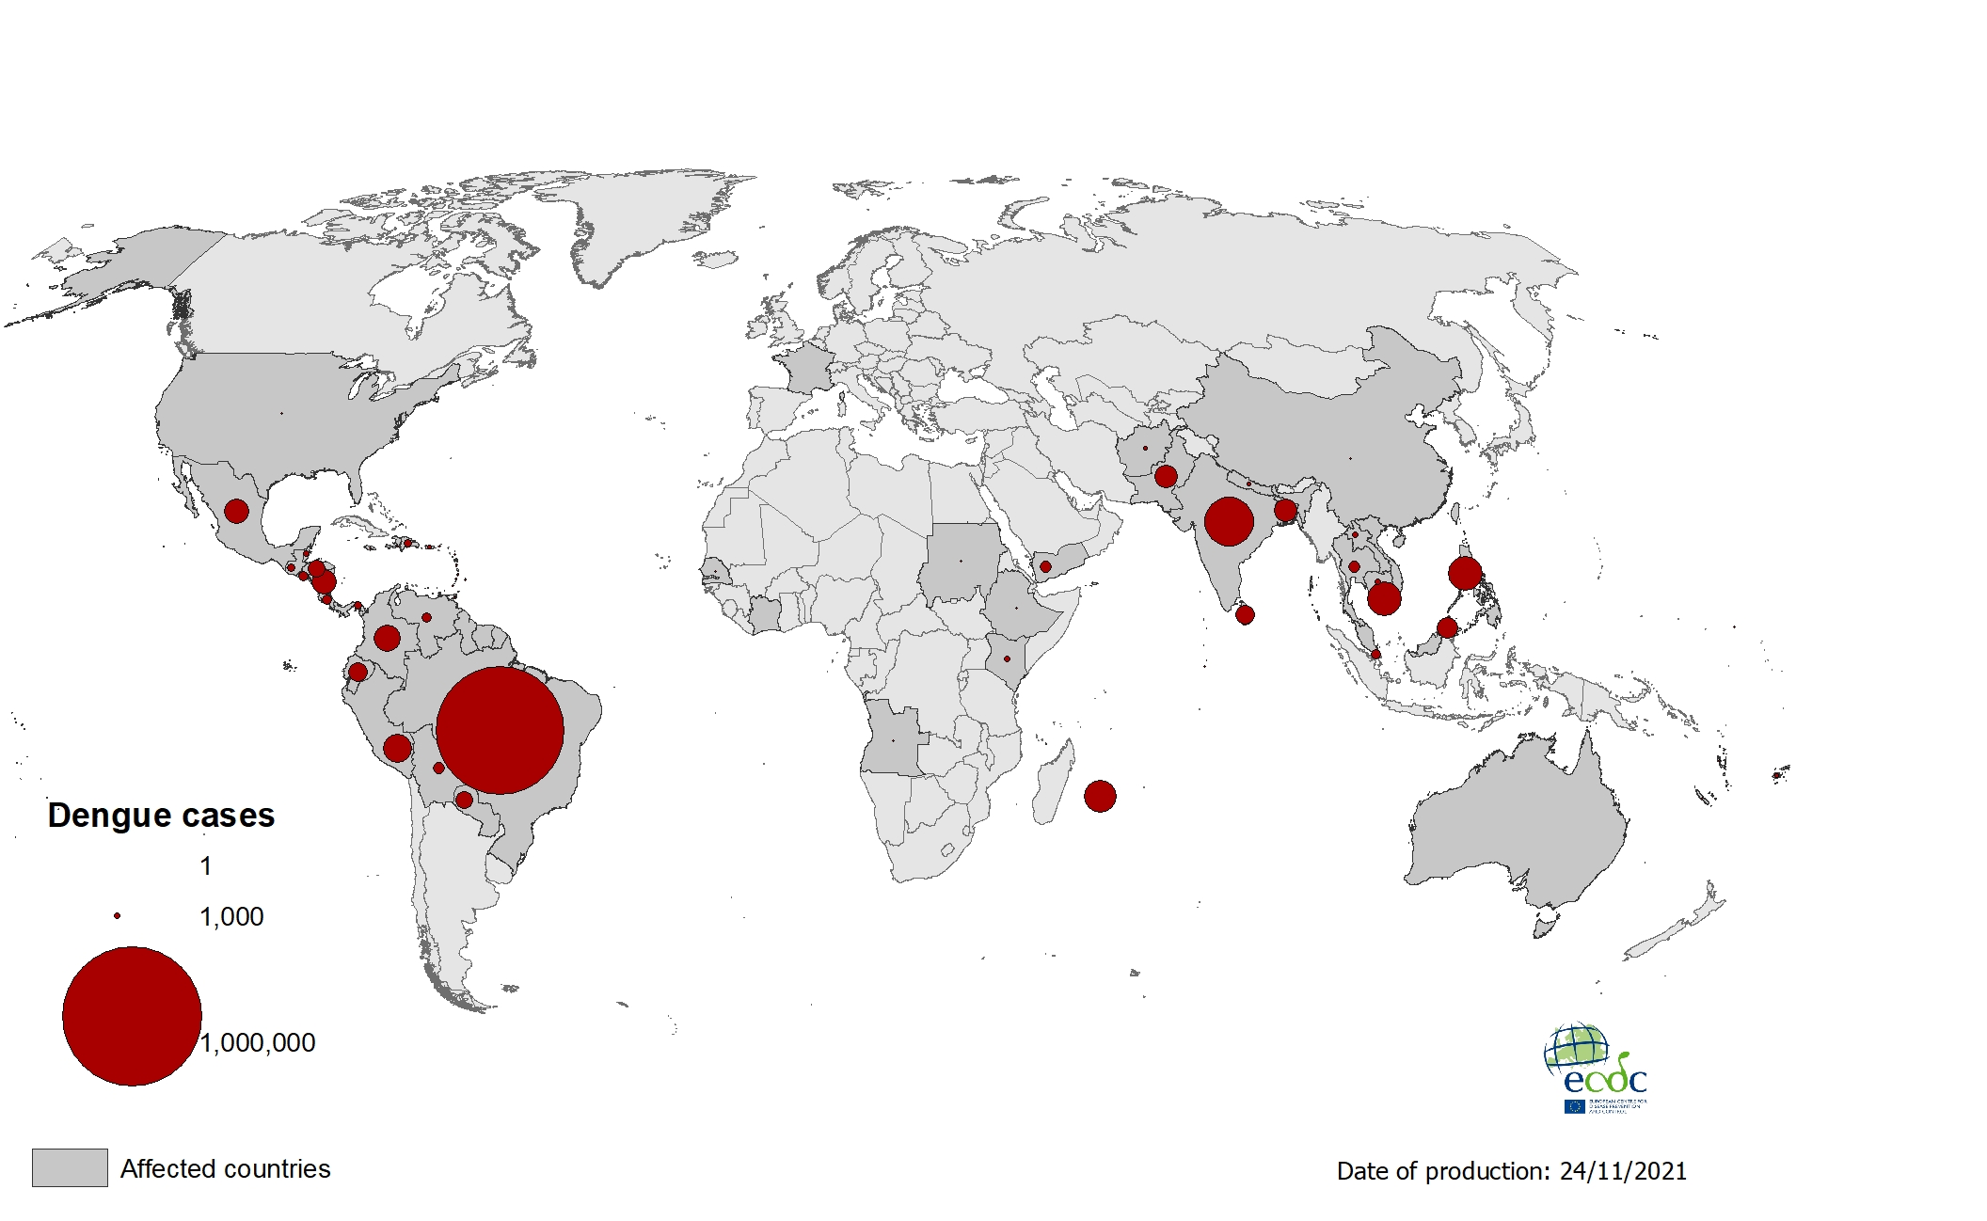
Geographical distribution of dengue cases
reported worldwide, January to November 2021

Slide 10
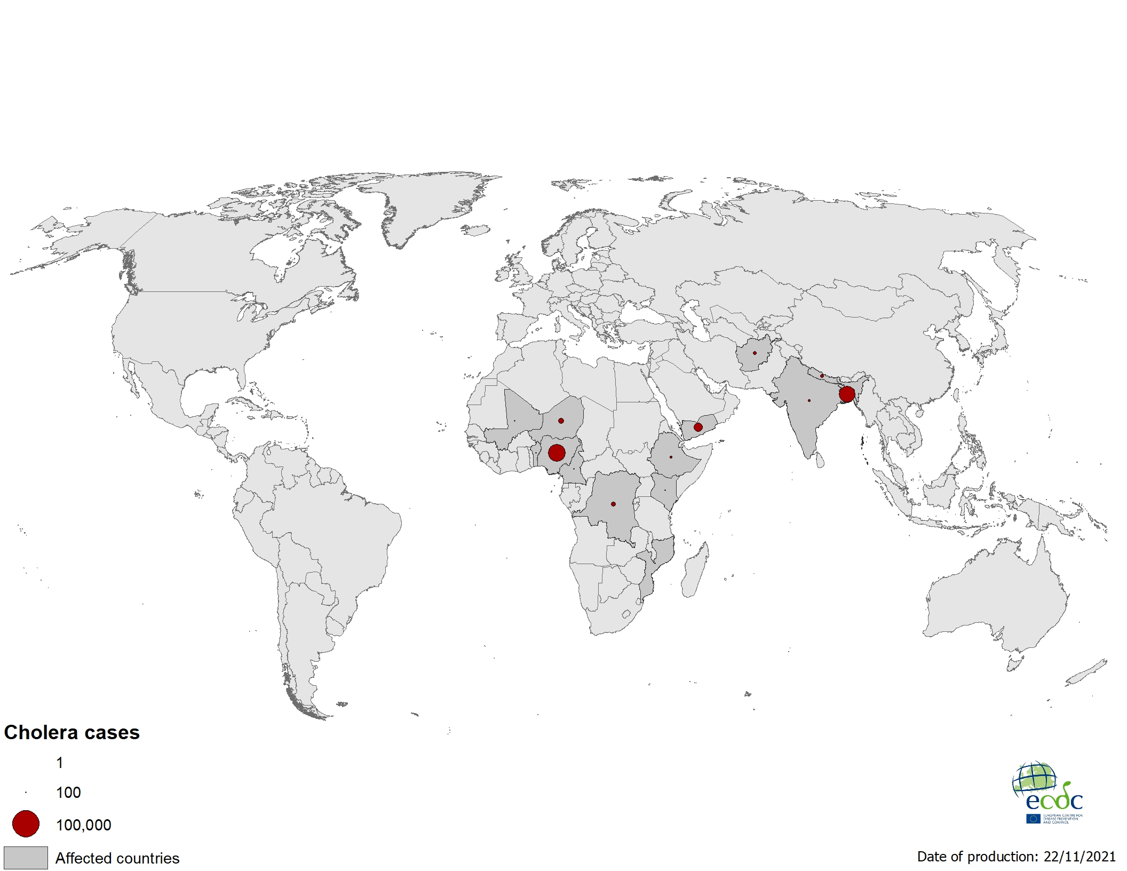
Geographical distribution of cholera cases reported worldwide from September to November 2021

Slide 11
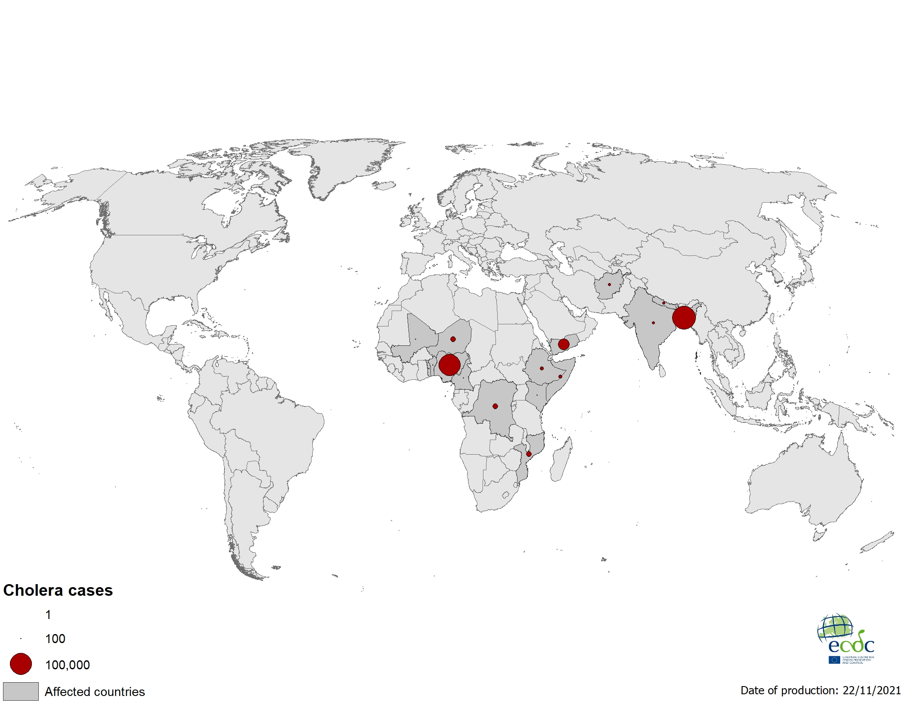
Geographical distribution of cholera cases reported worldwide as of November 2021

