Slide 1
You are encouraged to reuse our maps and graphs for your own purposes and free to translate, provided the content is not altered and the source is acknowledged.
Either copy the images from the following slides or download directly from: ecdc.europa.eu/en/publications/surveillance_reports/Communicable-Disease-Threats-Report/Pages/cdtr.aspx
European Centre for Disease Prevention and Control
Reusable maps and graphs from ECDC Communicable Disease Threats Report, week 43, 2017

Slide 2
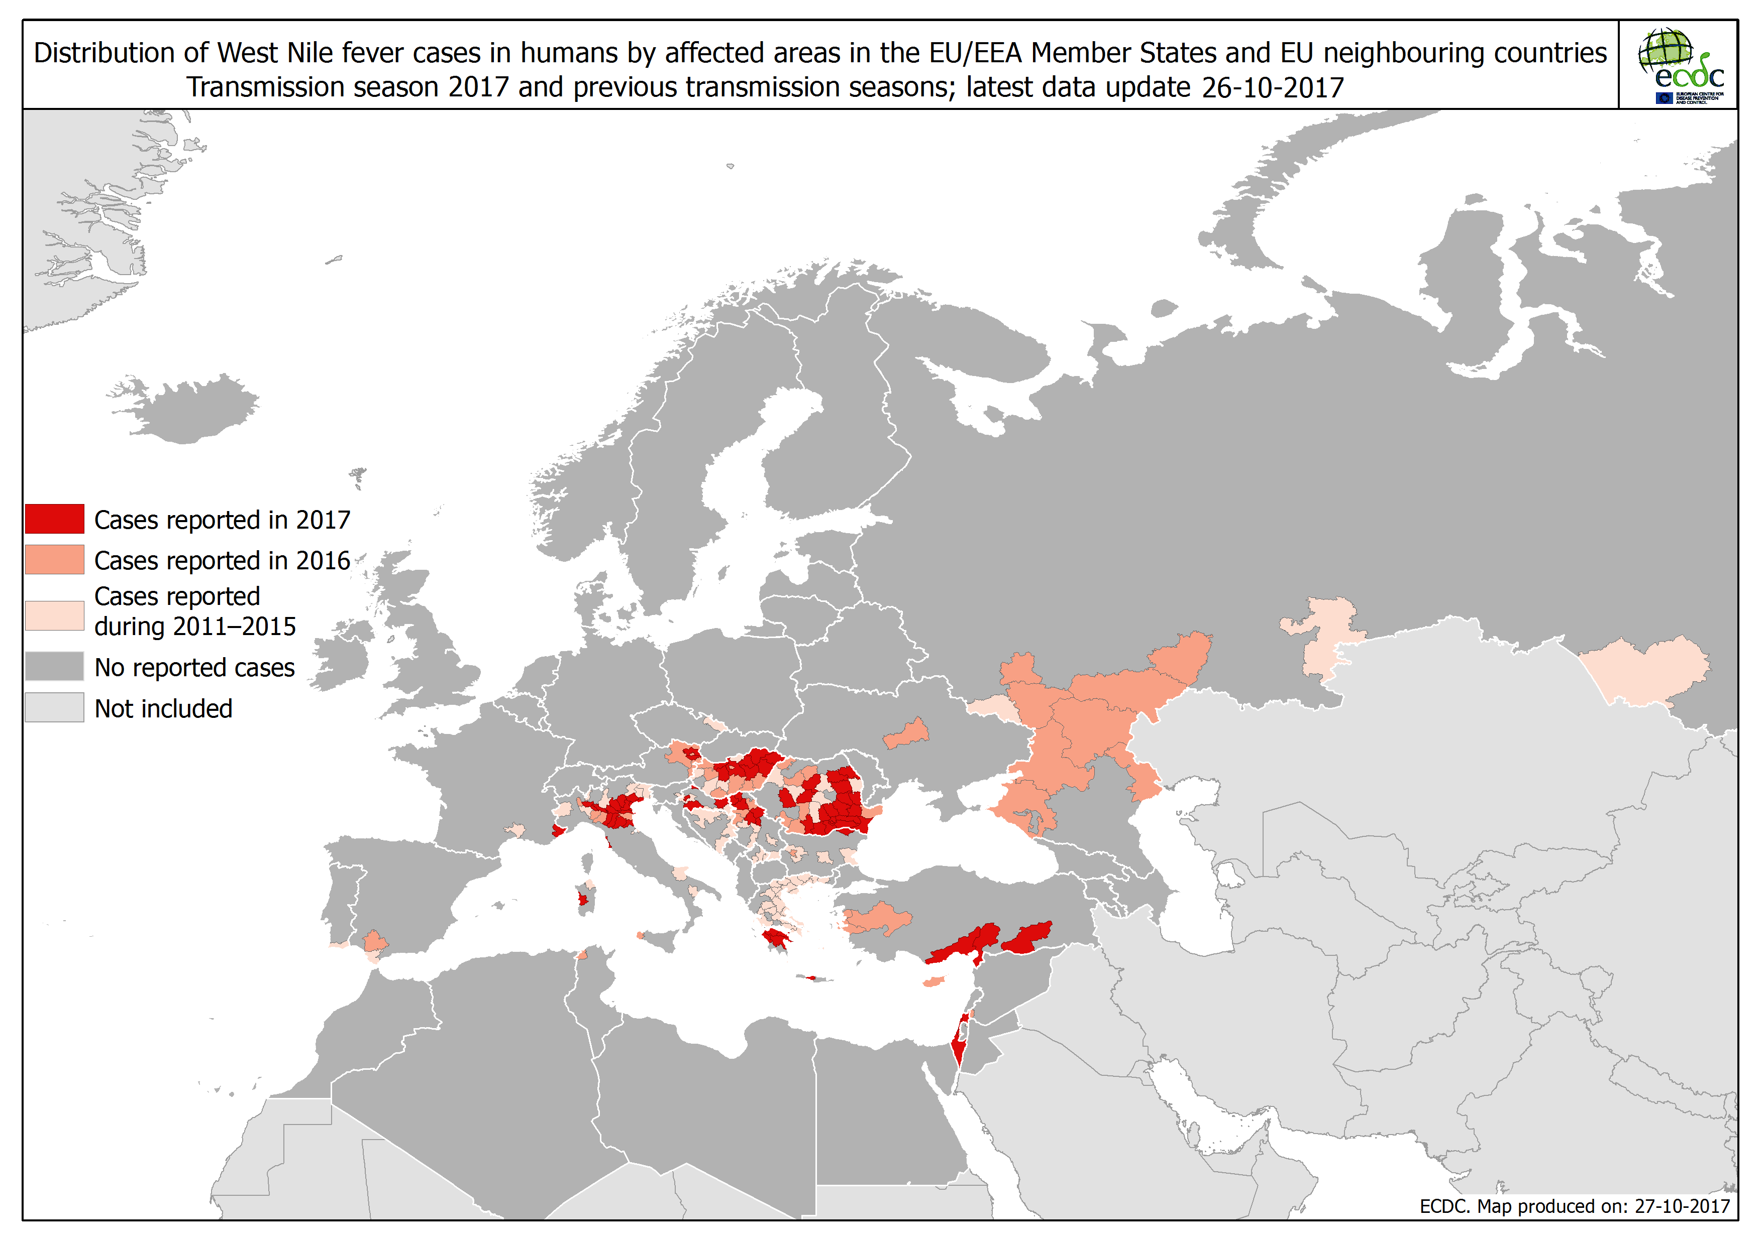

Slide 3
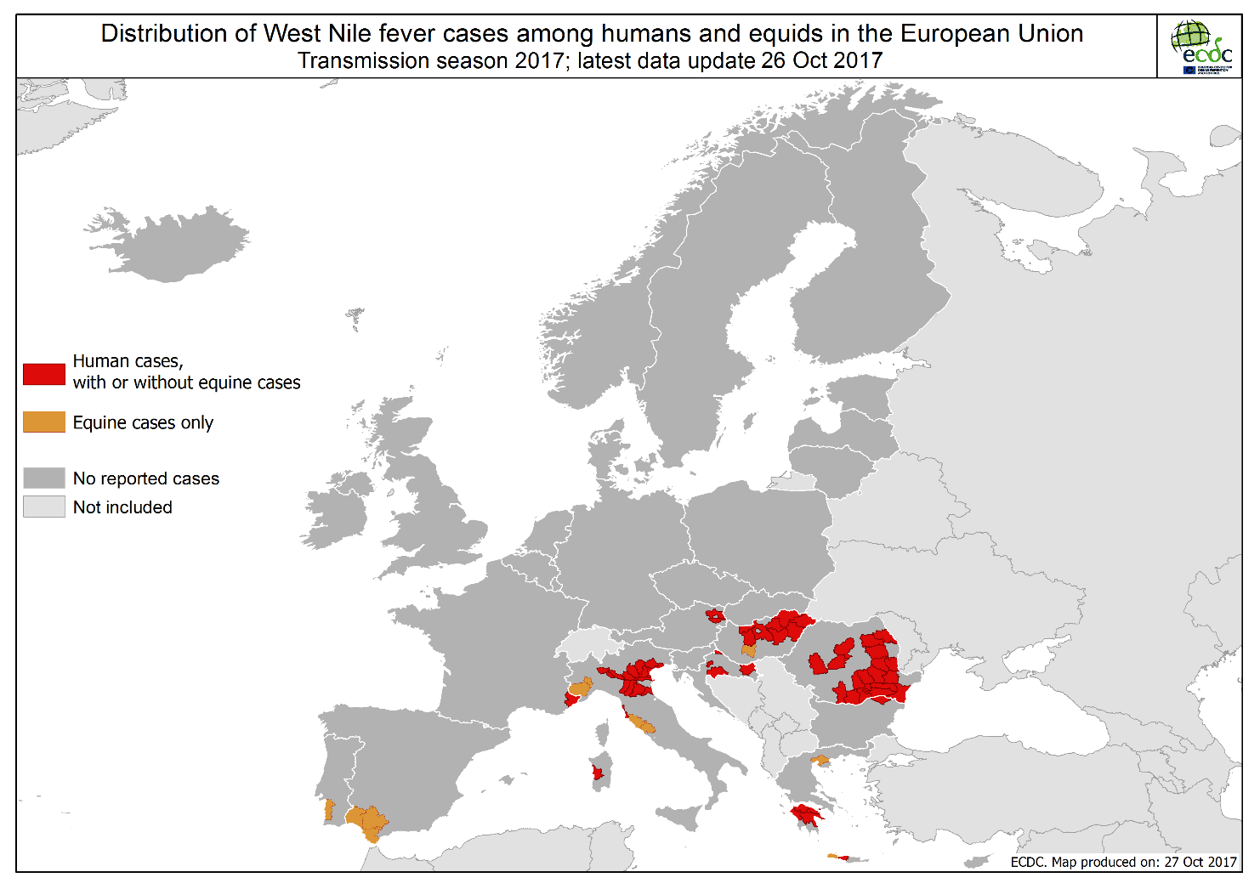

Slide 4
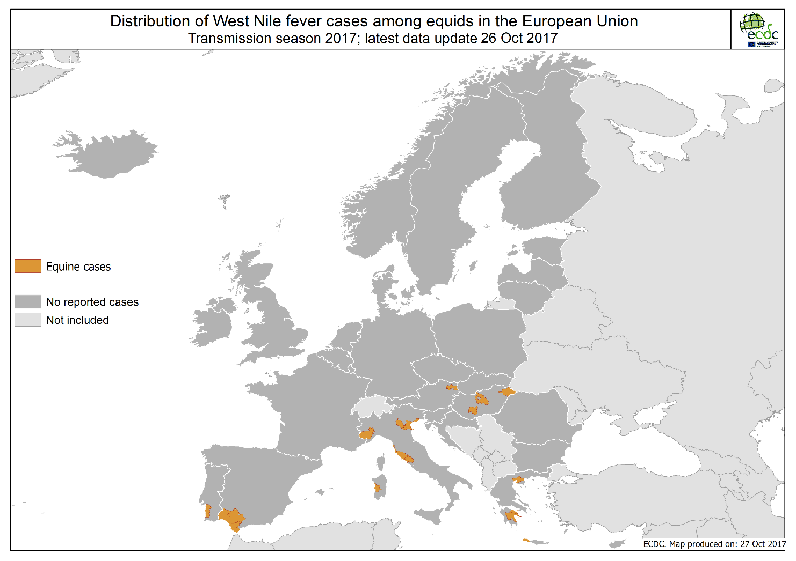

Slide 5
Distribution of plague cases per reporting week, Madagascar, weeks 2017-38 to 2017-42
*
*data up to 20 October
Please note that there is still uncertainty on the correct numbers due to case reclassification and reporting delays

Slide 6
Number of autochthonous malaria cases by week of reporting as of week 41 - 2017, Cape Verde

Slide 7
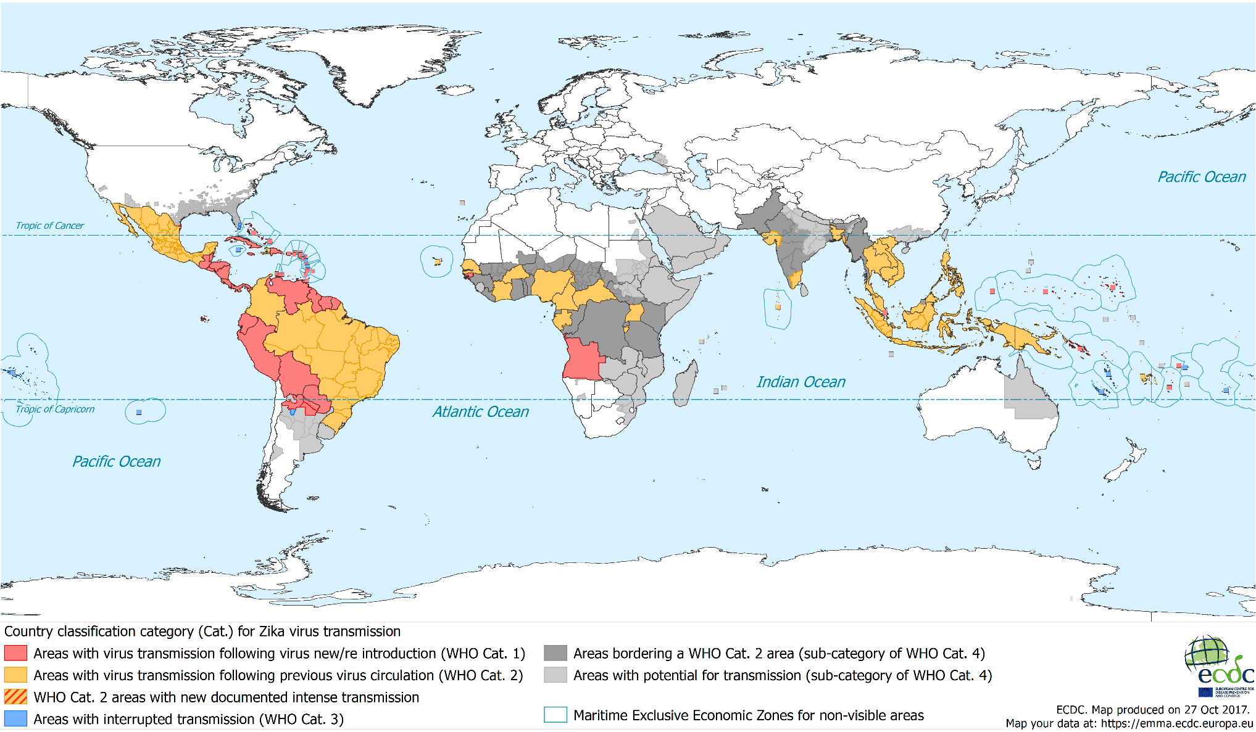
Countries and territories with reported confirmed autochthonous vector-borne
transmission worldwide of Zika virus infection as of 27 October 2017

