Slide 1
You are encouraged to reuse our maps and graphs for your own purposes and free to translate, provided the content is not altered and the source is acknowledged. Either copy the images from the following slides or download directly from: ecdc.europa.eu/en/publications/surveillance_reports/Communicable-Disease-Threats-Report/Pages/cdtr.aspx
European Centre for Disease Prevention and Control
Reusable maps and graphs from ECDC Communicable Disease Threats Report, week 31, 2017

Slide 2
New measles cases per week of reporting, week 2008-1 to 2017-30, Romania

Slide 3
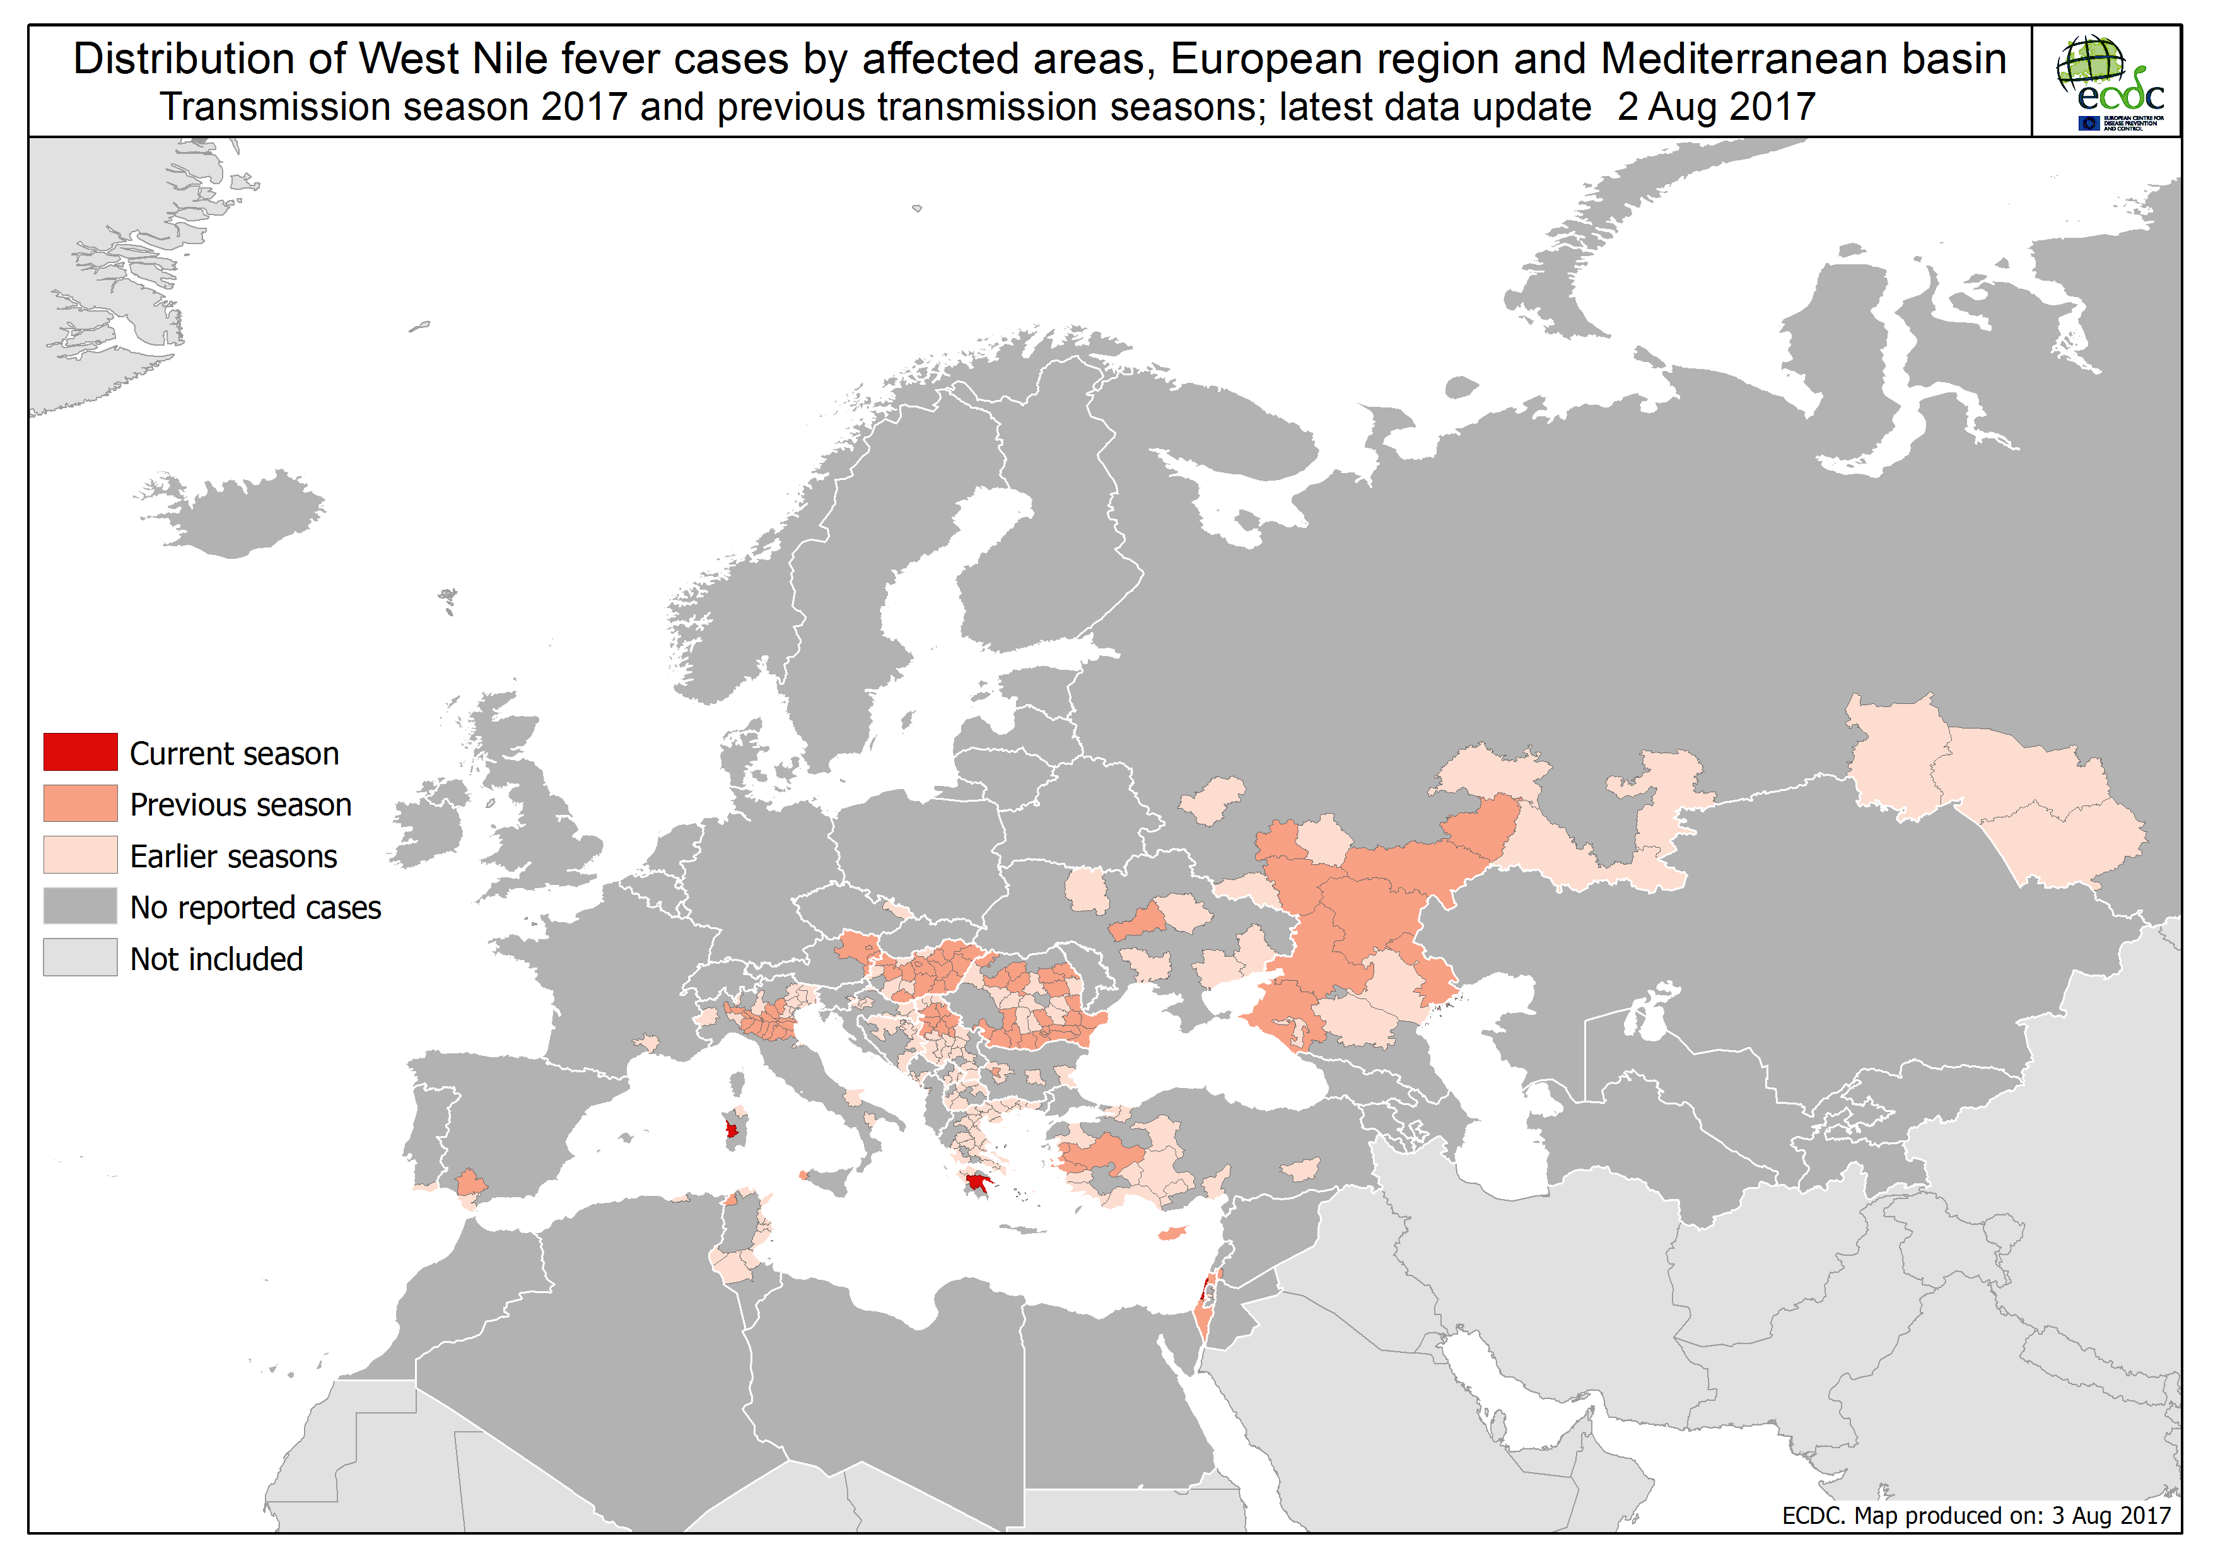

Slide 4
Distribution of confirmed cases of A(H7N9) by first available month, February 2013 to 31 July 2017

Slide 5
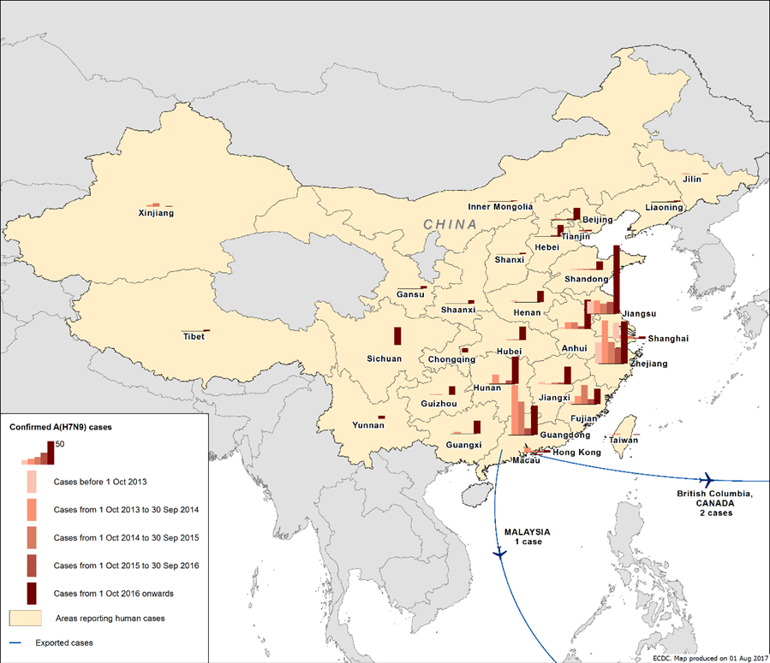
Distribution of confirmed cases of A(H7N9) by five periods (weeks 7-2013 to 31-2017)

Slide 6
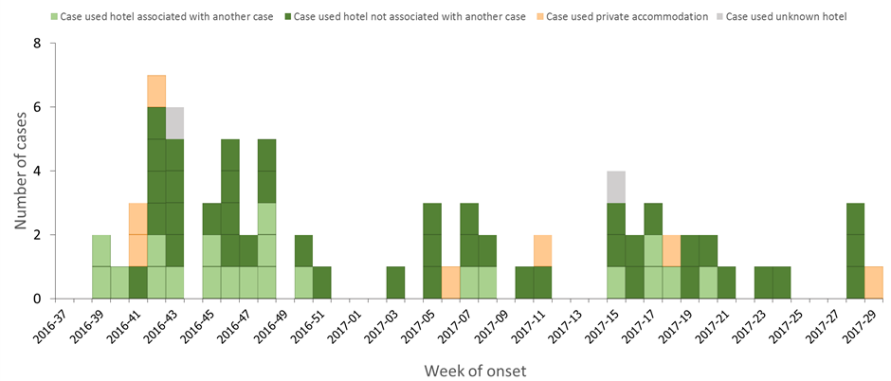
Distribution of travel-associated Legionnaires' disease cases with history of stay in Dubai, United Arab Emirates, by week of onset 37-2016 and 29-2017, EU/EFTA Member States

Slide 7
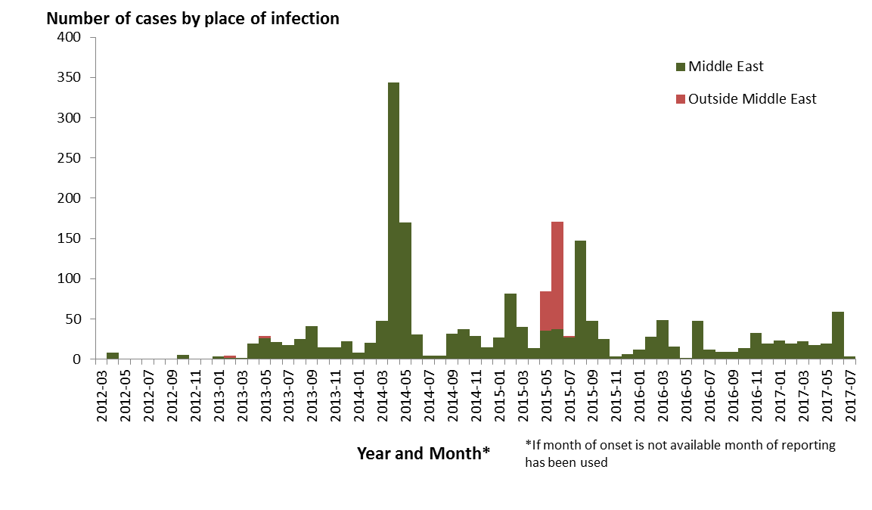
Distribution of confirmed cases of MERS-CoV by place of infection and month of onset, March 2012 – 31 July 2017

Slide 8
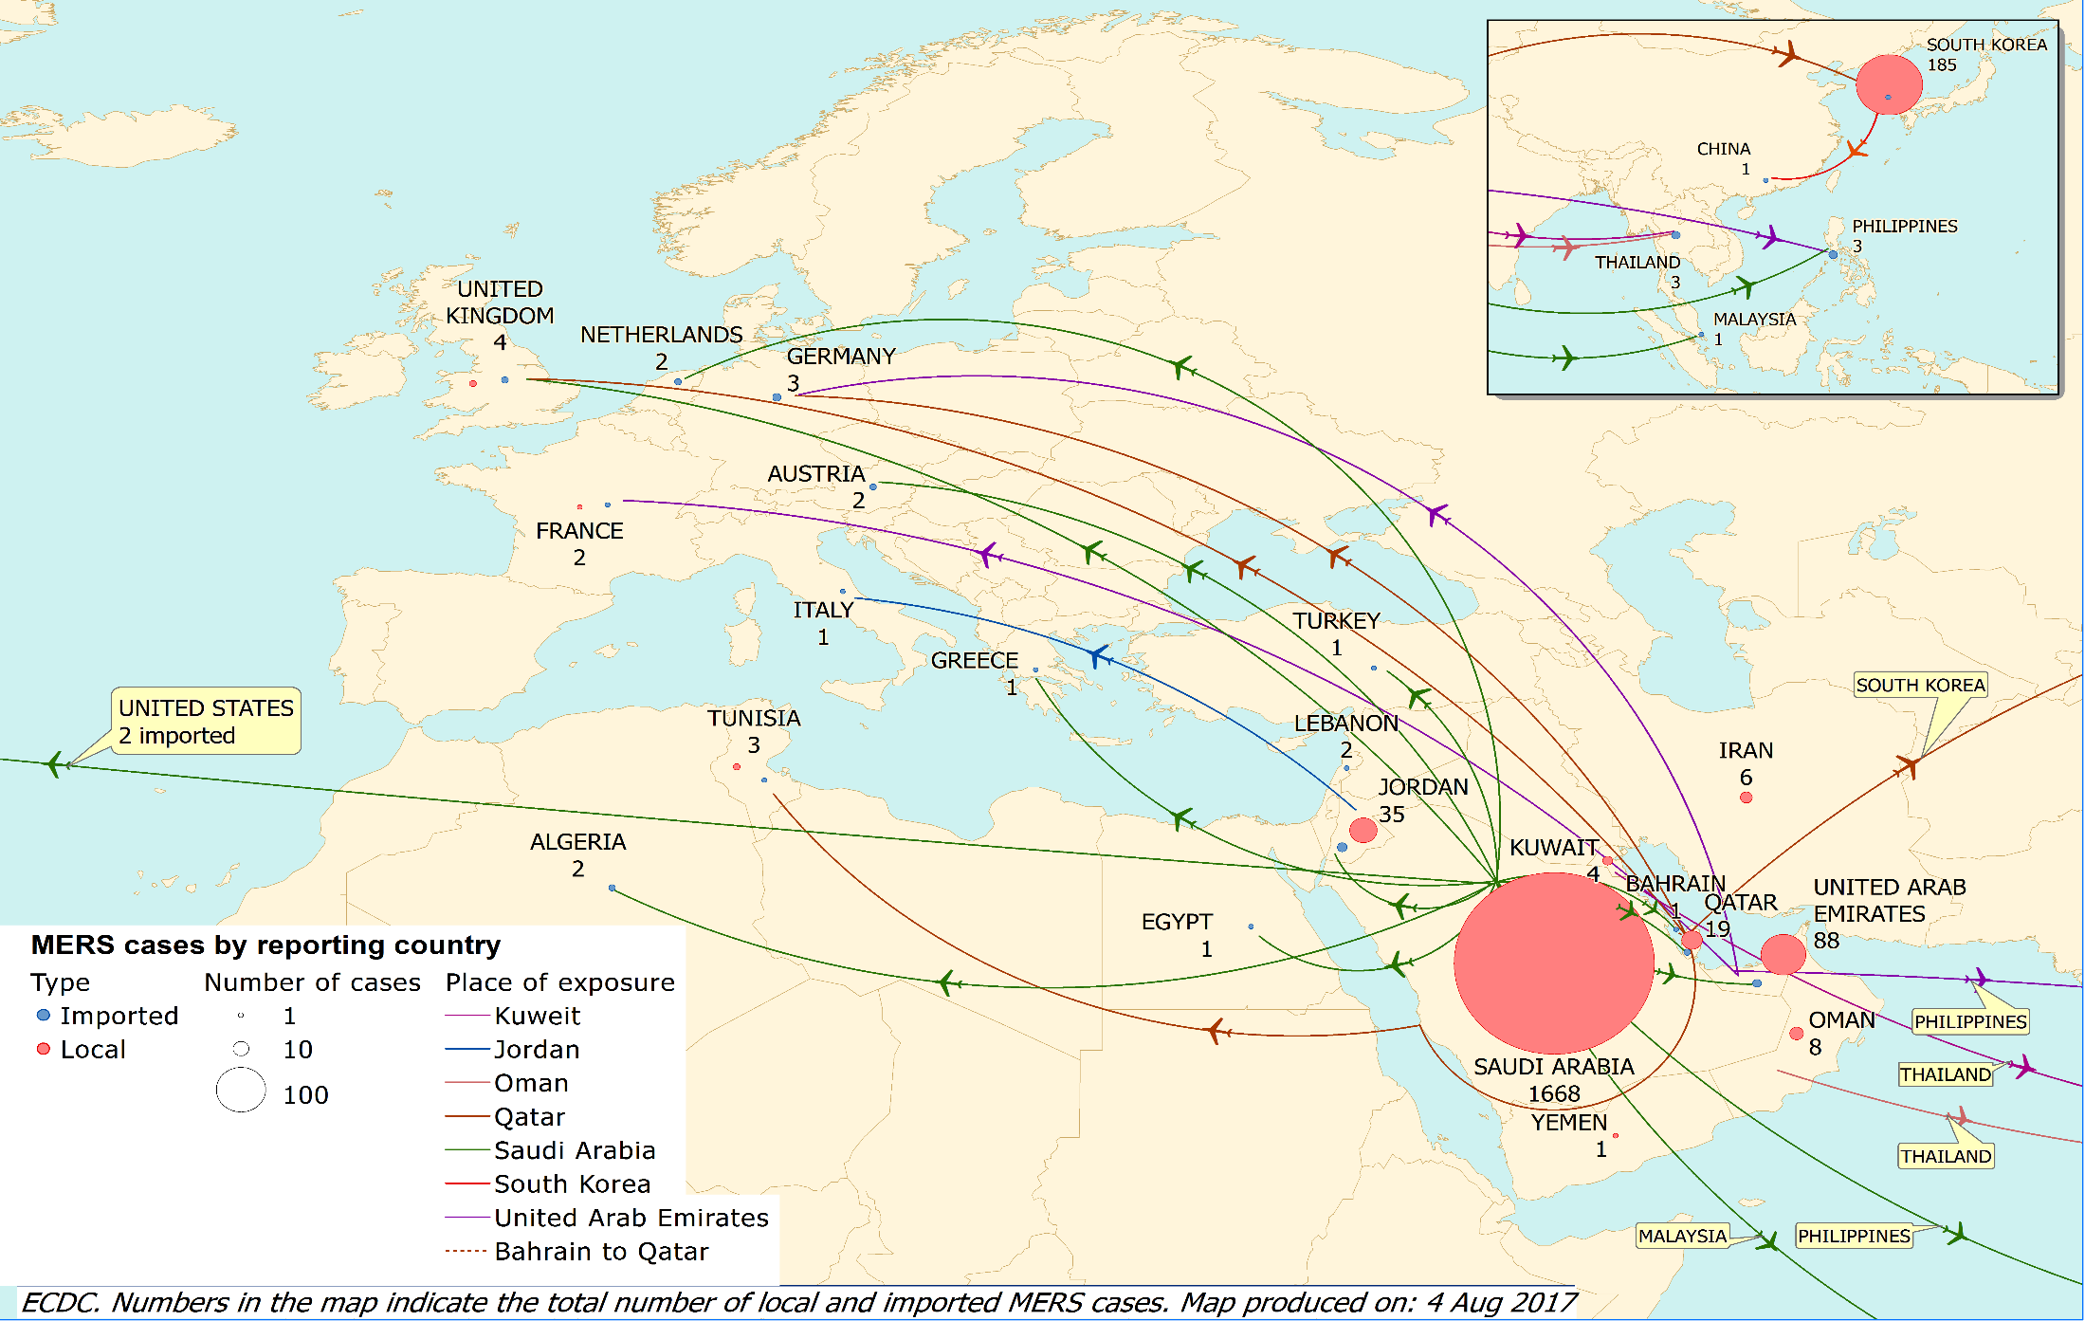
Distribution of confirmed cases of MERS-CoV by probable place of infection and place of reporting, March 2012 – 4 August 2017

