Slide 1
You are encouraged to reuse our maps and graphs for your own purposes and free to translate, provided the content is not altered and the source is acknowledged.
Either copy the images from the following slides or download directly from: ecdc.europa.eu/en/publications/surveillance_reports/Communicable-Disease-Threats-Report/Pages/cdtr.aspx
European Centre for Disease Prevention and Control
Reusable maps and graphs from ECDC Communicable Disease Threats Report, week 28, 2017

Slide 2
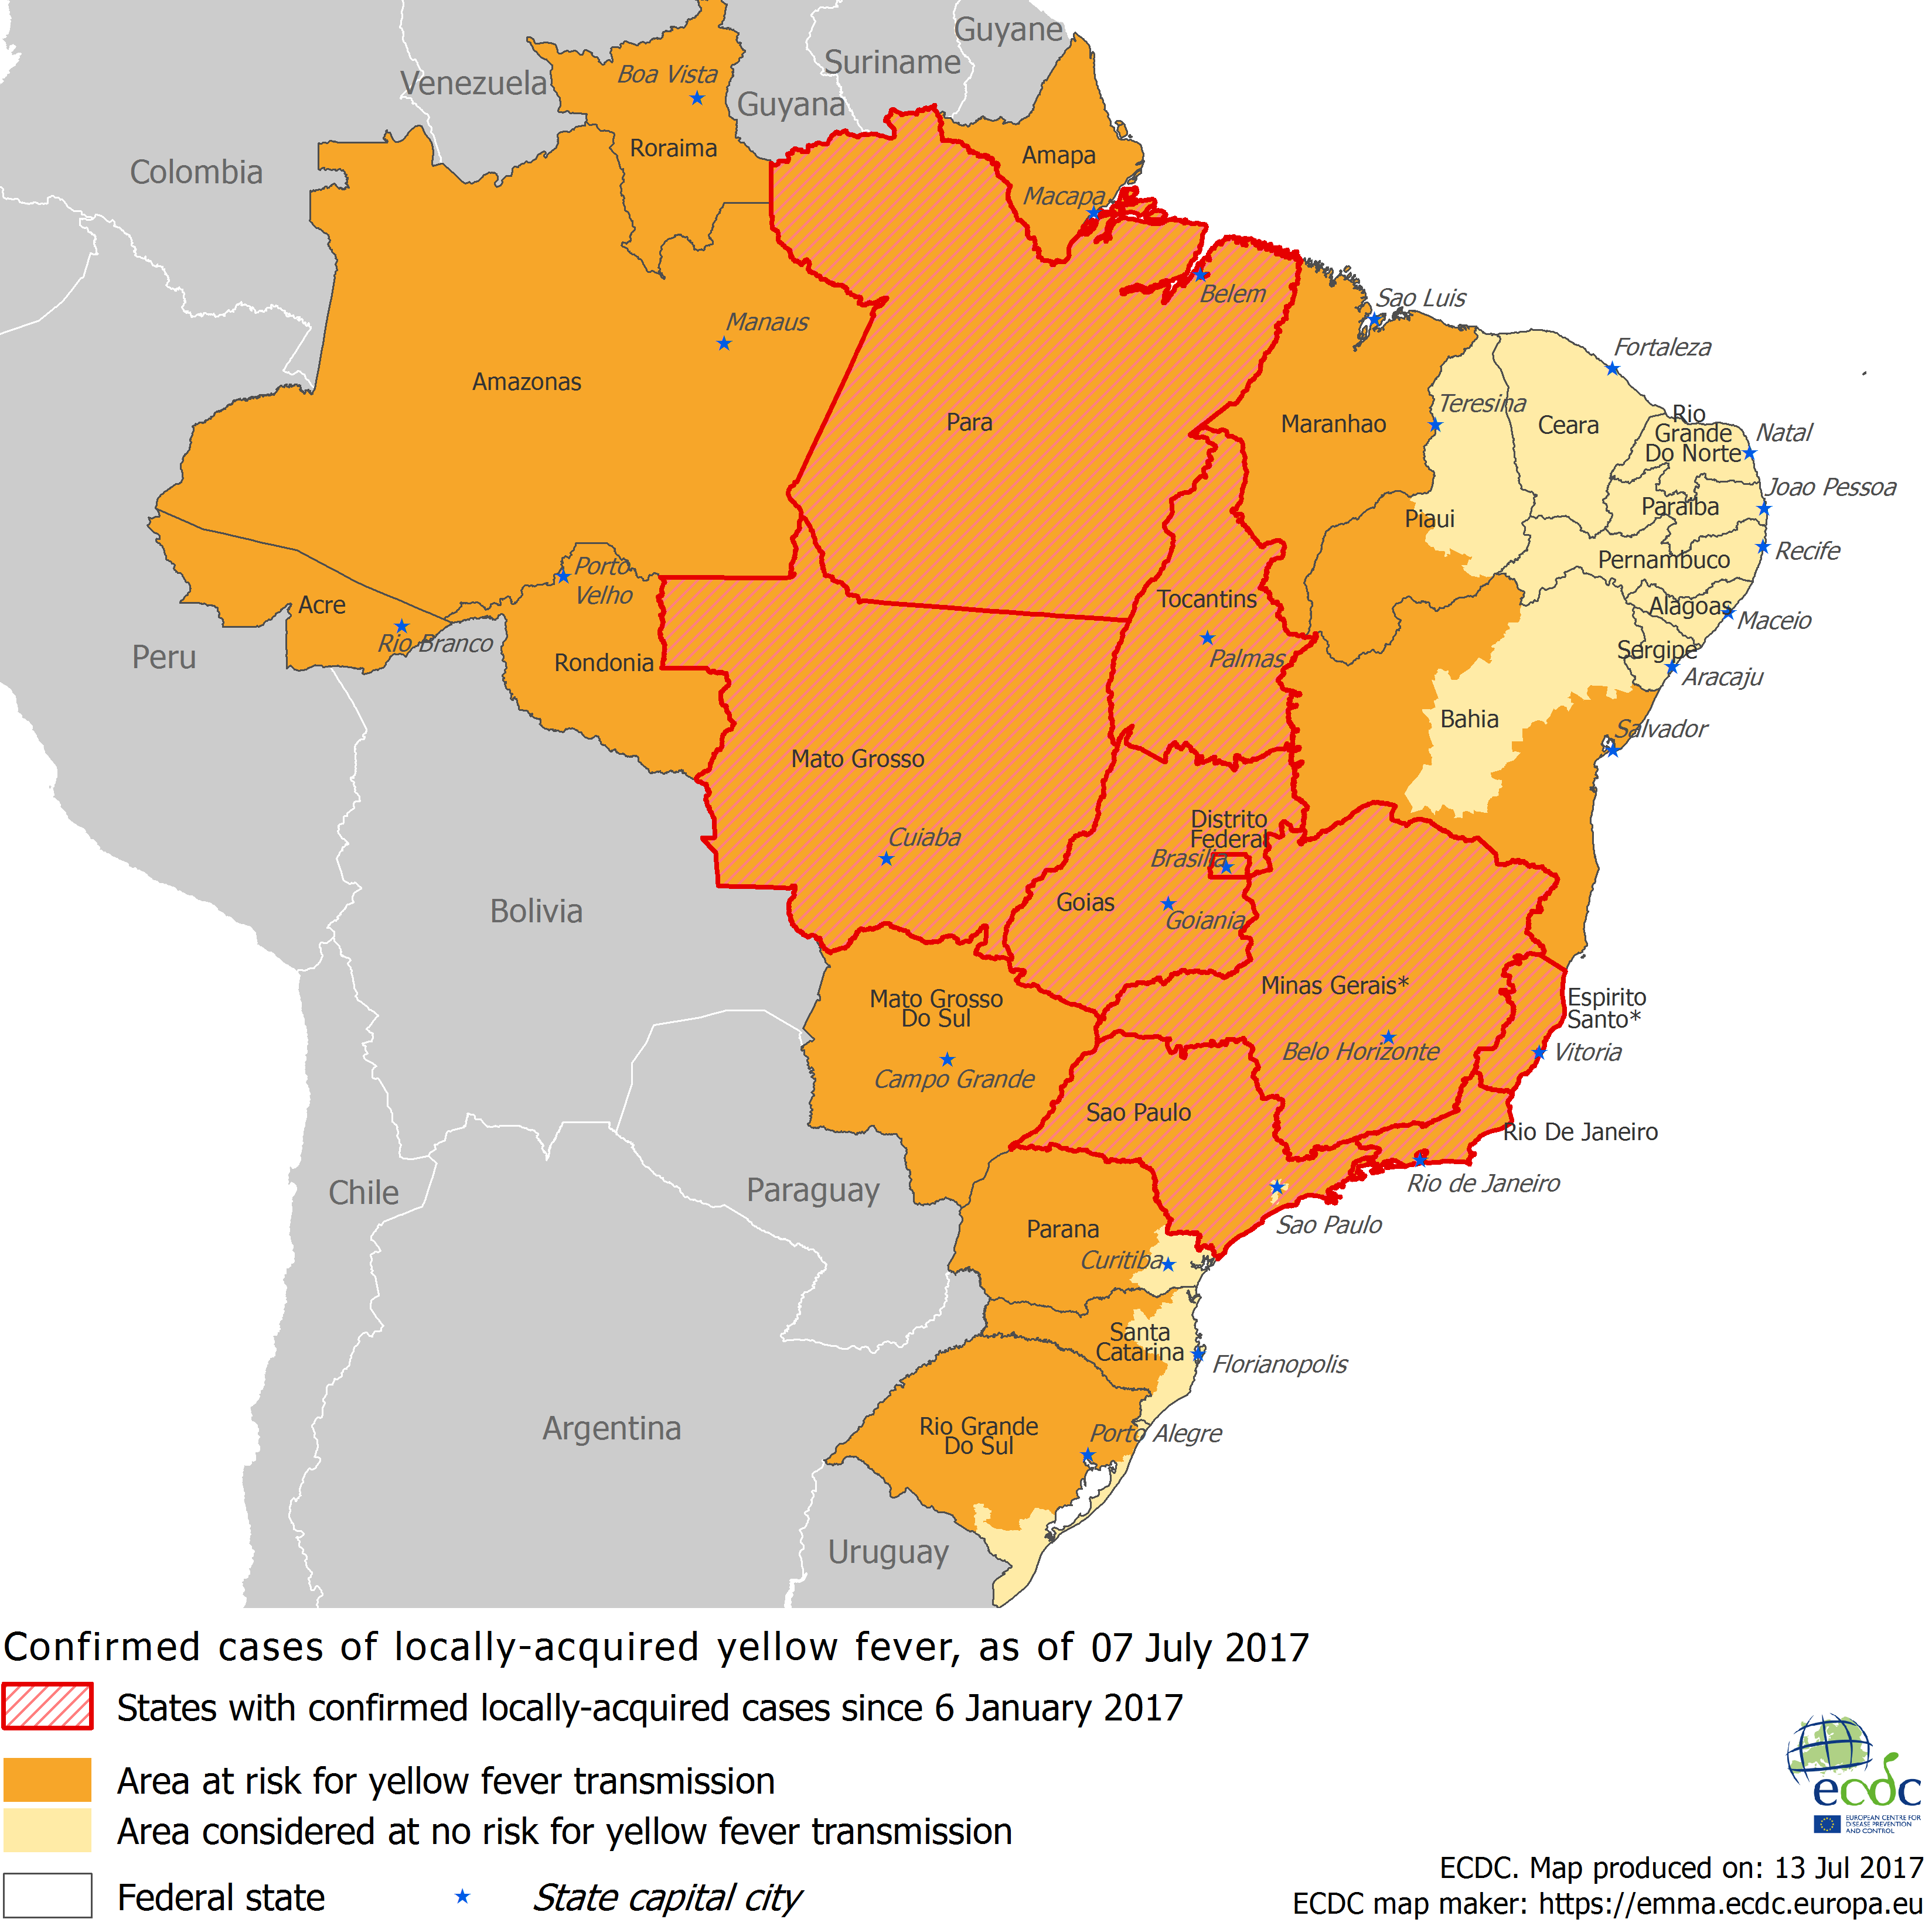
Distribution of confirmed human cases of yellow fever in Brazil by week of reporting
from 6 January to 7 July 2017

Slide 3
New measles cases per week of reporting, week 2008-1 to 2017-27, Romania

Slide 4
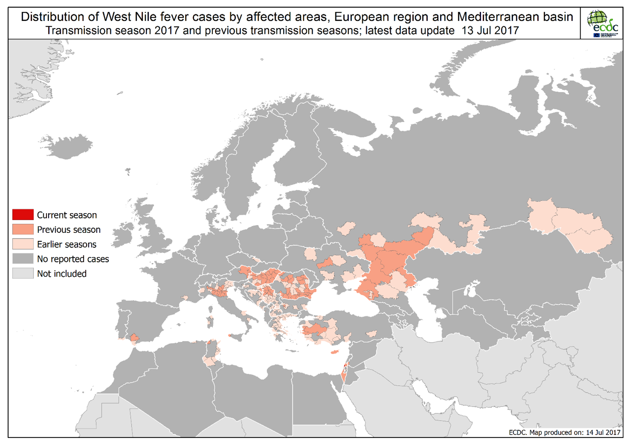

Slide 5
Distribution of confirmed cases of A(H7N9) by month of reporting, February 2013 to 13 July 2017**
** Data for July 2017 is incomplete

Slide 6
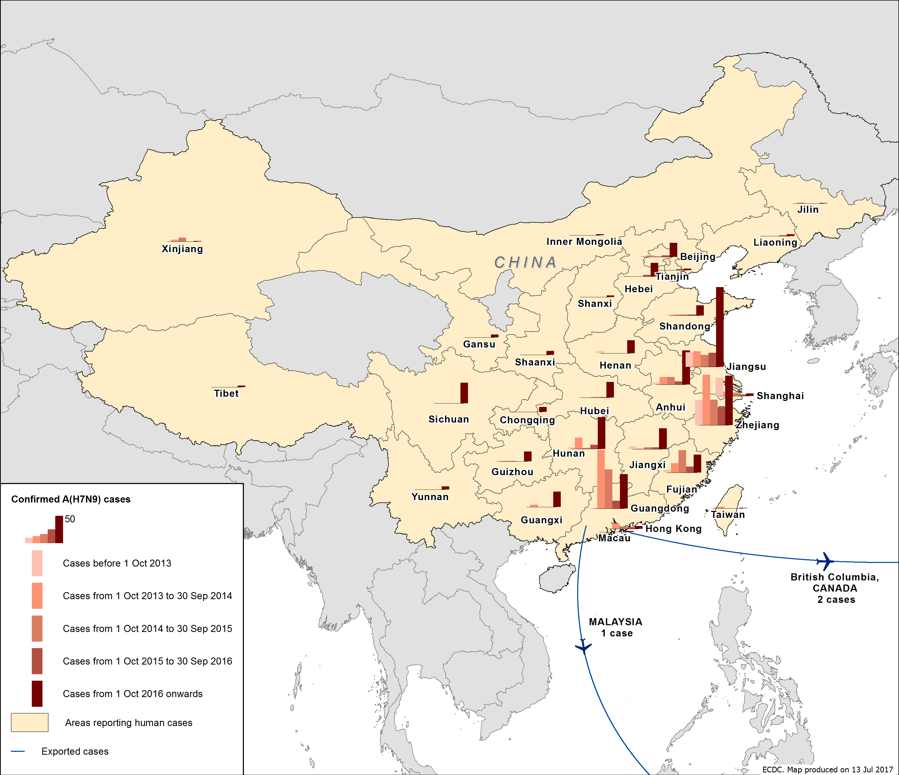
Distribution of confirmed cases of A(H7N9) by five waves, February 2013 to 13 July 2017

