Slide 1
Reusable maps and graphs from ECDC Communicable Disease Threats Report Week 24, 2023
You are encouraged to reuse our maps and graphs for your own purposes and are free to translate them, provided the content is not altered and the source is acknowledged.

Slide 2
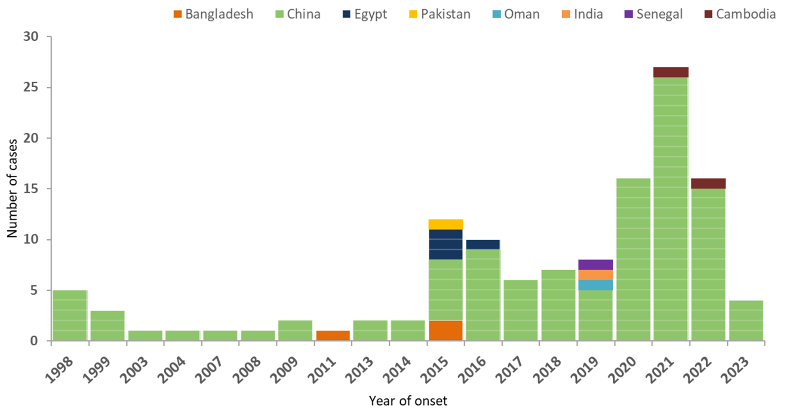
Distribution of confirmed human cases of avian influenza A(H9N2) virus infection by year of onset and country, 1998–2023 (n=125, updated 12 June 2023)

Slide 3
Twelve-month Chikungunya virus disease case notification rate per 100 000 population, June 2023-May 2023

Slide 4
Three-month Chikungunya virus disease case notification rate per 100 000 population, March-May 2023

Slide 5
Three-month dengue virus disease case notification rate per 100 000 population, March-May 2023

Slide 6
Twelve-month dengue virus disease case notification rate per 100 000 population, June 2022-May 2023

