Slide 1
Reusable maps and graphs from ECDC Communicable Disease Threats Report
Week 2, 2023
You are encouraged to reuse our maps and graphs for your own purposes and are free to translate them, provided the content is not altered and the source is acknowledged.

Slide 2
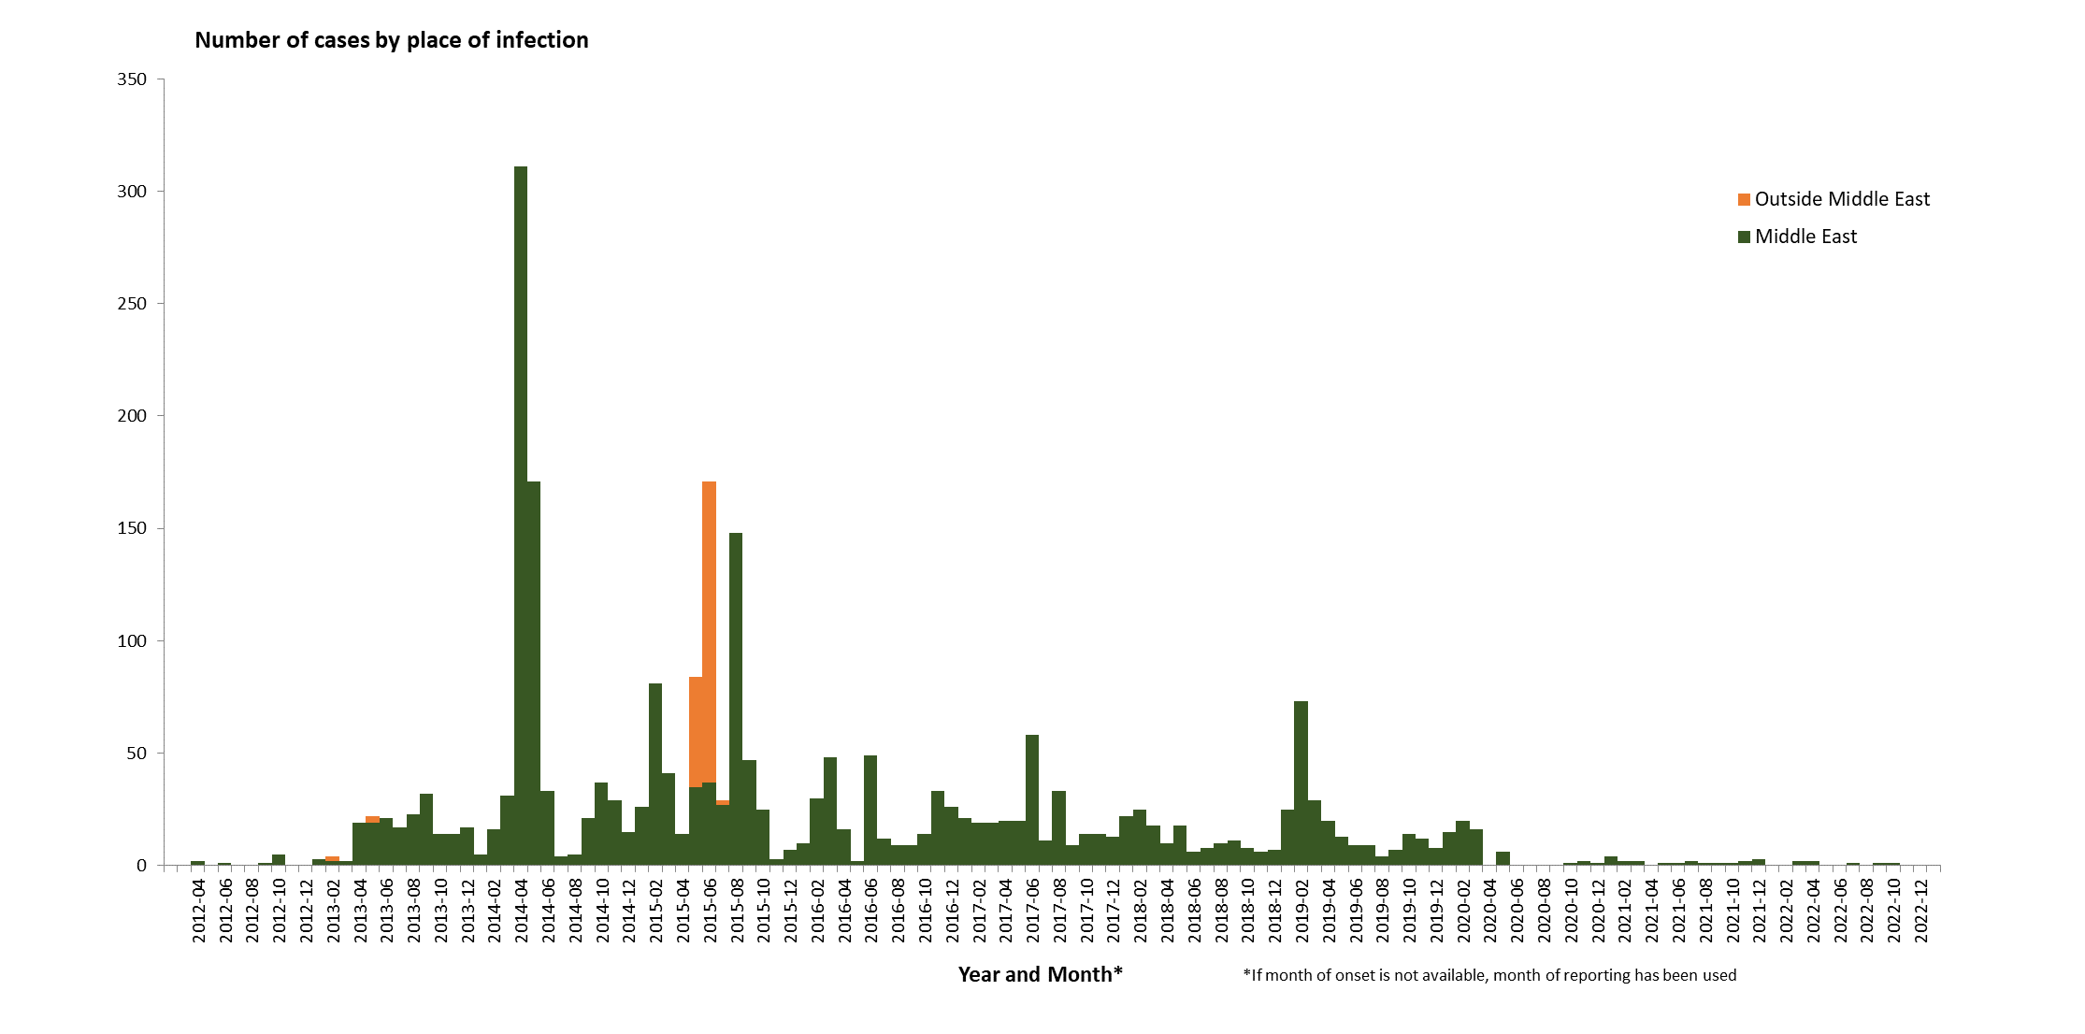
Distribution of confirmed cases of MERS-CoV by place of infection and month of onset, March 2012– January 2023

Slide 3
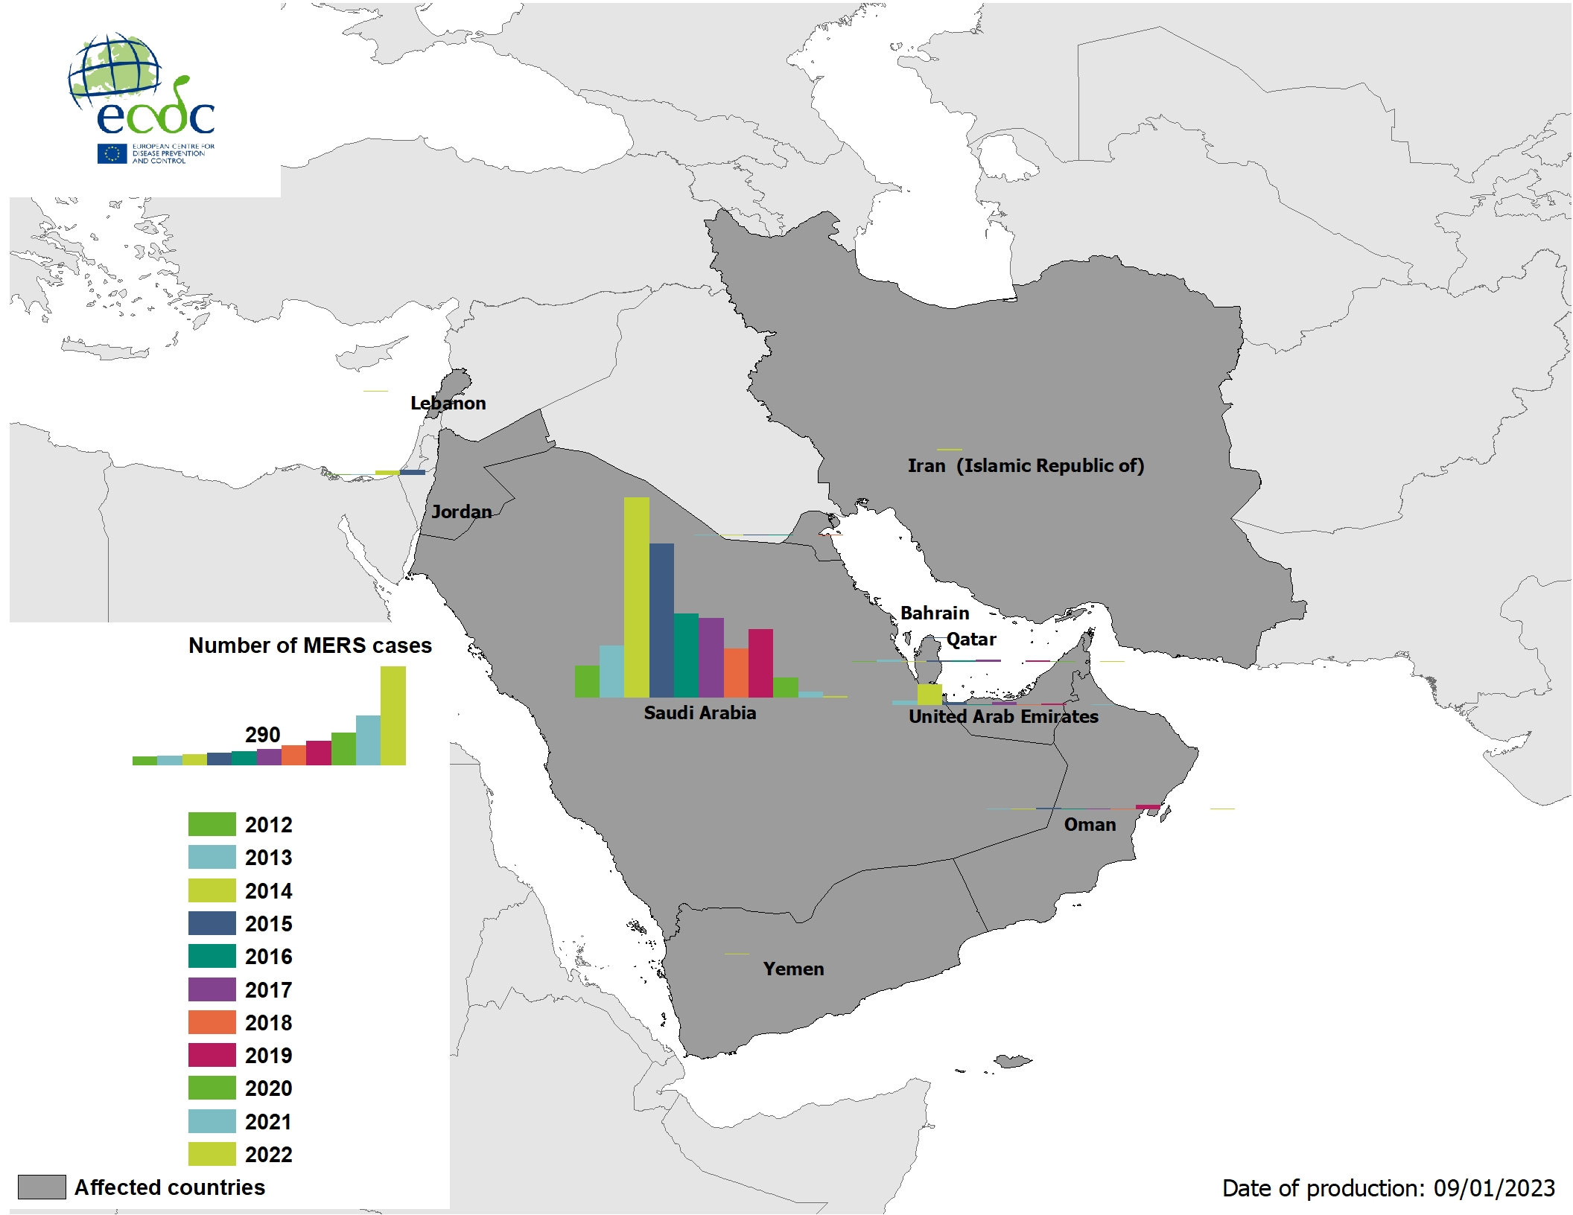
Geographical distribution of confirmed MERS-CoV cases by country of infection and year, from April 2012 to 9 January 2023

Slide 4
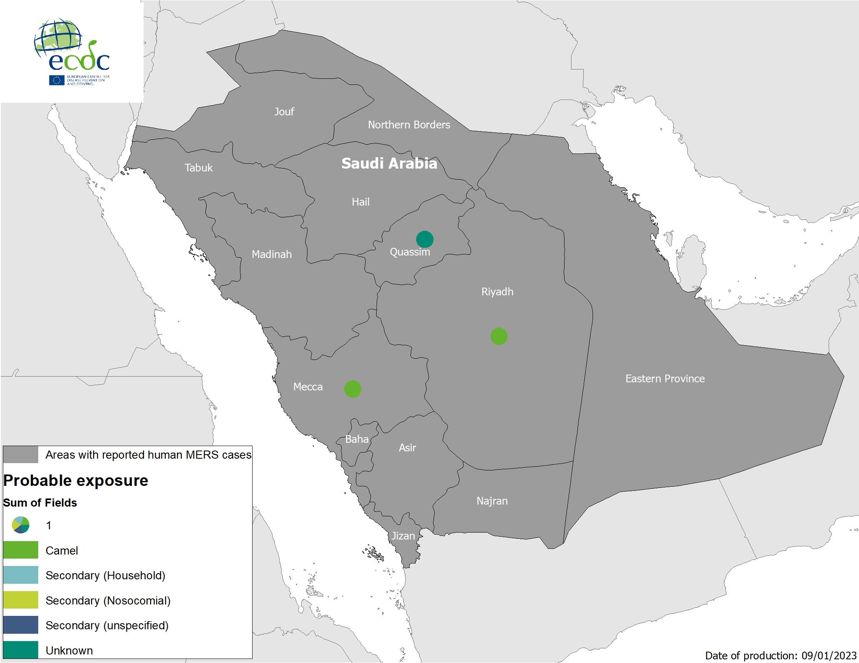
Geographical distribution of confirmed cases of MERS-CoV in Saudi Arabia by probable region of infection and exposure, from 1 January 2022 to 9 January 2023

Slide 5
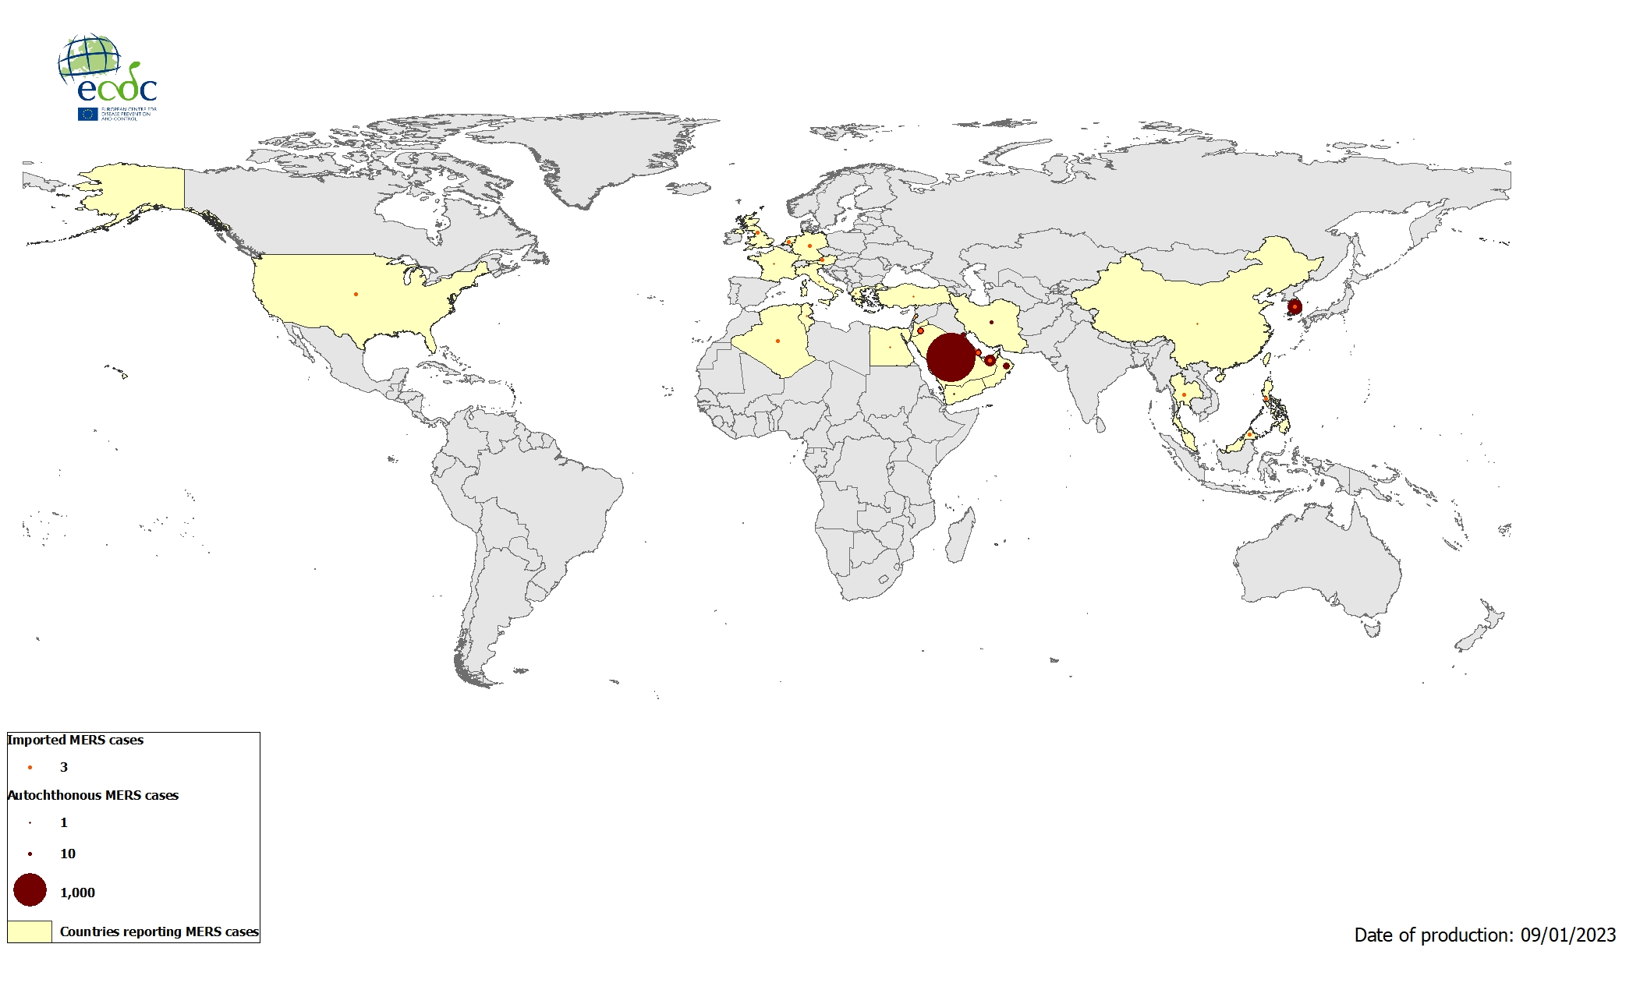
Geographical distribution of confirmed cases of MERS-CoV by reporting country, April 2012 - January 2023

