Slide 1
Reusable maps and graphs from ECDC Communicable Disease Threats Report Week 51, 2022
You are encouraged to reuse our maps and graphs for your own purposes and are free to translate them, provided the content is not altered and the source is acknowledged.

Slide 2
Geographical distribution of cases of Sudan virus disease (SVD) in Uganda, 2022

Slide 3
Ebola disease cases reported in Uganda in 2022, by week of reporting

Slide 4
Distribution of confirmed human cases of avian influenza A (H9N2) virus infection by year of onset and country, 1998–2022 (updated on 20 December, n=115)

Slide 5
Distribution of human cases of avian influenza A (H5N1) virus infection by year of onset and country, 2003–2022 (updated on 20 December, n=868)

Slide 6
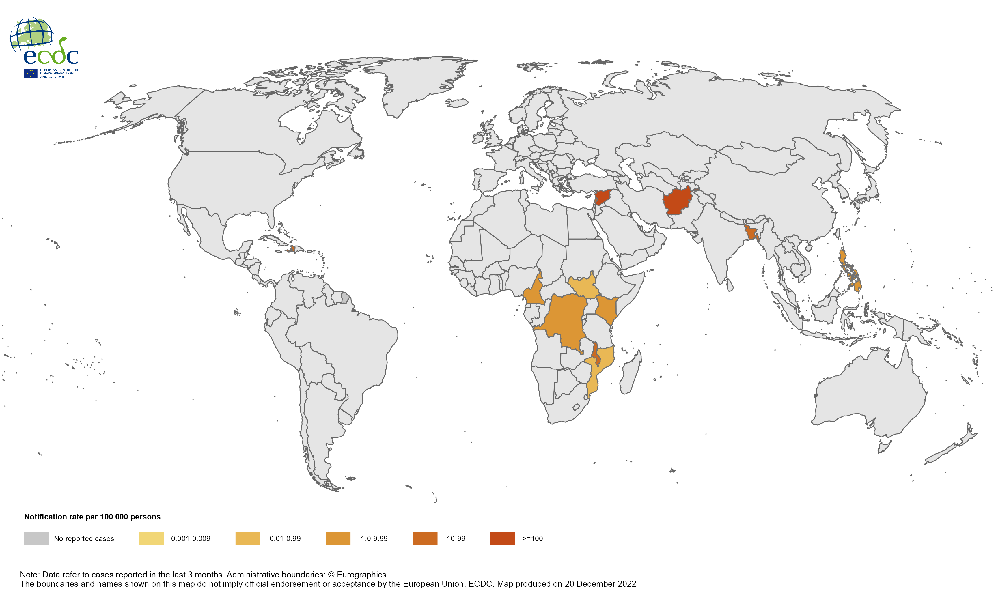
Geographical distribution of cholera cases reported worldwide, October 2022 – December 2022

Slide 7
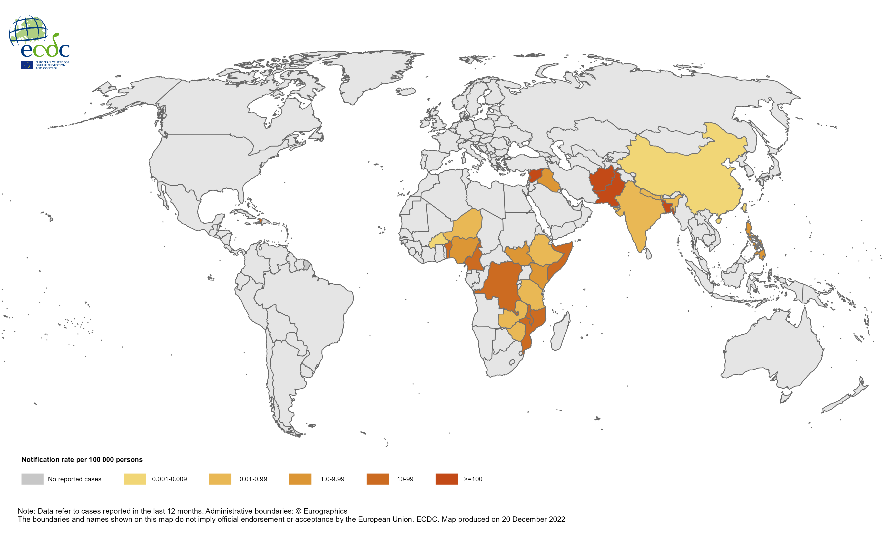
Geographical distribution of cholera cases reported worldwide, January 2022 – December 2022

Slide 8
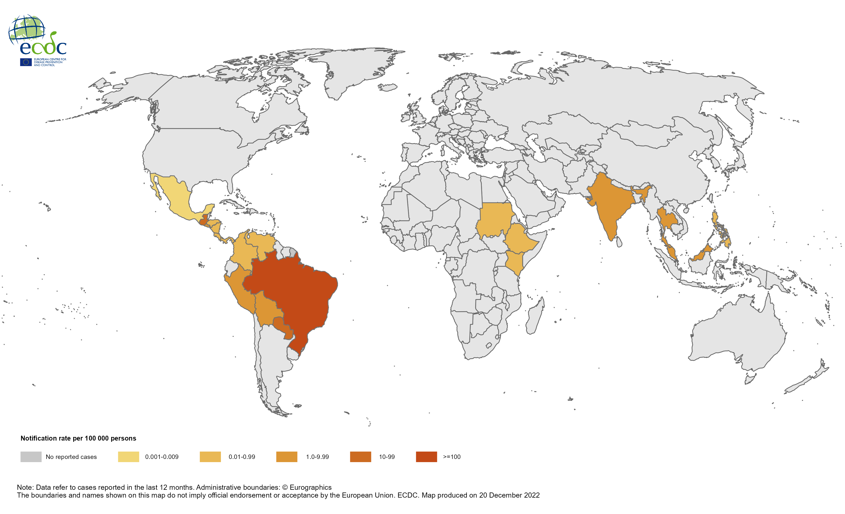
Twelve-month chikungunya virus disease case notification rate per 100 000 persons, January 2022 – December 2022

Slide 9
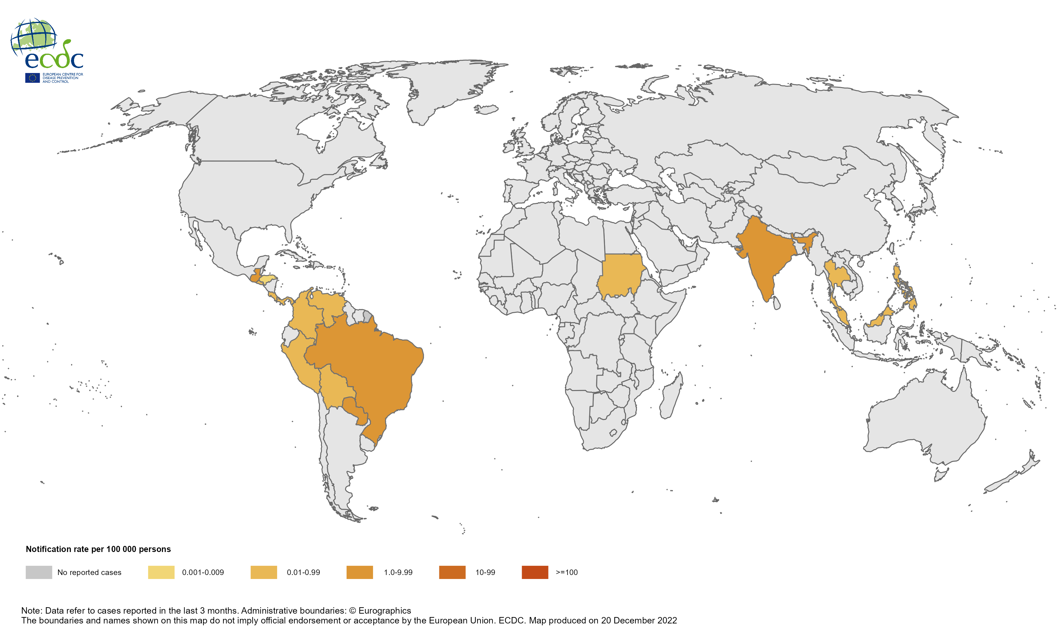
Three-month chikungunya virus disease case notification rate per 100 000 persons, October 2022 – December 2022

Slide 10
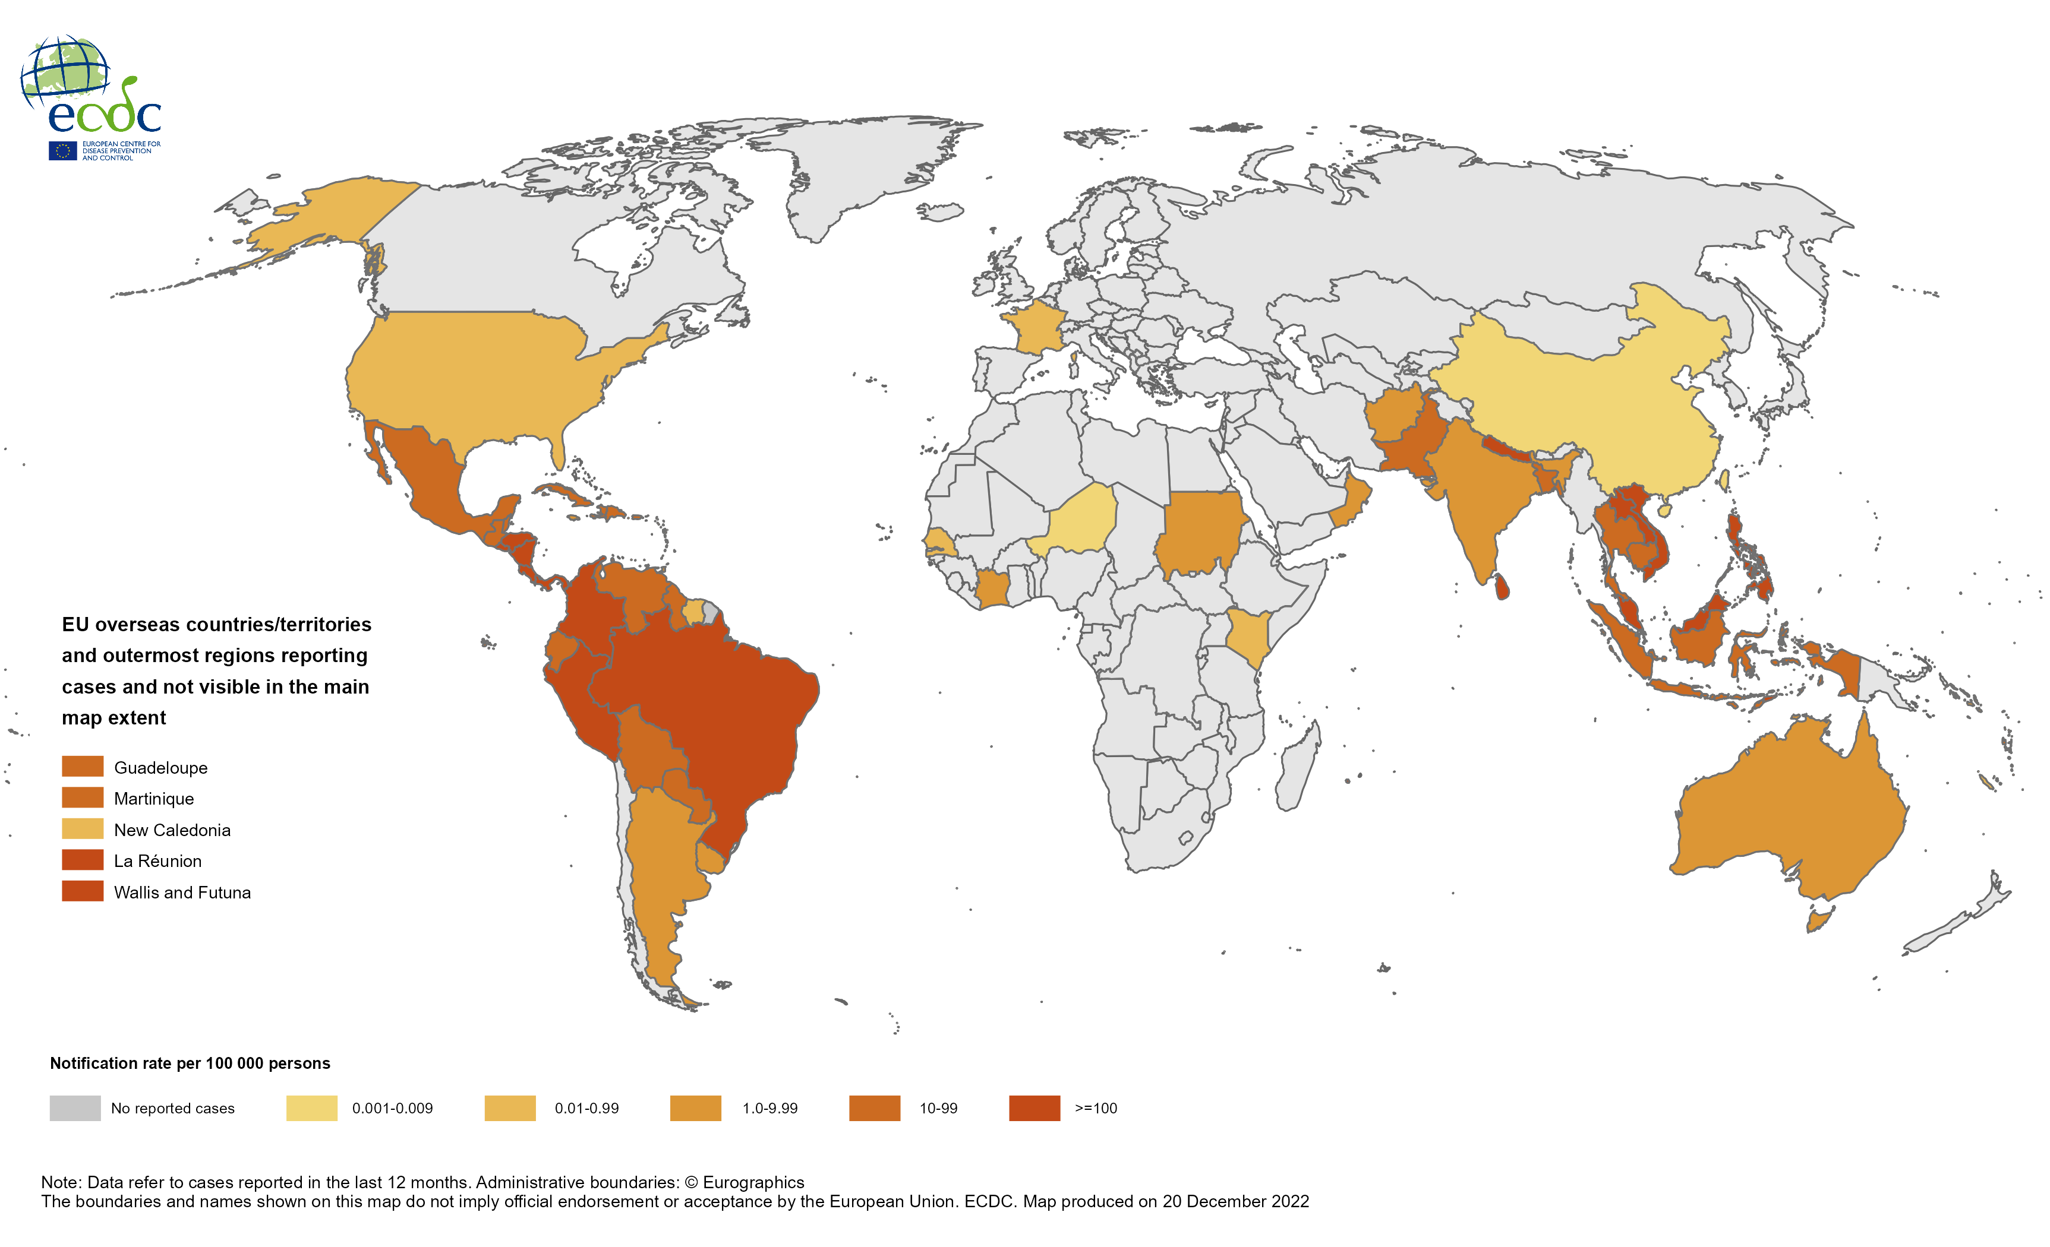
Twelve-month dengue case notification rate per 100 000 persons, January 2022 – December 2022

Slide 11
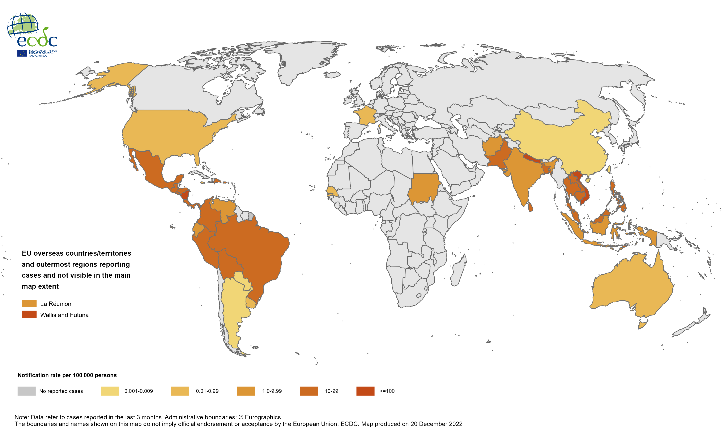
Three-month dengue case notification rate per 100 000 persons, October 2022 – December 2022

