Slide 1
You are encouraged to reuse our maps and graphs for your own purposes and free to translate, provided the content is not altered and the source is acknowledged. Either copy the images from the following slides or download directly from: ecdc.europa.eu/en/publications/surveillance_reports/Communicable-Disease-Threats-Report/Pages/cdtr.aspx
European Centre for Disease Prevention and Control
Reusable maps and graphs from ECDC Communicable Disease Threats Report, week 40, 2017

Slide 2
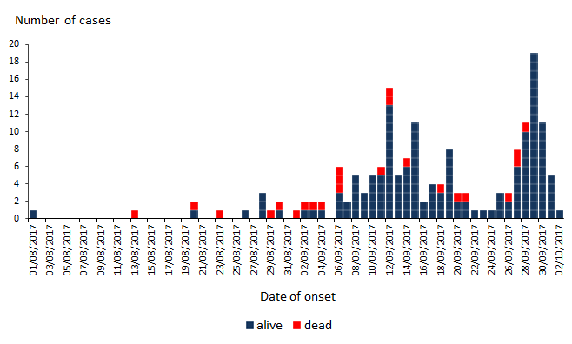
Distribution of plague cases and deaths by date of onset, 1 August – 3 October 2017, Madagascar (n=172 cases where the date of onset is known)

Slide 3
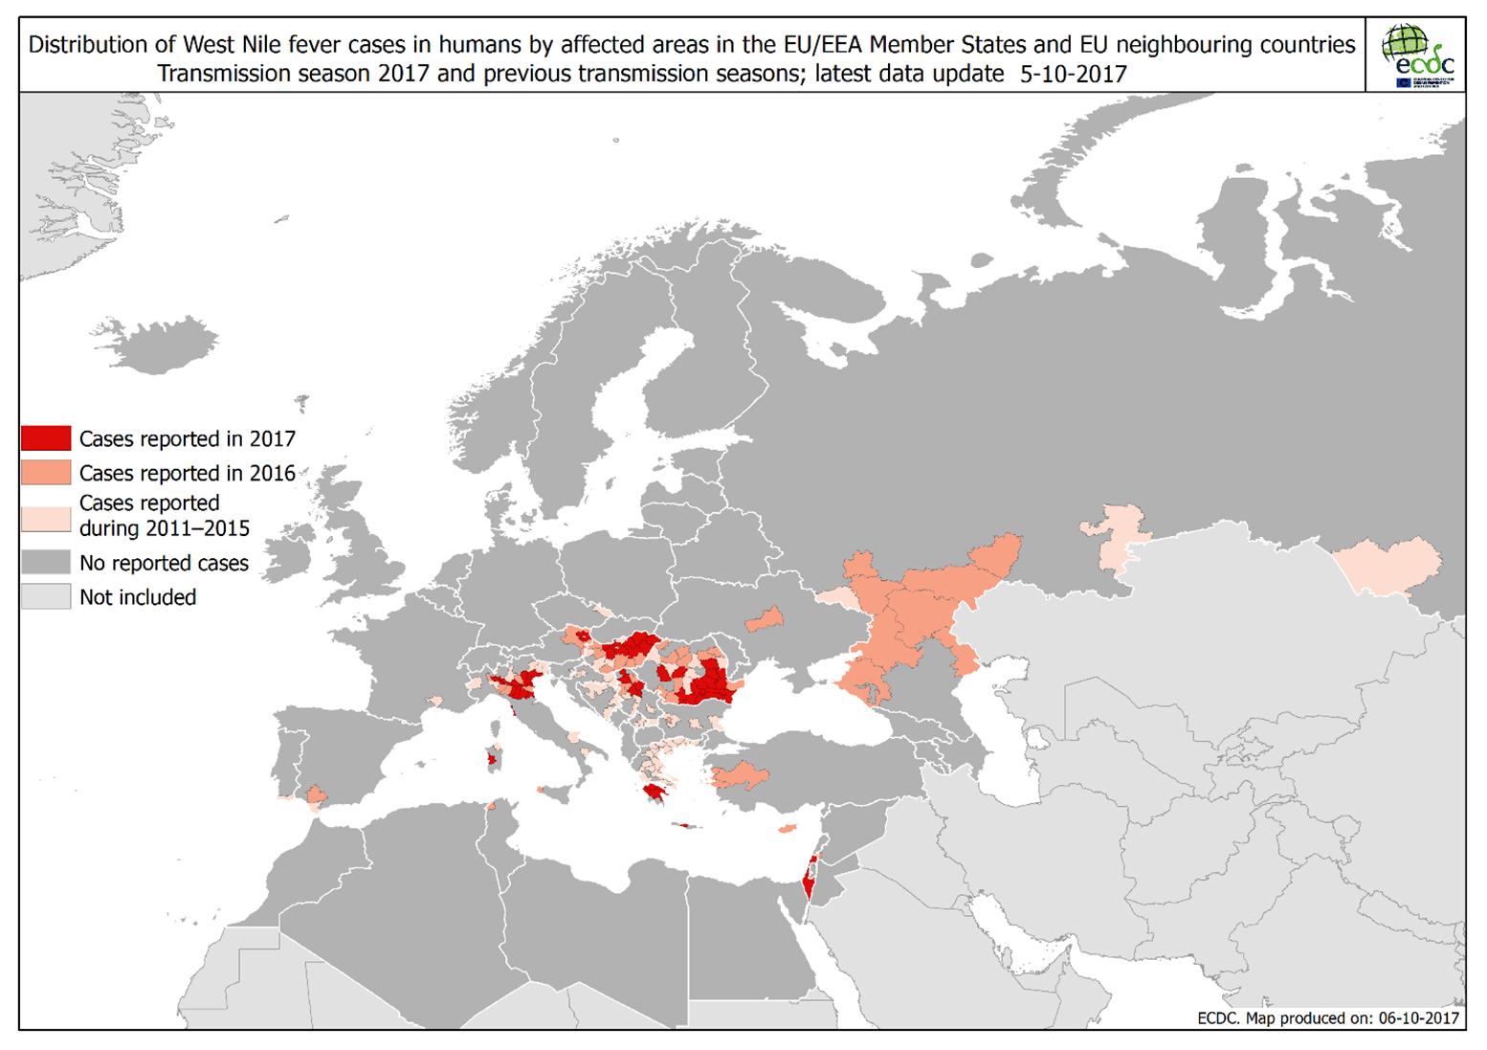

Slide 4
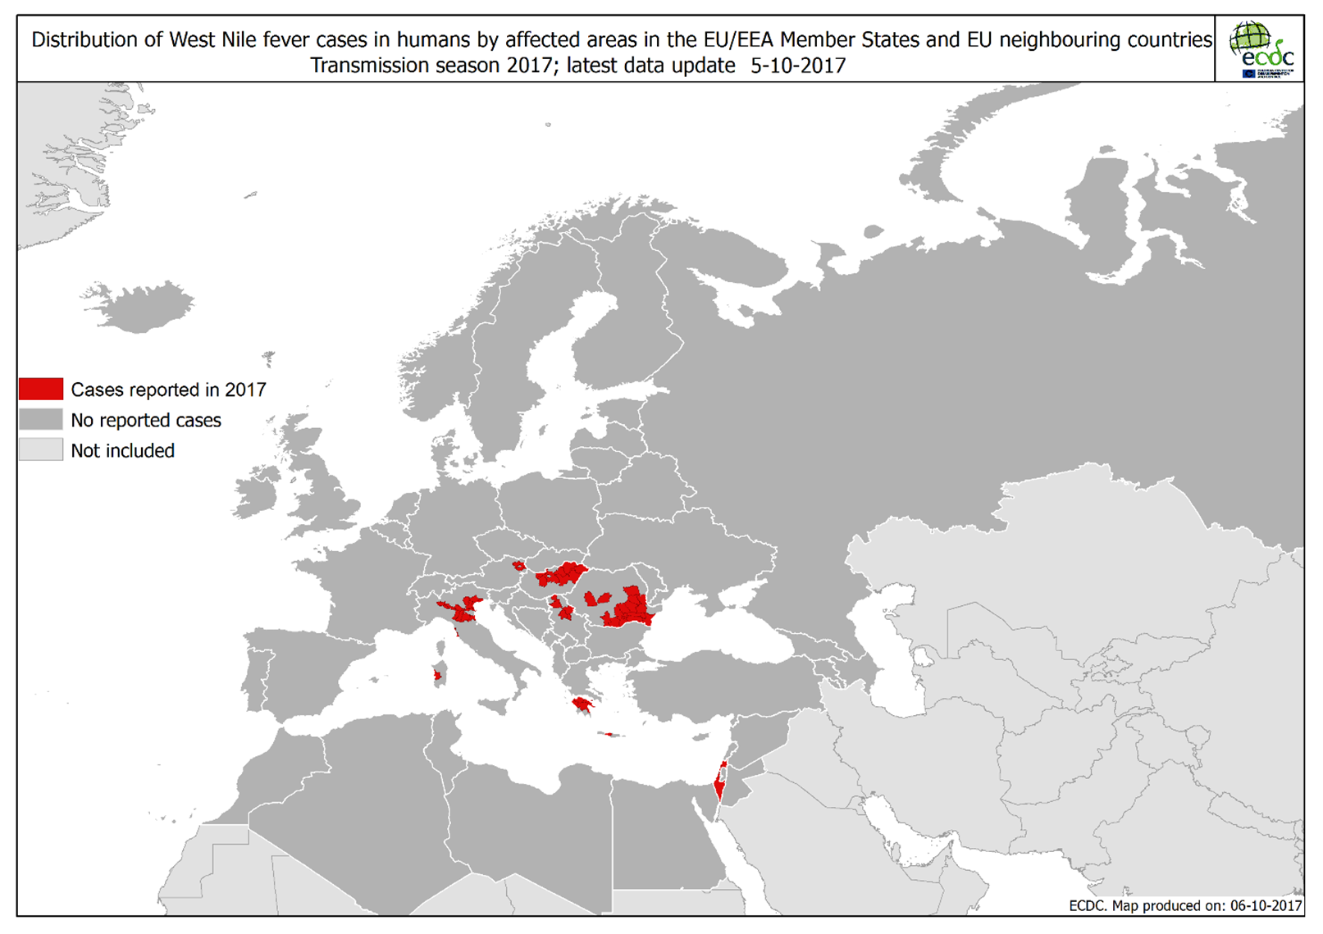

Slide 5
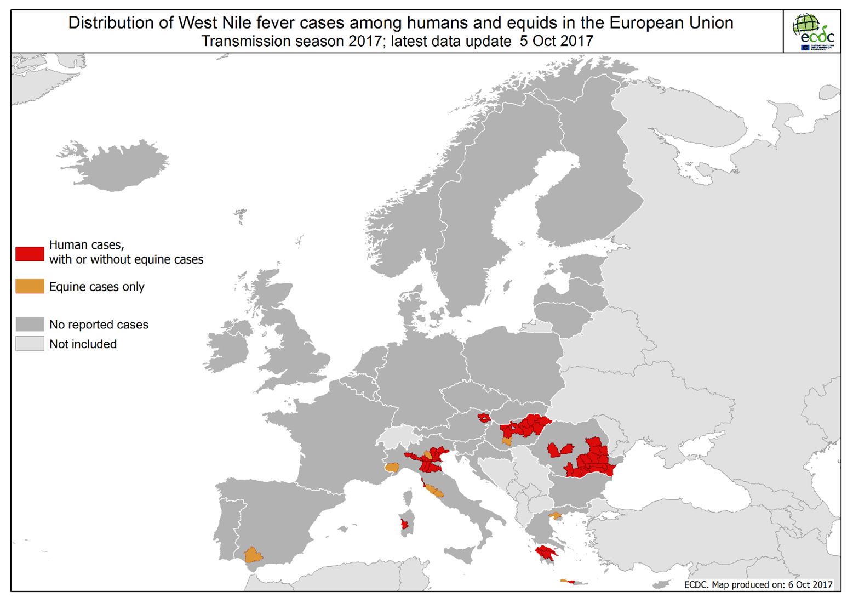

Slide 6
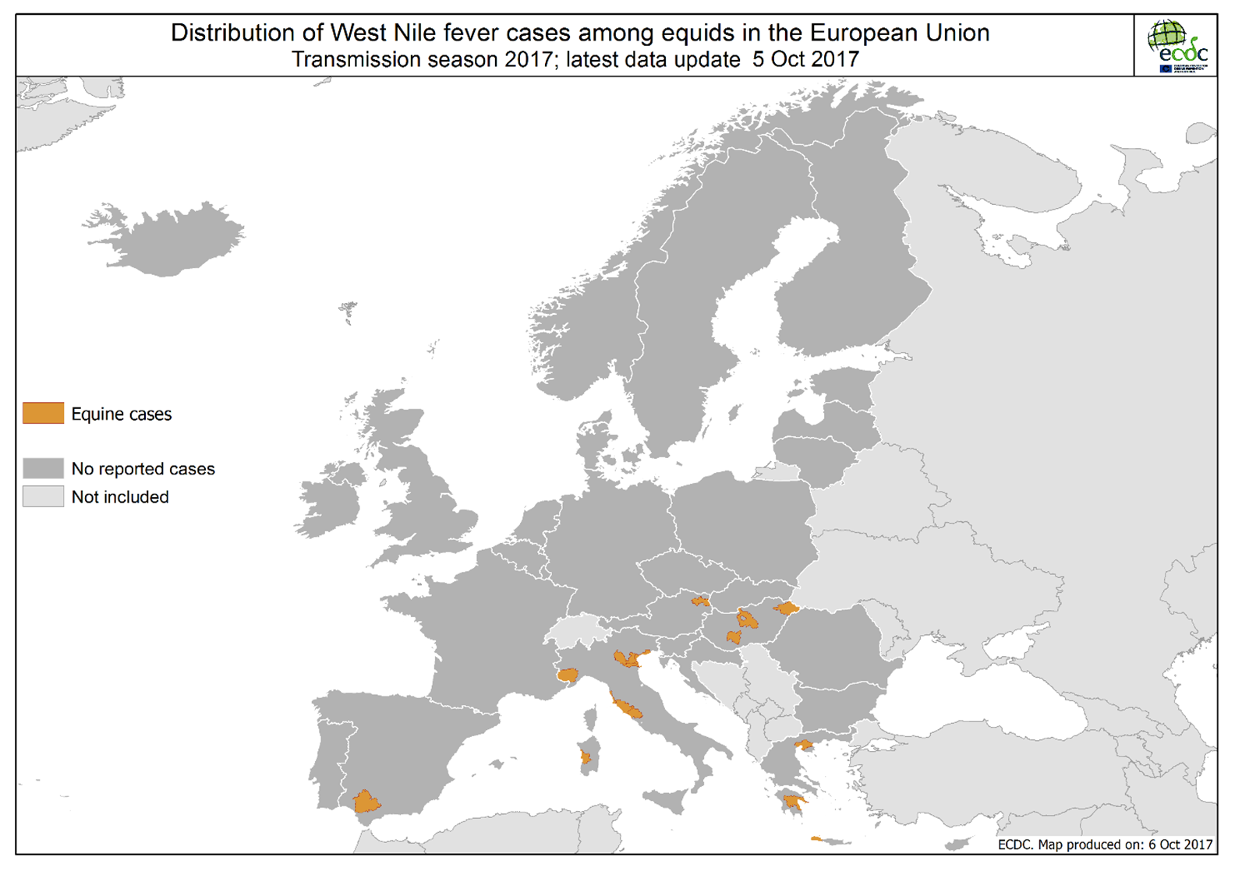

Slide 7
Distribution of confirmed cases of A(H7N9) by five seasons, February 2013 to 3 October 2017

Slide 8
Distribution of confirmed cases of A(H7N9) by first available month, February 2013 to 3 October 2017

Slide 9
Distribution of confirmed cases of MERS-CoV by country of probable infection and country of report March 2012 to 3 October 2017

Slide 10
Distribution of confirmed cases of MERS-CoV by first available month and region, March 2012 to 30 September 2017

Slide 11
Distribution of hepatitis A outbreak-confirmed cases, by month of onset and genetic sequence, June 2016 to September 2017, as of 27 September 2017, EU/EEA (n=2 863*)
* Where date of onset was unavailable we used date of sampling or date of receipt by the reference laboratory. An additional 16 cases with missing dates are not included. A total of 308 additional cases have sequencing pending in Spain. Countries included: Austria, Belgium, Denmark, Estonia, Finland, France, Germany, Greece, Ireland, Italy, Latvia, Luxembourg, Malta, the Netherlands, Norway, Portugal, Slovenia, Spain, Sweden and the United Kingdom. Outbreak-confirmed cases for Germany, Scotland and Spain are reported until June 2017.

Slide 12
Distribution of hepatitis A cases by gender and male-to-female ratio, January 2012 to August 2017, as of 27 September 2017, EU/EEA*
* Where date of onset was unavailable we used date of sampling or date of receipt by the reference laboratory. The 2017 data from the UK are only for England and Wales and data from April are provisional. Data from Belgium are missing for 2015 and 2016. Countries included: Austria, Belgium, the Czech Republic, Denmark, Estonia, Finland, France, Germany, Greece, Ireland, Iceland, Italy, Luxembourg, Malta, the Netherlands, Slovenia, Spain, Sweden and the United Kingdom.

