Slide 1
Reusable maps and graphs from ECDC Communicable Disease Threats Report
Week 26, 2023
You are encouraged to reuse our maps and graphs for your own purposes and are free to translate them, provided the content is not altered and the source is acknowledged.

Slide 2
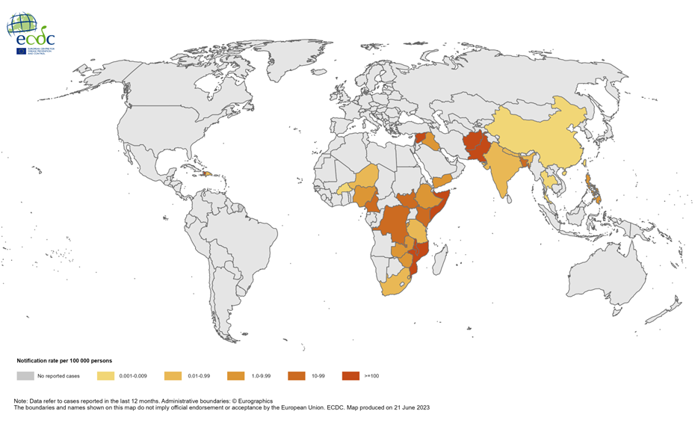
Geographical distribution of cholera cases reported worldwide from July 2022 to June 2023

Slide 3
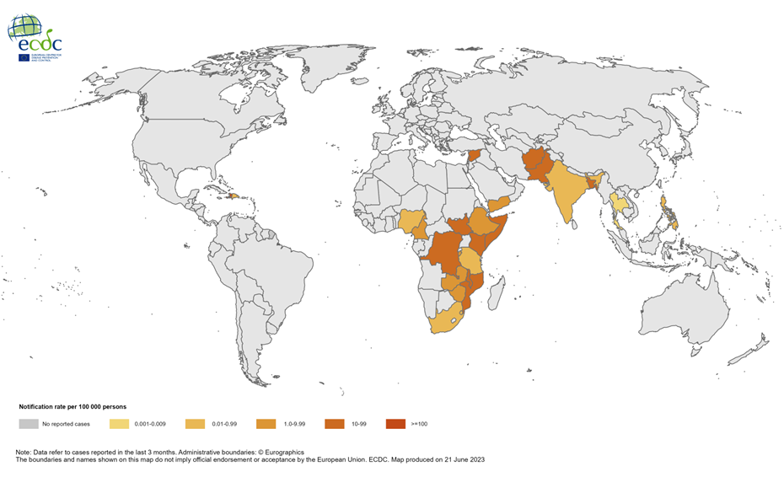
Geographical distribution of cholera cases reported worldwide from April 2023 to June 2023

