Slide 1
Chlamydia
In 2016, 403 807 cases of chlamydia infection were reported in 26 EU/EEA Member States.
The overall notification rate was 184 per 100 000 persons.
Notification rates of chlamydia infection varied considerably across Europe, with the highest country-specific rates more than 5 000 times the country with the lowest rates. This is mainly a reflection of the differences in chlamydia testing and case finding rather than real differences in chlamydia prevalence.
Notification rates continue to be highest among young adult women and heterosexuals.
The overall trend appears stable over recent years, both at the European and at the country level.
Source: European Centre for Disease Prevention and Control. Chlamydia infection. In: ECDC. Annual Epidemiological Report for 2016. Stockholm: ECDC; 2018. Online: http://bit.ly/AERch16

Slide 2
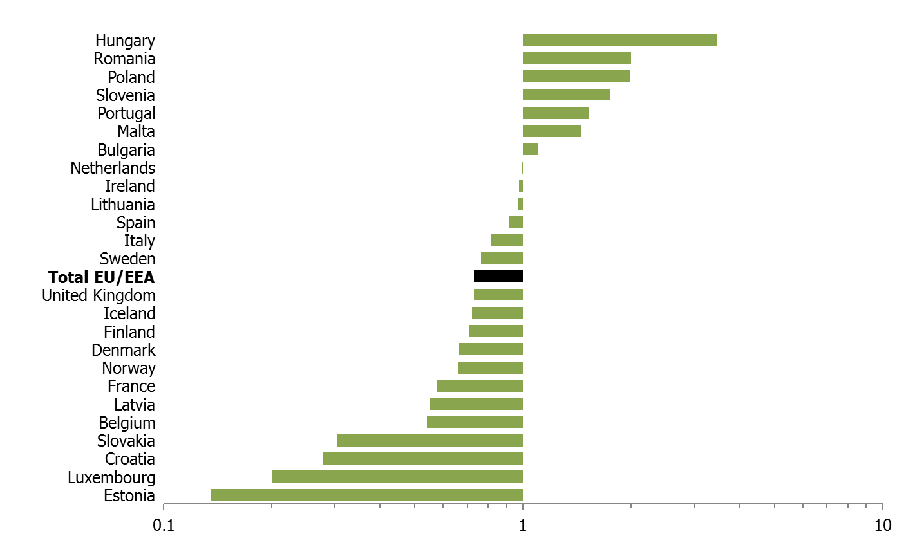
Chlamydia male-to-female ratio, 25 EU/EEA countries, 2016
Source: European Centre for Disease Prevention and Control. Chlamydia infection. In: ECDC. Annual Epidemiological Report for 2016. Stockholm: ECDC; 2018. Online: http://bit.ly/AERch16

Slide 3
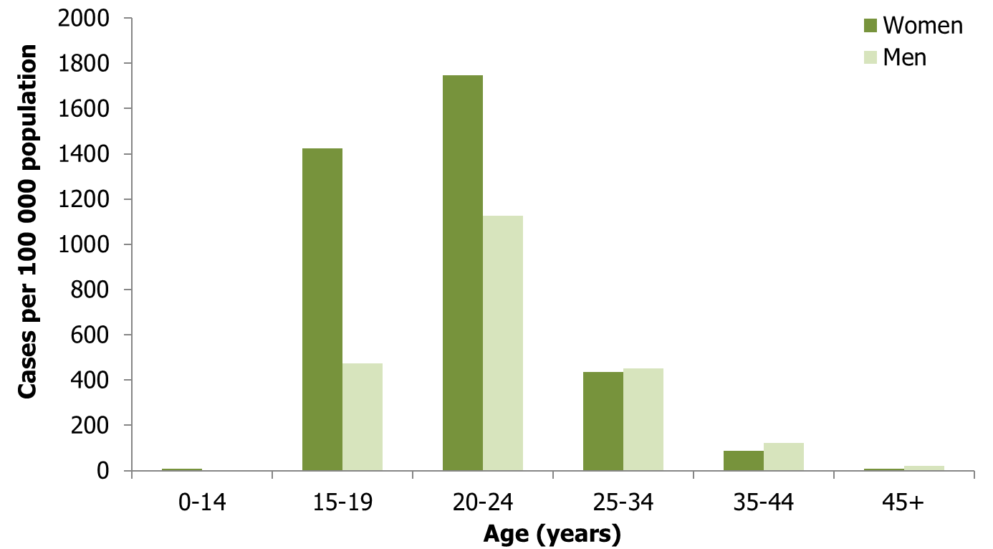
Chlamydia cases per 100 000 population, by age group and gender, EU/EEA, 2016
Source: Country reports from Bulgaria, Croatia, Cyprus, Denmark, Estonia, Finland, Iceland, Ireland, Latvia, Lithuania, Luxembourg, Malta, Norway, Portugal, Romania, Slovakia, Slovenia, Sweden and the United Kingdom.
Source: European Centre for Disease Prevention and Control. Chlamydia infection. In: ECDC. Annual Epidemiological Report for 2016. Stockholm: ECDC; 2018. Online: http://bit.ly/AERch16

Slide 4
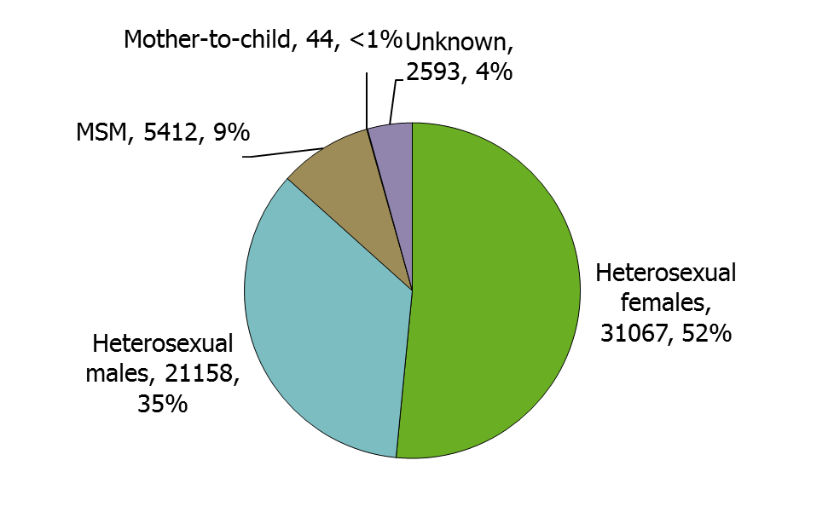
Chlamydia infections by transmission category and gender (n=60 274), EU/EEA, 2016
Data from countries reporting transmission category for more than 60% of cases: Hungary, Latvia, Lithuania, Malta, the Netherlands, Portugal, Romania, Slovakia, Slovenia and Sweden
Source: European Centre for Disease Prevention and Control. Chlamydia infection. In: ECDC. Annual Epidemiological Report for 2016. Stockholm: ECDC; 2018. Online: http://bit.ly/AERch16

Slide 5
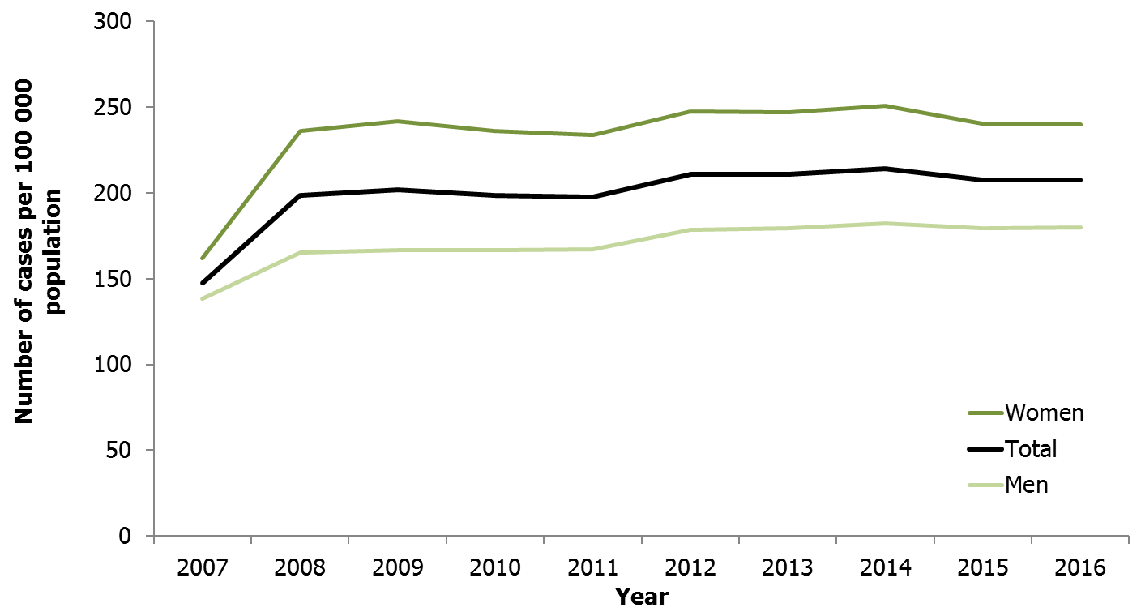
Confirmed chlamydia cases per 100 000 population by year, EU/EEA countries reporting consistently, 2007−2016
Source: Country reports from Cyprus, Denmark, Estonia, Finland, Iceland, Ireland, Latvia, Malta, Norway, Poland, Romania, Slovakia, Slovenia, Sweden, and the United Kingdom.
Source: European Centre for Disease Prevention and Control. Chlamydia infection. In: ECDC. Annual Epidemiological Report for 2016. Stockholm: ECDC; 2018. Online: http://bit.ly/AERch16
Notes:
Note: In 2008, the United Kingdom started including data from a screening programme targeted at 15–24-year-olds in England. This programme offers community-based testing services outside of STI clinics and resulted in a large increase of chlamydia diagnoses from 2008 onwards.

