Slide 1
You are encouraged to reuse our maps and graphs for your own purposes and free to translate, provided the content is not altered and the source is acknowledged.
Reusable maps and graphs from ECDC Communicable Disease Threats Report
Week 39, 2018

Slide 2
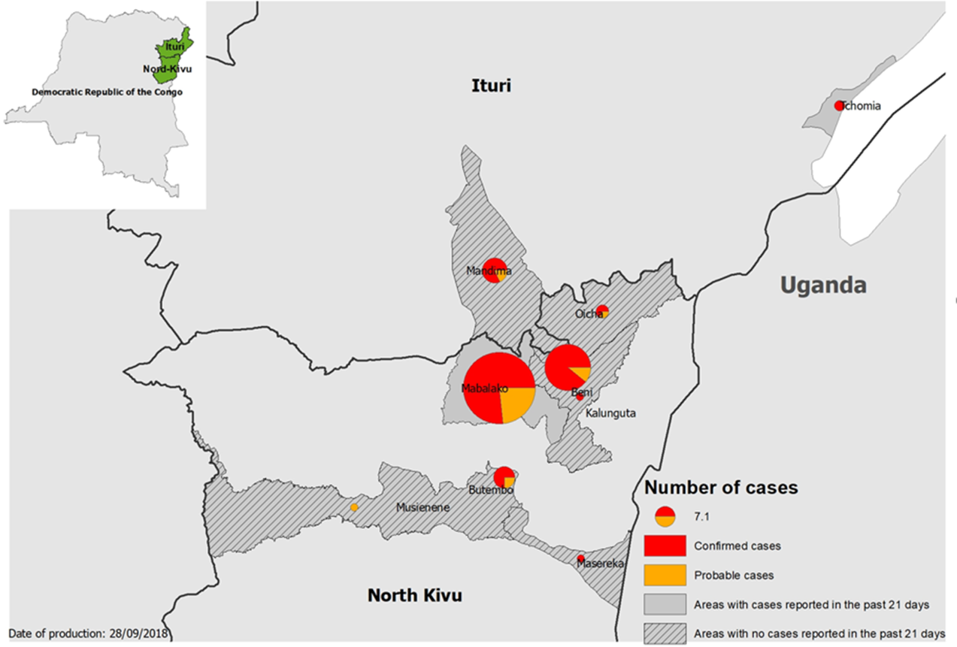
Geographical distribution of confirmed and probable cases of Ebola virus disease, North Kivu and Ituri Provinces, Democratic Republic of the Congo, as of 26 September 2018

Slide 3
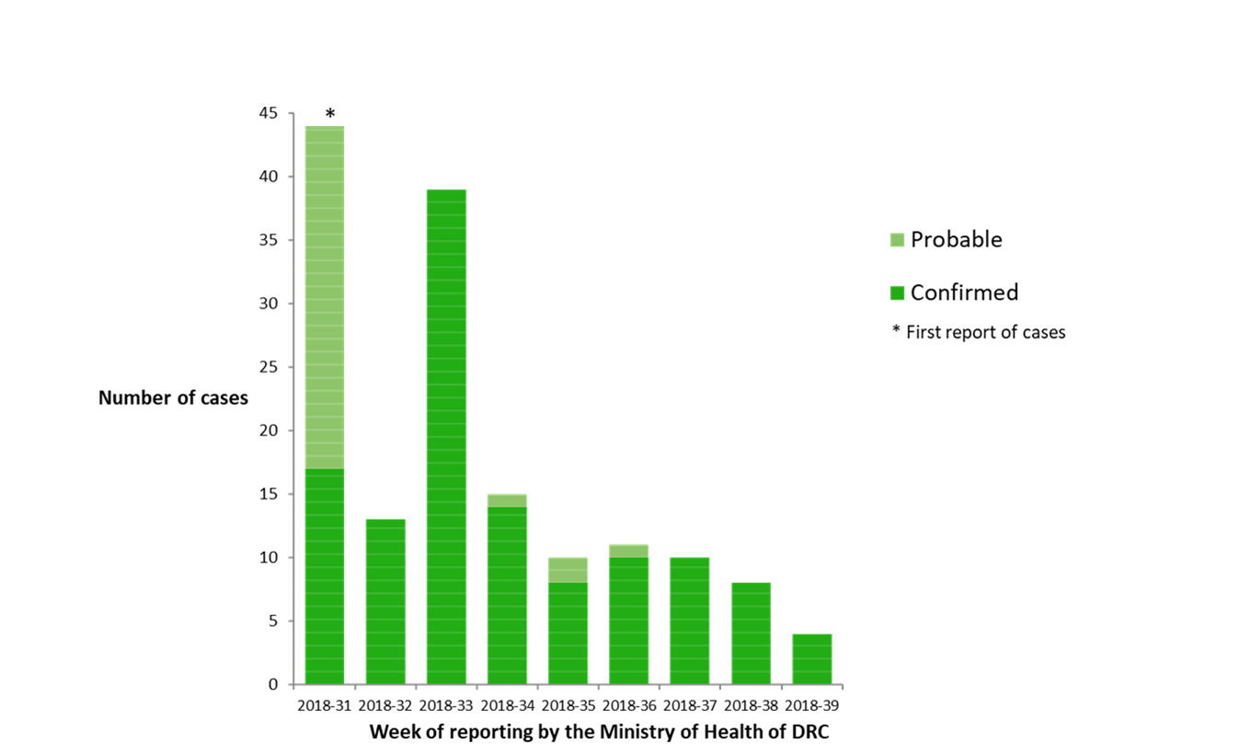
Distribution of confirmed and probable cases of Ebola virus disease, North Kivu and Ituri Provinces, Democratic Republic of the Congo, as of week 39 - 2018

Slide 4
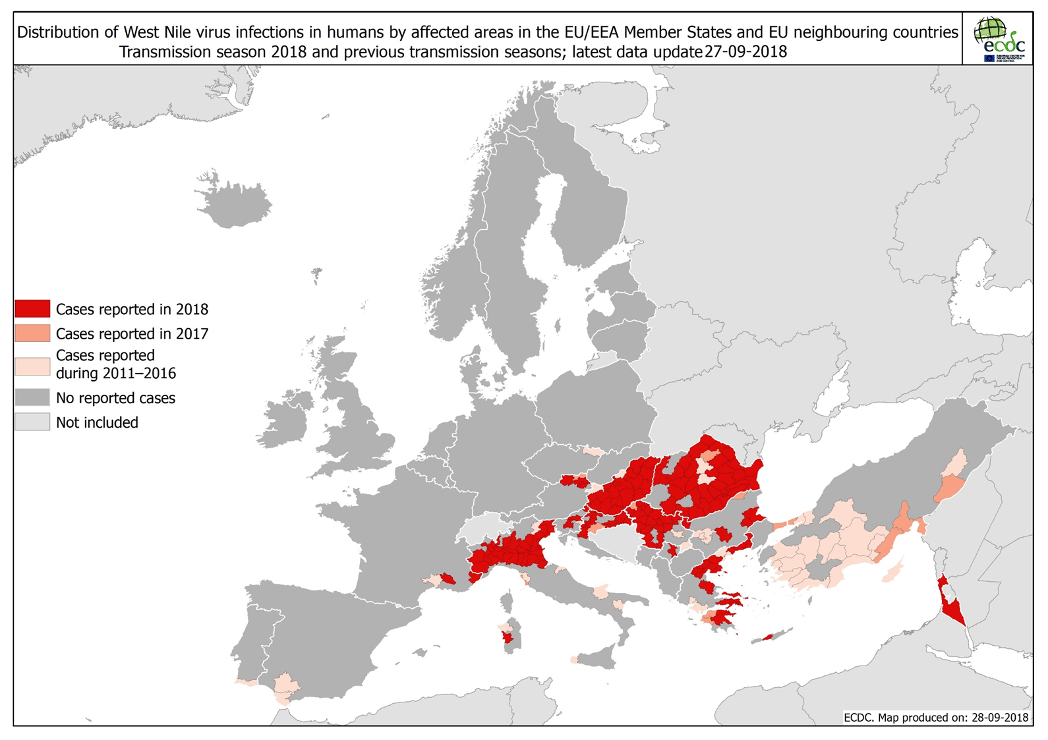

Slide 5
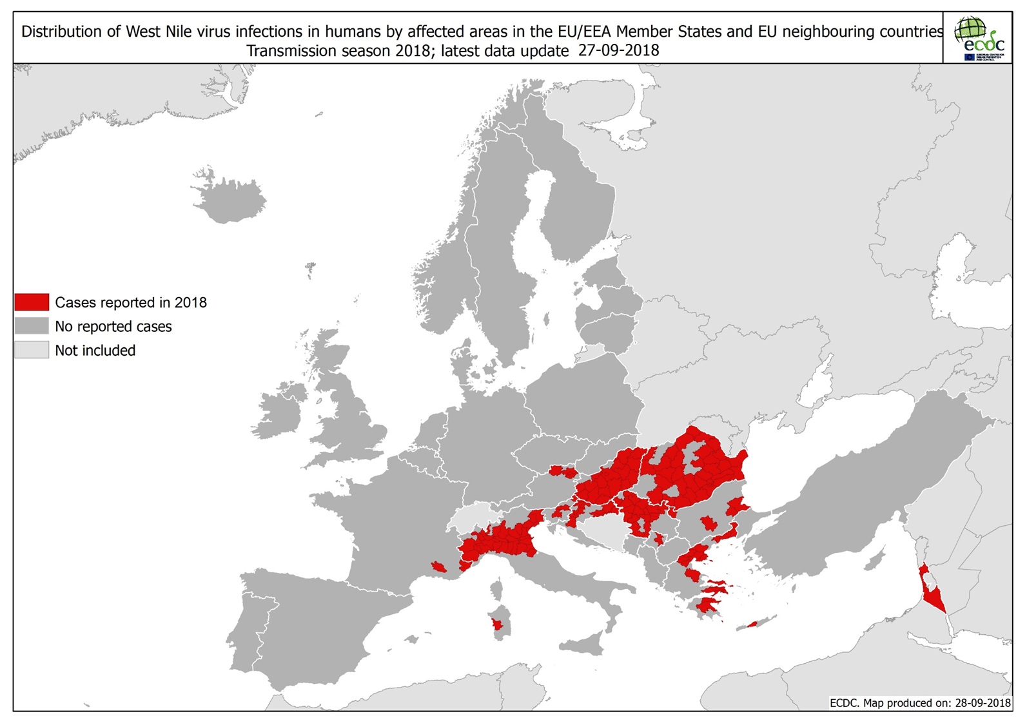

Slide 6
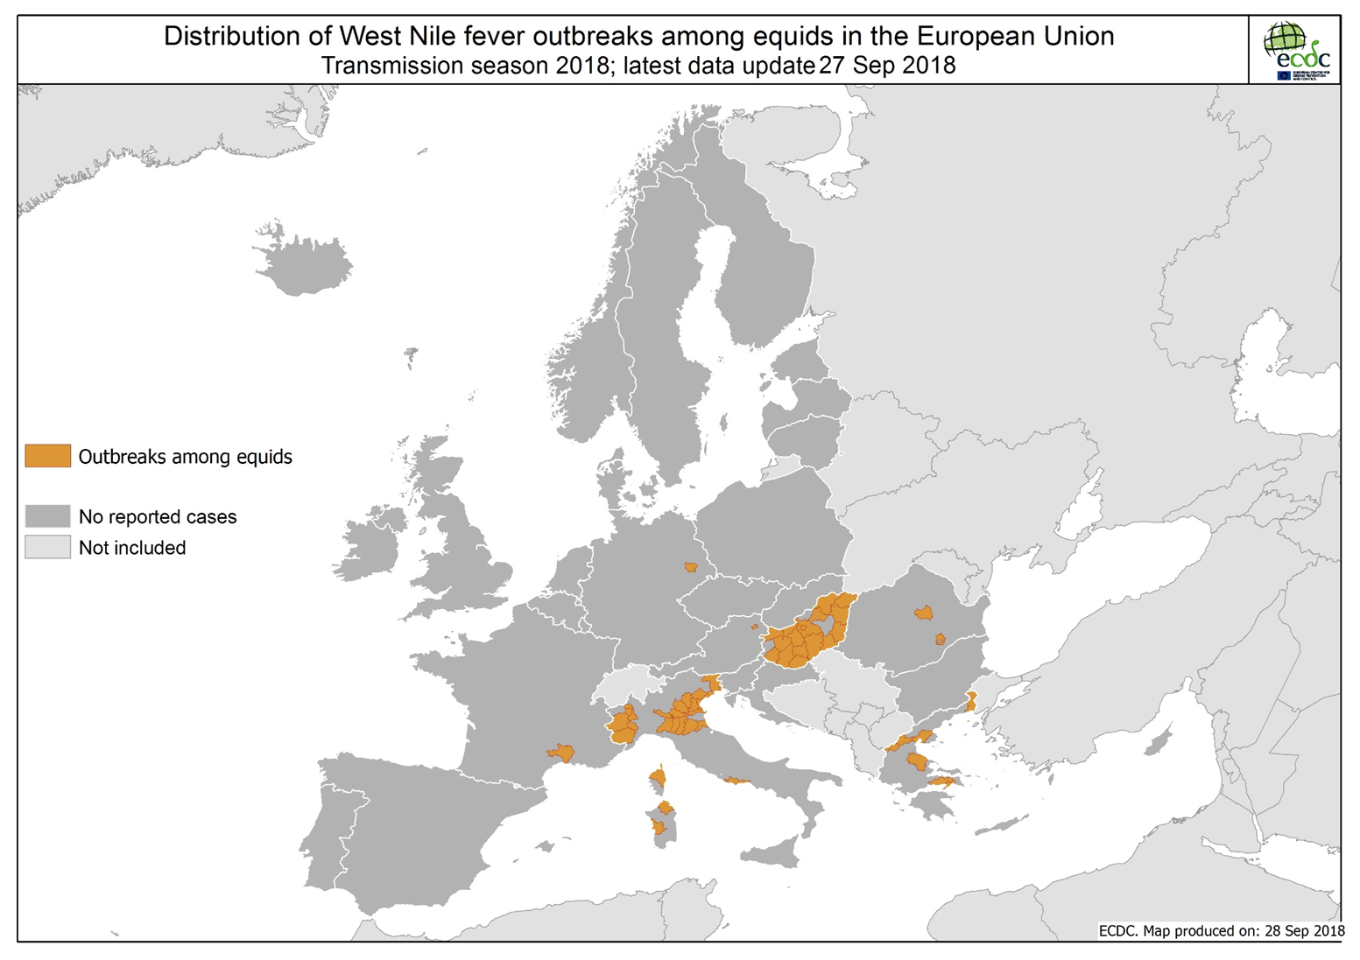

Slide 7
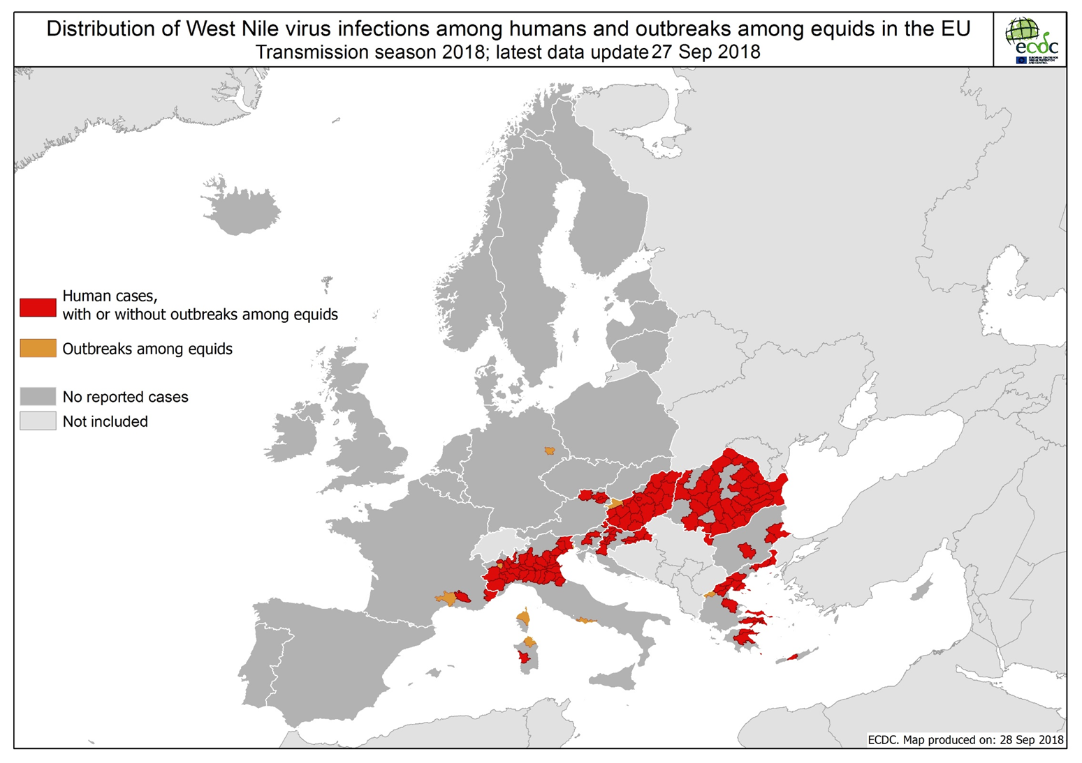

Slide 8
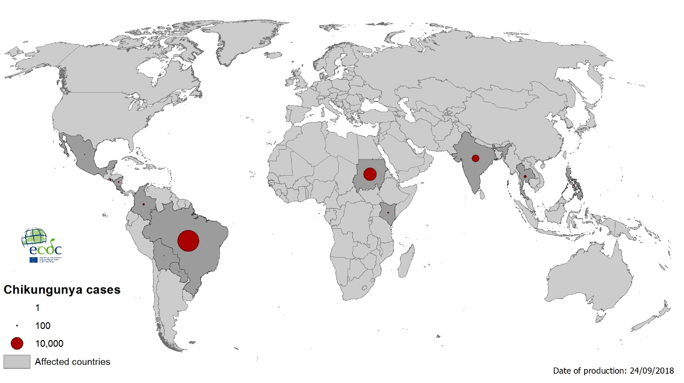
Geographical distribution of Chikungunya cases reported worldwide in the past three months

Slide 9
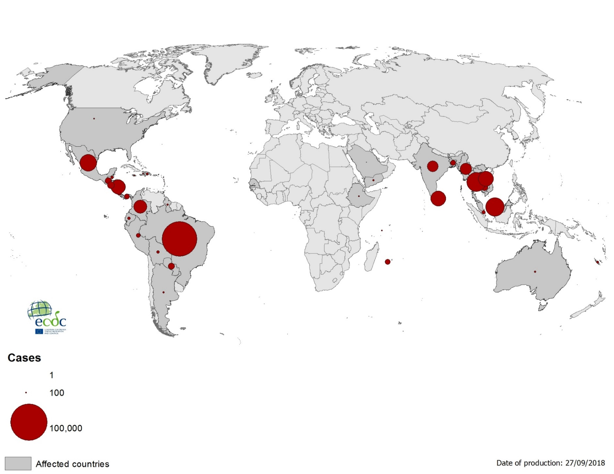
Geographical distribution of Dengue cases reported worldwide in the past three months

