Slide 1
You are encouraged to reuse our maps and graphs for your own purposes and free to translate, provided the content is not altered and the source is acknowledged.
Either copy the images from the following slides or download directly from: ecdc.europa.eu/en/publications/surveillance_reports/Communicable-Disease-Threats-Report/Pages/cdtr.aspx
European Centre for Disease Prevention and Control
Reusable maps and graphs from ECDC Communicable Disease Threats Report, week 23, 2018

Slide 2
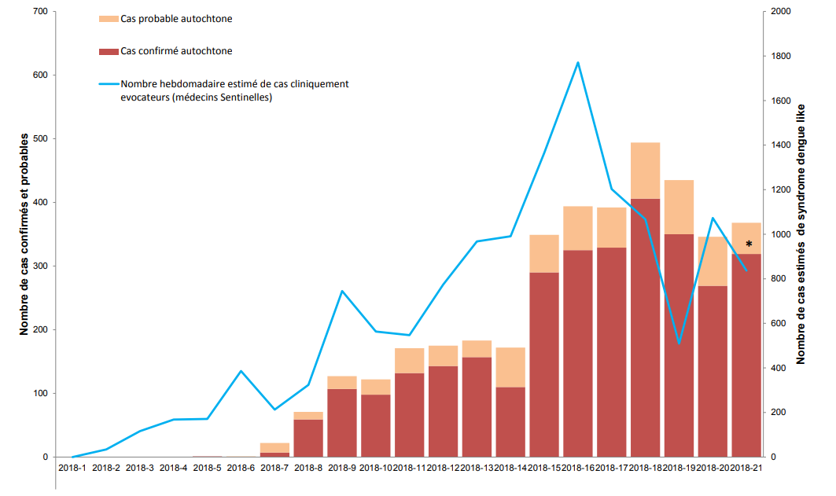
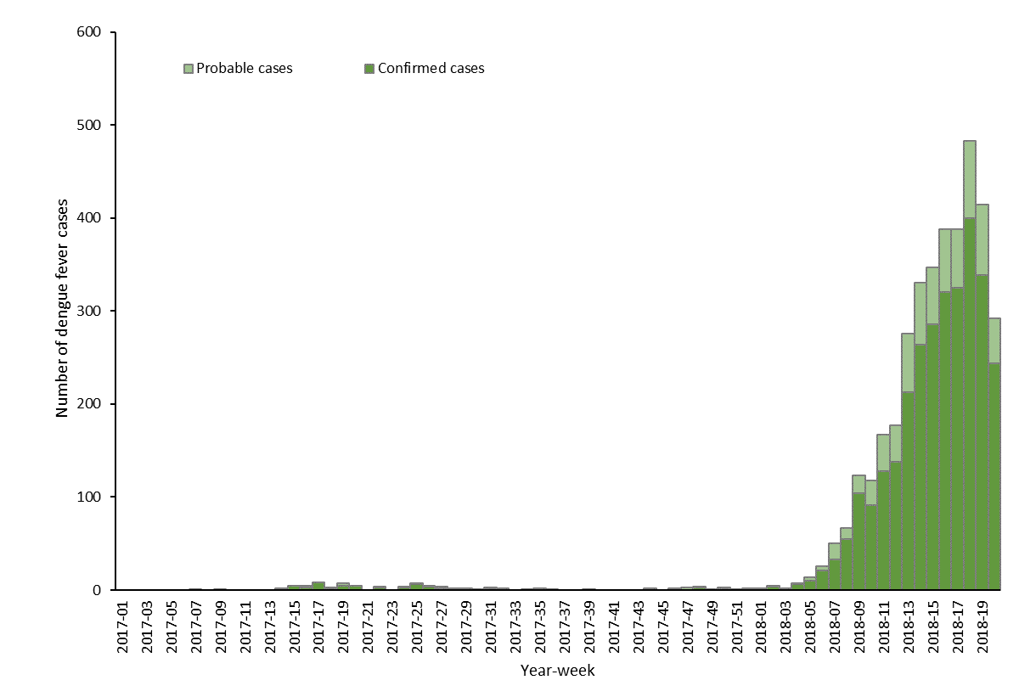
Distribution of autochthonous dengue cases by week of onset, week 2017-1 to week 2018-21, Réunion
Source: MoH bulletin "Surveillance de la dengue à la Réunion. Point épidémiologique au 6 jun 2018”

Slide 3
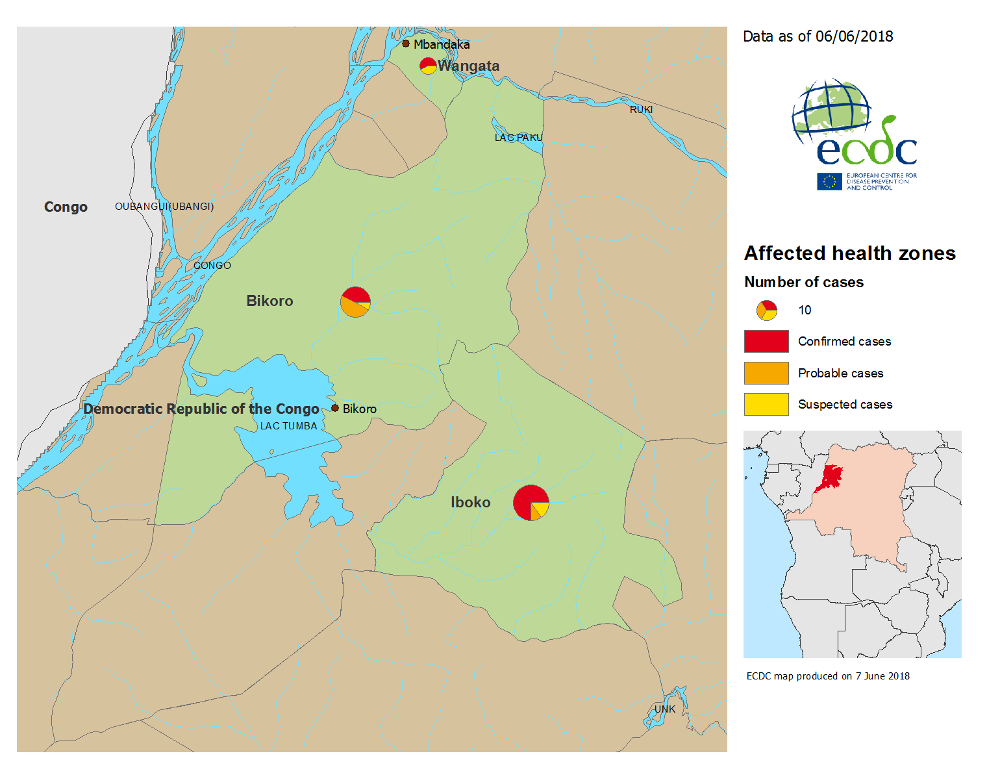
Geographical distribution of confirmed, probable and suspected cases of Ebola virus disease, Equateur Province, The Republic Democratic of Congo, as of 6 June 2018

Slide 4
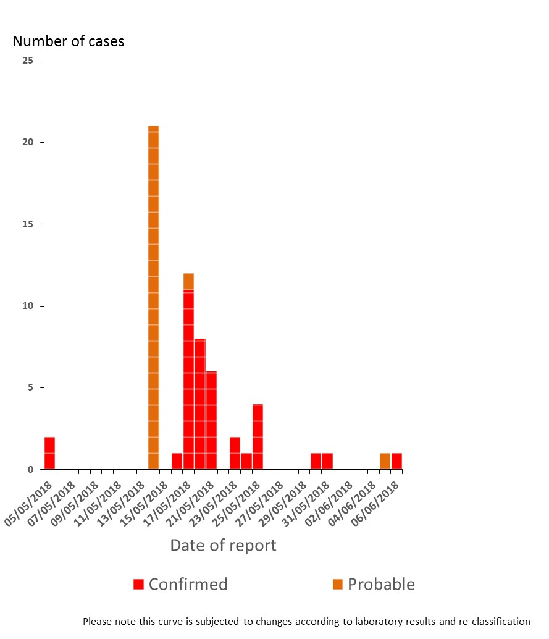
Distribution of confirmed and probable cases of Ebola virus disease, Equateur Province, The Republic Democratic of Congo, as of 6 June 2018

Slide 5
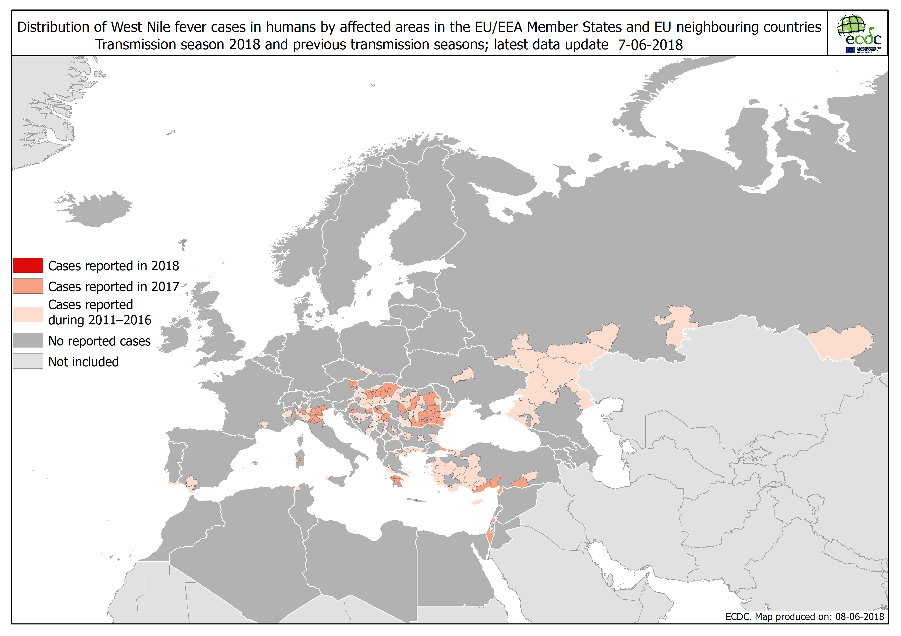

Slide 6
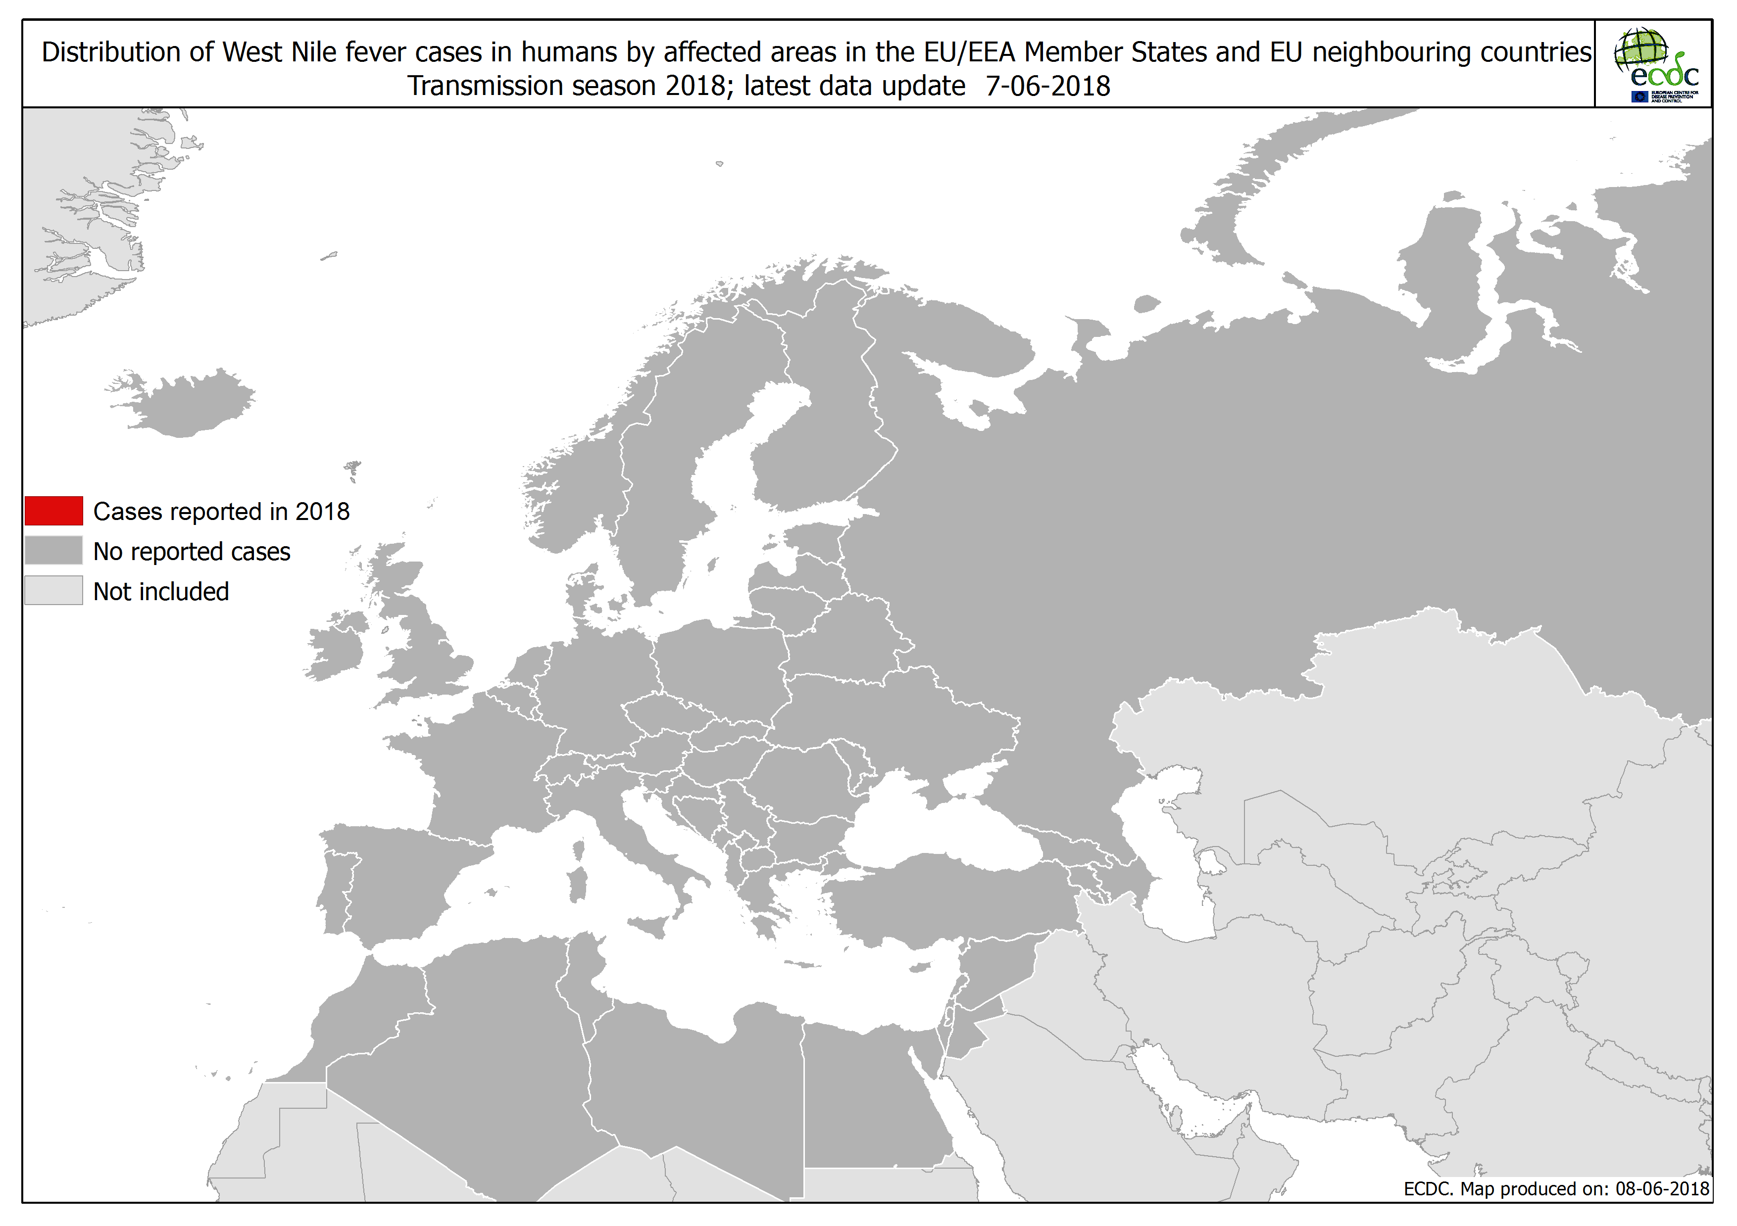

Slide 7
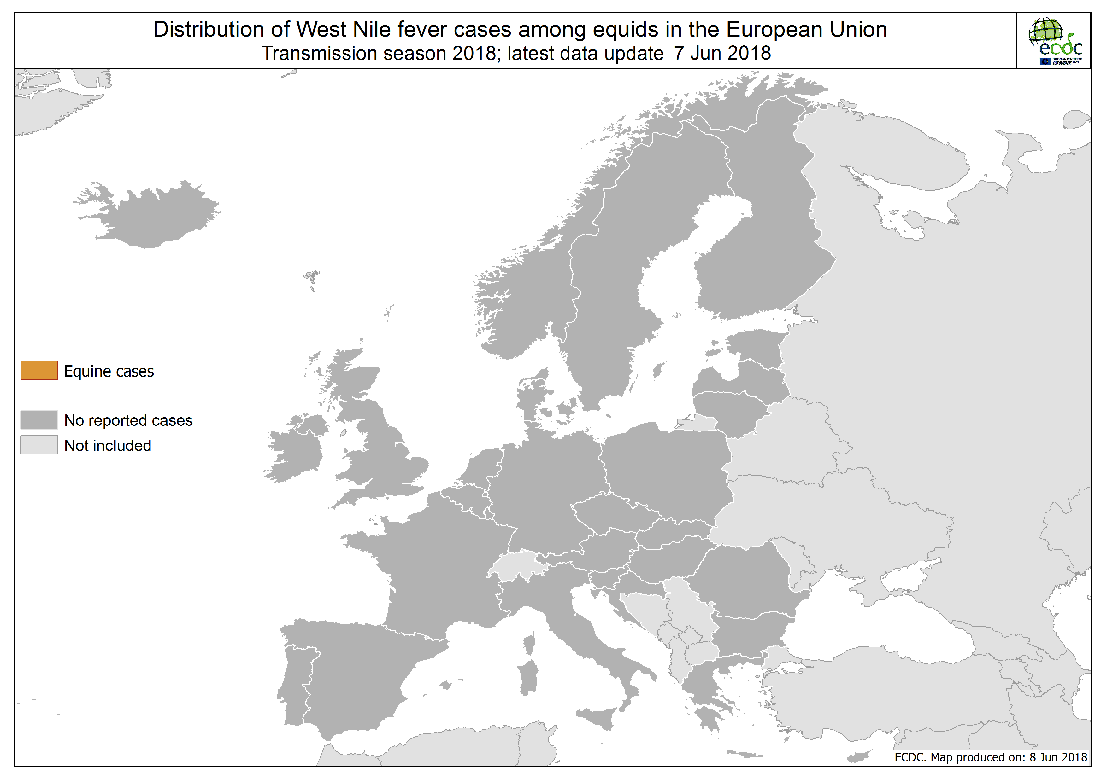

Slide 9
Distribution of confirmed cases of MERS-CoV by first available month and region, from March 2012 and as of 31 May 2018

Slide 10
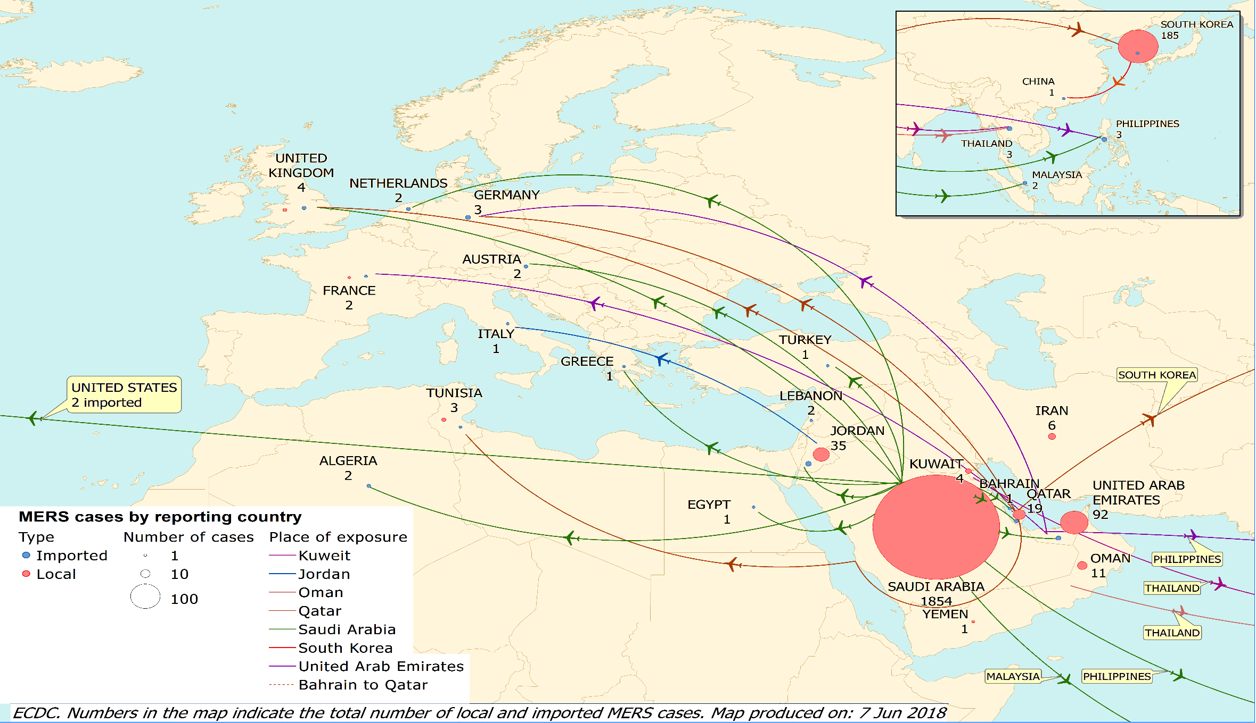
Distribution of confirmed cases of MERS-CoV by country of probable infection and country of report from March 2012 and as of 31 May 2018

