Slide 1
You are encouraged to reuse our maps and graphs for your own purposes and free to translate, provided the content is not altered and the source is acknowledged. Either copy the images from the following slides or download directly from: ecdc.europa.eu/en/publications/surveillance_reports/Communicable-Disease-Threats-Report/Pages/cdtr.aspx
European Centre for Disease Prevention and Control
Reusable maps and graphs from ECDC Communicable Disease Threats Report, week 18, 2018

Slide 2
Distribution of autochthonous dengue cases by week of onset, week 1-2017 to week 16-2018, Réunion
Source: adapted from "Surveillance de la dengue à la Réunion. Point épidémiologique au 30 avril 2018”

Slide 3
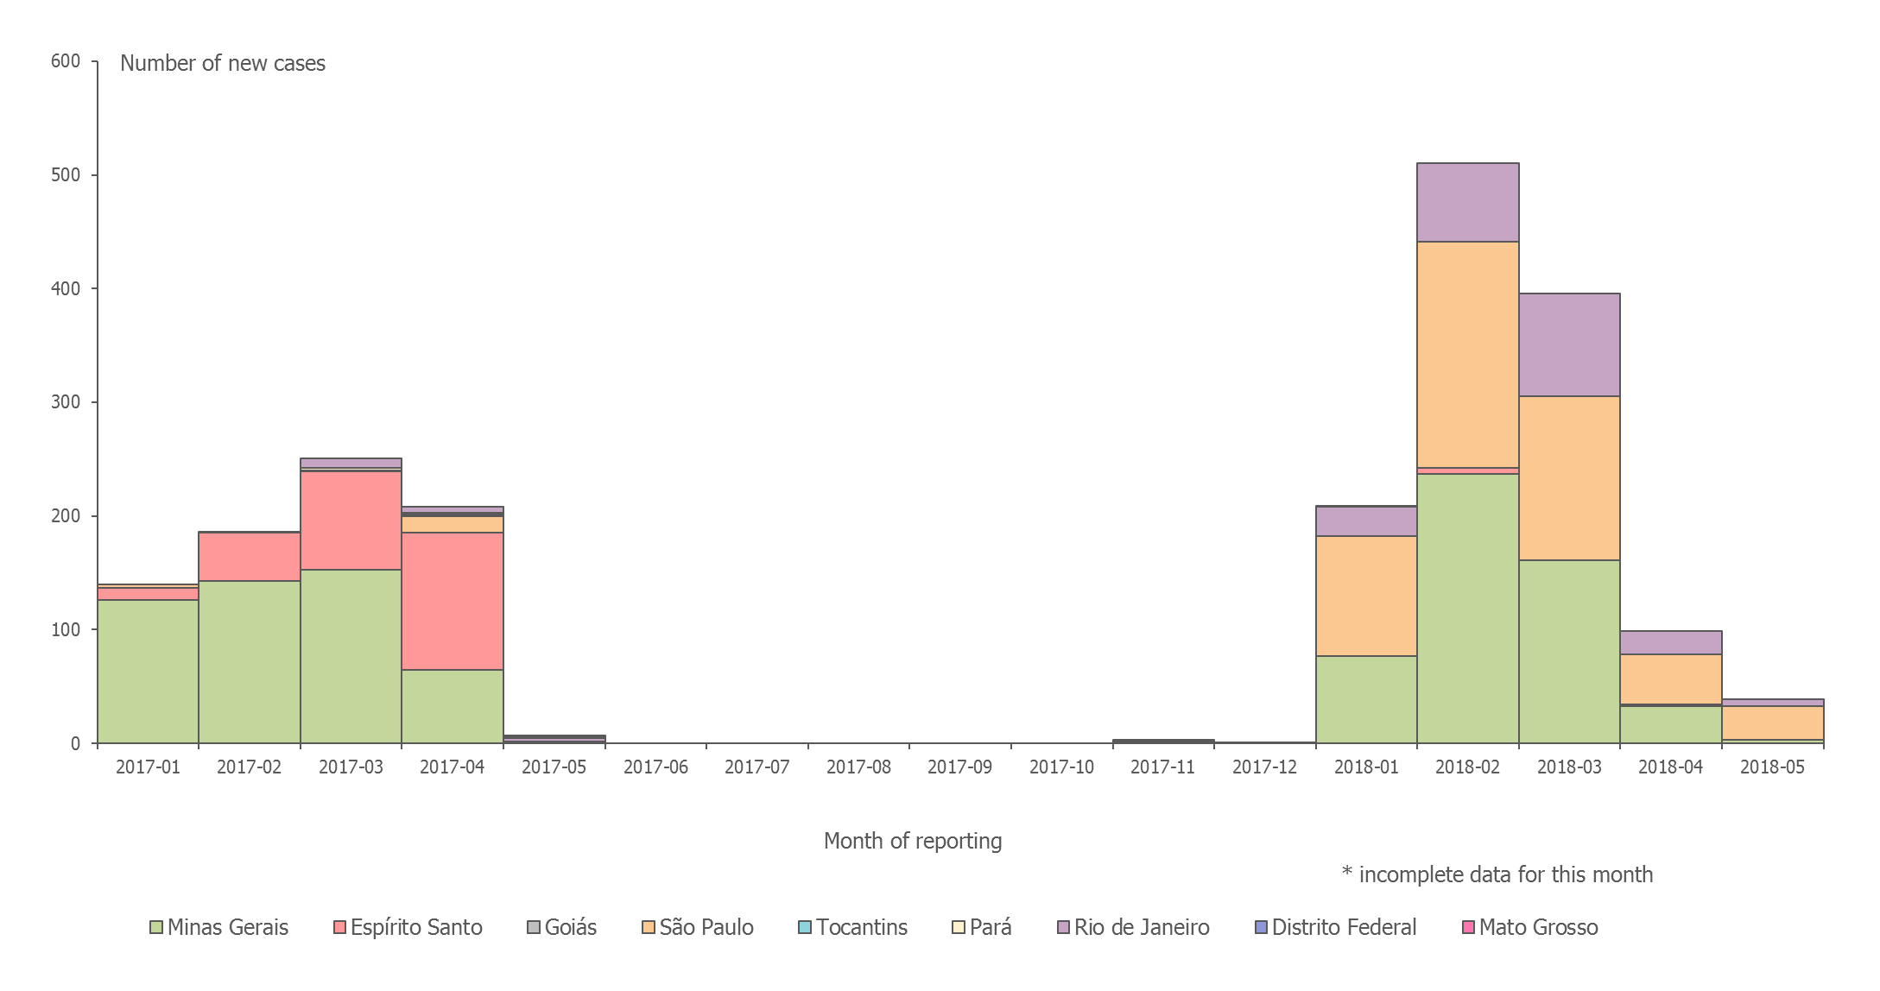
Distribution of confirmed human cases of yellow fever by month, Brazil, January 2017 – 2 May 2018
*

Slide 4
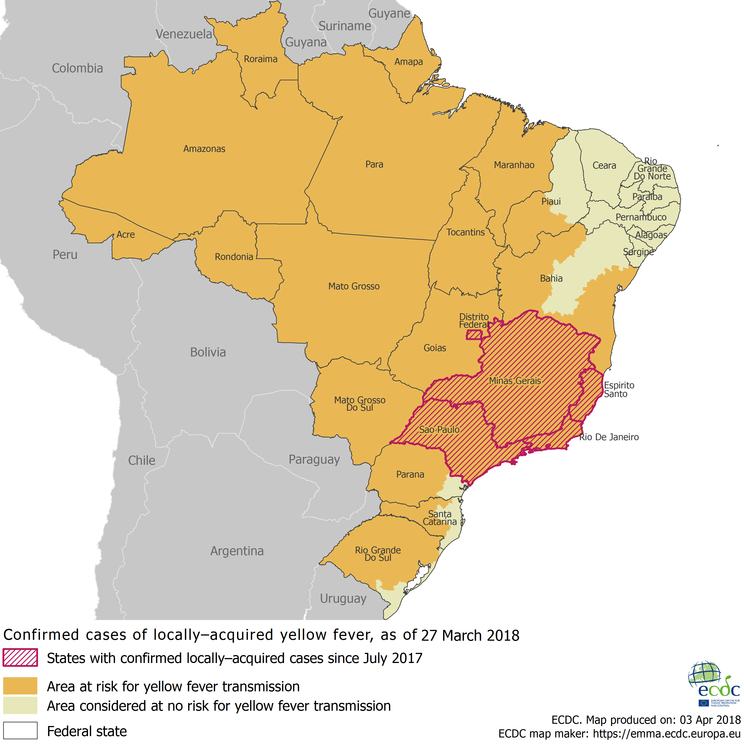
Distribution of confirmed yellow fever cases by state, Brazil, July 2017 – April 2018

Slide 5
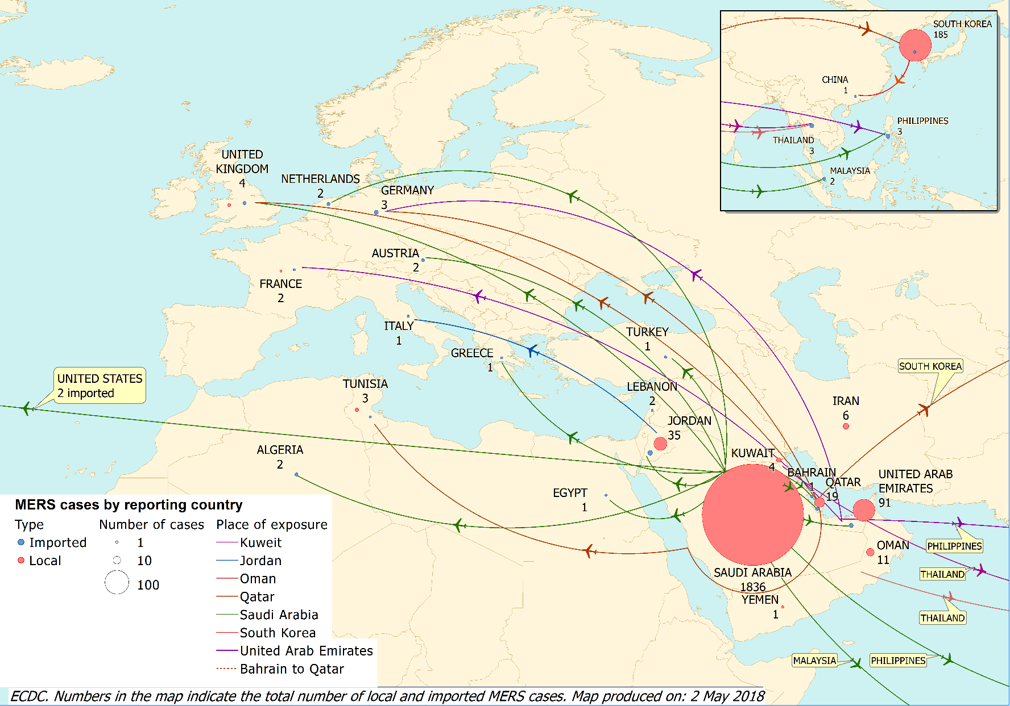
Distribution of confirmed cases of MERS-CoV by country of probable infection and country of report from March 2012 and as of 30 April 2018

Slide 6
Distribution of confirmed cases of MERS-CoV by first available month and region, from March 2012 and as of 30 April 2018

